Slide 1
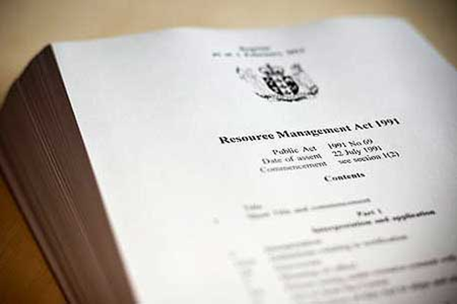
NZ regulation and policy
Requiring alternatives to landfill:
Waste Minimisation Act (2008)
Regulating production, use, transport, handling:
RMA (1991), ACVM (1997), HSNO (1996), Health Act (1956), HSWA (2015), Land Transport Act (1998)
RMA Policy Perspectives
Regional and District Plans
Resource consenting issues

Slide 2
Consenting requirements for biosolids and regional rules - HRC
Rule 14-7 - Discharges^ of grade Aa biosolids* and compost* to production land^
Permitted
Rule 14-8 - Grade Ab, Ba or Bb biosolids*
Restricted Discretionary
Rule 14-7 - Discharges^ of grade Aa biosolids* and compost* to production land^
Permitted
Rule 14-8 - Grade Ab, Ba or Bb biosolids*
Restricted Discretionary
Notes:
HL

Slide 3
Consenting requirements for biosolids and regional rules - GWRC
Rule 77: Application of Aa biosolids to land
Permitted activity
Rule 78: Application of biosolids (Ab, Ba, or Bb) to land
Restricted discretionary activity
Notes:
HL

Slide 4
Industry restrictions
Only Fonterra
Notes:
HL

Slide 5
NES for Contaminated Land Management – what does it mean for biosolids and sludges
Hazardous Activities and Industries List (HAIL)
G Cemeteries and waste recycling, treatment and disposal
1. Cemeteries
2. Drum or tank reconditioning or recycling
3. Landfill sites
4. Scrap yards including automotive dismantling, wrecking or scrap metal yards
5. Waste disposal to land (excluding where biosolids have been used as soil conditioners)
6. Waste recycling or waste or wastewater treatment
Notes:
KB
Note use of term “soil conditioner”

