Slide 1



Biosolids: an Australian perspective on volume, treatment and re-use
Nicola Helme
Project Manager
Australian & New Zealand Biosolids Partnership

Slide 2
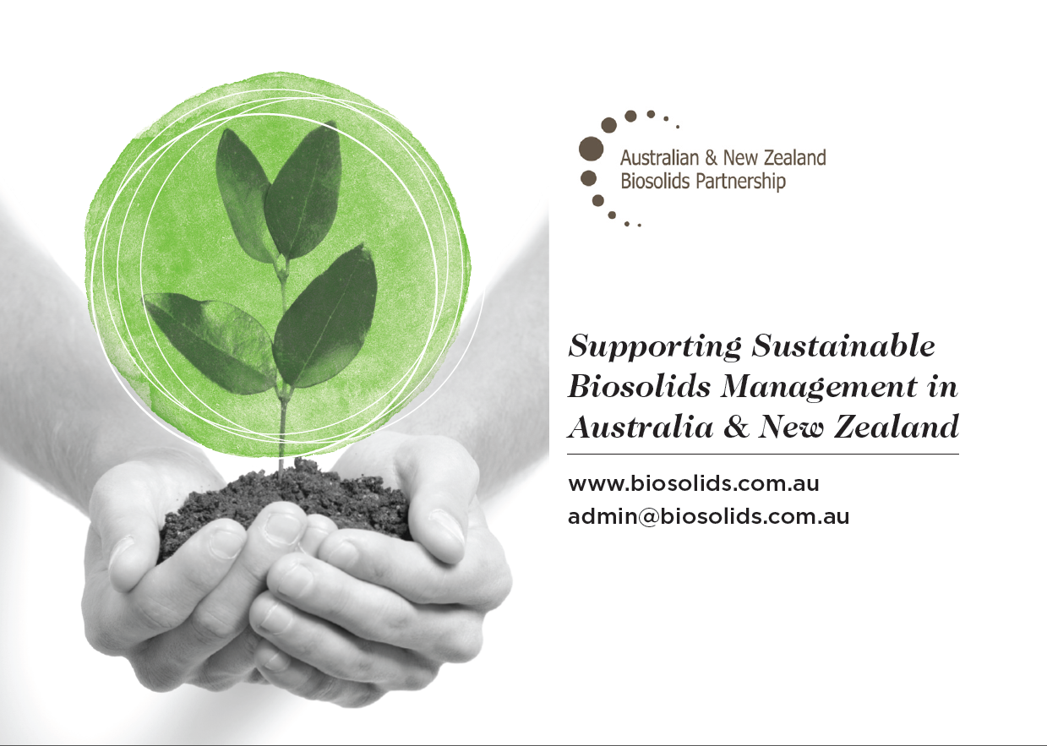


Notes:
The Australian & New Zealand Biosolids partnership is a membership based collaboration of biosolids producers, researchers, consultants and application specialists committed to supporting the sustainable management of biosolids in Australia and new Zealand.
Events like this are just part of our work, supporting information sharing and industry networking. We use the subscriptions generated by our membership to commission research that supports progression in the industry and to create resources to aid professionals in our industry to do more with less. We advocate for our membership in regulatory review processes and guideline development at both a national and international level. Collectively we believe we can create more benefit together in order to bring about development in our industry to achieve an increase in beneficial use that has both environmental and economic impacts.
This presentation is on research commissioned biannually both in Australia and new Zealand, and is a great example of the work that we do. If you would like to discuss in more detail the opportunities you have for joining ANZBP and what benefits this brings, please come and chat to me after the session or drop me an email at admin@biosolids.com.au.

Slide 3
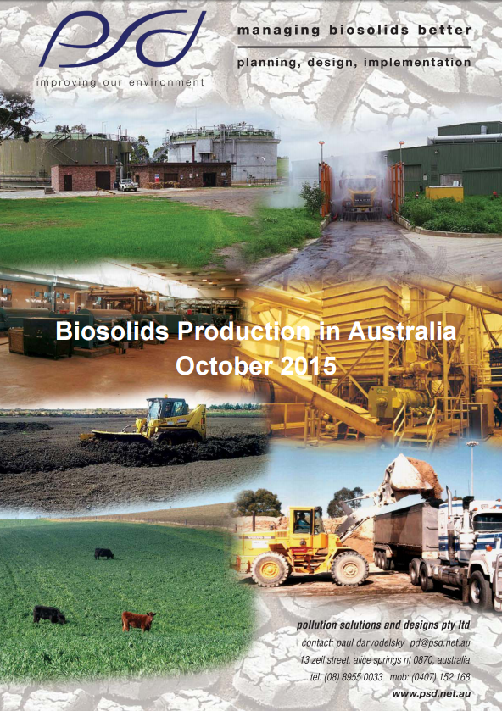
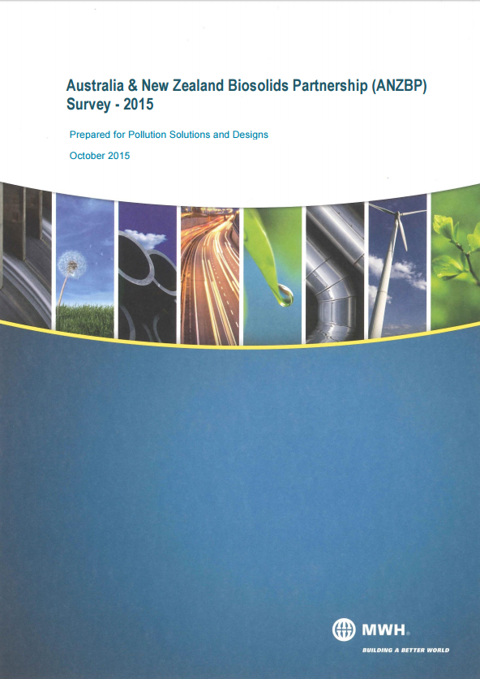
The 2015 Biosolids Production in Australia Survey
Notes:
In order to track biosolids trends across Australia and New Zealand, the ANZPB regularly commissions national surveys of biosolids management. In 2010, 2013 and 2015 we took a snapshot of the sector in both countries, examining the following key parameters:
Biosolids production;
end use;
contamination grade;
stabilisation grade;
primary stabilisation process;
dewatering process.
Today I will take you through our findings in each of these regards, offering a comparison to the New Zealand experience and some insight into trends across Australia and changes over time.
Im afraid that our original presenter, Paul Darvodelsky was unable to attend today, and I am not a technical specialist on biosolids, so I will do my best to answer your questions but if I don’t know, I will take your details at the end and arrange for this information to be sent to you.
I have hard copies of both the Australian and New Zealand reports available for you to take a look at in the break. They, and the historical data are available to ANZBP members via our website www.biosolids.com.au. high level summaries are available to anyone via our site as well.
The approach used to determine the biosolids production in Australia was to survey all plants over 25,000 people or 5 ML/day. The ANZBP identified that this criteria would capture around about 80% of Australia’s population. In the course of the survey many water utilities provided information on plants smaller than this threshold and where they did, the data was included.

Slide 4
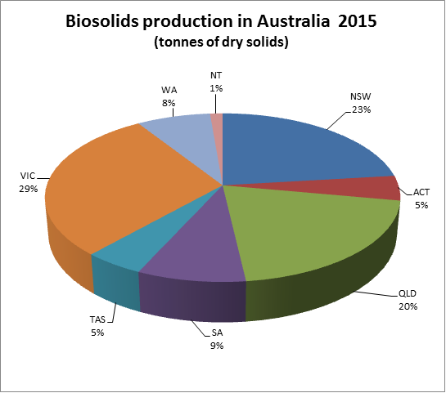
Production
Notes:
Australia generated around 310,000 tonnes per year of biosolids on a dry basis in 2015. This compares to 300,000 tonnes in 2010 and 330,000 tonnes in 2013. This does not reflect any significant change in biosolids production, and is due to both changes to analysis and records keeping and improvement in and implementation of stabilisation processes. The average solids content of biosolids is around 21% and this equates to around 1.5 million tonnes of biosolids in dewatered form.
As you can see there are no surprises in the proportional distribution of this production on a state by state level, although interestingly the Australian Capital Territory produce the highest quantity of biosolids per person in Australia with just over 1.5% of the population producing 5% of the biosolids.

Slide 5
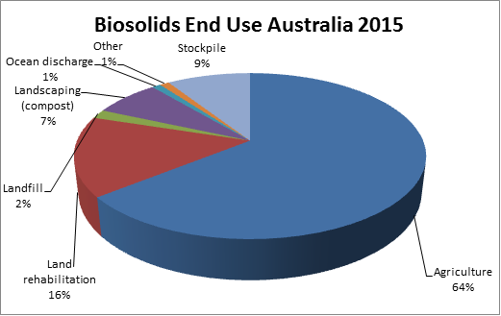
End use
Notes:
Biosolids end use nationally presented here.
As you can see, Biosolids end use in Australia is dominated by land based beneficial use. Most biosolids is used in agriculture with the second most common use being land rehabilitation projects. Both of these streams have shown an increase since our last survey, with land rehabilitation up from 4% in 2013 to 16% in 2015. (this aspect was not measured in 2010 ). biosolids used for agriculture has grown from 55% in 2010 and 59% in 2013 to 64%.
Overall, there was a decrease in stockpiling of biosolids (down from 23% in 2010 and 20% in 2013 to 9%) while there was a marginal drop in other, unspecified and landfill end uses of biosolids.
This indicates a significant shift towards greater beneficial use of biosolids which is very positive to see. More and more of our utilities are seeking to commoditise their biosolids, engaging with farmers to ensure that the product that is created meets their needs and is of a consistent standard. Such is the success in some areas, that they have moved to a chargeable model, and have extensive waiting lists to buy the product.

Slide 6
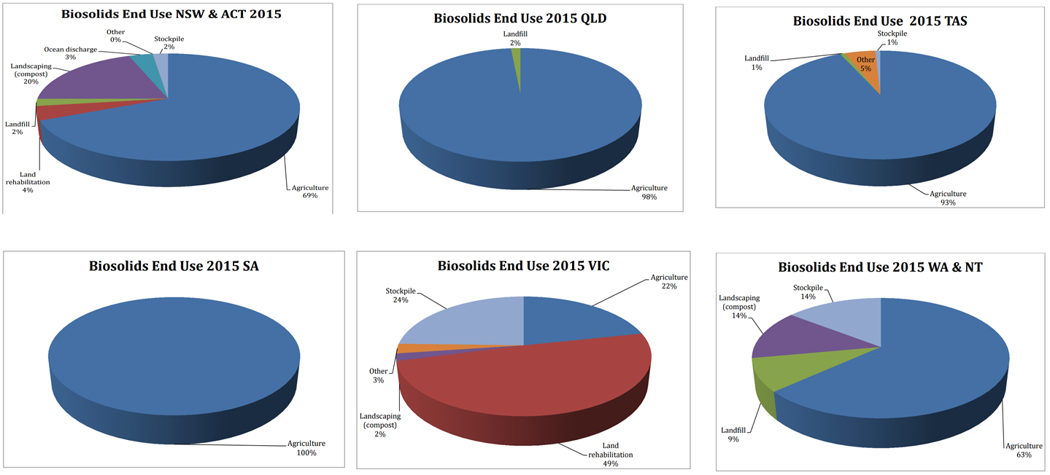
State variations in end use
Notes:
There is variation on a state by state basis for beneficial use, depicted very clearly in this set of charts. You will notice that Victoria has a markedly different biosolids landscape to the rest of Australia, due to a strong reliance on land rehabilitation uses and stockpiling. The stockpiling component of this is likely to change in future years, as Victorian utilities explore alternative uses, available space for stockpiling decreases, and the trend towards biosolids sales as a product grows.

Slide 7
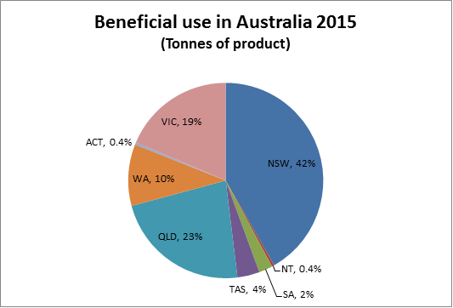
Beneficial
use
Notes:
In terms of volume of product moved from treatment plants to beneficial end use markets, NSW, Queensland and Victoria dominate the national market. Beneficial use in all states is generally in proportion to their populations, as would be expected. Notable exceptions are:
NSW uses relatively more biosolids, most likely due to being the most advanced state in terms of regulation and biosolids practices;
Qld uses relatively more biosolids due to absence of stabilisation facilities at treatment plants (missing out on solids reduction) and lower standard of dewatering facilities (lots of old belt filter presses), both of which result in more biosolids;
Victoria uses relatively less biosolids due to the stockpiling approach being a more prominent feature of its biosolids management approach. Victorian figures are dominated by Melbourne Water which has few restrictions on the amount of biosolids it can stockpile at Western Treatment Plant;
SA and ACT use significantly less biosolids in proportion to their populations due to the processing approach they have, both of which give a significant reduction in volumes.

Slide 8
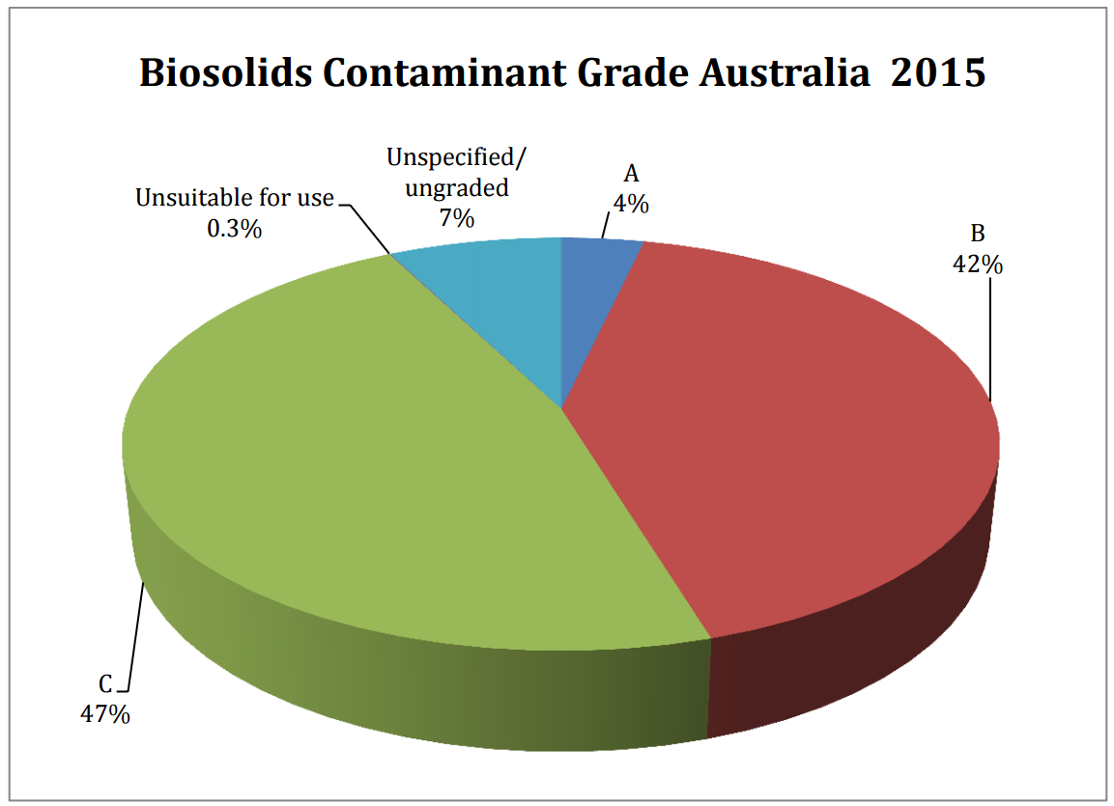
Contaminants
Notes:
In Australia biosolids contaminant and stabilisation grading approaches vary between states. For purposes of this national level research these were standardised as far as is possible to enable comparability.
Biosolids stabilisation grade nationally and for each state is presented here. This was not surveyed in 2010. Since 2013 there has been a marginal increase in contaminant grades A, B and C with a marginal decrease in the unspecified/ungraded category, which is a positive indication of increased rigor in biosolids management.

Slide 9
Stabilisation
Notes:
Biosolids stabilisation grade nationally is presented here. A greater proportion of biosolids is now classified as Grade B (up 36% from 2010 and 51% in 2013 to 57%). Previously the increase in classification Grade B was due to changes in the way respondents categorised their biosolids however the increase in this year’s Grade B classification is mainly due to greater testing and grading of biosolids which was previously ungraded.

Slide 10
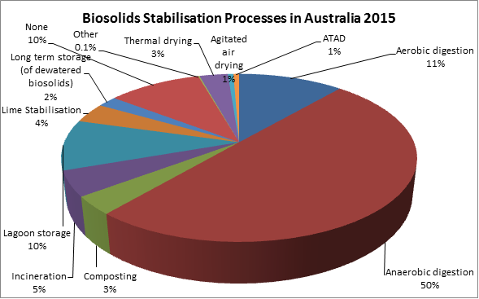
Stabilisation
process
Notes:
Biosolids stabilisation process nationally is presented here. Stabilisation in Australia is dominated by anaerobic digestion. Overall there was a moderate increase in Anaerobic Digestion (up from 31% in 2010, 46% in 2013 to 50%) likely due to new plants coming online. There was also an increase in lagoon stabilisation (3% in 2010 to 10%) likely due to better data reporting. There was a marginal increase in composting, thermal drying, lime stabilisation and incineration which is likely due to small differences in collecting and reporting of data.
The amount of biosolids being stored on site for the primary stabilisation process held steady (20% in 2010, to 2% in 2013 and 2015). Aerobic digestion returned to the 2010 levels (12% in 2010, 18% in 2013 to 11%). This is likely due to reporting errors rather than changes to stabilisation processes.
Notable other features of stabilisation in Australia are:
Victoria stands out with 25% of biosolids processed in lagoons. Note that a significant portion of biosolids in Victoria, i.e. Western Treatment Plant is treated in anaerobic lagoons and therefore classified as anaerobic digestion.
Qld stands out with 40% of biosolids production not being processed and therefore is unstabilised.

Slide 11
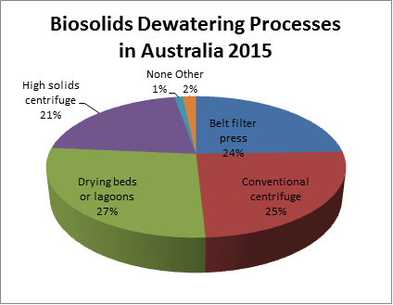
Dewatering
Notes:
Biosolids dewatering process nationally is presented here Overall, there was a moderate increase in drying beds and lagoons (up from 21% to 27%) with much of this attributable to improved reporting (unspecified decreasing from 12% in 2010, 6% in 2013 to 0% in 2015).
Dewatering in Australia as determined by quantity is dominated by centrifuge dewatering which accounts for nearly half of all dewatering. Centrifuge dewatering is roughly equally divided between high solids and conventional centrifuges. Belt filter presses and drying beds/lagoons comprise roughly one quarter each of all dewatering in Australia.
There are state by state variations in this:
NSW, ACT, WA and SA are dominated by centrifuge processes
Tasmania and Victoria are dominated by lagoon dewatering
And QLD is predominantly belt press

Slide 12
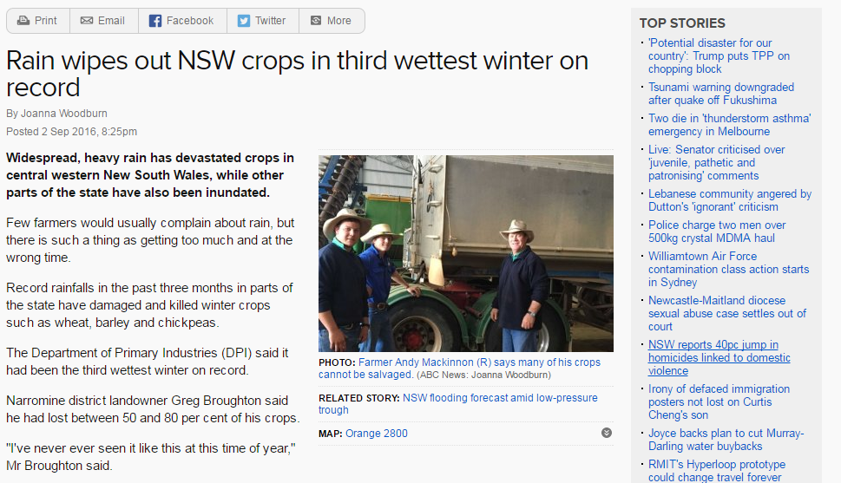
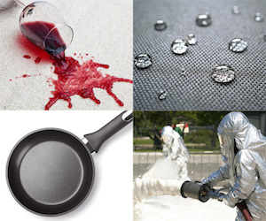
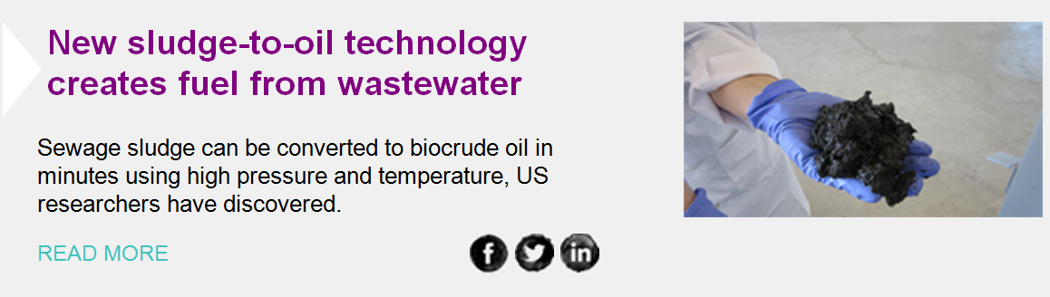
Influencing factors for the future
Notes:
In the short, medium and longer terms, there are a wide variety of elements which may change the biosolids landscape of Australia.
Regulation – In Queensland changes have recently been implemented, and biosolids guidelines are under review in NSW, Tas and SA. These will bring up to date controls on contaminants, pathogens and odour requirements, removing obsolete aspects and adding new relevant monitoring and management criteria.
Emergent contaminants - Of particular concern at the present time is the PFAS family of contaminants which are currently being investigated by a range of Australian Utilities to determine the extent of the problem. The utilities are starting to get a handle on the presence of these contaminants but not are not yet confident in assessing the risks posed to the environment and human health.
Weather - This year has seen significant adverse weather impacting the capacity for land application, particularly in NSW and Tasmania. Stockpiling and composting has been reverted to in the short term, and is likely to impact upon the 2017 data analysis conducted by ANZBP. With more and more years featuring extreme weather conditions, this uncertainty may be regarded as becoming the new normal.
Beneficial use trends - Finally there is much discussion about maximising beneficial use and financial return. Trade offs between nutrient recovery and land application versus energy recovery through co-digestion were hot topics at the recent Australian water association conference. New innovations such as the possibility of creating biocrude oil from sludge may pave the way to a dramatically different biosolids industry in years to come.

Slide 13
Thank you.
admin@biosolids.com.au

