Slide 1
Biosolids: International, National and Regional Scales

Slide 2
Draft Programme
Time | Item | Speaker
1.30pm | Introductions and welcome | Jacqui Horswell (ESR)
1.45pm | Biosolids: a New Zealand perspective on volume, treatment and re-use | Hamish Lowe (LEI)
2.00pm | Biosolids: an Australian perspective on volume, treatment and re-use | Nicola Helme (ANZBP)
2.15pm | How will you approach working within the regulations? The regulation and policy perspective: what will the new NZ guidelines mean to you? What has the Australian regulatory experience been? | Katie Beecroft (LEI) Nick Walmsley (WaterNZ) Nicola Helme (ANZBP)
2.45pm | Creating an impactful regional strategy. We will take a look at: • The status of the current strategy proposal • Case study: MDC – the Manawatu composting facility • Case Study: KCDC/CIBR – Iwi community engagement • Case Study: Examples of regional approaches in Australia | Jacqui Horswell (ESR/CIBR) Chris Pepper (MDC) Martyn Cole (KCDC) Nicola Helme ANZBP
3.45pm | Latest research roundup: odour, EOCs etc | Nicola Helme ANZBP
4.15pm | Closing comments | Hamish Lowe (LEI)

Slide 3
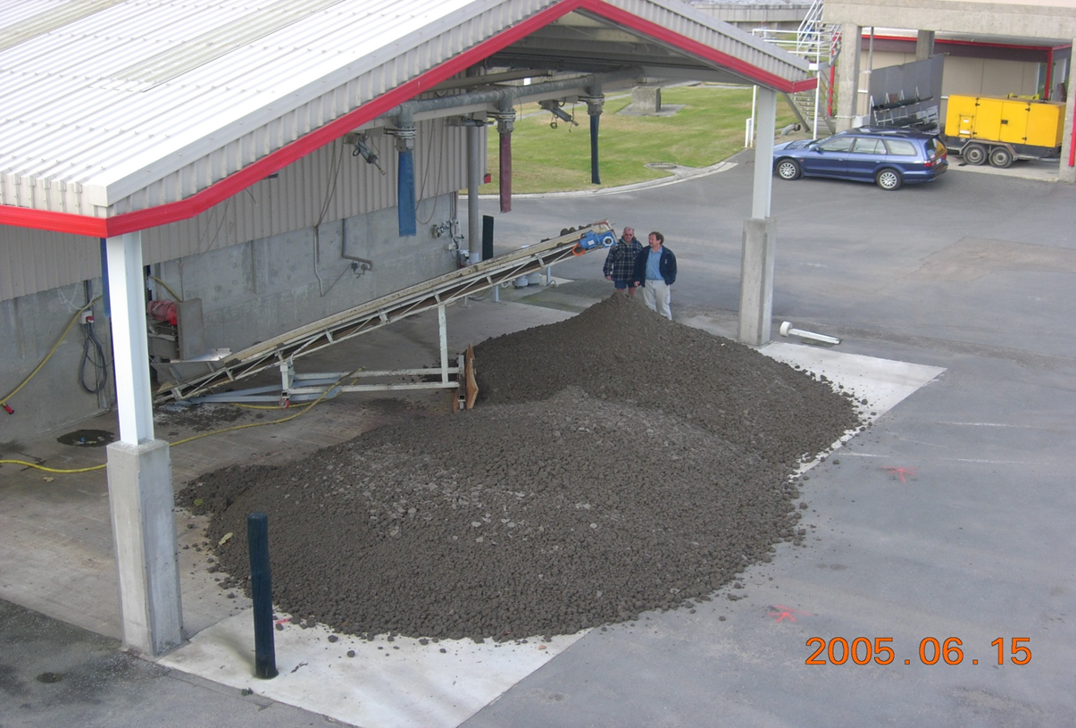
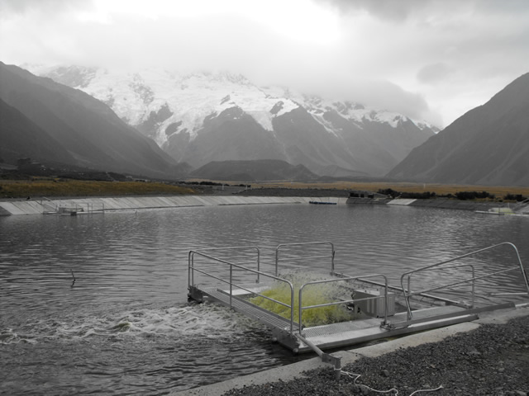
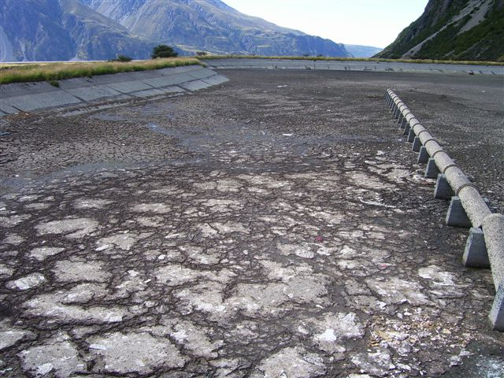
Biosolids: NZ perceptive - volume
440,000 tonnes of dewatered biosolids is produced per year.
330 treatment plants in NZ.
Approx. 200 waste treatment pond systems, built 30-50 years ago and require desludging.

Slide 4
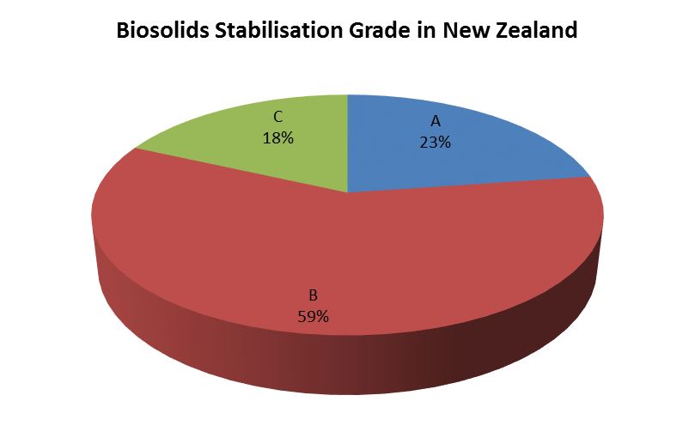
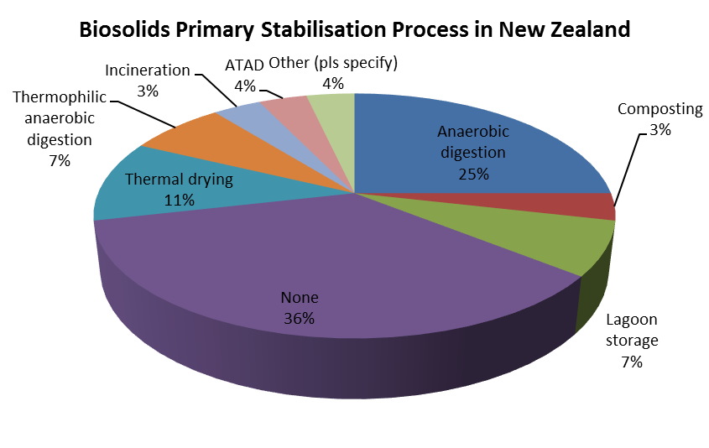
Biosolids: NZ perceptive - treatment
Volume basis
Number of plants

Slide 5
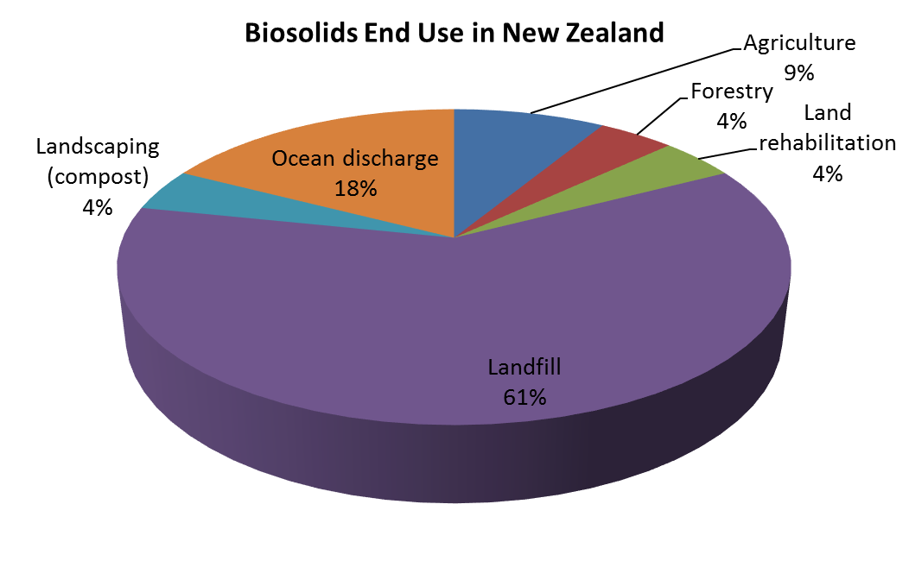
Biosolids: NZ perceptive - end-use
Current state of affairs Lower North Island Council’s
Landfill
Mono-fill
Stock-pile
Geo-bags
Composting
Note above are not necessarily end uses

