Slide 1
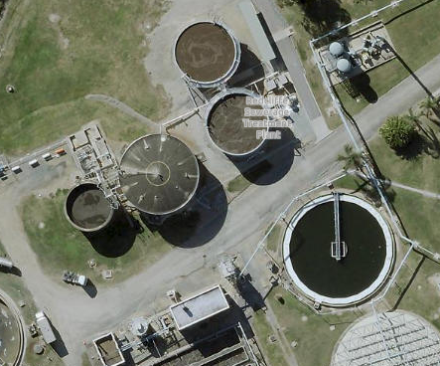



A New Spin on an Old Approach
- Hybrid Digestion Configuration at Redcliffe STP
Cameron Staib (Stantec)
Rebecca Randall (TRILITY)
Ramraj Kulkarni (UNITYWATER)

Slide 2
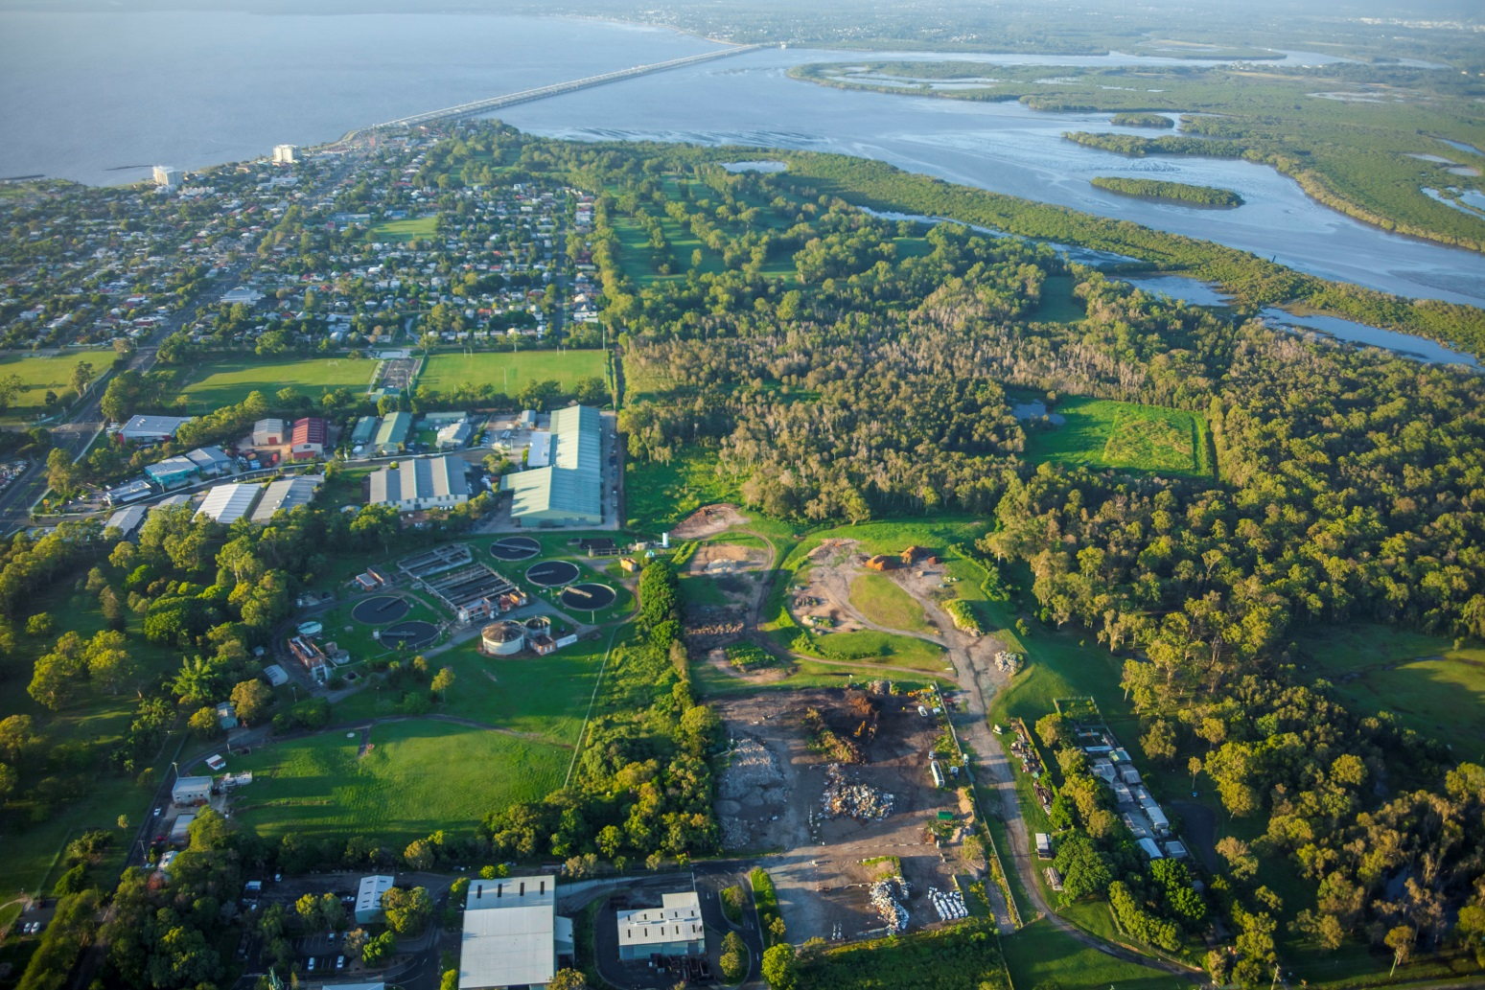
Outline
The Challenge
The Design Solution
Commissioning & Operations
Lessons, Legacy and Reflection and Conclusion

Slide 3
The Challenge

Slide 4
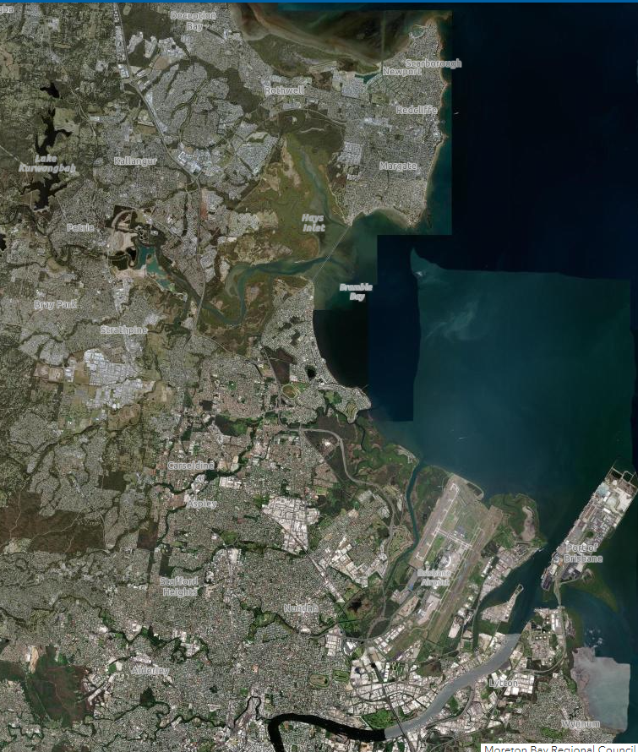


Project Background – Redcliffe STP Rehabilitation Project
2014/5 Unitywater to market for Design Build Operate and Maintain Rehabilitation Contract
  O&M Contract to Nov 2022
  Fixed Scope:
    Inlet Works - ASAP
  Firm Scope:
    Comply with odour performance requirements ASAP
    Upgrade/rehab as required to meet performance requirements through to 70,000 EP (circa 20% growth)
      TN 5 mg/L, TP 1 mg/L long term medians
      Meet PPR Biosolids Requirements
  TRILITY team included Stantec (then as MWH), Aquatec-Maxcon and Alliance Automation
Redcliffe STP

Slide 5
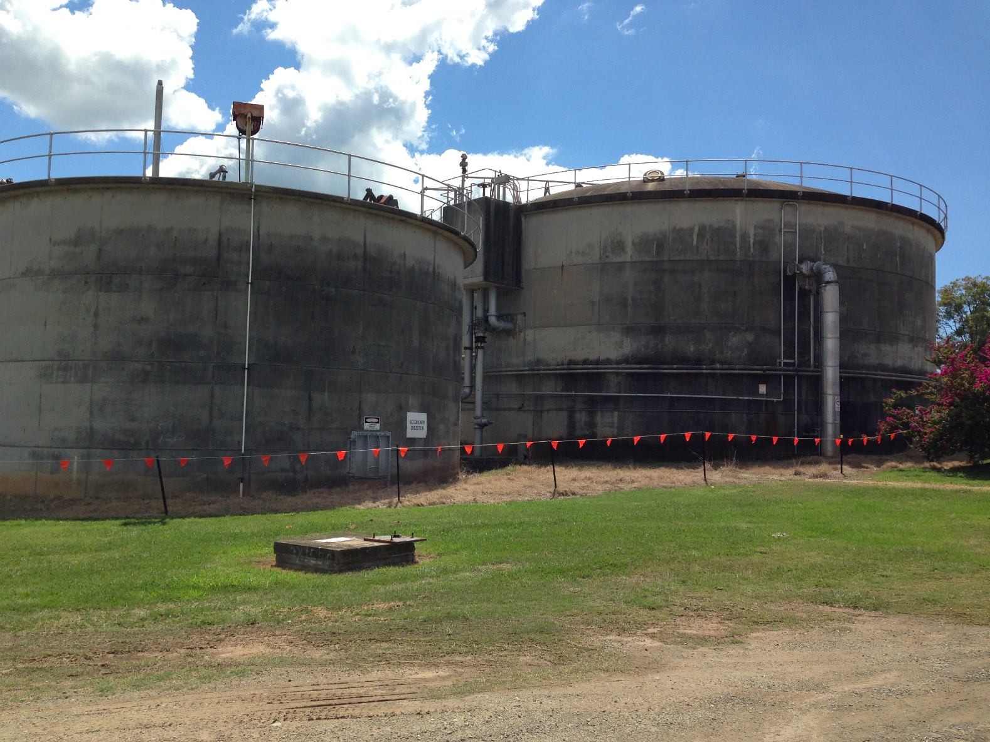
Redcliffe STP Rehabilitation DBOM – 2014 Principal’s Project Requirements (PPR)
  Clean out, disposal of content and maintenance tasks related to primary and secondary digesters.
  Cake DS > 15%
  NSW Stabilisation Grade B, with at least 1 VAR Grade A methodologies
  Aerobic Stabilisation
    Total combined bioreactor digester SRT of 35 days

Slide 6
Process Selection Drivers:
Competitive DB Bid with tight capital budget
Minimise opex
Minimise secondary treatment solids inventory – manage sludge liquor nutrient loads
Maximise use of existing assets
Maintain future energy generation pathway
Design Inputs:
3000 kgDS/d WAS @ 0.8%DS
2300 kgDS/d Fermented Primary Sludge @ 5% DS
Client Specified Performance:
Aerobic Digestion of 35 day combined SRT OR
Anaerobic Digestion >38% VS Destruction
> 15% DS cake
Available Existing Assets:
Out of Service :
2.3 ML Anaerobic Digester
0.9 ML Secondary Digester
Lime storage and slurry system
In use:
1 sludge thickening centrifuge
1 common thickening or dewatering centrifuge
1 dewatering centrifuge

Slide 7
Short listed options (during tender)
All anaerobic digestion
All Aerobic digestion
Alkaline Stabilisation
Hybrid 1: anaerobic digestion of fermented PS in existing secondary digester, and convert primary digester to aerobic digester for WAS
Hybrid 2: anaerobic digestion of fermented PS in existing primary digester (unheated) and aerobic digestion of WAS in 2 new tanks and conversion of secondary digester to aerobic.
Winner
NPC Assessment Considered Whether to build early or late in the 8 year window, and also considered NPC just for OM contract period (8 years) AND also considered a 16 year period as a check on ‘legacy;

Slide 8
The Design Solution

Slide 9
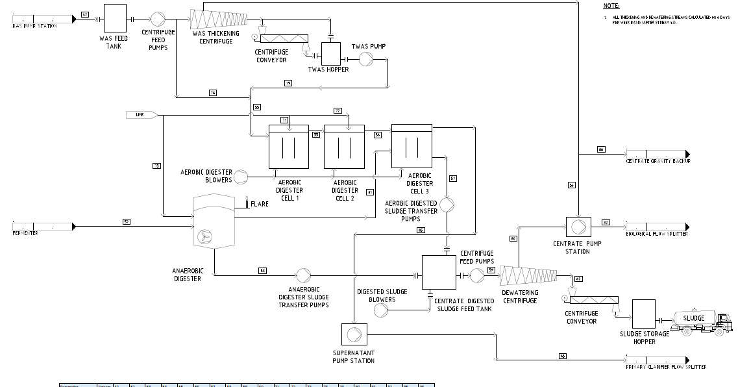

Slide 10
Odour Generation, P release avoidance and loss of aerobic digestion volume
Partial RAS/WAS bypass of existing thickening centrifuge
Alt 1: Run anaerobic digester as fill and spill and blend anaerobic and aerobic sludge in aerobic digester 3.
Alt 2: Anaerobic digester as variable volume (pump in and pump out) and blend sludges in covered smaller centrifuge feed tank.
Relatively high aerobic digester feed conc. (2-2.5%) – coarse bubble diffuser selection
Design
Features
‘Ambient’ anaerobic digestion of fermented primary sludge (available design HRT > 55 days)
3 cell cyclic aeration approach to manage N and P release in aerobic digester
Lime dose for alkalinity to both digestion systems AND to support P capture in aerobic digester (capture P and related solids OUTSIDE of 2ndry sludge inventory)

Slide 11
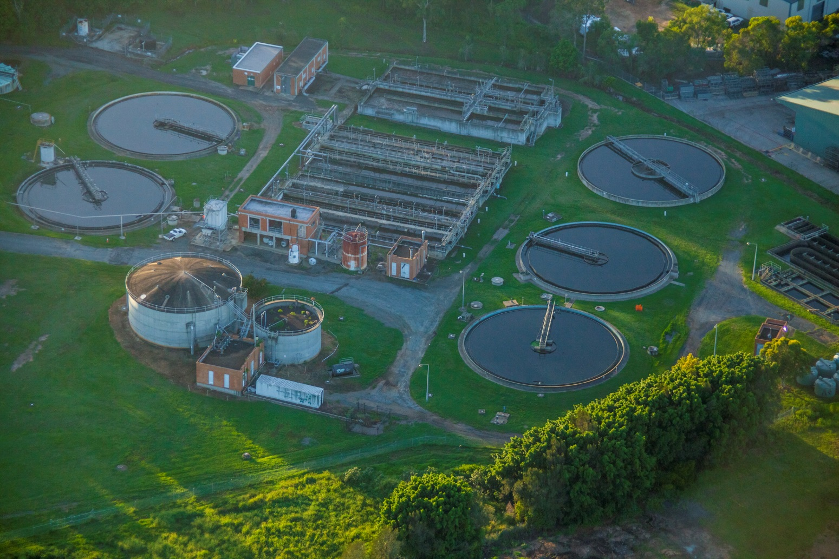
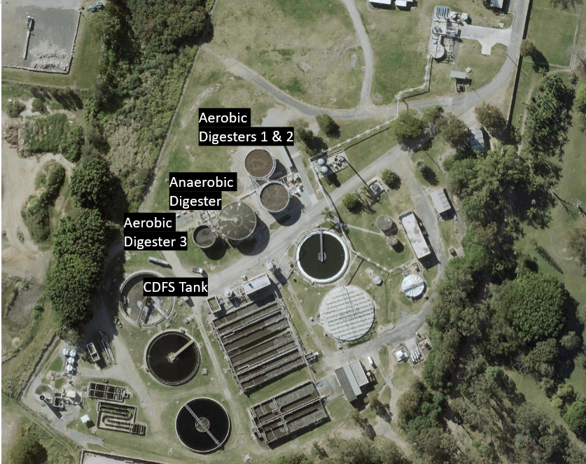


Slide 12
Commissioning and Operations RR

Slide 13
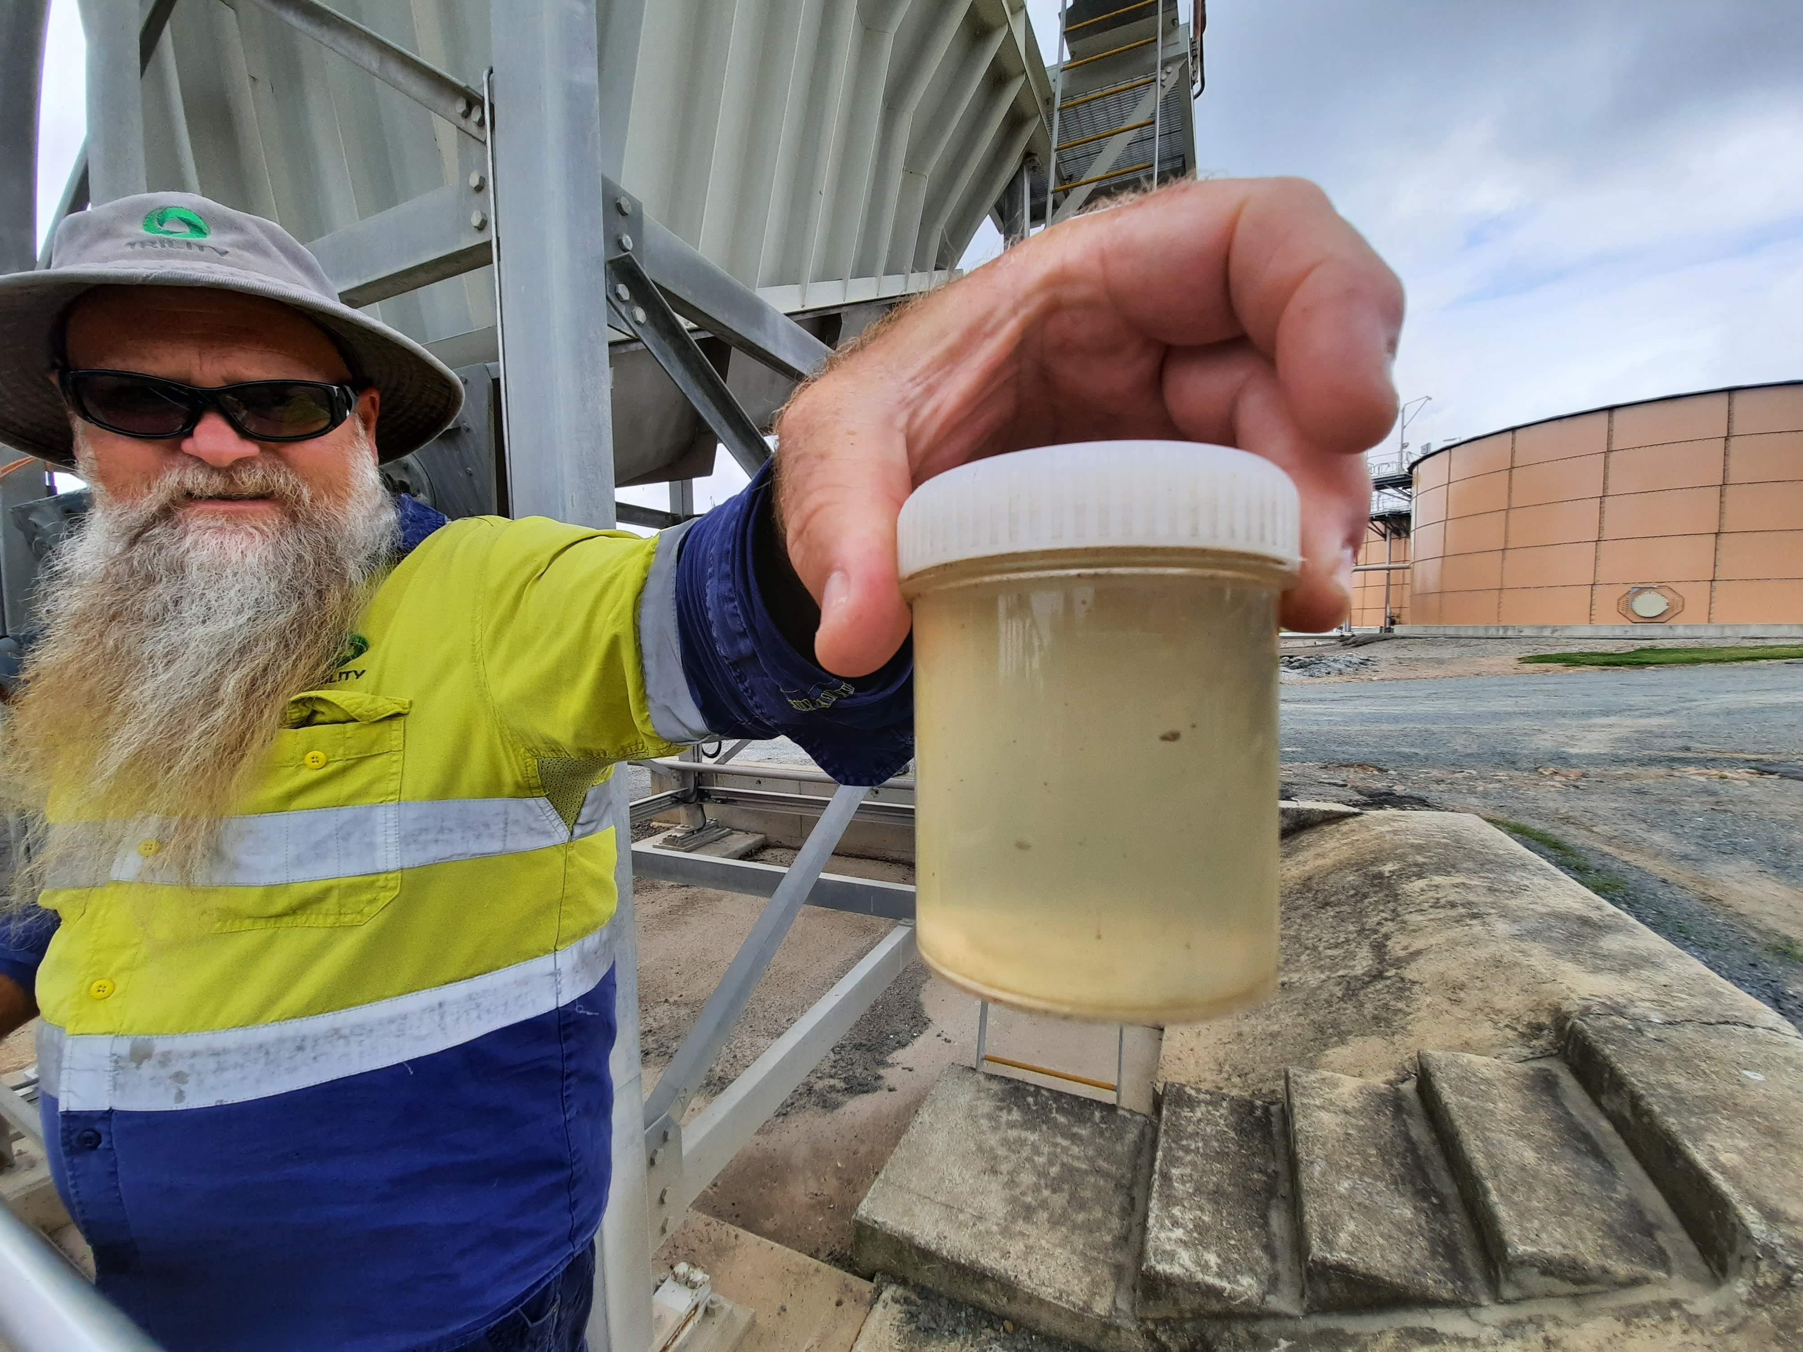
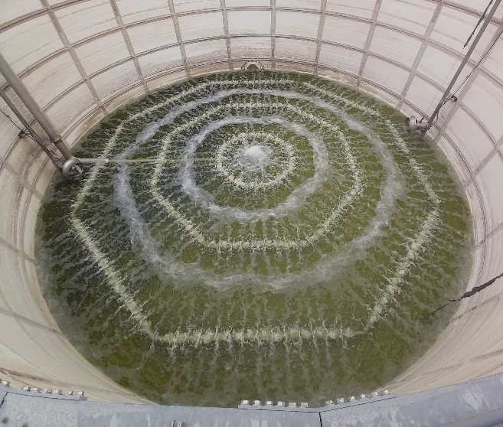
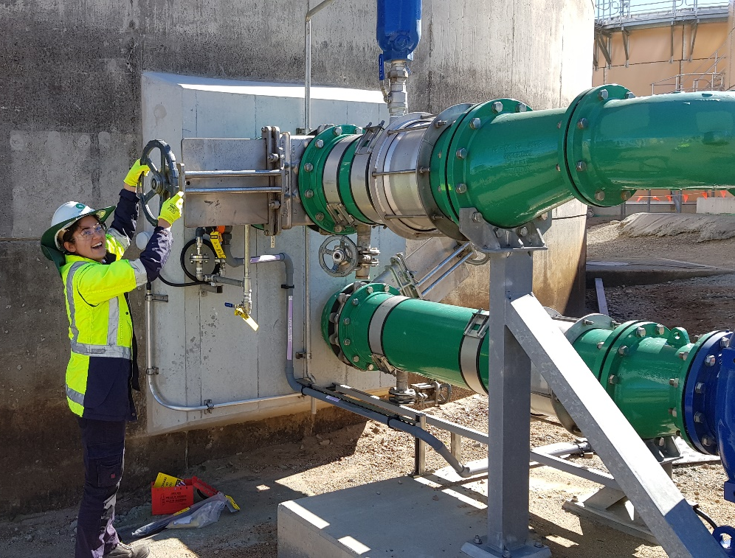
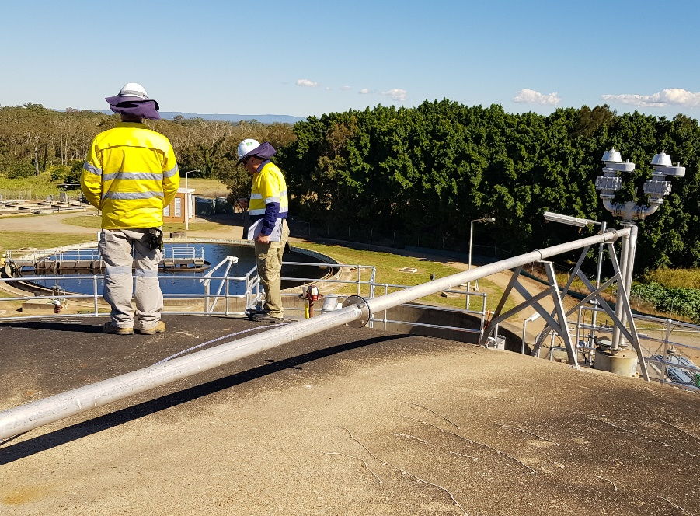
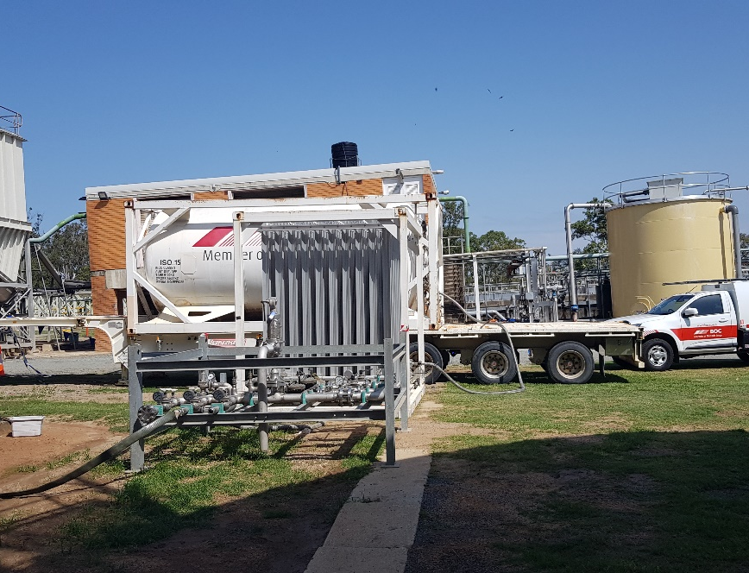
Commissioning
Anaerobic Digester Commissioning Build Up Rate
Aerobic Digester Equipment Issues
Aerobic/Anaerobic Blend Trials
Foaming and Dewatering Issues
Nutrient Control (centrate concentrations)

Slide 14
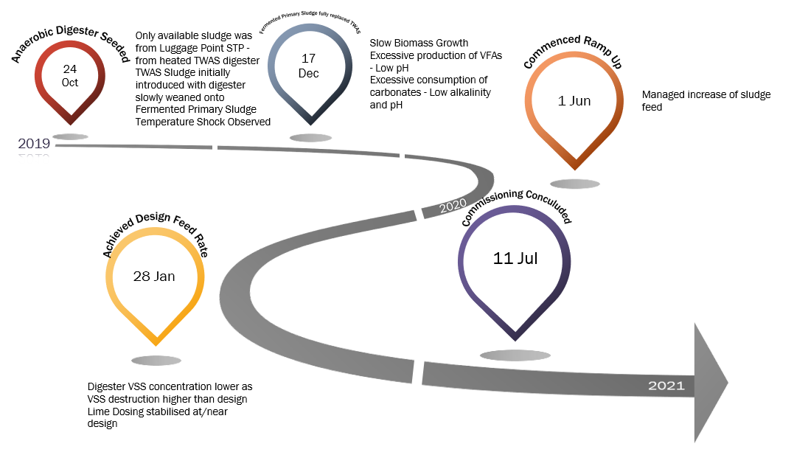
Anaerobic Digester Build Up Rate

Slide 15
Anaerobic Digester Build Up Rate (cont.)

Slide 16
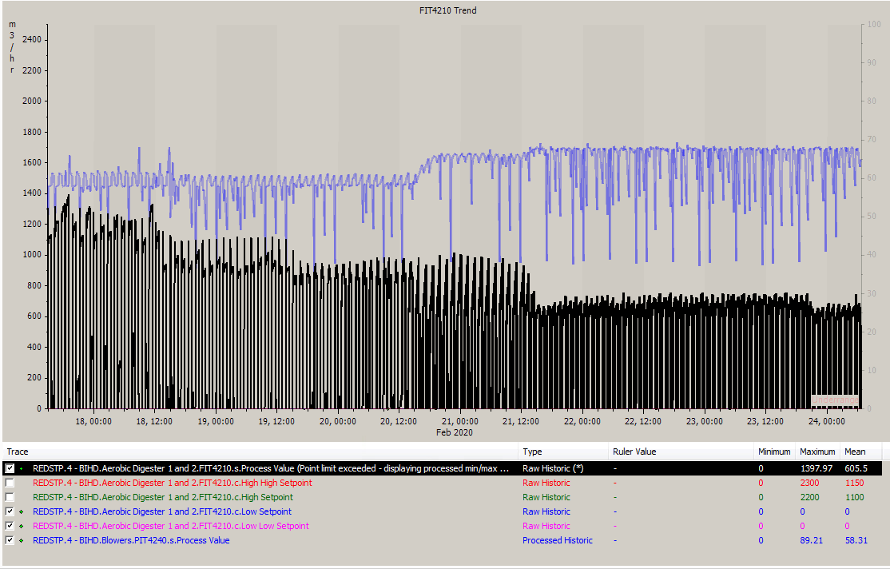
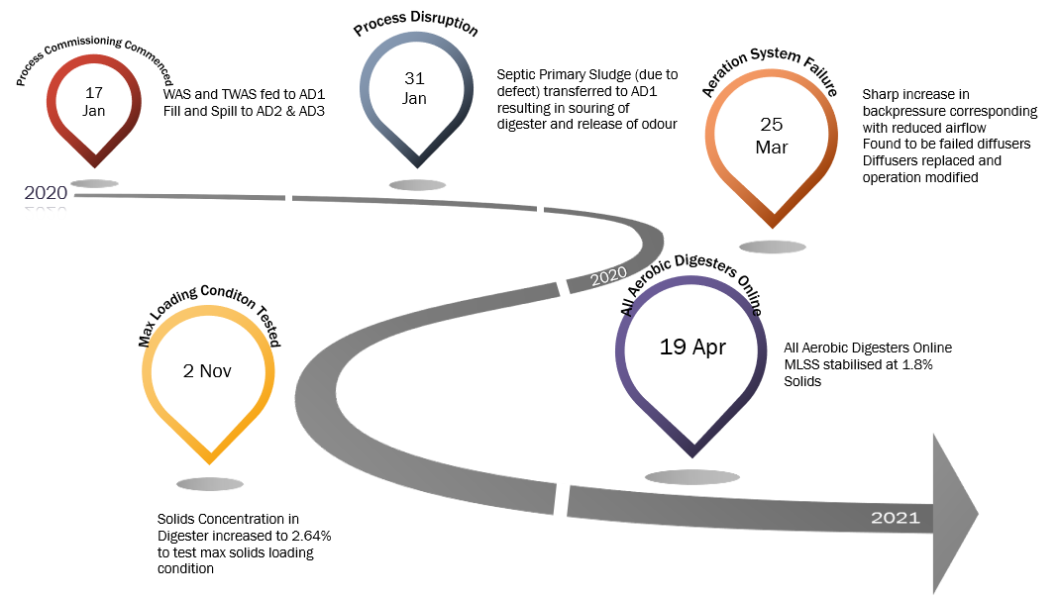
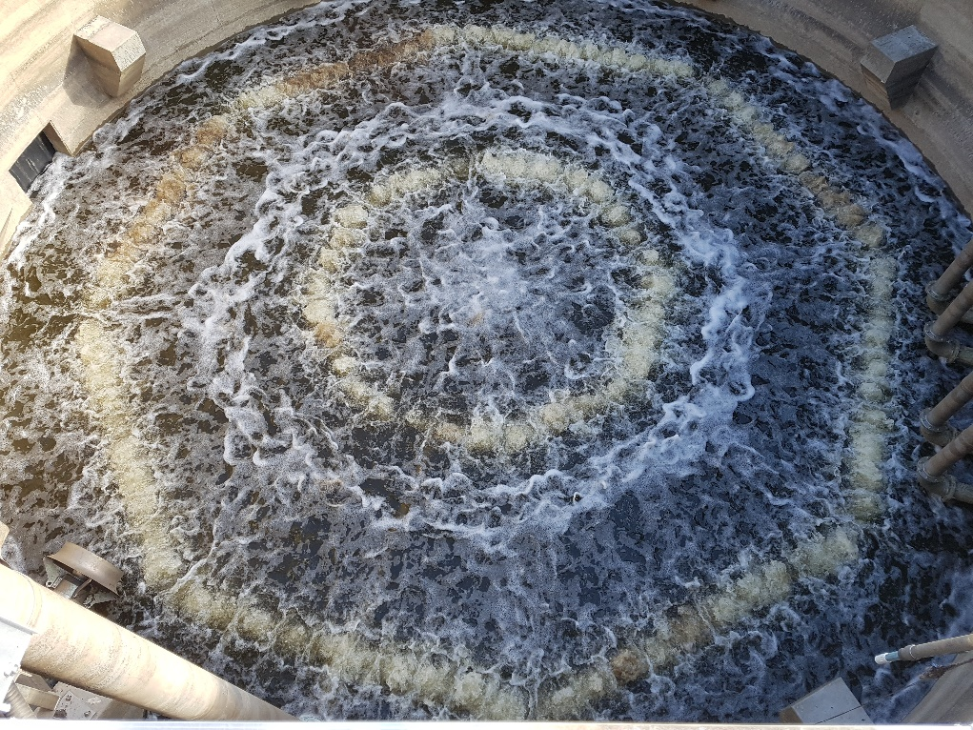
Aerobic Digester Commissioning

Slide 17
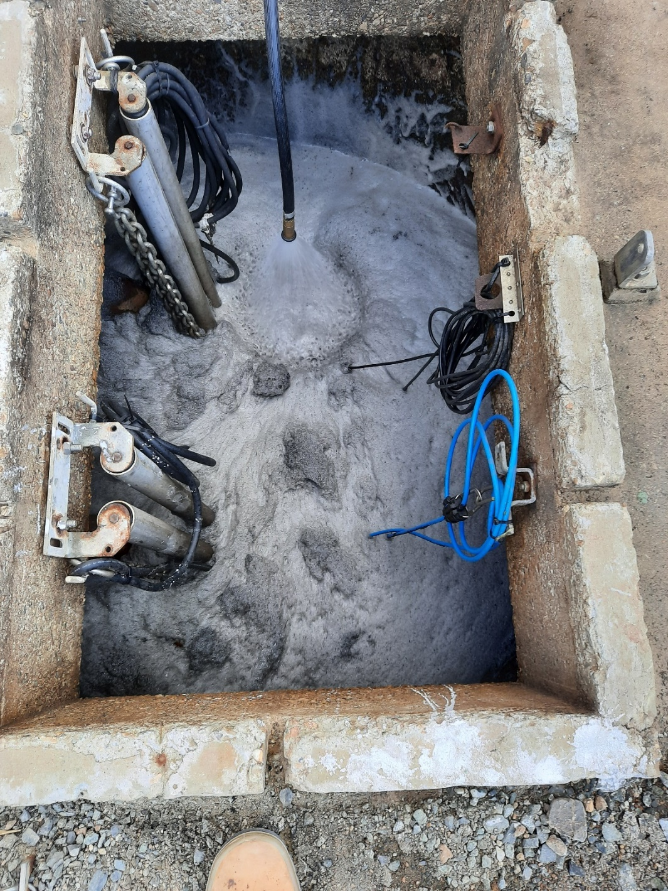
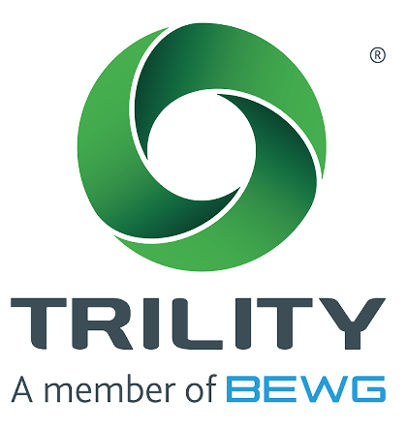

Anaerobic/Aerobic Sludge Blend Location Trials
Either AD3 or the CDSF tank
Blending in Aerobic Digester 3
  Anaerobic Digester in Fixed Volume
  Anticipated odour didn’t eventuate
  Sludge bulking occurred
Blending in CDSF Tank
  Anaerobic Digester in Variable Volume
  Process Interlocks were an issue
  Ratios >~30% resulted in reduced effectiveness of dewatering and foaming of the CDSF Tank and Centrate PS. Ok at design 25.8% but better at between 20-25%

Slide 18

Nutrient Returns
PO4-P Aerobic Digester 3, average < 50 mg/L
Ammonia – N Aerobic Digester 3 Average < 75 mg/L
Targets to avoid additional secondary treatment chemical dosing met!

Slide 19
Lessons, Legacy and Conclusions

Slide 20

Lessons
Temporary heating to support Anaerobic Digester commissioning may have ‘paid for itself’
Blending in the Aerobic Digester was found to provide the best results for dewatering efficiency and return rates.
Coarse bubble diffuser mixing needed to be supplemented with mechanical mixing during aeration cycle of Aerobic Digester at the higher solids concentrations
Fill and spill of anaerobic sludge into Aerobic 3 did not create an odour nuisance

Slide 21
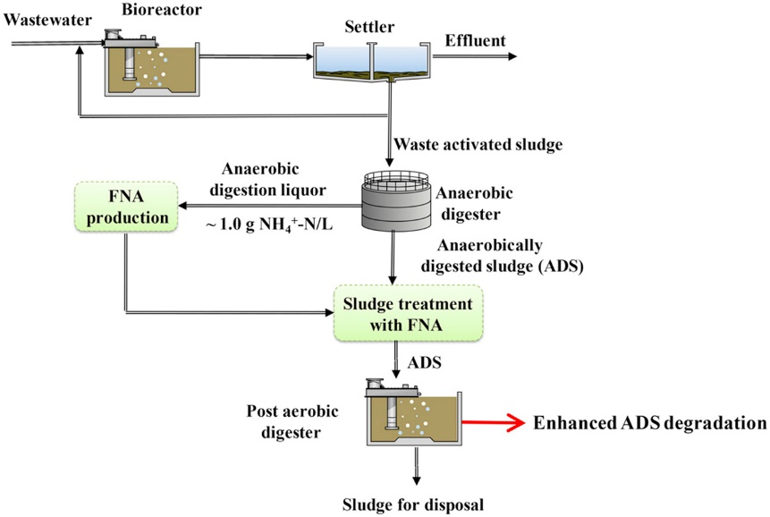
Legacy – Adaptable Assets
Future uses of aerobic digester tanks?
  PAD (post aerobic digestion) and variants
  Side-stream treatment reactors (e.g. Annamox based processes)
Ref: Wang et. Al 2016

Slide 22
Conclusions
Yes it worked!
    combining ambient/cold anaerobic digestion of fermented primary sludge and aerobic digestion of WAS
      Utilised existing assets
      Met sludge stabilisation requirements whilst managing nutrients and secondary solids inventory.
      Provided infrastructure with flexibility for future biosolids treatment pathways
      Provided redundancy options
But
  Commissioning of unheated digester on primary sludge difficult to manage and slow process

Slide 23
Acknowledgements:
TRILITY operations and project delivery teams
Other members of the Stantec Team
Aquatec-Maxcon and Alliance Automation
Unitywater

