Slide 1



Nutrient Recovery from Wastewater
Life Cycle Assessment of
COMMERCIAL STRUVITE RECOVERY PLANTS
S. Soltani, X. Gao, F. Xia, Ph. A. Schneider

Slide 2
Outline
Introduction
Importance of P recovery
Motivations & challenges
Objective
Results
Methodology
Notes:
Here is the outline of the presentation which includes an introduction and Importance of P recovery, and then after talking about Industry motivations and Challenges, we will move to the objective and methodology of this research. Then we will have the project results at the end.

Slide 3
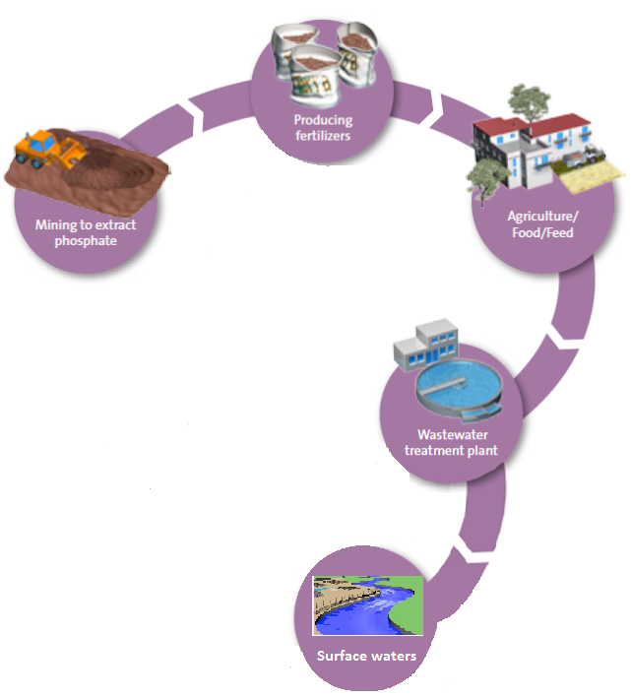
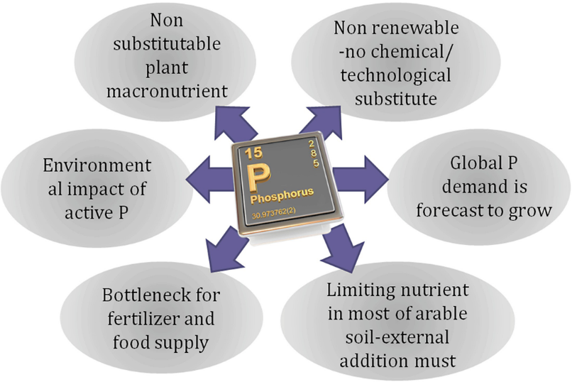
Current phosphorus cycle
Mining to extract phosphorus
Producing fertilizers
Wastewater treatment plant
Agriculture/Food/Feed
Surface waters
Adapted from www.veoliawatertechnologies.com
Handbook of Environmental Materials Management pp 821-868
Notes:
First of all, I would like to talk about importance of phosphorus as a non-renewable resource. It’s an essential element for life and is becoming increasingly scarce, contaminated, and difficult to extract.
Phosphorus is a key ingredient in the fertilizers used in agriculture and for animal feed. Every living thing needs phosphorus, unlike oil and gas, there is no alternative to this essential element. We get phosphorus in the chemical form of phosphate from our food and water. Plants get it from the soil. And finally, it enters surface waters.

Slide 4
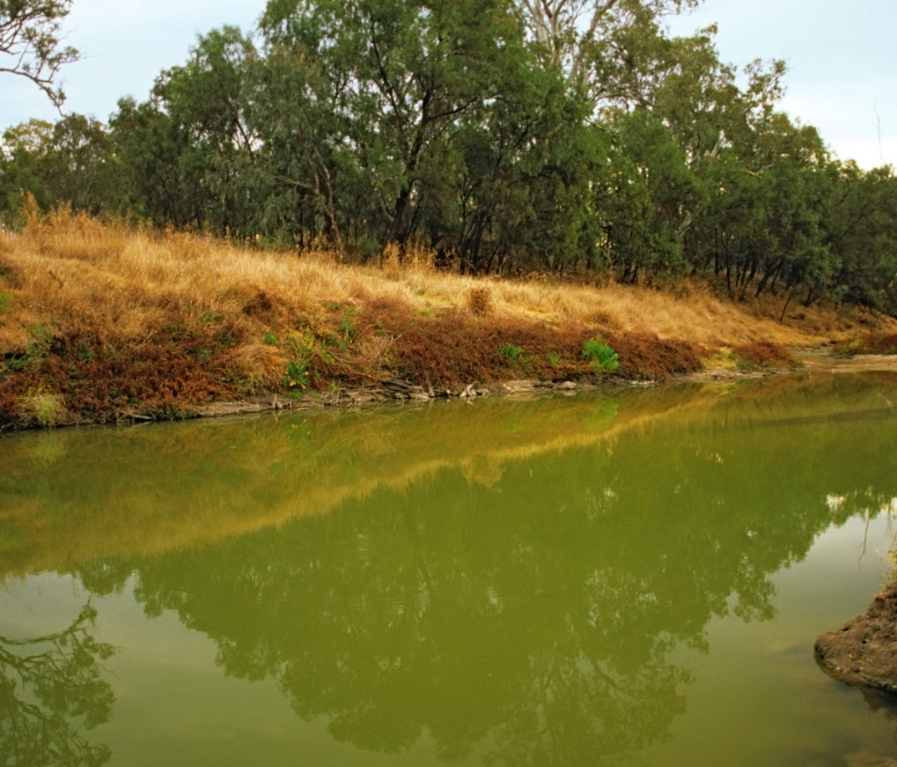
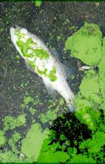
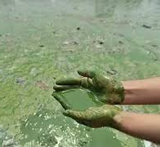
Importance of P Removal
www.thespruce.com
Notes:
Eutrophication is a tricky environmental problem worldwide, In simplest terms, eutrophication is a high concentration of nutrients in a body of water. These nutrients—(usually P and N)—are food for aquatic organisms like algae.
The recovery of P-specifically struvite precipitation-could limit the release of P and N into the natural habitat and prevents an imbalance in an aquatic environment.

Slide 5
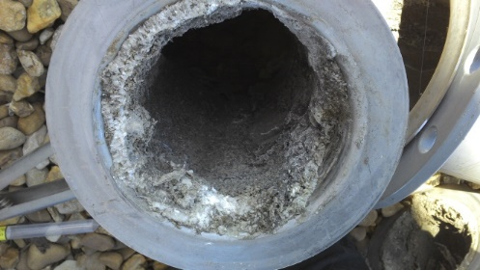
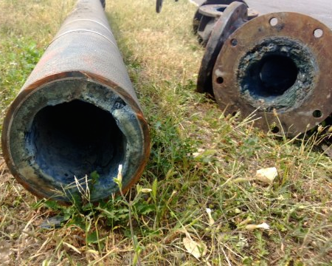
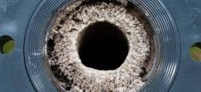
Importance of P recovery from WWTP
Notes:
clog pipes and unplanned operation downtime caused by uncontrolled struvite precipitation
reactive products injection into the wastewater treatment process

Slide 6
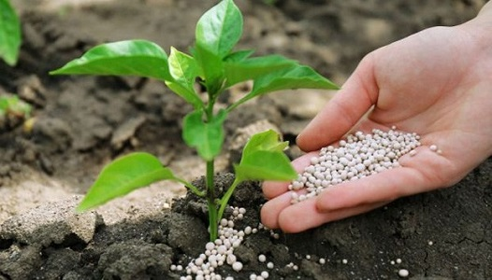
Struvite benefits as a fertilizer
Slow nutrient release
Successfully has been used on different plants.
Great fertilizer for those need magnesium.
Effective eco friendly fertilizer for fruit trees.
www.agchemigroup.eu
Higher phosphorus uptake rate than other phosphate fertilizers
A profitable investment in the agricultural sector
Reduction in the greenhouse-gas emissions
Notes:
Here is the benefits of struvite as a fertilizer.

Slide 7
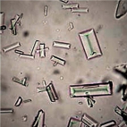
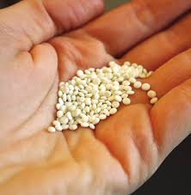
Struvite formation
Reactor
Wastewater (N, P)
struvite
MgNH₄PO₄.6H₂O
Source of Mg
$$NH_{4}^{+}+PO_{4}^{3−}+{Mg}^{2+}+6H_{2}O→MgNH_{4}PO_{4}.6H_{2}O$$
Source: capl@washjeff.edu
Notes:
In many wastewaters, specifically agri-food industry wastewater, we have ammonium and phosphate. Therefore, the artificial addition of magnesium to wastewater is a very convenient way of fixing amount of phosphorus and nitrogen in the wastewater and convert them into struvite. Therefore, in this way we can modify phosphorus cycle by producing struvite.

Slide 8
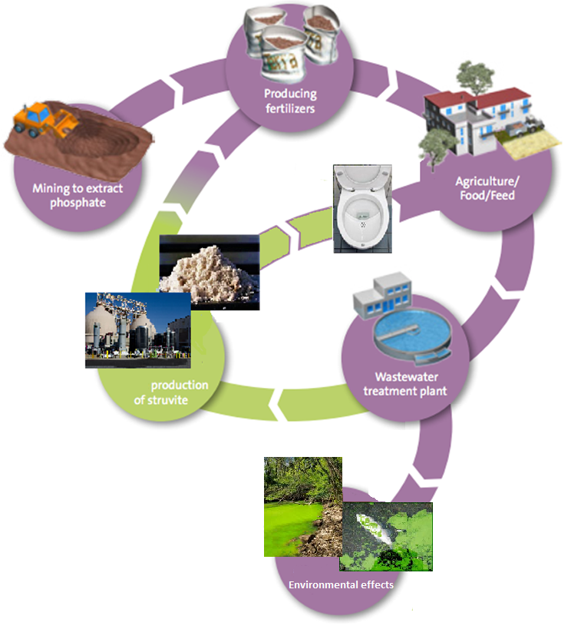


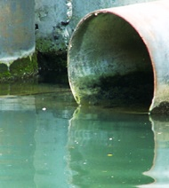
Modified phosphorus cycle
Reduction of rock phosphorus consumption
Production of an eco-friendly fertilizer
Prevention from eutrophication
Reduction of maintenance costs
Reduction of operating costs
Adapted from www.veoliawatertechnologies.com
Notes:
Here is the key benefits of phosphorus recovery from waste streams :
(1-first and foremost) )(2-there would be no more clog pipes and unplanned operation downtime caused by uncontrolled struvite precipitation that clogs pipes-and also the reactive products injection into the wastewater treatment process would be reduced). (3-by reduction in the production of sludge). Moreover, it prevents from eutrophication and results in production of a fertilizer.
Actually, struvite is an ideal solution to allow industries and municipalities to turn a cost into a benefit.

Slide 9
Motivations for
Advanced Nutrient Refinery and Recovery Systems
There has been a strong increase in technological developments for struvite recovery from wastewaters.
Full-scale struvite recovery plants have been shown to be technologically and economically feasible
Nutrient recovery technologies are becoming increasingly competitive with the conventional production technologies.
Stricter regulatory demands concerning wastewater treatment.
Direct use of struvite as fertilizer on land.

Slide 10
Challenges for
Selection and Implementation of Effective Technology
There are increasing concerns towards the environmental aspects and sustainability of struvite precipitation process.
Most previous LCA studies focused on positive impacts of struvite recovery on the overall environmental performance of the whole system and the footprints of the struvite itself are not presented.
The objective of this study was to determine to which extent different technologies for resource recovery from wastewater affect the environment during their life cycle.
Phosnix, Ostara’s Pearl, Multiform, Phospaq and NuReSys
Notes:
(previous) This hinders comparison of the performance of the currently commercialised technologies. With these limitations in mind, a gate-to-gate life cycle assessment is presented in this study, considering process-based EFP and CFP of the struvite in five commercially available technologies, including ...
This research has paid a special attention to the embedded energy of the struvite as the process’ product. The result of life cycle assessment in this research, could direct scientific research, to determine industrial policy and to assist investment decisions in the future.

Slide 11
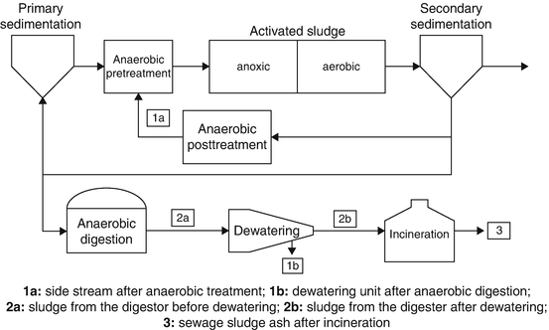
Possible Locations for Struvite Recovery in WWTP
Ketaki et al. 2018
Notes:
There is a range of feedstock sources which are feasible for struvite recovery. Availability of nutrients in the liquor after anaerobic digestion, due to mineralization of organic bound nutrients increases the potential of struvite formation. Therefore, the concentrated side streams after the anaerobic treatment or the dewatering unit after anaerobic digestion are the best options for phosphorus recovery.

Slide 12
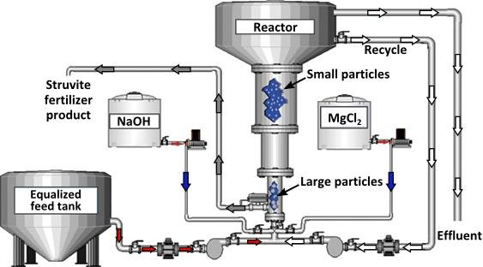
Process for struvite precipitation and recovery
Mg source
Adapted from Hazen and Sawyer 2010

Slide 13

Research Methodology
Gate-to-gate LCA
P concentration of 50 to 190 mg/lit
Wastewater flowrates:
1060-2400 m³/day
FBR or air-agitated crystallizer
Source of magnesium
Carbon & Energy footprint
Source of electricity
Notes:
Type of process in the studied technologies is crystallization, which occurs in a fluidized bed reactor or air-agitated crystallizer; Except for the NuReSys which has a top-entry agitated reactor after stripping tank and has similar performance to the rest of technologies. The technologies differ from each other in the source of magnesium, some operating parameters or equipment which result in differences in electricity and chemical consumption, and recovery efficiency of the processes, as well as quality and dry solid matter of the struvite as final product.

Slide 14
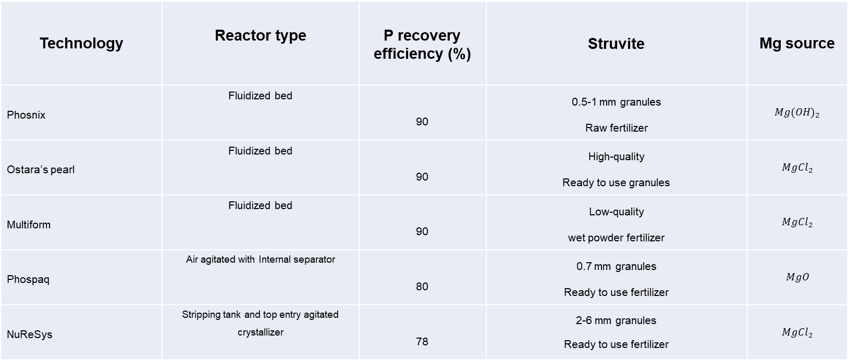
Life Cycle Inventory summary
Technology | Reactor type | P recovery efficiency (%) | Struvite | Mg source
Phosnix | Fluidized bed | 90 | 0.5-1 mm granules Raw fertilizer | $$Mg{(OH)}_{2}$$
Ostara’s pearl | Fluidized bed | 90 | High-quality Ready to use granules | $$Mg{Cl}_{2}$$
Multiform | Fluidized bed | 90 | Low-quality wet powder fertilizer | $$Mg{Cl}_{2}$$
Phospaq | Air agitated with Internal separator | 80 | 0.7 mm granules Ready to use fertilizer | $$MgO$$
NuReSys | Stripping tank and top entry agitated crystallizer | 78 | 2-6 mm granules Ready to use fertilizer | $$Mg{Cl}_{2}$$

Slide 15
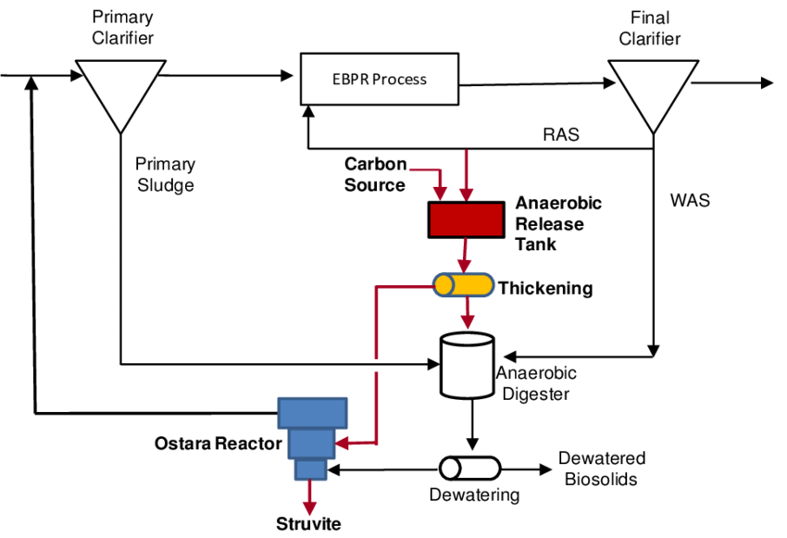
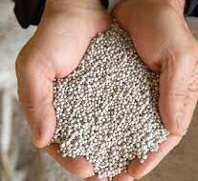
LCA Boundary and Functional Unit
Notes:
The scope of LCA in this work based on a G-to-G boundary, covering from pumping feedstock into the reactor to the separation and preparation of struvite from reactor effluents as a main product. And the functional unit is defined as 1 kg of the produced struvite. The information about all full-scale struvite installations was gathered through literature review and web search.

Slide 16
Struvite production technologies
Phosnix
Notes:
Unitika Ltd.
Wastewater after digestion or sludge treatment
Mg(OH)2- Japan (2) - Sold to fertilizer companies

Slide 17
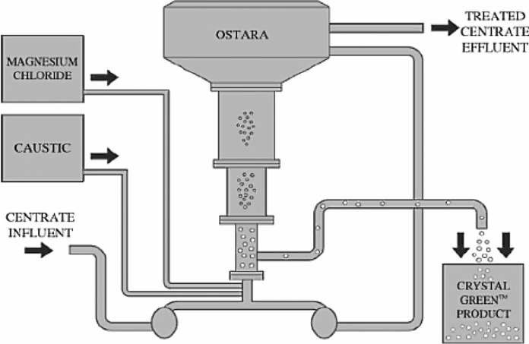
Struvite production technologies
OSTARA’ Pearl
Notes:
University of British Colombia/ Ostara
Sludge dewatering liquid- MgCl2, NaOH-United States (4) -Used as slow-release fertilizer at golf courses

Slide 18
Struvite production technologies
Multiform
Notes:
Similar to Ostara in concept but does not involve a recycle.
Multiform Harvest’s marketing strategy entails blending the struvite product prior to marketing.

Slide 19
Struvite production technologies
Phospaq
Notes:
Paques bv
Rejection water
MgO
The Netherlands(2)
Exported to Germany, mixed up with other fertilizer

Slide 20
Struvite production technologies
NuReSys
Notes:
Akwadok bvba
Anaerobic digestion effluent/Digested sludge
MgCl2, NaOH
Germany (1)
Belgium (2)
Exported to wine grower in France, mixed with compost

Slide 21
LCA diagram
Process
Operation electricity
CO2-eq/kg of struvite
(WA mix)
Energy
Carbon footprint
Raw material
Energy footprint
Mg source production embedded energy and CO2 emission
MJ/kg of struvite
Main product
Co product
Struvite
Effluent
Notes:
Here is the main stages and typical inflows and outflows considered in this research LCA. This research has paid a special attention to the embedded energy of the struvite as the process’ product. The result of life cycle assessment in this research, could direct scientific research, to determine industrial policy and to assist investment decisions in the future.
WA mix: a combination of natural gas, coal, wind, and solar photo voltaic with the shares of 45, 25, 15 and 15, respectively.

Slide 22
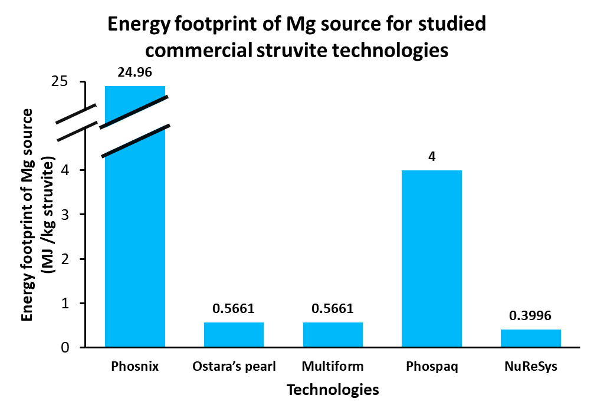
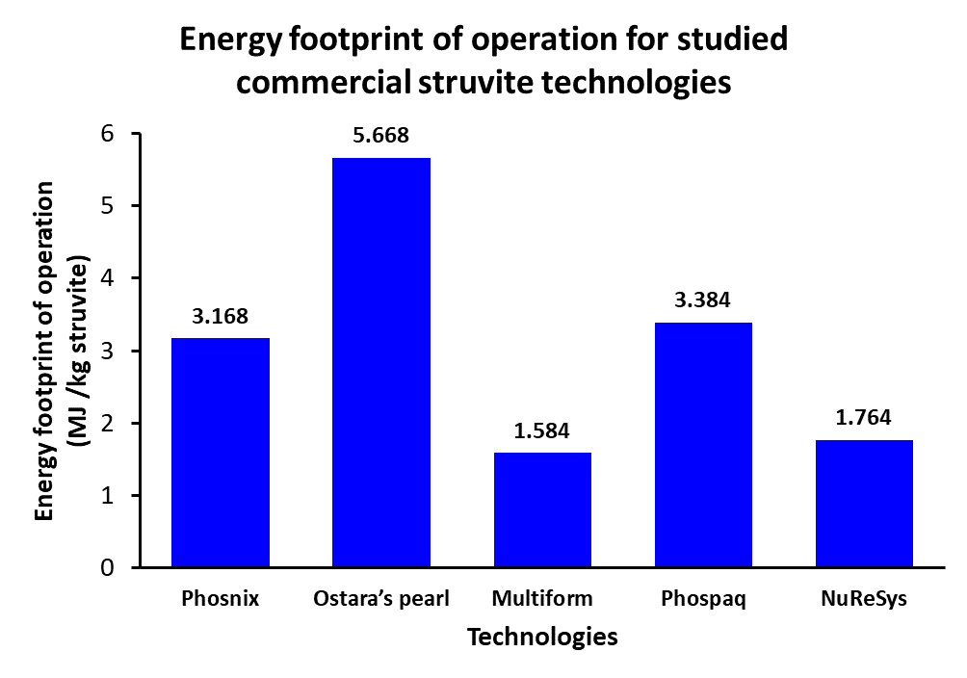
Results
Notes:
Mg(OH)2, MgCl2, MgCl2, MgO, MgCl2
S-L separator, Recycle ,-, Aeration, Separate stripper

Slide 23
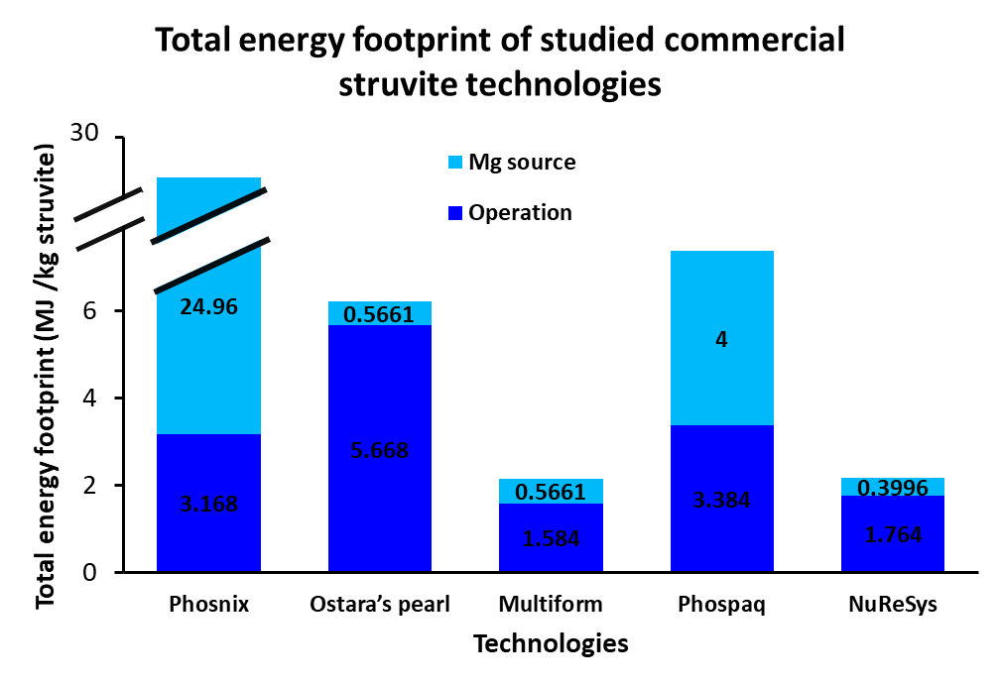
Results

Slide 24
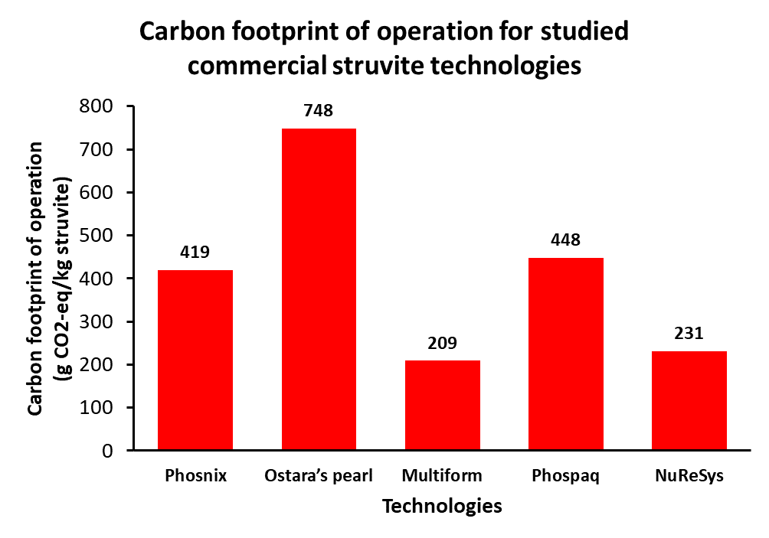
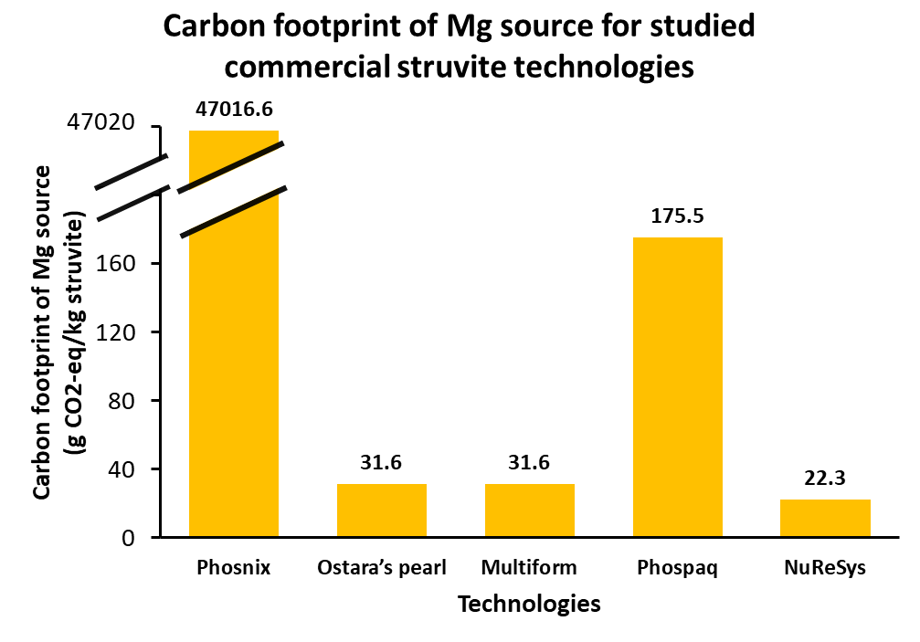
Results
Notes:
Mg(OH)2, MgCl2, MgCl2, MgO, MgCl2
S-L separator, Recycle ,-, Aeration, Separate stripper

Slide 25
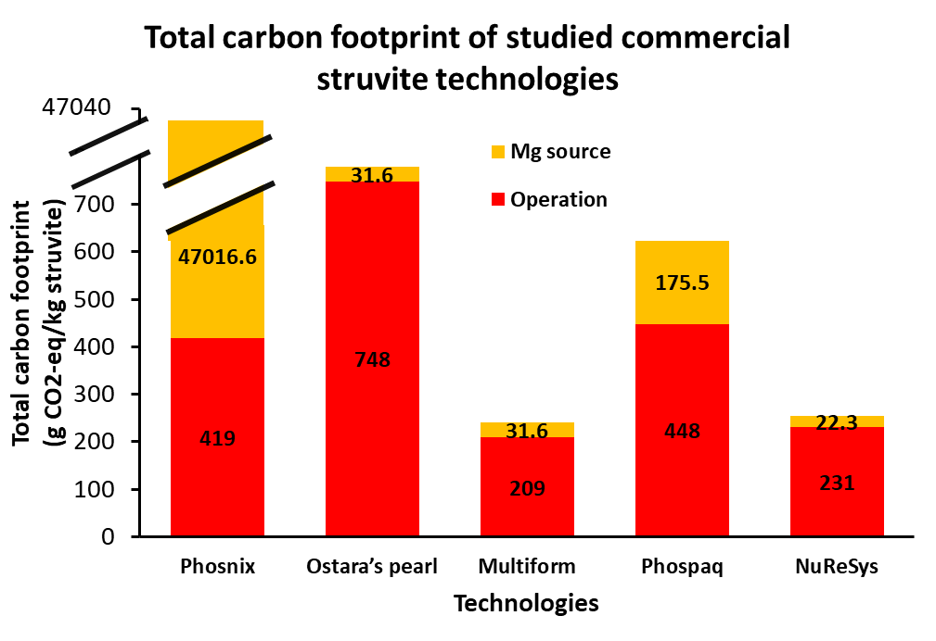
Results

Slide 26
Conclusions
A gate-to-gate LCA of struvite recovery from wastewater via five commercialised technologies.
Energy footprint 2.16 to 28.12 MJ/kg of struvite
Carbon footprint 240.62 to 47435 g CO2-eq/kg of struvite
Energy footprint order
Phosnix>Phospaq>Ostara’s Pearl>NuReSys>Multiform
Carbon footprint order
Phosnix>Ostara’s Pearl>Phospaq>NuReSys>Multiform
Notes:
The Phosnix technology has the higher amounts in energy footprint and carbon footprint. This is due to the magnesium hydroxide as source of Magnesium, which burdens a significant embedded energy and CO₂ emission in comparison to other magnesium sources in this work. In contrast, Multiform technology has the lowest E FP and C FP which results from lower consumption of electricity in the process. Source of Mg is the reason of different CFP & EFP trends.

Slide 27



