Slide 1
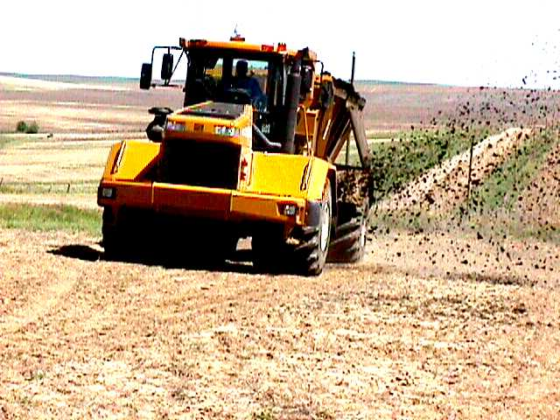
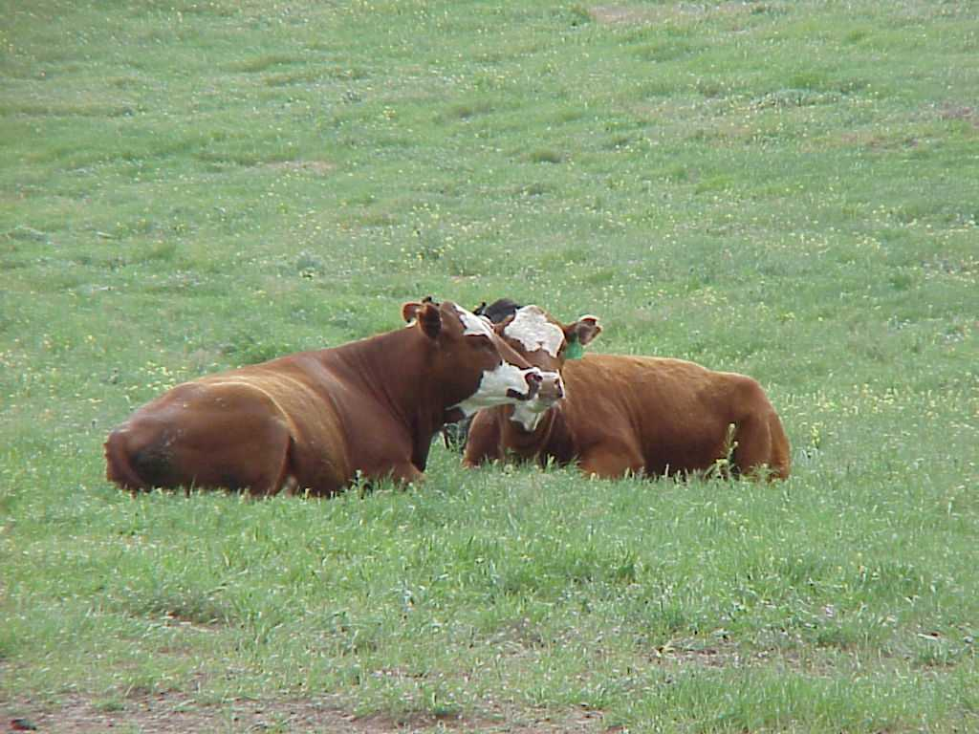
LONG-TERM REVIEW OF PRACTICES PUBLIC ACCEPTANCE FOR BIOSOLIDS LAND APPLICATION IN COLORADO
PRESENTED BY:
Mike Scharp, CPSS
Vice President – Sales and Environmental Services
Rocky Mountain Region
Denali Water

Slide 2
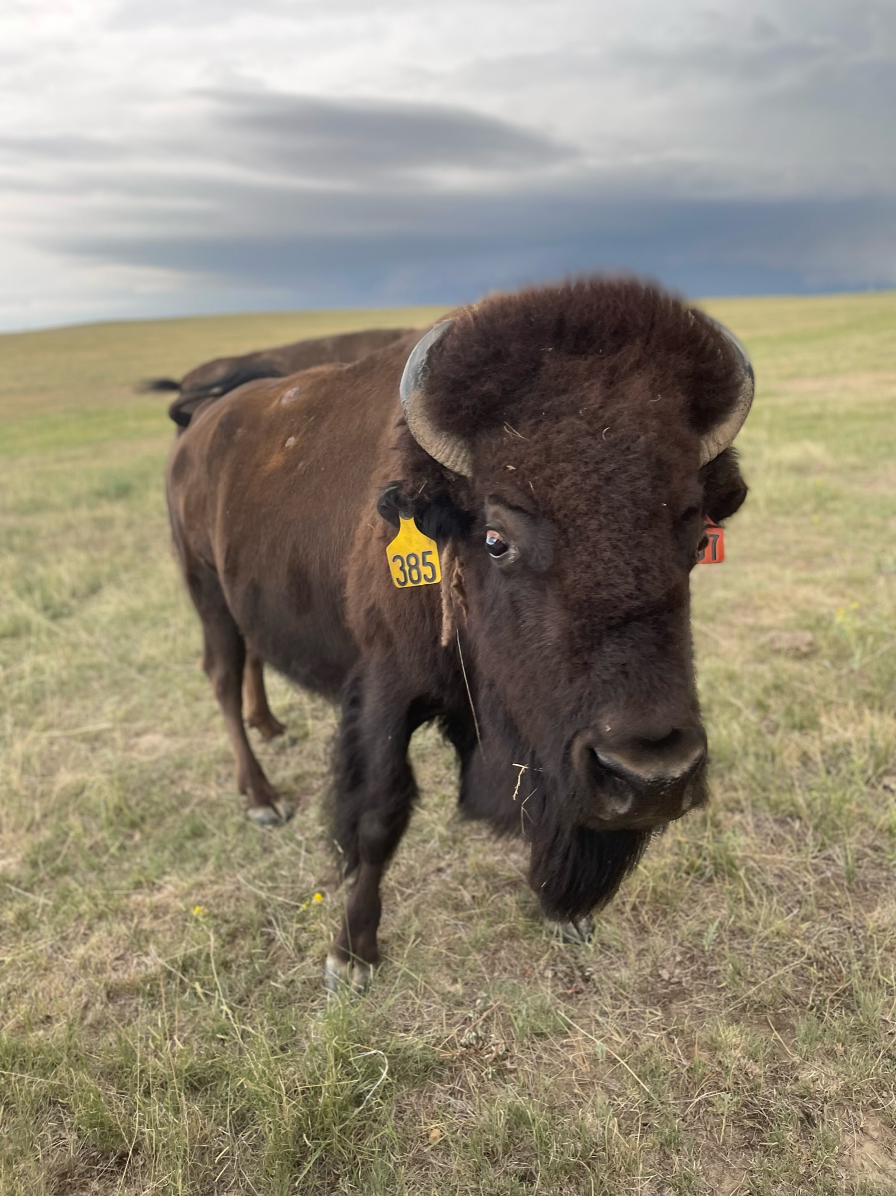
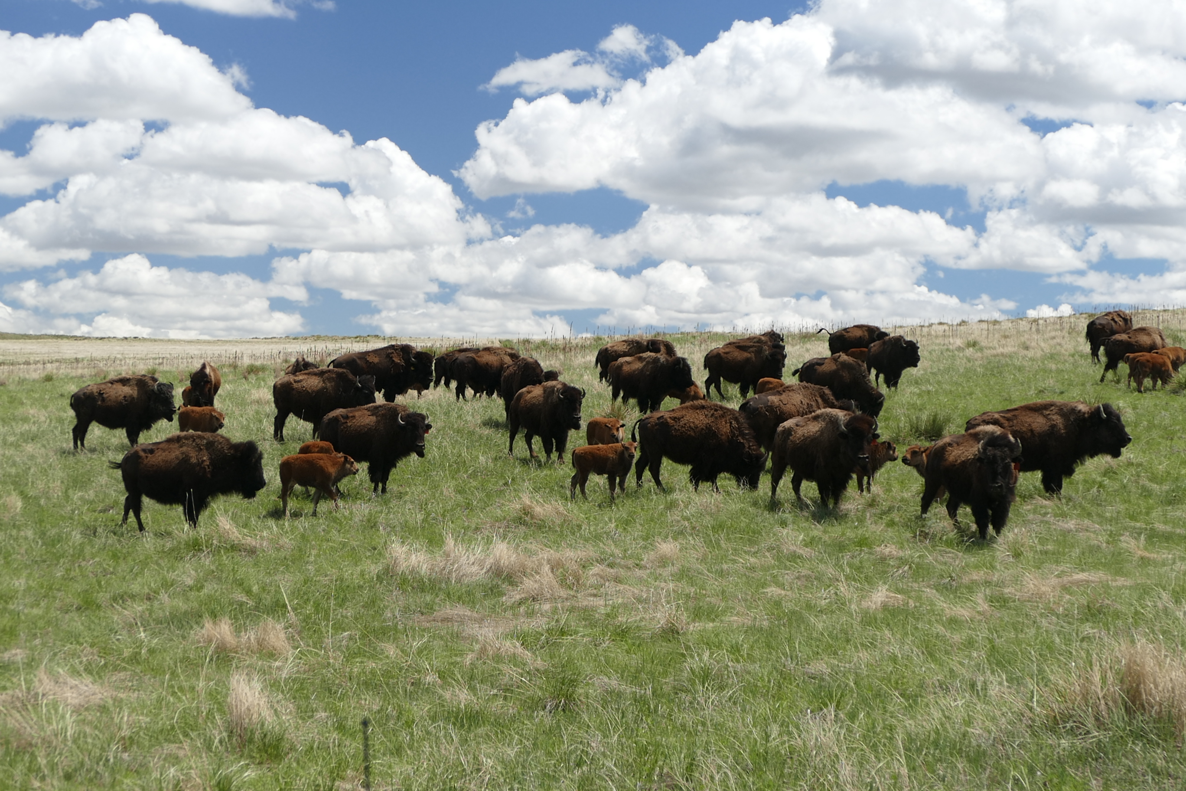

Slide 3
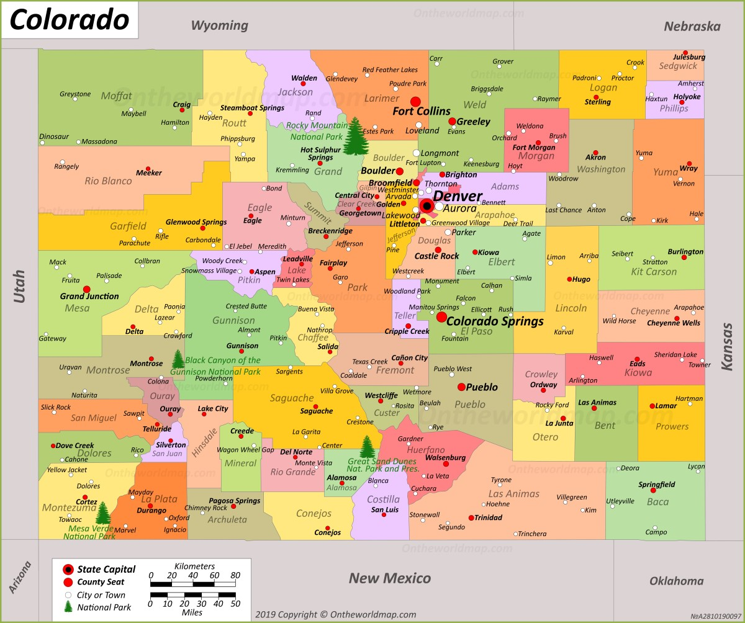
Details about Colorado
5.7 million people live in Colorado
All but 1 million live in Front Range
  Fort Collins – North
  Pueblo – South
  30 - 50 km wide
Vast majority of biosolids land applied in Weld County
66 m acres total
  24 m acres is federal (36%)
  32 m acres is farmland (50%)

Slide 4
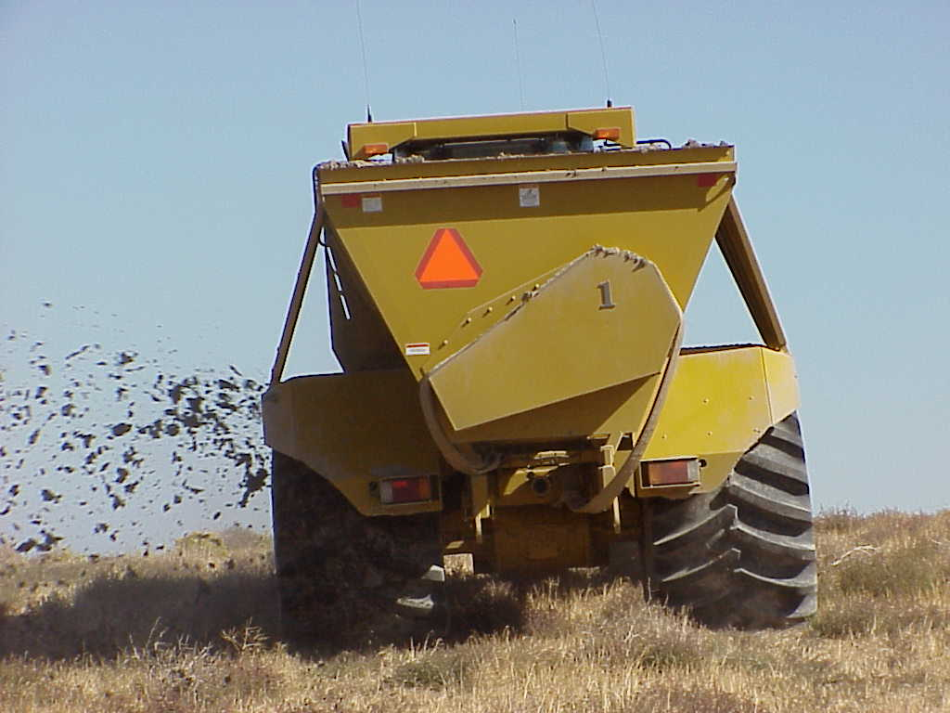

Slide 5
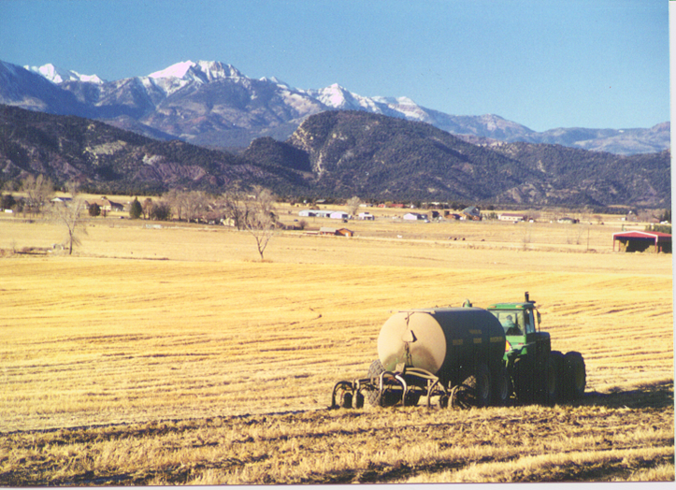
Biosolids in Colorado
75,000 DMT produced annually
Predominately land applied to dry land winter wheat
MWRD (Denver metro area) produces and est. 30,000 DMT annually
Denali is the primary sludge contract in Colorado
There are two large scale composting operations in Colorado

Slide 6
4 Main Gate Keepers
What is a gatekeeper?
Users – Farmers
Regulators
Employees
Neighbors
Generators

Slide 7
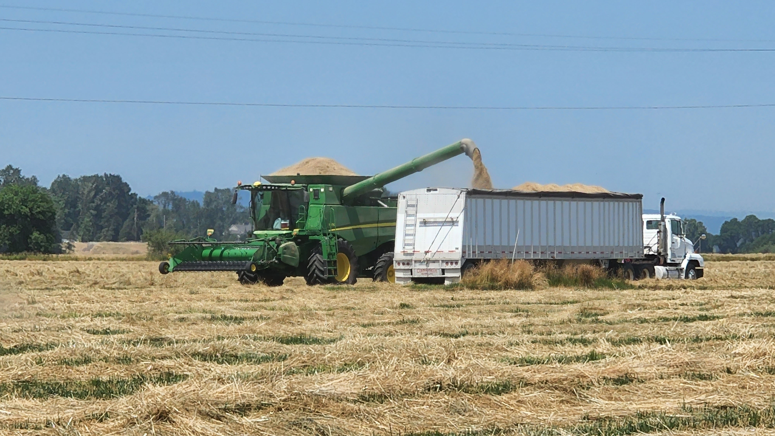
Users - Farmers
Equip your end-users with info
They are your spokesmen
You are his fertilizer agent – treat is as such
We sell Class B cake biosolids to farmers $1/WT
Get the best farmers
  Former Commissioners of Agriculture
  Large respected farmers

Slide 8
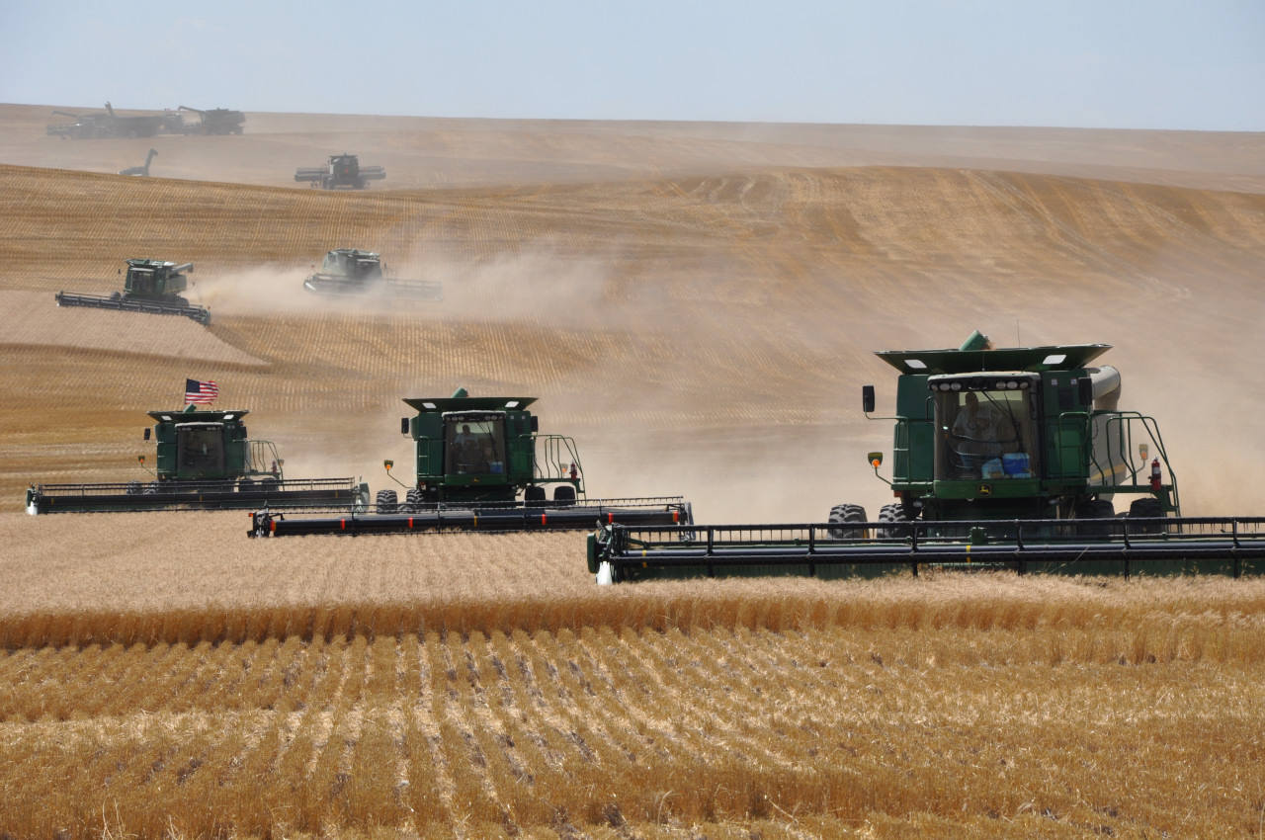

Slide 9
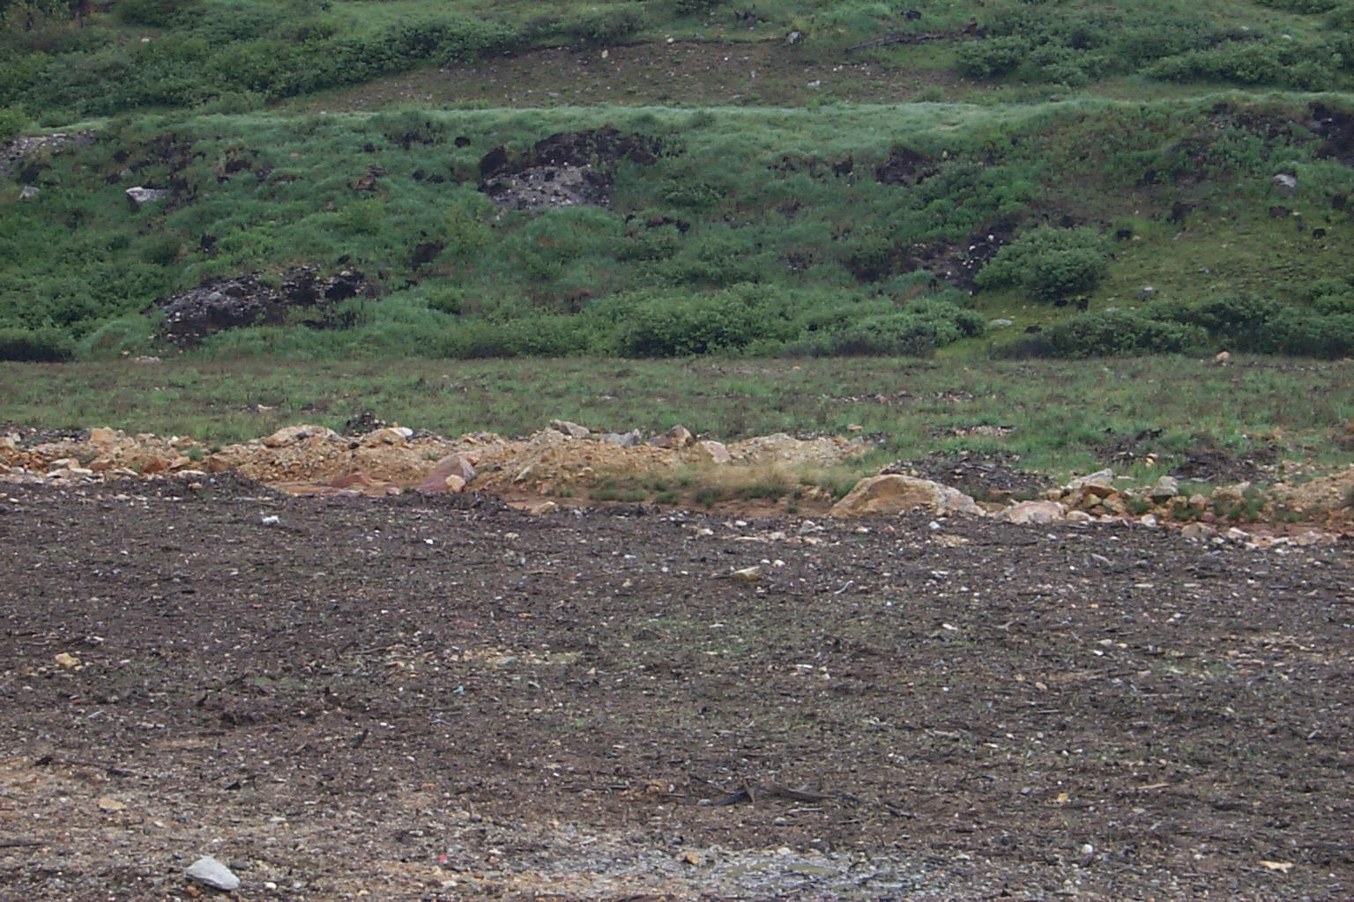
Last year’s application
This year’s application

Slide 10
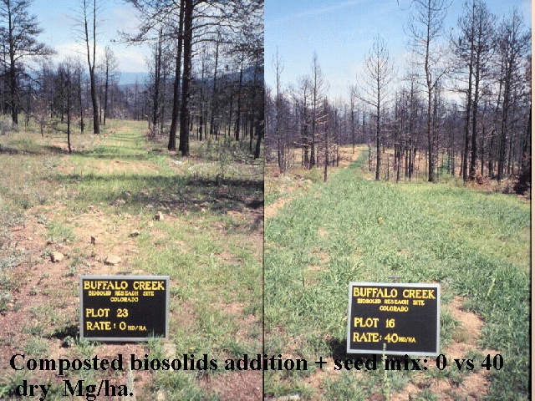

Slide 11
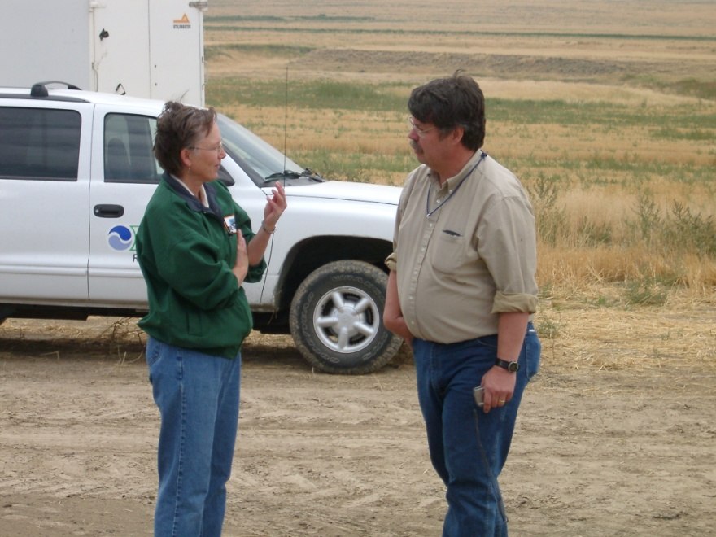
Regulators
Know your regulations
Know the science
ALWAYS comply
  Report on yourself
Inspections
  Without notice
Weekly Notices

Slide 12
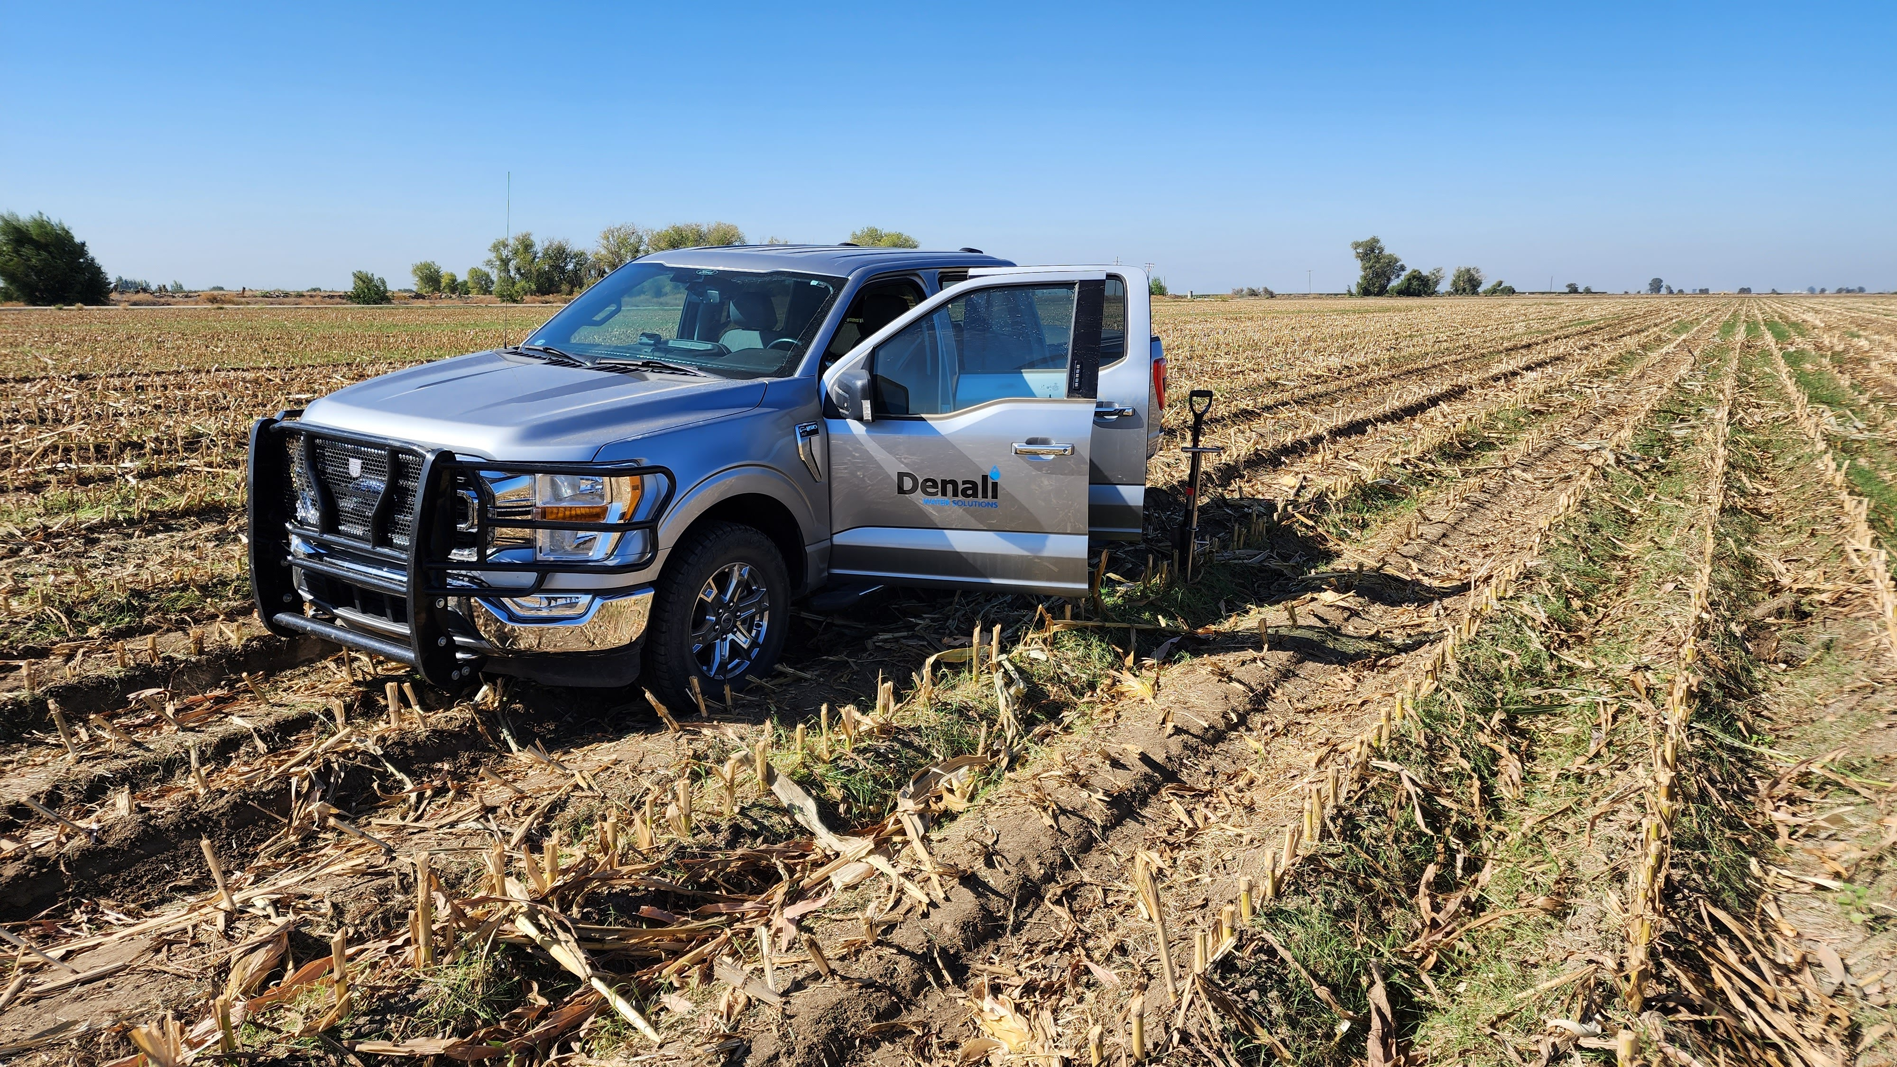
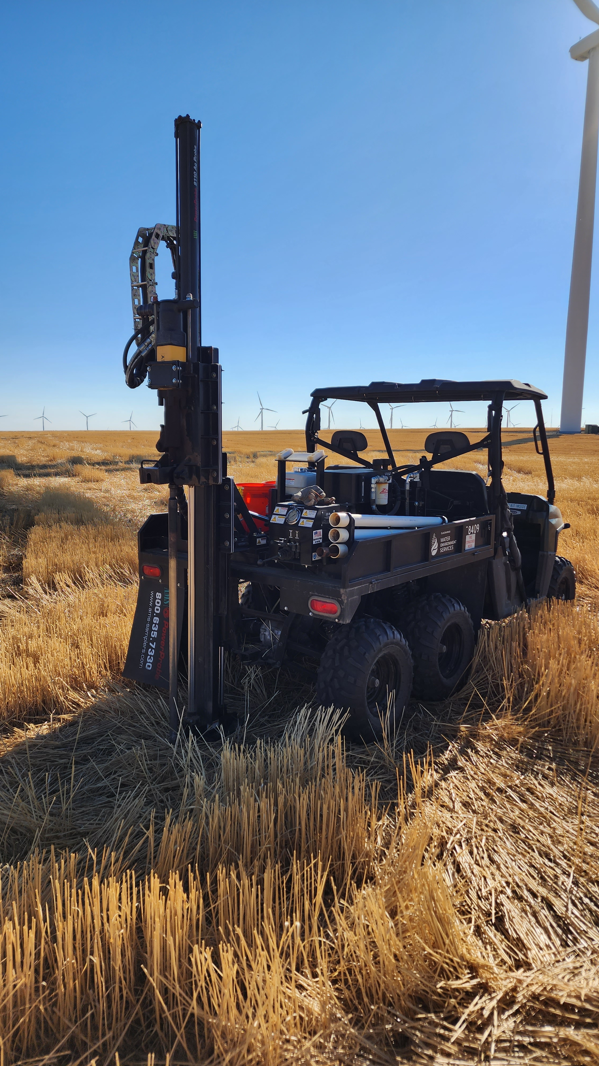

Slide 13
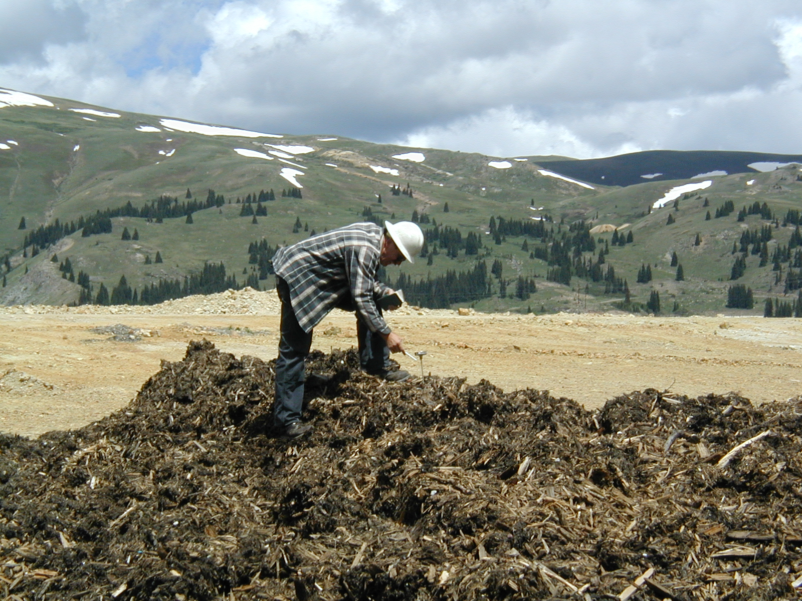

Slide 14
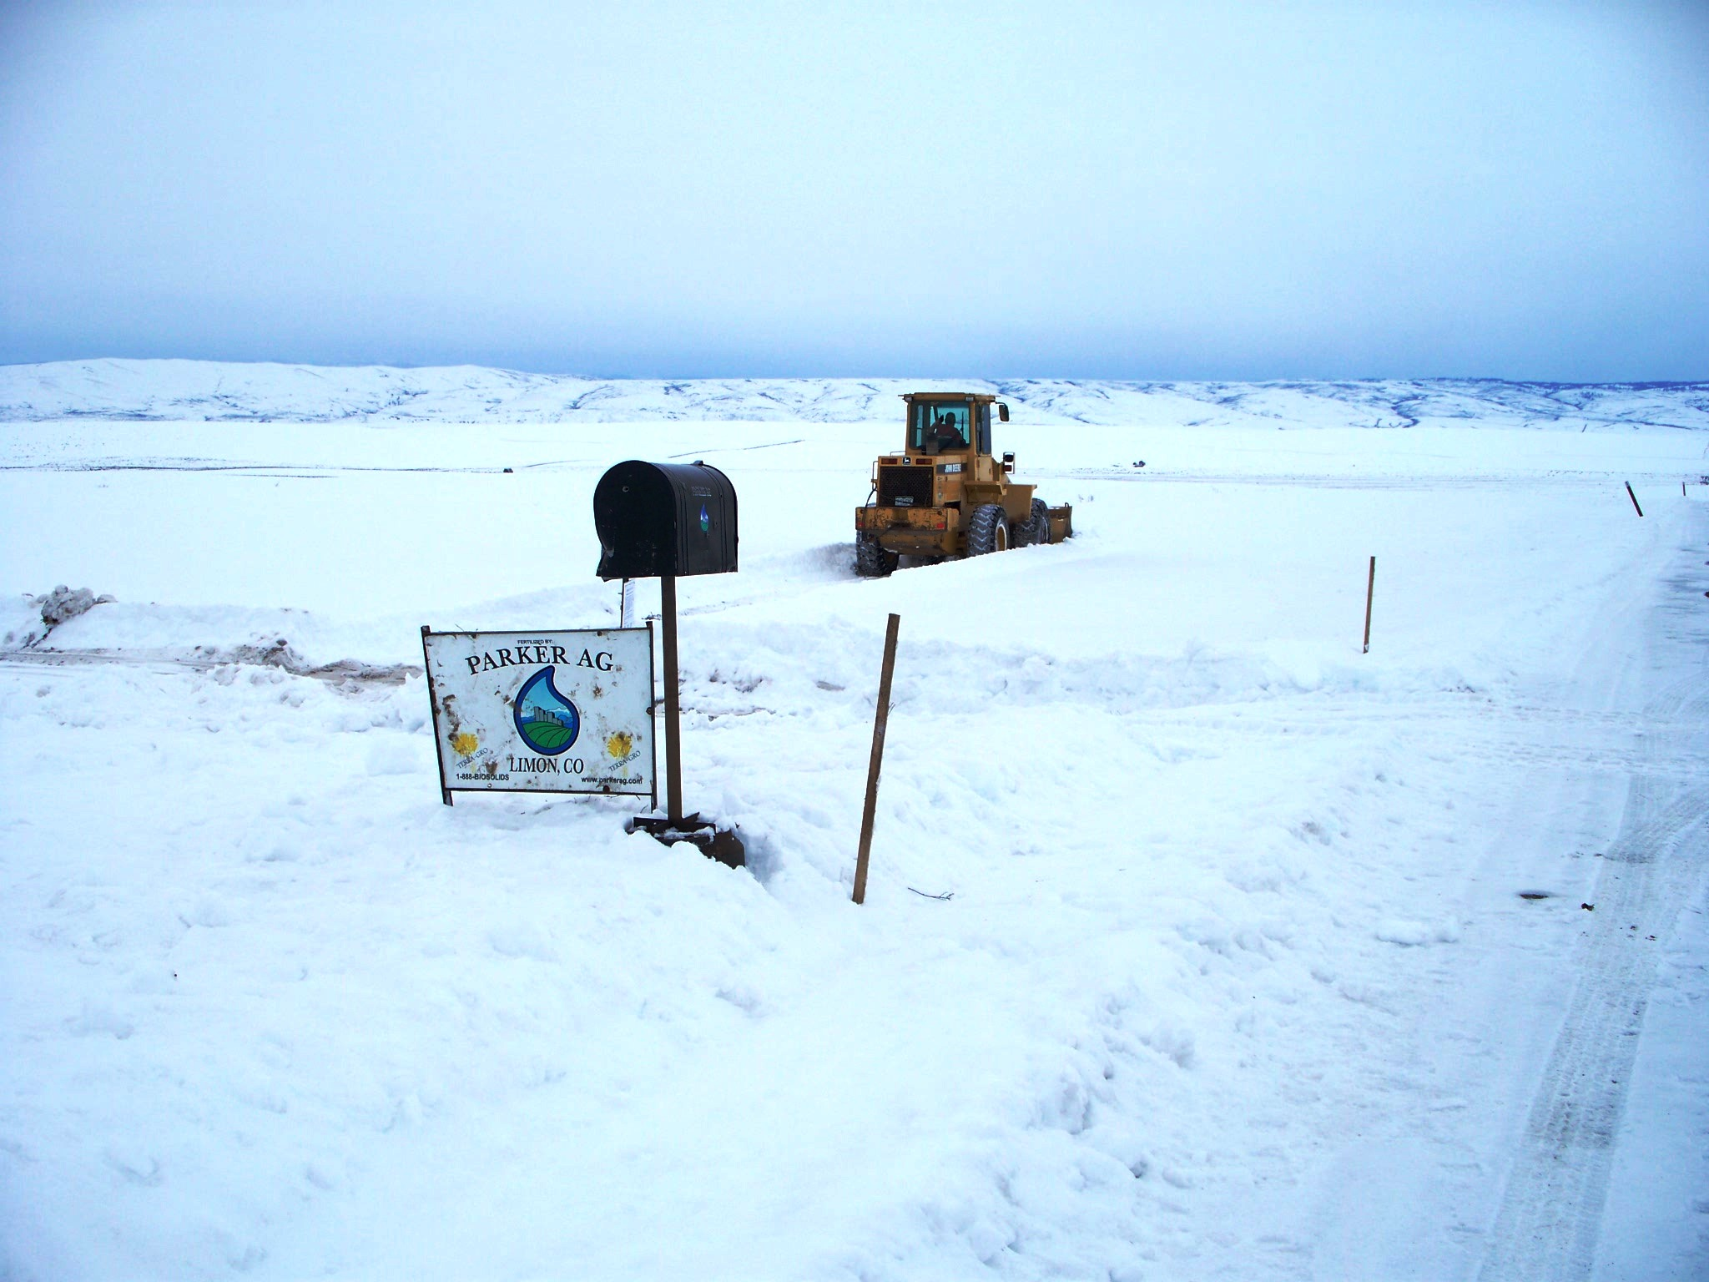
Neighbors
Know the area
Dog on the farm
Be respectful
  Weekend wedding/Holidays
Slow down
  Phone call from a neighbor you had complained many time just to say thanks for slowing down

Slide 15
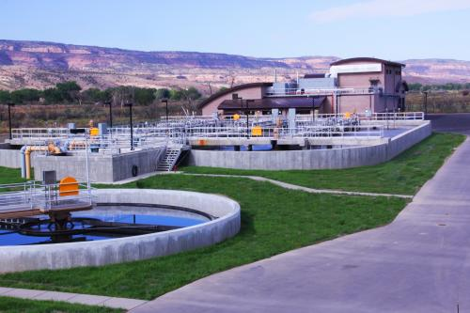
Generators
Partners but typically not connected to the site
Garbage in the biosolids
Working on the “bottom” of the tanks
Bad weather
Different weather from plant to application sites
City of Fruita, CO

Slide 16
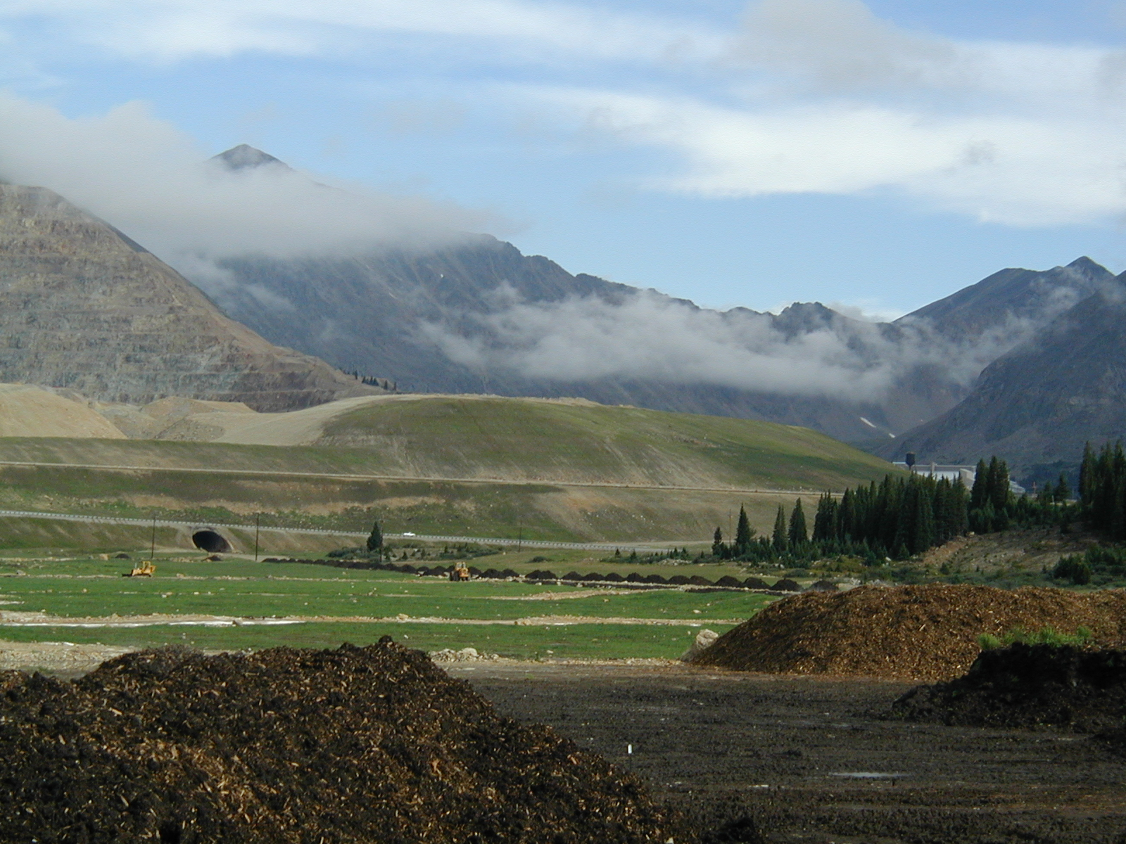
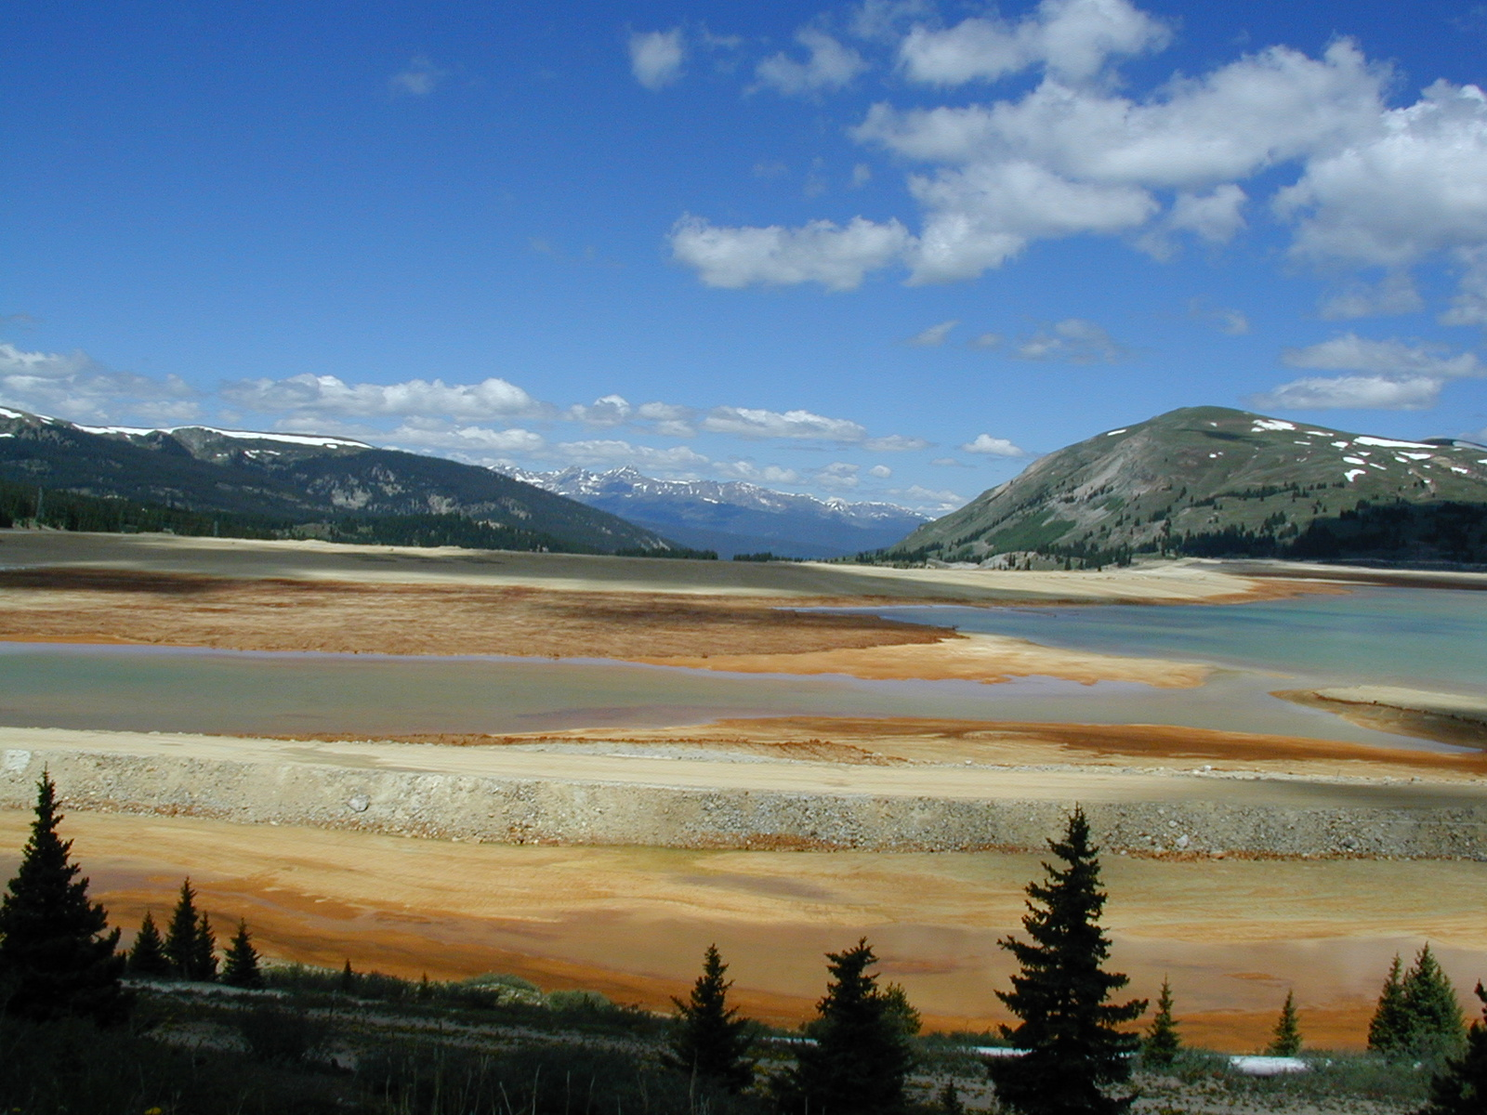
Before…

Slide 17
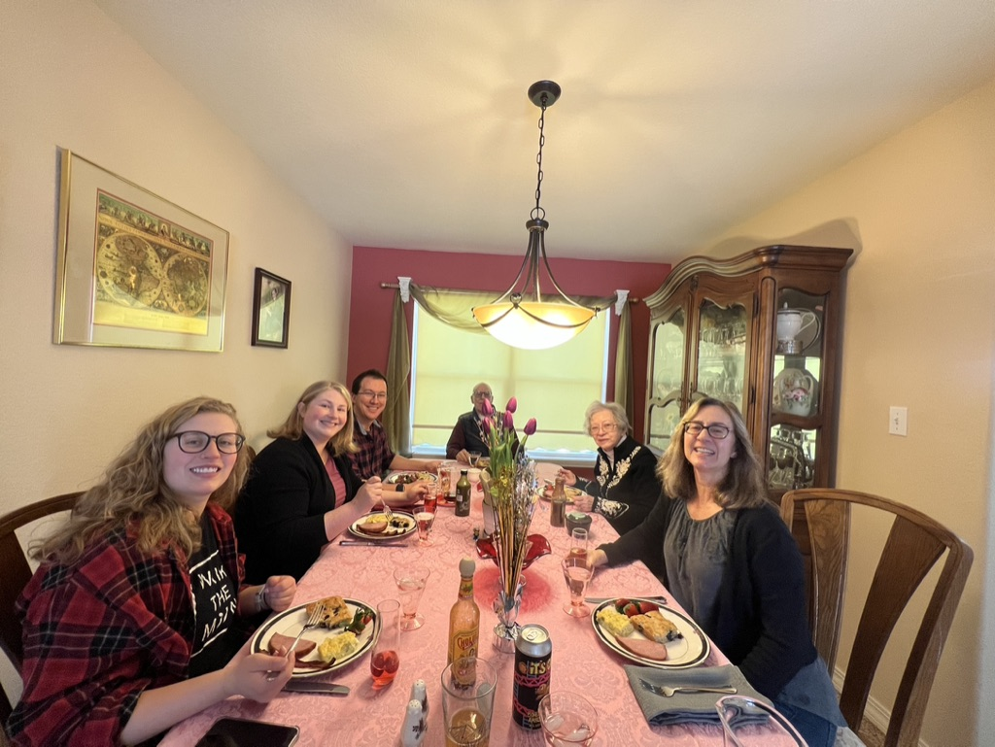
Employees
Empower one person at a time
What do you tell your “Aunt Millie” what you do for a living?
  I haul fertilizer
  I am part of the industry keeping the waters of our nation clean
  I am a poo hauler
Truckers have business cards
Why is this important?
  Frustration

Slide 18
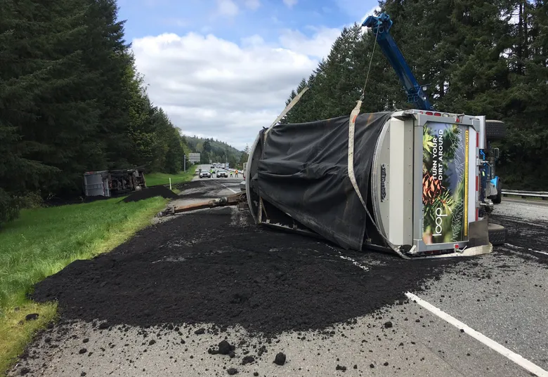
Actual Accident in Denver, CO
Not actually this picture
Accident caused by other driver
Load of biosolids spilled on highway
Law enforcement asked the driver what it was
After mumbling for a while driver says it is a load of poop
Next thing you know this turns into an evening news event with helicopters

Slide 19
Somethings that have not worked for me
Press
  You can say No
Public meetings
  Depends on it was set up
  KY example
Farm Days
  Your own guys
Researchers
  What are they really supporting
Professional Crop Advisors/Ag Agents Etc.
  Some just don’t know about biosolids
Doctors
  Doctor of Theology is not the same as a Doctor of Soil
Peer Review articles
  Much less of them today

Slide 20
Cake biosolids application
Mike Scharp
Mike.Scharp@denaliwater.com
Notes:
Insert picture of cake application on rangeland (Application & results at Stulp’s)

