Slide 1
BIOSOLIDS IN THE CIRCULAR ECONOMY – AN ADAPTIVE PLANNING APPROACH
Presenters:
Lauren Randall, A/Manager Sustainable Wastewater, Hunter Water
David Solley, Principal Process Engineer, GHD

Slide 2
ACKNOWLEDGEMENT OF COUNTRY
We acknowledge the Traditional Countries of the Awabakal, Geawegal, Darkinjung, Wonnarua and Worimi peoples on which we operate and the Countries beyond where our water flows.
We recognise and respect the cultural heritage, beliefs and continuing connection to the lands and waters of our Traditional Custodians and pay respect to their Elders past, present and emerging.

Slide 3
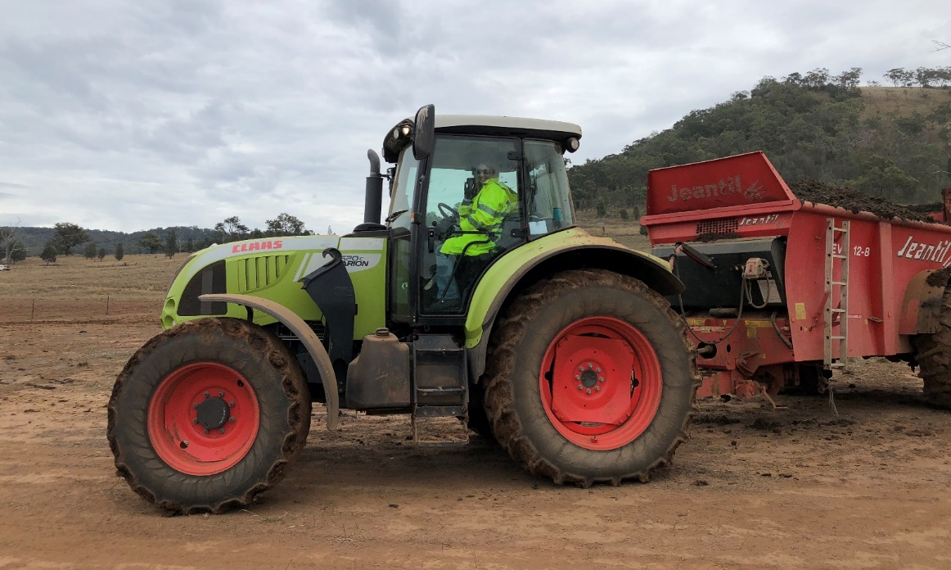
Presentation Content
Background
Technology and site shortlisting
Adaptive planning process
Cost-benefit analysis
Conclusion

Slide 4
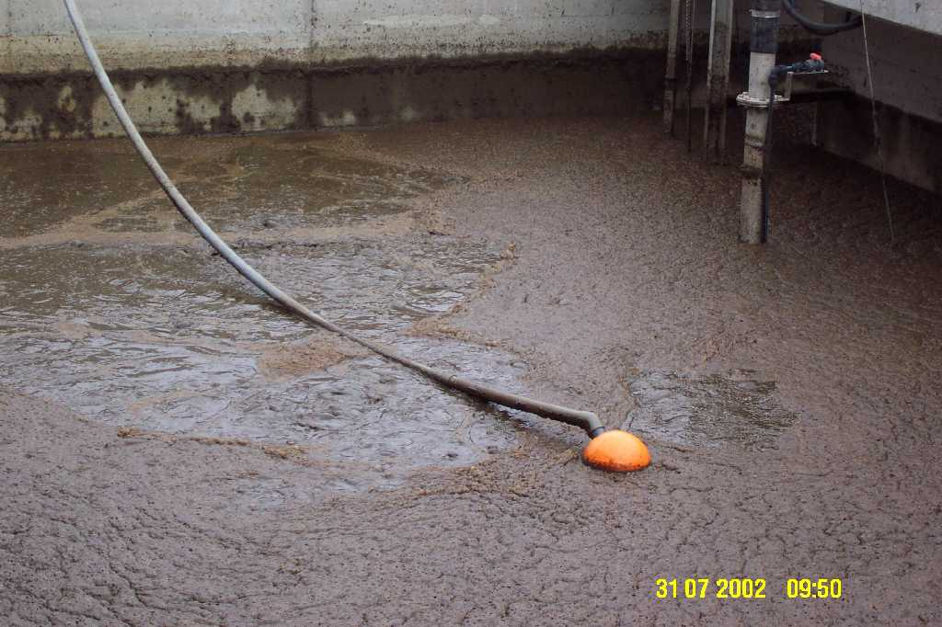
Current Approach
100% biosolids reuse
Agriculture and mine rehab
1,000 tonnes inorganic fertiliser replaced
Majority is from 10 sites
Aerobic digestion
Notes:
Hunter Water has had a successful biosolids land application program for many years now and we typically reuse 100% of the biosolids generated to improve farm production and support mine site rehabilitation programs.
In 2021/22 we recovered almost 55,000 tonnes of biosolids for land application. That’s enough to replace more than 1,000 tonnes of inorganic fertilisers.
Although we have 19 Sewage treatment plants, most of our biosolids comes from 8 plants located in the larger population centres within the region.
We typically use direct dewatering of waste activated sludge or aerobic digestion at larger sites and sludge lagoons at smaller sites.
We also have one small anaerobic digestion plant treating primary sludge and recovering some energy for onsite use.

Slide 5
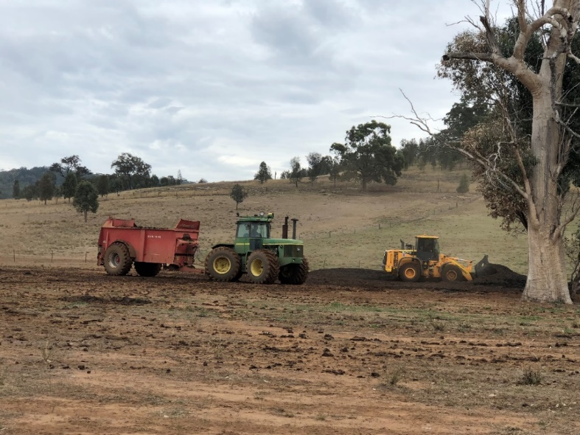
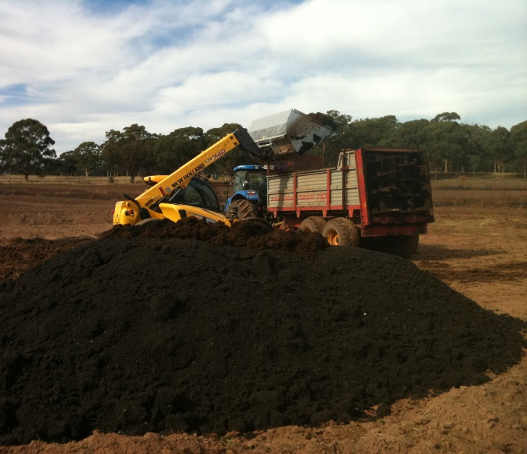
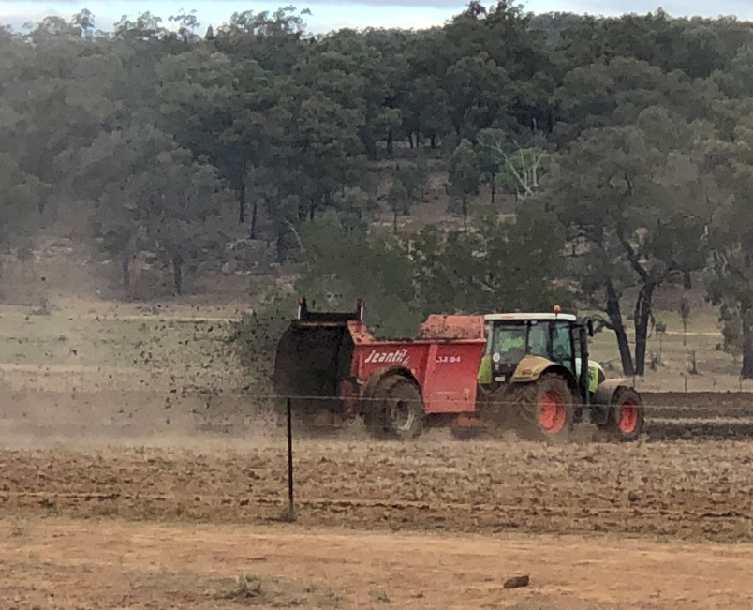
Agricultural Use
Biosolids being loaded for spreading
Loading biosolids into the muck spreader
Applying biosolids with the muck spreader

Slide 6
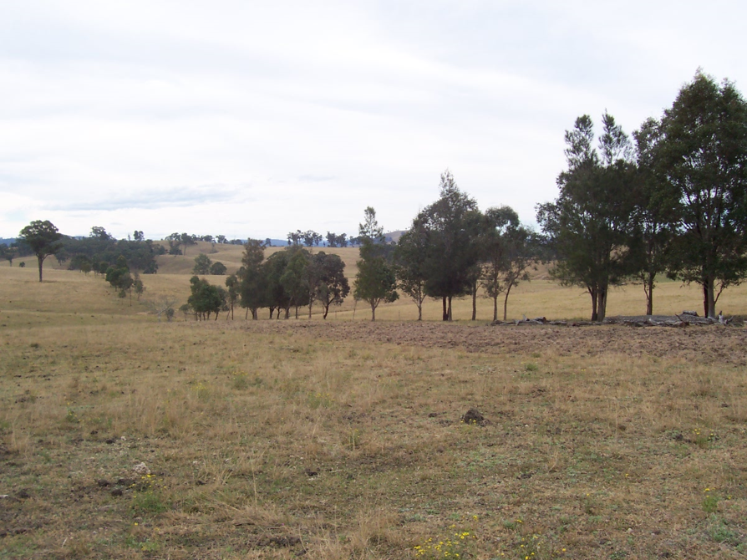
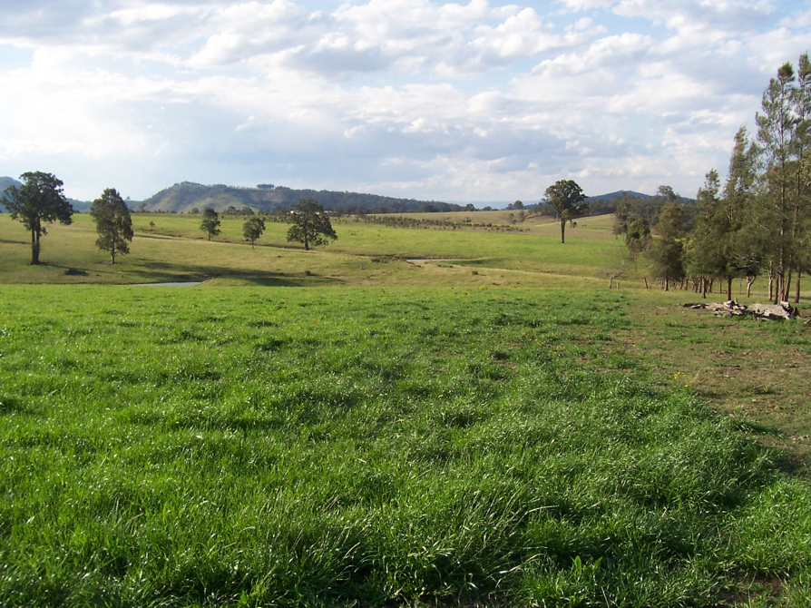
Agricultural Use
Before
After
Notes:
These before and after photos show the benefit provided by the application of biosolids at a farm in the upper Hunter.
Note the change in angle in the second photo – point out the line of trees

Slide 7
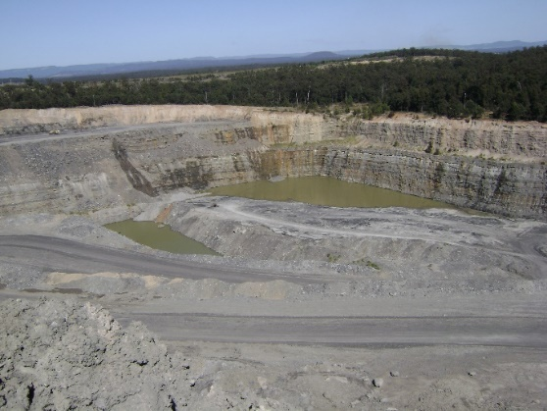
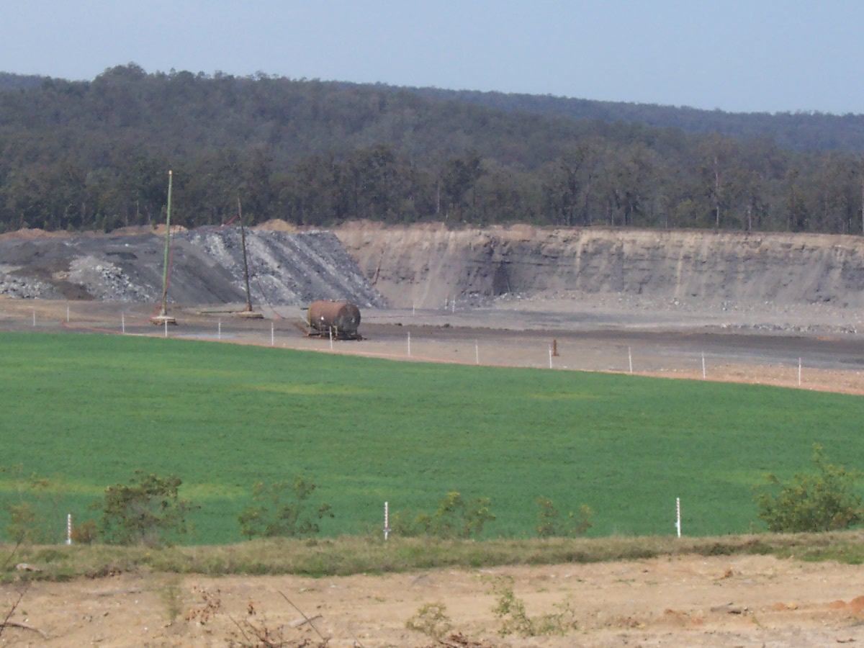
Mine Site Rehabilitation
Before
After

Slide 8
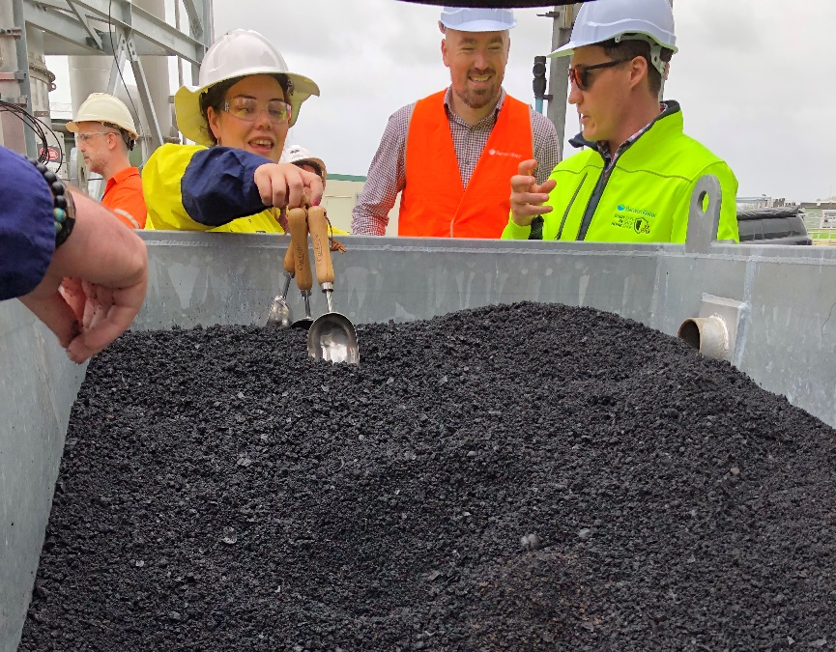
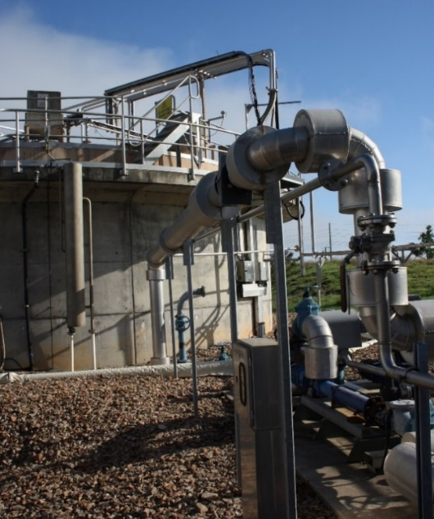
Investment Drivers
Population growth (2030 time constraint)
Regulatory
Financial
Carbon footprint
Market uncertainty
Anaerobic digestion
Biochar (Loganholme WWTW, Logan City Council)
Notes:
Significant population growth is driving substantial investment in biosolids treatment, with major upgrades required by approx. 2030. (This was originally 2025 but with contingency measures in place we can extend this to 2030.)
Further investment in biosolids treatment may also be required to address potential changes to the NSW Biosolids Guidelines.
Financial and carbon drivers are moving us away from aerobic digestion towards anaerobic digestion.
We’re considering risks and opportunities around emerging contaminants from both a regulatory perspective as well as existing and future market drivers. This may drive us to thermal treatment.

Slide 9
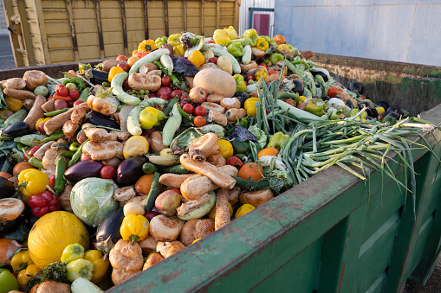
The Opportunity
Optimise investment
Create new revenue streams
Reduce carbon footprint
Move to a more circular economy
Improve resilience to future uncertainty
Food waste (gate fee, increased renewable energy generation)
Notes:
We recognise that for a utility of our size and geographical context, centralised biosolids treatment provides opportunities for improved financial, carbon, circular economy and resilience outcomes.
For example, we could potentially receive gate fees for accepting organic waste feedstocks which would also boost our renewable energy production.

Slide 10
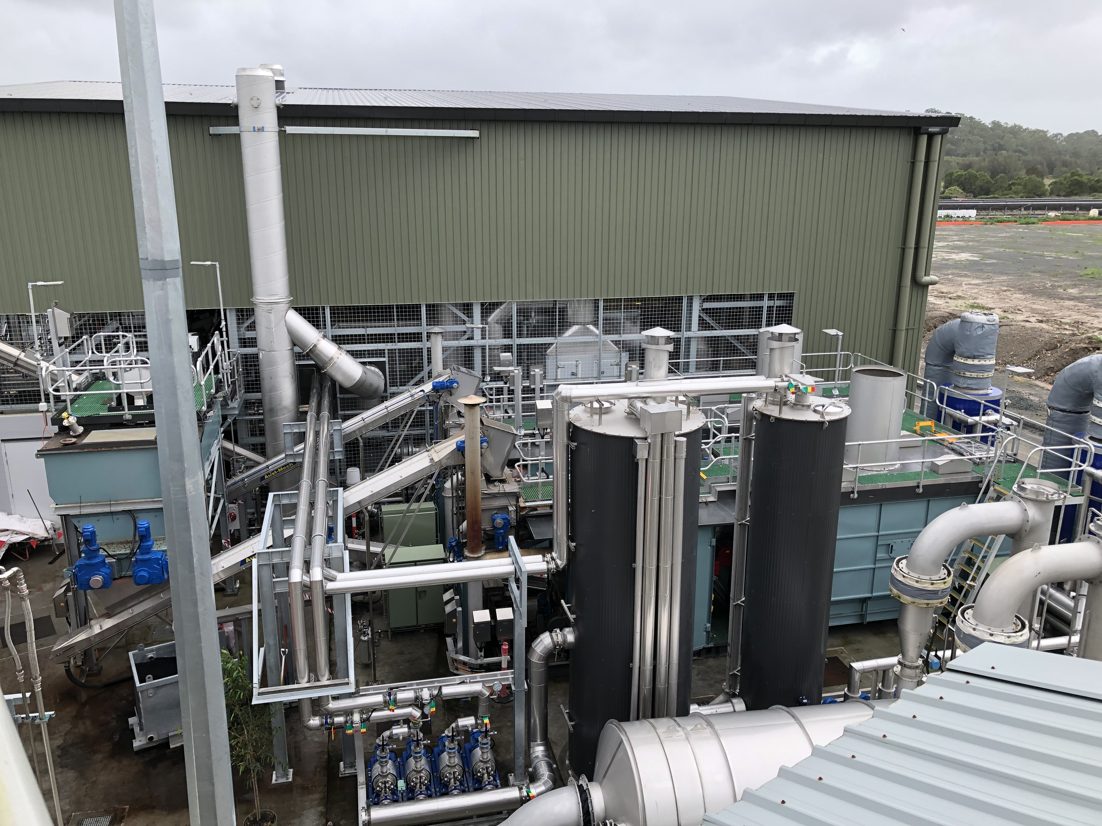
Technology Options
Mesophilic anaerobic digestion (MAD)
MAD with thermal hydrolysis process (THP)
High solids loading plug flow AD
Co-digestion
Gasification (biosolids only)
Gasification (biosolids + woodchip)
Loganholme biosolids gasification plant
Notes:
Considered a range of technologies. Landed on these as the main options.

Slide 11
Technology Shortlisting Criteria
Financial
Capital cost
Operating and maintenance cost
Regulatory
Regulatory approval pathway for product end use
Regulatory approval pathway for facility
Environmental
Impact on site constraints (footprint, odour, noise, amenity, etc.)
Broader environmental impacts (return stream impacts, waste streams, etc.)
Lifecycle cost
Step change in cost due to biosolids feed solids required
GHG emissions
Commercial
Offtake product markets
Organic waste markets
Energy production
Notes:
Skip over quickly – people can download slides and look later
Note “return stream impacts” ended up being a really important consideration – site and technology could not be selected independently. THP colour risk – needed large dilution ratio to avoid performance implications for sites with UV disinfection and a coloured plume upon effluent discharge.

Slide 12
Technology Shortlisting Criteria
Technological
Technology maturity / commercial readiness
Operational reliability and risks
Supplier risks
Community perception
Social
Truck movements
Odour
Ability to remove emerging contaminants
Adaptability
Resilience to biosolids guideline changes
Staging/modularity
Feedstock flexibility
Notes:
Skip over quickly – people can download slides and look later

Slide 13
Site Options
Existing sewage treatment plants (STPs)
Former STPs
Waste management centres
Industrial estates
Notes:
Considered existing & decommissioned treatment plant sites, as well as landfill sites and industrial areas.
No obvious site option for centralised biosolids treatment. Will be a big thing at any site (truck movements, odour risk, effluent quality, etc)

Slide 14
Site Shortlisting Criteria
Environmental
Biodiversity
Social
Community disruption due to truck movements
Commercial
Proximity to organic waste feedstocks
Buffer zones and proximity to sensitive receivers
Indigenous and non-Indigenous heritage
Native Title issues
Proximity to natural gas network
Proximity to large energy users
Site electricity demand
SEPP Coastal Management
Notes:
Skip over quickly – people can download slides and look later

Slide 15
Site Shortlisting Criteria
Proximity to biosolids production sites
Land issues
Zoning and surrounding land use
Proximity to biosolids application sites
Land ownership
Acid sulfate soils
Topography
Footprint
Site road access
Liquid discharge suitability
Site Suitability
Logistical
Notes:
Skip over quickly – people can download slides and look later
Note “liquid discharge suitability” as a key consideration – site and technology could not be selected independently. THP colour issue – needed large dilution ration to avoid coloured plume and performance implications for sites with UV disinfection.

Slide 16
Adaptive Planning Process
1
Define problem, aims, objectives, requirements
3
Understand functioning of current system
5
Understand functioning of system under future scenarios
6
Identify Actions
7
Assess Actions
8
Develop the Adaptive Pathways
9
Evaluate the Pathways
10
Recommend preferred pathway(s)
11
Develop the Adaptive Plan
12
Implement, Monitor, Review, Learn
2
Define your Adaptive Pathways Planning approach
4
Define scenarios and drivers of change and uncertainty
_{Living Plan}
Framework for monitoring indicators of change, and updating plan at regular intervals, to allow for uncertainty & change
_{Big Thinking}
Context-first approach, rather than focussing unduly on detailed analysis & modelling
_{Implementation}
Appraising pathways not just individual options (valuing flexibility, real options, etc.)
_{Structuring the Problem}
_{Multiple Plausible Futures}
Broad range, incl. ‘Extreme plausible’ or ‘low probability high impact’ scenarios
_{Appraising Solutions}
_{Visualisation}
Route-map / decision trees for pathways
_{Exploring Solutions}
_{Option Pathways}
Sequencing actions over time, to respond to thresholds and objectives, with identified tipping points and trigger points, to avoid lock-ins and keep options open
_{Impacts and thresholds}
Identify tipping points, start discussing trigger points.
Notes:
Dave take over here: (7 mins)
Skip over pretty quickly.
The adaptive planning (AP) framework developed by GHD and used in this work enabled HW to make short-term investment decisions to address current drivers whilst maintaining flexibility to respond to future changes (e.g., market and regulatory shocks) and opportunities for improved environmental, social, and economic outcomes (e.g., co-treatment of biosolids with organic waste feedstocks).

Slide 17
Adaptive Planning Process
“PESTLE” analysis (political, economic, social, technological, legal and environmental)
Classification of uncertainties as variables, key decision points (thresholds and shocks)
Graphical representation of option pathways
Notes:
The key points of interest that I’ll talk about today include:
“PESTLE” analysis to consider political, economic, social, technological, legal and environmental drivers of uncertainty or change;
classification of uncertainties as variables to be explored through sensitivity analysis or key decision points that may trigger a change in biosolids management approach including thresholds (e.g. plant capacity limits) and shocks (e.g. market and regulatory changes); and
graphical representation of option (or investment) pathways using option pathway diagrams, to show the sequencing of investments and the range of options available to respond to key decision points.

Slide 18
‘PESTLE’ Analysis
_{Economic / Markets}
Markets: closure of existing biosolids land application customers
Markets: Changing value of green waste e.g. councils implement composting at green waste facilities which reduces gate fee of organics.
Markets: Phosphorus becomes less readily available which raises the demand for alternative fertilisers i.e. biosolids.
Cost: Energy prices reduces, as renewables drive down price
_{Cost: Petrol prices increases}
Cost: Energy price increases, due to ERS or Carbon Price
Resource Use: Upstream resource extraction & use (digestion) by other parties
_{Political}
_{P}
Climate Change Action: Emissions Reductions Scheme or Carbon Price
_{Social / Demographic}
_{E}
_{Future growth}
Organic feedstock changes/availability
Source control - improved source separation or increased co-mingling
Changing community expectations
_{S}
_{T}
_{Legal / Regulatory}
NSW Biosolids are updated to align with National Guidelines (pathogen/stabilisation requirements)
_{Ocean sludge discharges ceased}
Biosolids to agriculture & mine rehabilitation ceased
_{Organics to landfill ceased}
WWTW licensing changes (reduction in nitrogen levels)
Thermal treatment approval pathway (NSW Energy from Waste framework)
_{L}
_{Technological}
New novel technology, that couldn’t be accounted for today, becomes favourable in the future.
_{E}
_{Environmental}
Emerging contaminants e.g. PFAS
Mandated carbon neutrality (currently aspirational)
Notes:
We used “PESTLE” analysis to consider political, economic, social, technological, legal and environmental drivers of uncertainty or change.
Often the drivers of change and uncertainty are inter-related.
E.g. political action on climate change can drive changes to energy and fuel markets, changing community attitudes, with enough political pressure, can lead to regulatory change, as can understanding of new and emerging environmental risks such as PFAS or other contaminants.

Slide 19
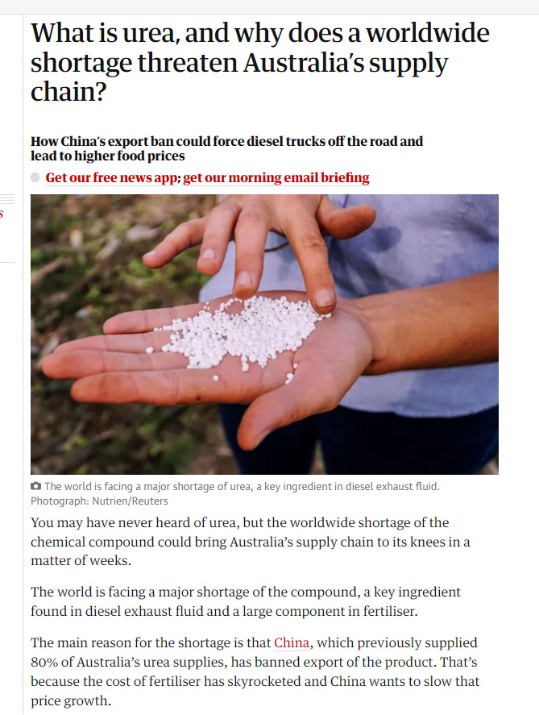
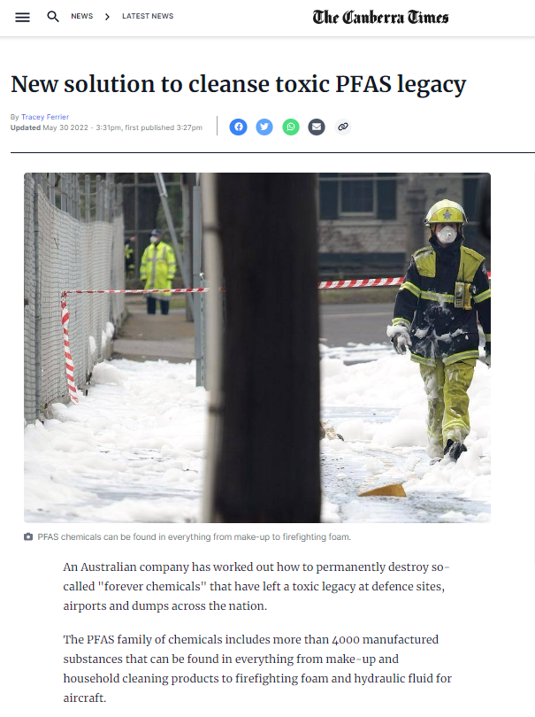
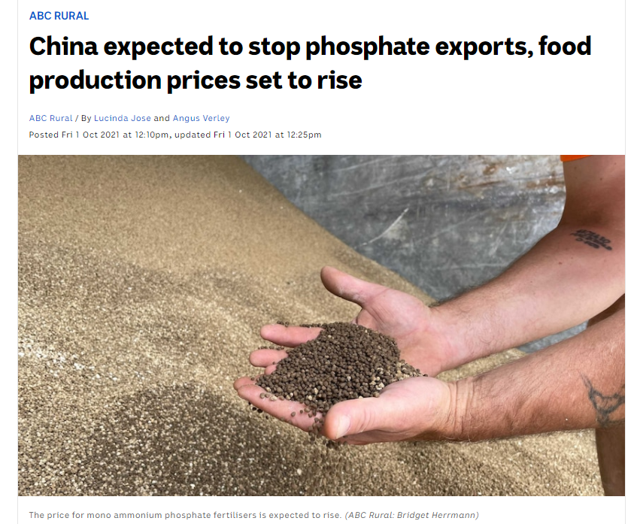
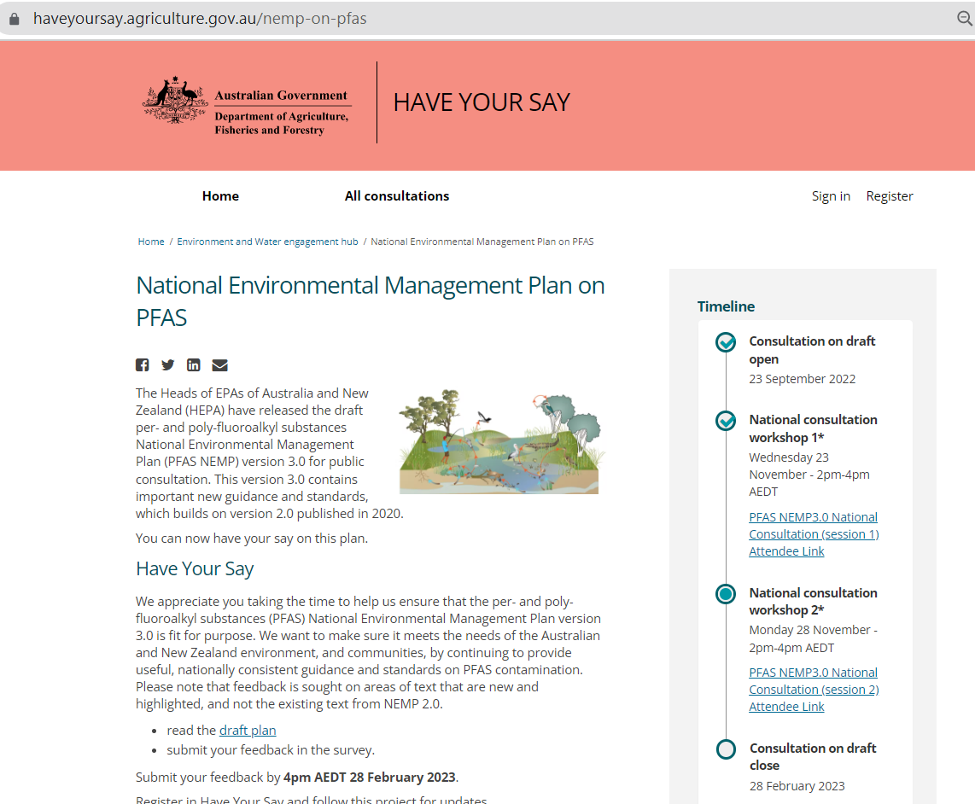
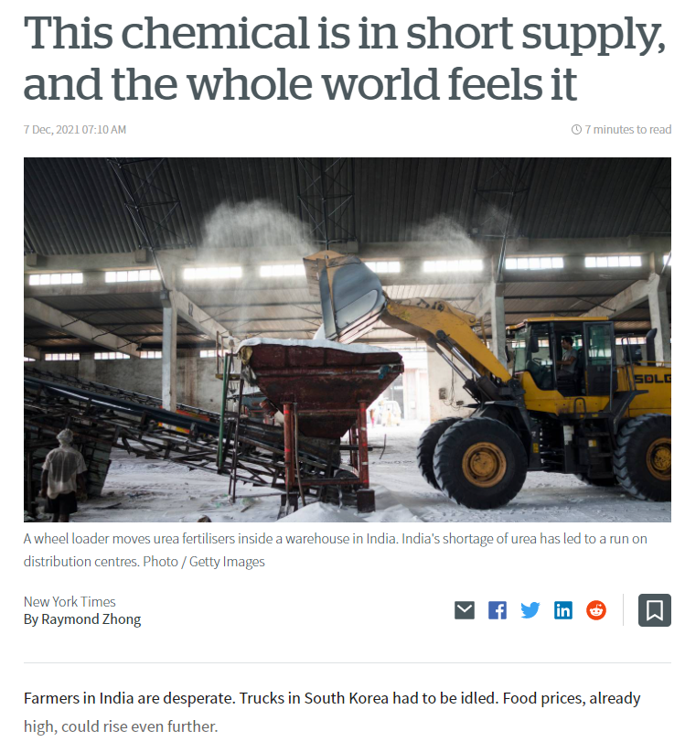
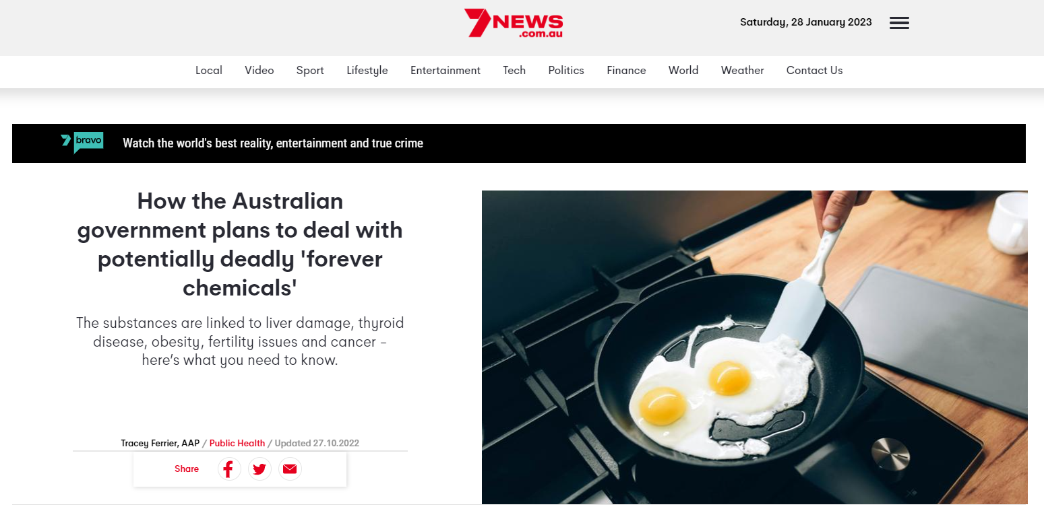
Examples of Uncertainty
Notes:
Here are some examples of some of the drivers of uncertainty already starting to play out since the PESTLE analysis was undertaken in 2020.
E.g. phosphorus and urea markets increasing demand for alternative fertilisers, and
PFAS starting to impact public perception and biosolids regulation through the introduction of the PFAS NEMP 3 which is currently out for consultation.

Slide 20
Dealing with uncertainty
_{Economic / Markets}
_{SENSITIVITY ANALYSIS}
Markets: closure of existing biosolids land application markets
Markets: Changing value of green waste e.g. councils implement composting at green waste facilities which reduces gate fee of organics.
Markets: Phosphorus becomes less readily available which raises the demand for alternative fertilisers i.e. biosolids.
Cost: Energy prices reduces, as renewables drive down price
_{Cost: Petrol prices increases}
Cost: Energy price increases, due to ERS or Carbon Price
Resource Use: Upstream resource extraction & use (digestion) by other parties
_{Political}
_{Energy price}
Climate Change Action: Emissions Reductions Scheme or Carbon Price
_{Biosolids/biochar reuse cost}
_{Social / Demographic}
_{Gate fees}
_{Future growth}
Organic feedstock changes/availability
Source control - improved source separation or increased co-mingling
Changing community expectations
_{Transport cost}
_{Growth}
_{Organic waste available}
_{Legal / Regulatory}
_{Organics contamination rate}
NSW Biosolids are updated to align with National Guidelines (pathogen/stabilisation requirements)
_{Ocean sludge discharges ceased}
Biosolids to agriculture & mine rehabilitation ceased
_{Organics to landfill ceased}
WWTW licensing changes (reduction in nitrogen levels)
Thermal treatment approval pathway (NSW Energy from Waste framework)
_{Technological}
TECHNOLOGY SELECTION
New novel technology, that couldn’t be accounted for today, becomes favourable in the future.
_{Feedstock flexibility}
_{Environmental}
SITE SELECTION
Emerging contaminants e.g. PFAS
Mandated carbon neutrality (currently aspirational)
_{Liquid discharge suitability}
Notes:
Once the uncertainties were agreed on, we went through a process to classify uncertainties as either:
variables that may impact timing or cost, but don’t necessarily require a significant change in approach, and so could be explored through sensitivity analysis; or
key decision points that may trigger a change in biosolids management approach including thresholds (e.g. plant capacity limits) and shocks (e.g. market and regulatory changes);
(Click through examples fairly quickly):
Economic/market drivers and social/demographic drivers were largely covered through sensitivity analysis.
Ceasing landfill disposal of organic wastes was considered through technology selection, by considering feedstock flexibility for each technology.
Similarly, changes to effluent quality nitrogen limits in WWTW licenses considered through site selection process

Slide 21
Dealing with uncertainty
_{Economic / Markets}
Markets: closure of existing biosolids land application markets
Markets: Changing value of green waste e.g. councils implement composting at green waste facilities which reduces gate fee of organics.
Markets: Phosphorus becomes less readily available which raises the demand for alternative fertilisers i.e. biosolids.
Cost: Energy prices reduces, as renewables drive down price
_{Cost: Petrol prices increases}
Cost: Energy price increases, due to ERS or Carbon Price
Resource Use: Upstream resource extraction & use (digestion) by other parties
_{Political}
_{KEY DECISION POINTS}
Climate Change Action: Emissions Reductions Scheme or Carbon Price
Pathogen/stabilisation upgrades required
_{Social / Demographic}
_{Future growth}
Organic feedstock changes/availability
Source control - improved source separation or increased co-mingling
Changing community expectations
_{Ocean sludge discharge ceased}
_{Legal / Regulatory}
Biosolids to agriculture & mine rehabilitation ceased
NSW Biosolids are updated to align with National Guidelines (pathogen/stabilisation requirements)
_{Ocean sludge discharges ceased}
Biosolids to agriculture & mine rehabilitation ceased
_{Organics to landfill ceased}
WWTW licensing changes (reduction in nitrogen levels)
Thermal treatment approval pathway (NSW Energy from Waste framework)
_{Technological}
New novel technology, that couldn’t be accounted for today, becomes favourable in the future.
_{New Technology}
_{Environmental}
Thermal treatment approval pathway
Emerging contaminants e.g. PFAS
Mandated carbon neutrality (currently aspirational)
Notes:
The remaining drivers were identified as key decision points to be considered in the adaptive pathways approach.
Workshop participants voted on how important they thought each decision point was in the context of the business case, and when they thought each decision point might occur.
Due to the iterative nature of the project, these did tend to evolve a bit over time.

Slide 22
Example Option Pathway Diagram
OPTIONS
2021 - 2025
2026 - 2030
2031 - 2050
BIOSOLIDS TO AGRICULTURE & MINE REHABILITATION CEASED / MARKET CLOSURE (E.G. PFAS)
2
THPMAD at Site 1
2
MAJOR CAPITAL WORKS WOULD BE REQUIRED TO MAINTAIN BAU BEYOND 2025
BAU
Decentralised aerobic digestion
ORGANICS TO LANDFILL CEASED
Conduct market sounding for liquid food waste e.g. fat/oil/grease (FOG)
1
Plug flow AD at Site 2
1
7
Plug flow AD at Site 2 + Opportunistic co-digestion
7
If shock occurs, thermal treatment will be required. Transfer cost of switching to option #3/#8 is significant
3
Gasification at Site 2 + Wood chip importation
3
8
Gasification at Site 2 w/ Sludge only
WOOD CHIP CONSIDERATIONS
8
Option #3 versus #8 dependent on price/availability of wood chip
LEGEND
NOTES
Monitor
Minor decision points
Not all options are represented.
Preferred option pathways
Key decision points
Possible option pathways
Notes:
We used option pathway diagrams, like this one, to show the sequencing of investments and the range of options available to respond to key decision points.
In this example, the preferred option is to shift from decentralised aerobic digestion to THP/MAD at site 1 in around 2025. If in future, disposal of organics such as food and garden organics to landfill is ceased, the may be an option to implement co-digestion.
If contaminant requirements for biosolids change in future, we may need to shift to thermal treatment, and at that point would need to decide whether to treat biosolids only feed, or incorporate another feedstock such as woodchip.

Slide 23
Example Option Pathway Diagram
OPTIONS
2021 - 2025
2026 - 2030
2031 - 2050
Revert to #2 if gasification technologies not viable (see #2 pathway)
2
THP/MAD at Site 1
2
MAJOR CAPITAL WORKS WOULD BE REQUIRED TO MAINTAIN BAU BEYOND 2025
CONFIRMATION OF AVAILABLE TECHNOLOGIES
BAU
Decentralised aerobic digestion
1
Plug flow AD at Site 2
1
Donor sites need contingency in place beyond 2025 to manage additional biosolids during delay period associated with regulatory approvals for the gasification facility (options 3/8), and additionally to realise success of Logan WAS only gasification trial and implementation of full-scale facility (option 8)
7
Plug flow AD at Site 2 + Opportunistic co-digestion
7
WOOD CHIP CONSIDERATIONS
BIOSOLIDS TO AGRICULTURE & MINE REHABILITATION CEASED / MARKET CLOSURE (E.G. PFAS)
3
Gasification at Site 2 + Wood chip importation
Option #3 versus #8 also dependent on price/availability of wood chip
3
No impact on options 3 & 8
8
Gasification at Site 2 w/ Sludge only
8
Gasification with sludge only (#8) is heavily dependent on the Logan trial, whereas #3 has been proven at the Yorkshire Water Huddersfield facility.
LEGEND
NOTES
Monitor
Minor decision points
Not all options are represented.
Preferred option pathways
Key decision points
Possible option pathways
Notes:
In this example, if we can find a way to get by until 2030 with contingency measures in place, we buy ourselves some time to increase confidence in the performance and regulatory approval pathway for thermal treatment options.
If we implement thermal treatment instead of THP/MAD, then if and when the contaminant shock occurs we would not expect to need any upgrades to address contaminants.
We assumed (by consensus) the contaminant shock would not happen before 2030.

Slide 24
Cost-Benefit Analysis
Options assessed relative to BAU (decentralised aerobic digestion)
Iterative approach:
  Compare technologies, compare sites, consider multiple site options, consider co-treatment with organic waste
  Select preferred technology
  Select preferred location
Notes:
The cost-benefit analysis (CBA) compared the economic value of each option relative to the base case of continuing with our current biosolids management approach, which can also be labelled business as usual.
An iterative approach was adopted for the CBA:
To compare short-listed technologies at a given site, compare short-listed sites for a given technology, compare single site vs two-site options and compare biosolids-only options against options for co-treatment of biosolids with organic waste streams.
To examine the more subtle differences between options and select the preferred technology.
To select the preferred location for the chosen technology.

Slide 25
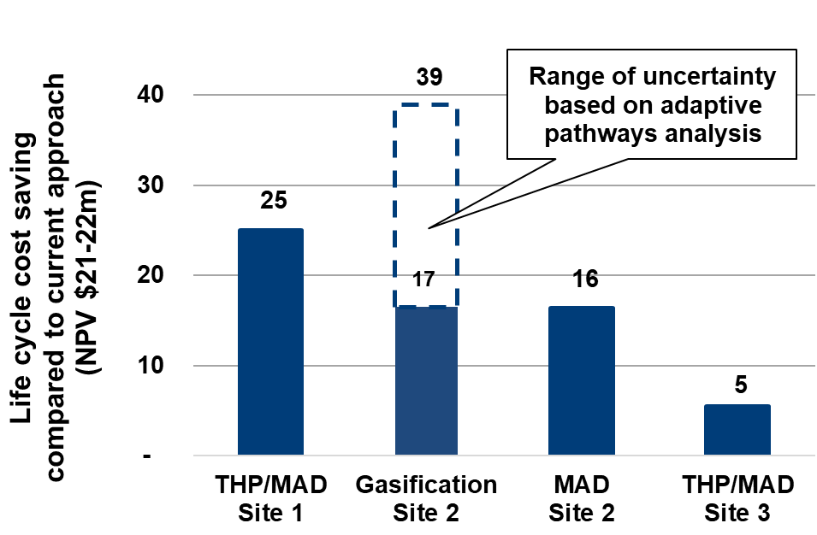
Cost-Benefit Analysis
Centralised options have lower lifecycle cost than BAU
Thermal treatment has higher uncertainty and implementation risk
Notes:
This chart summarises the results of the cost benefit analysis. Net present values (NPV) for each option are shown incremental to the base case of continuing with our current biosolids management approach, or business as usual. A positive number represents a saving (benefit or avoided cost) compared to BAU. The results showed that centralised options have lower lifecycle costs than BAU, primarily due to the avoided capital expenditure associated with a single centralised facility compared to upgrades across multiple sites. Other significant contributors were implementation time for each option (and the associated interim biosolids management costs prior to capital works being commissioned) and biosolids transport cost savings.
Cost estimates and delivery timeframes for gasification are subject to higher uncertainty or implementation risk than other technologies, particularly regarding technology maturity (for biosolids-only feed) and environmental approvals (particularly in NSW). AP analysis was used to explore the economic implications of a range of potential outcomes related to this uncertainty (refer chart). The more favourable NPV for gasification assumes best-case environmental approval timeframes and successful commissioning of a biosolids-only gasification process. The least favourable NPV assumes worst-case approvals timeframes and the need to reconfigure the gasification process to accept a mixed feedstock (50:50 mix of biosolids and woodchip).
Although gasification at site two had the potential for the highest life cycle cost savings, it also had the greatest uncertainty and implementation risk.

Slide 26
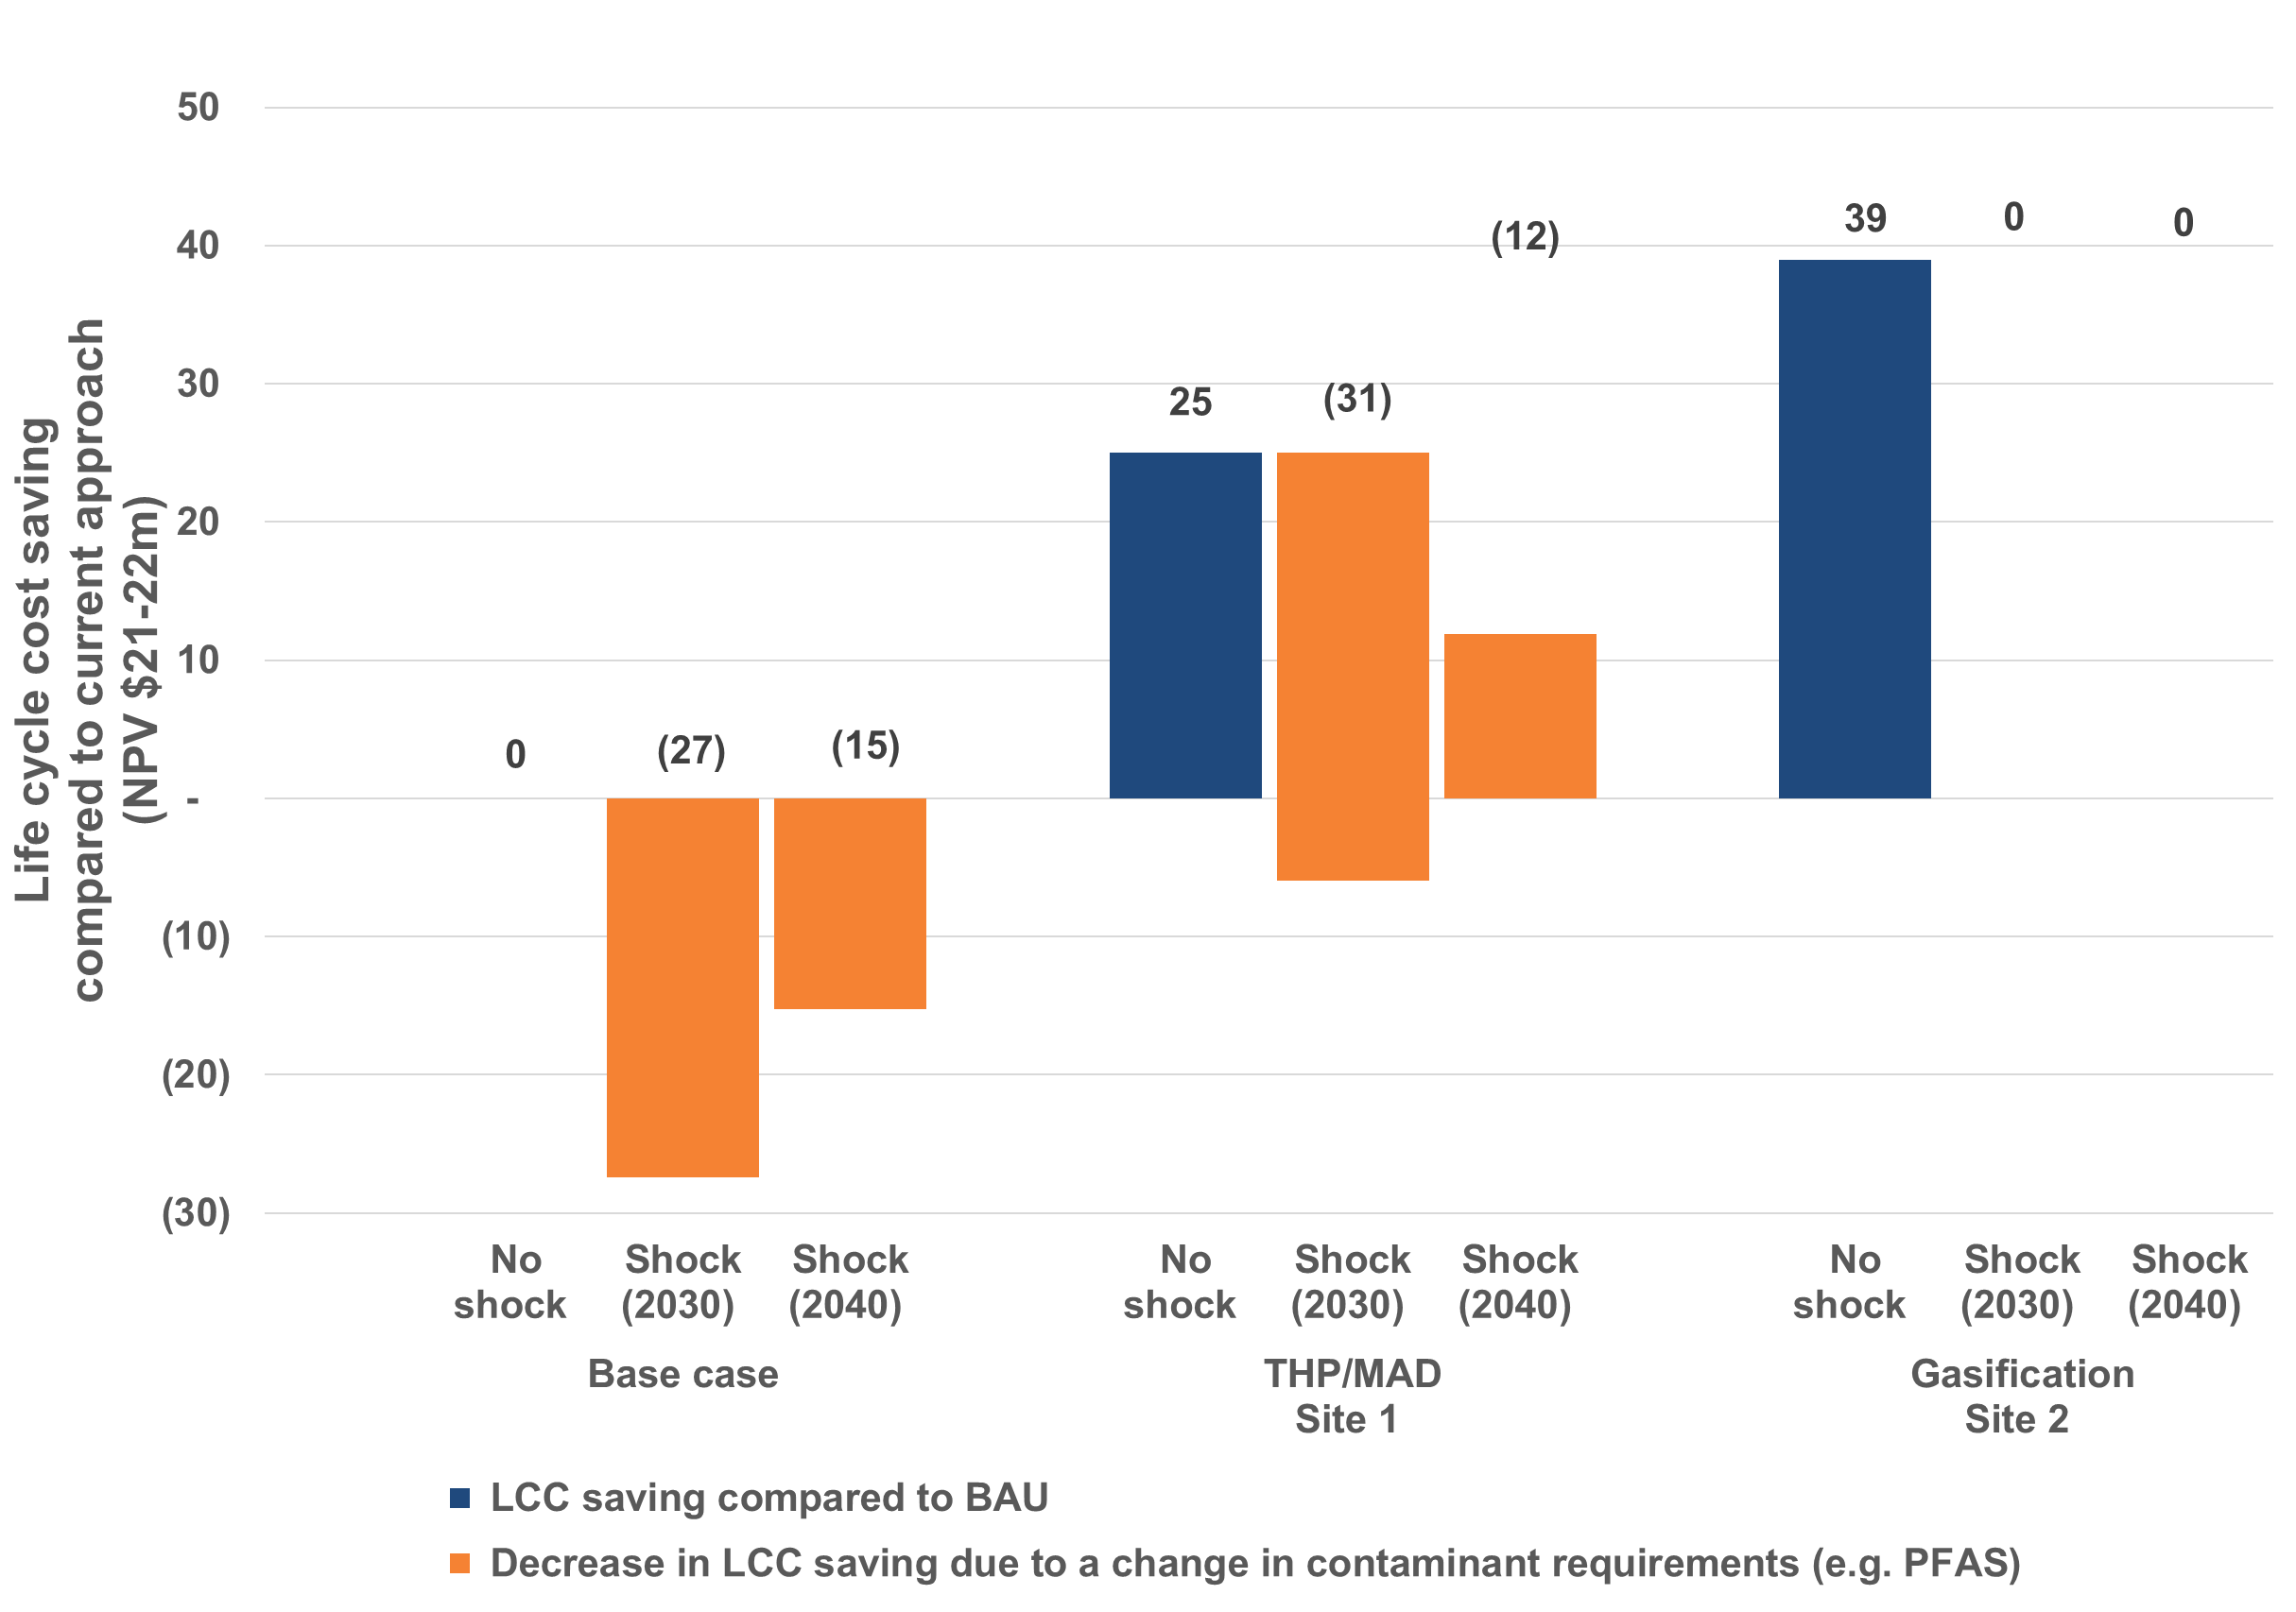
Cost-Benefit Analysis
BAU and THP/MAD require upgrades to address contaminants (e.g. PFAS)
Thermal treatment resilient to changes in contaminant requirements
Notes:
CBA and adaptive planning used to investigate how different scenarios might play out, exploring the uncertanmty and putting more definition around potentila impacts of the uncertainty.
We considered the resilience of the options to future changes in contaminant requirements, which could be triggered by either regulatory change or market closure due to perceived risk.
If contaminant requirements change in either 2030 or 2040, both BAU (which involves aerobic digestion) and THP/MAD would require capital expenditure, e.g. to add thermal treatment on the back end. The earlier the contaminant shock occurs, the larger the reduction in LCC saving. It was assumed there would be no additional expenditure required for the gasification option if this contaminant shock occurs, as thermal treatment is expected to remove contaminants such as PFAS.
Given the timing constraint of needing additional biosolids capacity by 2030, the higher uncertainty and implementation risk for thermal treatment, and the assumption that contaminant requirements are unlikely to change significantly until at least 2030, THP/MAD at site one was selected as the preferred option, to address current investment drivers, provide a range of financial, environmental and resilience benefits and maintain flexibility to respond to future regulatory and market changes.

Slide 27
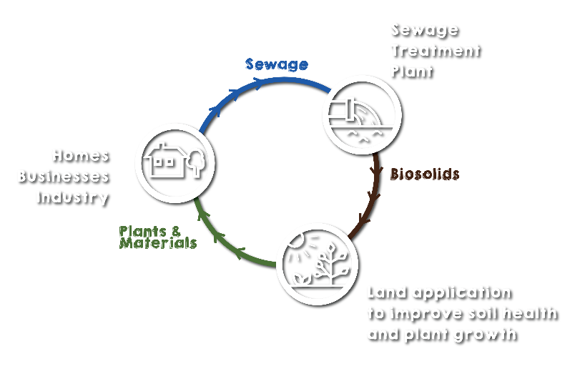
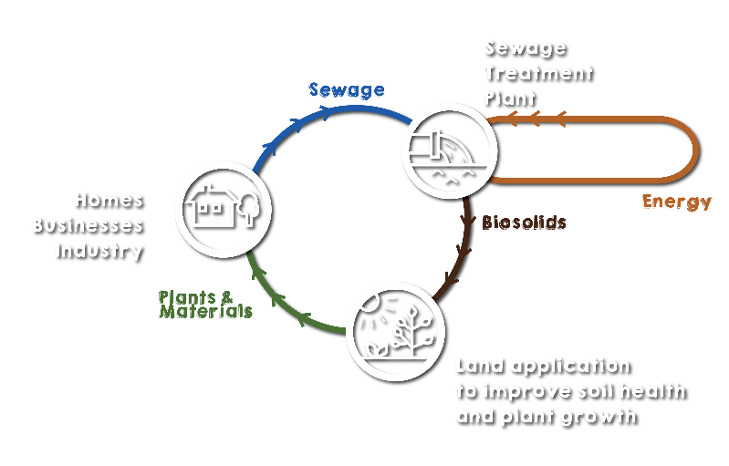
Overview of business case
Current biosolids management approach:
Current production: ~45,000 tonnes p.a.
Distribution: Biosolids recovered from 16 of HW’s 19 sites, with 80% recovered from 8 sites in the Newcastle, Maitland and Lake Macquarie areas
Treatment: Sludge lagoons, aerobic digestion, extended aeration with direct dewatering
End use: Agriculture and mine rehabilitation
New biosolids management approach:
Production at 2050: ~20,000 tonnes p.a.
Distribution: Sludge from 10 sites trucked to a central location for treatment
Treatment: Anaerobic digestion with thermal hydrolysis pre-treatment (option to add thermal treatment in future)
End use: Agriculture and mine rehabilitation
Investment benefits (compared to current approach): renewable electricity, life cycle cost saving, O&M cost saving (electricity, transport and biosolids application), reduction in total GHG emissions (scope 1 and 2)
Other considerations: Resource recovery, community aspirations and impacts, regulatory and market uncertainty
Notes:
This summarises our business case developed in 2021 to move from the current distributed biosolids management approach to centralised AD with THP.
Benefits of the change include generation of renewable electricity (3.4 GWh p.a.), an overall life cycle cost saving of $25m (NPV), O&M cost savings (average of $0.43m p.a.) (electricity, transport and biosolids application cost savings) and a reduction in total (scope 1 and 2) GHG emissions (6% by 2030).
(Don’t need to quote the numbers in brackets/italics, just there in case of questions. Subject to change with further design work.)

Slide 28
Conclusion
Adaptive planning supports investment decision-making under uncertainty
Adaptive planning enables clear communication of decision points and path dependencies
Centralised THP/MAD preferred (assuming contaminant requirements remain unchanged until 2030)
Notes:
The AP approach adopted for this business case effectively supported decision-making under uncertainty through logical analysis and clear communication of decision points and path dependencies. It enabled HW to systematically consider a range of uncertainties, including implementation risk, flexibility to respond to future market and regulatory changes and opportunities to improve social, environmental, and economic outcomes by embracing a more circular economy.
In light of all the uncertainty considered, and based on the assumptions we made at the time, THP/MAD at site one was the preferred option to address current investment drivers, provide a range of financial, environmental and resilience benefits and maintain flexibility to respond to future regulatory and market changes.
In hindsight, given recent developments with the PFAS NEMP, we are re-considering whether that is still the preferred option.
We will be able to provide an update for you all at the next biosolids conference in 2025.

Slide 29

Educating the Community
https://www.hunterwater.com.au/our-water/sustainability/recycling-and-reuse
Notes:
In the lead up to commencing community engagement on the project, we have expanded our water literacy program to include new educational materials relating to our sewer network, sewage treatment and biosolids. You can check out our new biosolids animation here if you are interested.

Slide 30
Thank You
    Any Questions?

