Slide 1

Why Have Some Digesters Been Operated Successfully Without Mixing?
Coenraad Pretorius
Carlo Modulon
David Solley
Duncan Taylor
Jay Surti

Slide 2
Goals of Digester Mixing
Blend feed into digester contents
Create homogeneous conditions
  Minimal variation in TS concentration and temperature
  Prevent short-circuiting
  CSTR vs plug flow conditions
Can be part of scum & grit management strategy
Manage viscosity to allow gas bubbles to escape
Keep solids in suspension for thin sludge (e.g. THP)
Maximize reactor biomass contact with substrate

Slide 3
Water vs Wastewater Mixing Criteria
Parameter | Coagulation | Mixed Liquor | Flocculation
Velocity Gradient, G, s⁻¹ | 600 – 1,000 | 75 – 90 | 10 – 80
HRT, s | 1 – 10 | – | 600 – 1,800
G.HRT, - | 600 – 10,000 | – | 10,000 – 100,000
Parameter | Coagulation | Mixed Liquor | Flocculation
Power Level, W/m³ | 360 – 1,000 | 6 – 8 | 0.1 – 6

Slide 4
Digester Mixing System Criteria
Parameter | Range
 | Min | Max
Mechanical mixing, hp/kcf | 0.2 | 0.3
Gas mixing, cfm/kcf
- Unconfined | 4.5 | 5
- Confined | 5 | 7
- W/m³ | 8 | -
All mixers, G, s⁻¹ | 50 | 80
Turnover time, min | 20 | 30

Slide 5
Why Not Mix?
  Digester mixing second highest power use at typical WRRF
  Energy neutral/positive/sustainable operations a goal
  Singh et al (2020) reviewed digester mixing
    Mixing affected microbial population, CH4 %, VFA & VSR
    Intermittent mixing better than continuous mixing
    Optimum mixing power level exists
    More power ≠ improved performance

Slide 6
VFA, g/L
Singh et al, 2020

Slide 7
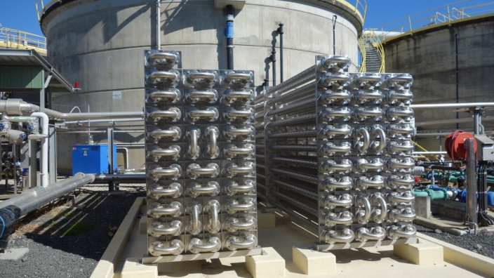
When might a digester not need mixing
  Low viscosity
    Low TS% or sludge hydrolysis
  Highly loaded
    0.4 lb VS/cf.d or 6.4 kg VS/m³.d
      (US EPA, Anaerobic Sludge Digestion, Operations Manual, 1976)
  Feed is effectively blended and dispersed
  Foaming/rapid rise is under control
  Settling inorganics can be disposed of

Slide 9
Impact of mixing on viscosity – Too little
Steep slope:
Large change in viscosity for minor change in shear rate
Digester operating at this condition would be unstable
Modest loss of shear rate
→ significant increase in viscosity
Method: Krugel & Stallman, 2018

Slide 10
Impact of mixing on viscosity – Too much
Gentle slope:
Small change in viscosity for large change in shear rate
Operating digester at this condition would waste power
Large change in shear rate
→ almost no impact on viscosity
Method: Krugel & Stallman, 2018

Slide 11
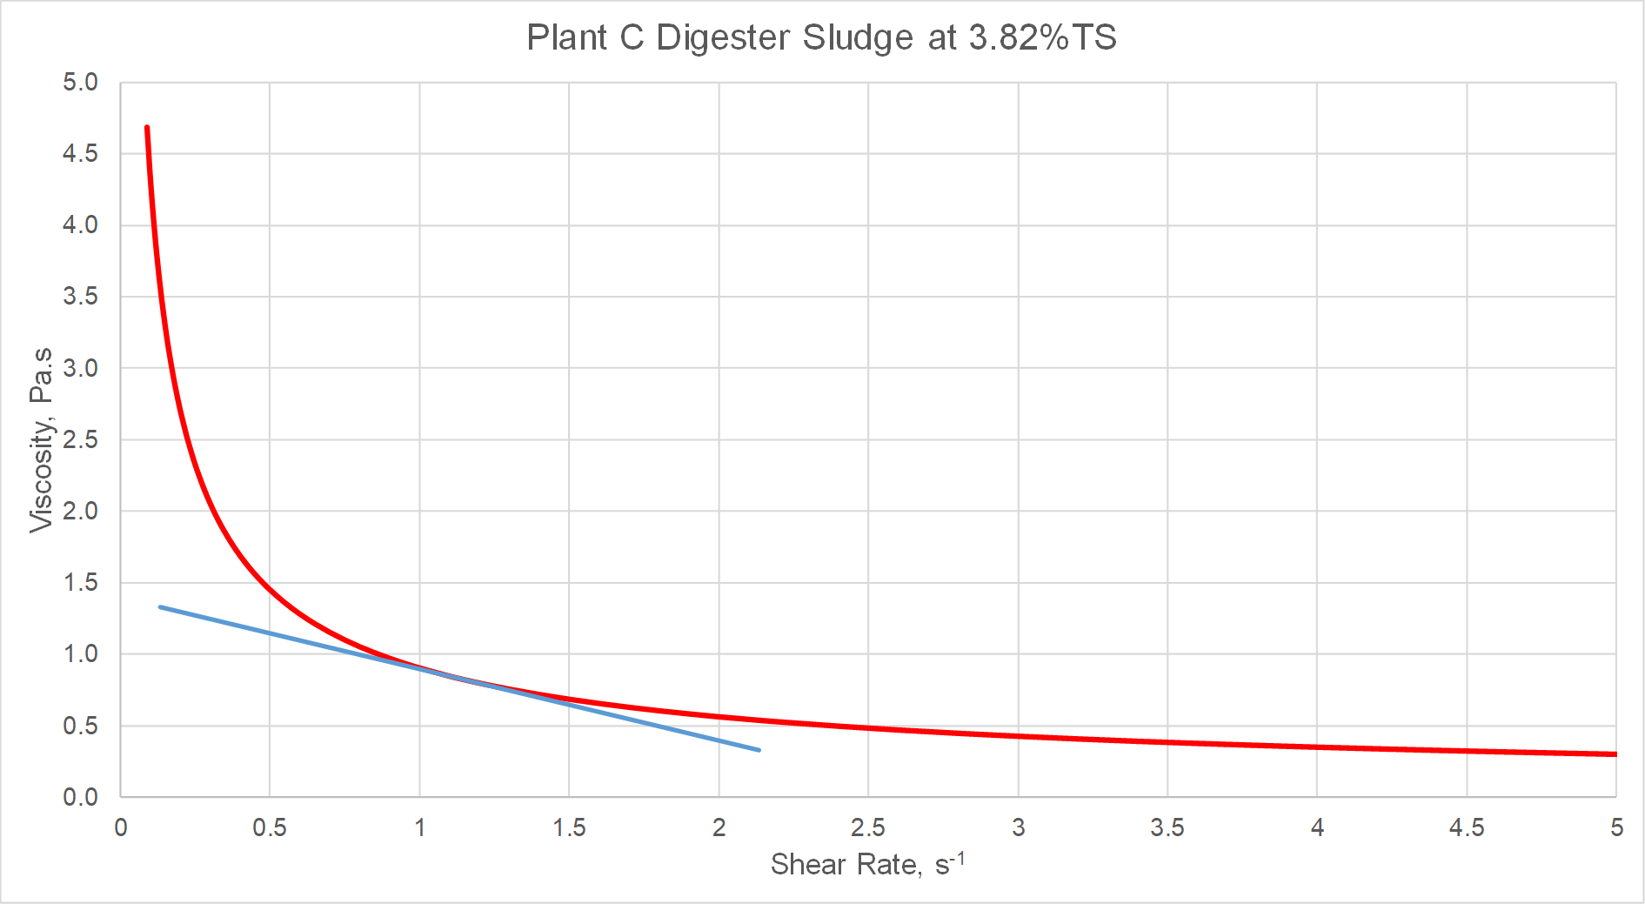
Impact of mixing on viscosity – Just right
Intermediate slope:
Balance between the extremes
Operating digester at this condition would avoid both wasting Power and instability
Small change in shear rate
→ some impact on viscosity, but not significant
Method: Krugel & Stallman, 2018

Slide 16
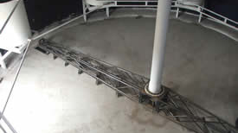
Impact of shape on grit accumulation
  Steep cone bottom allows grit to collect at a single location
    Grit can be removed
    Potential for resuspension by providing high local mixing intensity
  Other options for grit collection exist
    For example: Free-energy’s / Auto Degritting Technology
    Claim: 1 W/m³ sufficient for mixing

Slide 17
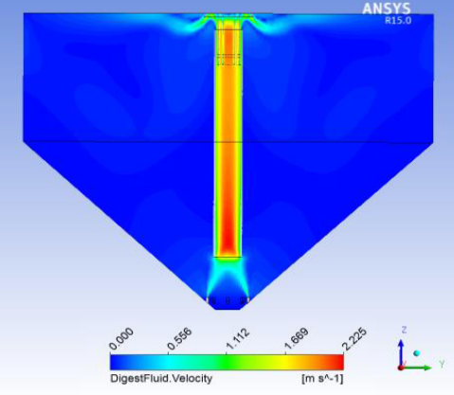
Cone Shape vs Pancake

Slide 19
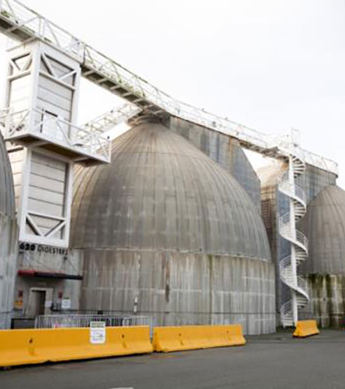
Oceanside Water Pollution Control Plant, SF PUC
Historical Operation and Challenges
  Egg-shaped units & pump-mix system
  Experienced seasonal foaming events
    Related to foaming in ASR (HPO)
Pump-mix system:
  To/from top ring, bottom ring and middle
Mixing system setup to incl. heat loop
Heat loop set up to blend feed sludge
  Maintain 10:1 ratio - recycle: feed
  1.15 turn overs/day

Slide 20
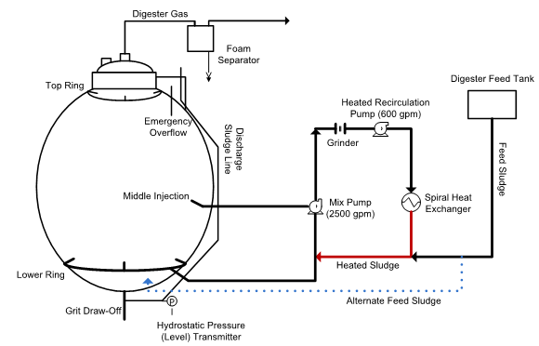
Oceanside Egg-shape Digesters

Slide 21
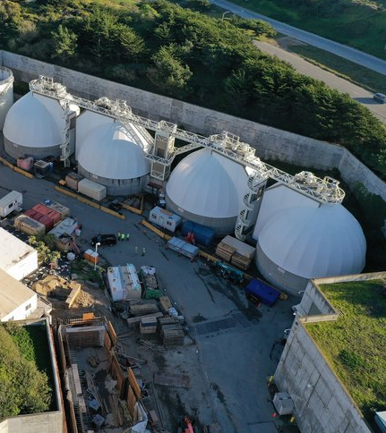
Oceanside Results
  Operations staff experimented with new approach
    Developed tools for early detection of foaming
    Reduce run time of pump-mix:
    100% → 75% → 50% → 25% → 0%
    Heat loop remained in service
    ~1.5% of mixer system power level
    Digester performance (gas flow) was maintained
    Contributed to solving foaming issues
  Significant power savings
    200 hp/150 kW → $80,000 per year or 5% of plant power use

Slide 22
Mixing Effect on Gas Production
Parameter | Experiment Phase | Digester 1 | Digester 2 | Digester 4
Mixing Frequency (% of the Time) | Pre-Experiment Condition | 100% | 100% | 100%
 | Phase 1 | 100% | 75% | 50%
 | Phase 2 | 100% | 50% | 25%
 | Phase 3 | 25% | 25% | 0%
Avg. Gas Production (ft³/day) | Pre-Experiment Condition | 140,000 | 118,000 | 132,000
 | Phase 1 | 128,000 | 106,000 | 132,000
 | Phase 2 | 135,000 | 139,000 | 129,000
 | Phase 3 | 125,000 | 125,000 | 112,000
Standard Deviation (ft³/day) | Pre-Experiment Condition | 6,000 | 19,000 | 4,000
 | Phase 1 | 3,000 | 36,000 | 1,000
 | Phase 2 | 9,000 | 9,000 | 11,000
 | Phase 3 | 400 | 2,000 | 250
Average TS Concentration in Digesters
P-EC | 2.6% ± 0.15% | Ph 2 | 2.6% ± 0.14%
Ph 1 | 2.5% ± 0.25% | Ph 3 | 2.8% ± 0.13%
Miot et al, 2013

Slide 23
180 ML/d WWTP, United Kingdom
  6 MAD received WAS + PS as well as imported WAS, PS + septage
  Combined digester feed ~ 4.5 – 5%
  Operating concentration ~ 2 – 2.5%
  Operating SRT with all digesters IS ~14 days
  Vertical shaft mechanical mixers
  During routine inspection, noted that one mixer shaft “sheared off” and total failure of mixing had occurred
  Unclear when it sheared – no noticeable impact on performance
  Further inspections indicated mixers in 4 of 6 digesters had failed
  Action plan for mixer replacement
  Mixers in remaining 2 digesters failed
  No mixing energy provided to any digesters for ~ 4 months, while project for replacement was established
  pH measured daily on-site during period
  VFA, alkalinity tested 3 times per week in lab
  Methane content in biogas tested weekly in lab
No deterioration in performance indicators observed

Slide 24
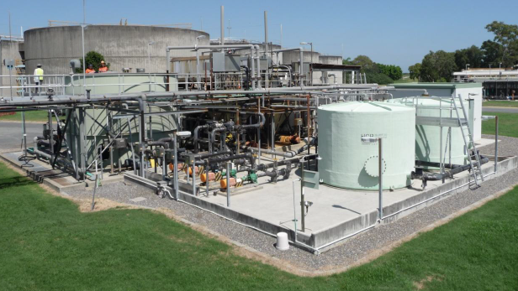
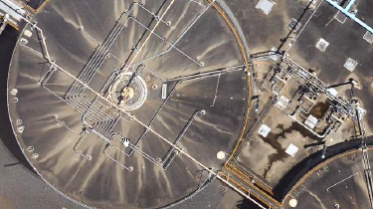
Luggage point STP, QLD Australia
  Six 5.5 ML “Pancake” digesters
  Sequential gas lance mixing systems
  Failure of 4 of 6 gas mixing compressors over 12 months
  Mixing of all units thru cross connections
  Operation for months with limited mixing
  Pumped heat loop remained in service
  Loading: 0.07 lb VS/cf.d or
  1.1 kg VS/m³.d
  Stable performance
    VSD = 48%, VFA/Alk < 0.02

Slide 25

Conclusions
  It is possible to successfully operate a digester w/o mixing
    Has been done intentionally and unintentionally
  Several factors some into play
    Sludge rheology determines min required mixing power
    Organic loading rate and HRT/SRT determines natural mixing
    Blending before adding to main digester volume
    Digester shape affects ability to control grit and scum
  Proposed method for relating sludge rheology to mixing needed
  Design systems for turndown or cyclic operation to take advantage of lower requirements
Coenraad.Pretorius@ghd.com

Slide 26
Coenraad.Pretorius@ghd.com

