Slide 1
Enhancing Anaerobic Digestion Performance
with the
Microbial Hydrolysis Process
David L. Parry, PhD, PE, BCEE
dave.parry@jacobs.com

Slide 2
Jacobs’ recent research on enhancing anaerobic digestion with the addition of C. bescii.
Where and how did we test MHP using C. bescii?
What were our findings?
How can this be applied at full-scale?
What is the Microbial Hydrolysis Process (MHP) and C. bescii?

Slide 3
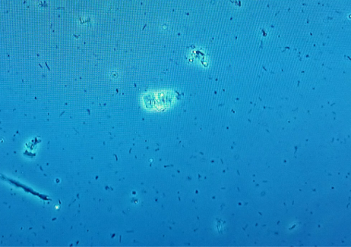
C. bescii is a hyper-thermophilic anaerobic bacteria that is capable of hydrolyzing recalcitrant organic materials.
Caldicellulosiruptor bescii (C. bescii) was isolated in a geothermally heated freshwater pool in Russia in 1990
Thrives at 75°C
Hydrolyzes cellulose and other recalcitrant organic material like waste activated sludge
Data/Figure to support title assertion
C. bescii bacteria under a microscope

Slide 4
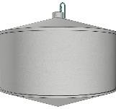

Anaerobic Digestion (AD) enhancement with the Microbial Hydrolysis Process (MHP) using C. bescii bacterium.
Biogas
VFA → Biogas
Thickened Sludge
Anaerobic
Digestion
Biosolids
Mesophilic (40°C) Thermophilic (55°C)
VS → VFAs
2-day HRT
MHP
pH: ~7.0
Hyper-thermophilic (72-78°C)
Notes:
Short retention time, flexibility in where it goes in the process train
Improved volatile solids conversion to biogas, reduction in biosolids

Slide 5
MHP is compatible with all AD processes, including the thermal hydrolysis process (THP).
More Biogas
THP
VFA → Biogas
Thickened Sludge
Anaerobic
Digestion
Less Biosolids
(optional)
Mesophilic (40°C) Thermophilic (55°C)
Hyper-thermophilic (75°C)
VS → VFAs
2-day HRT
MHP
pH: ~7.0
Notes:
In Microbial Hydrolysis Process (MHP), C. bescii hydrolyzes volatile solids (VS) and converts VS into volatile fatty acids (VFAs). In the digester, Methanogen Archaea convert VFAs into biogas.

Slide 6
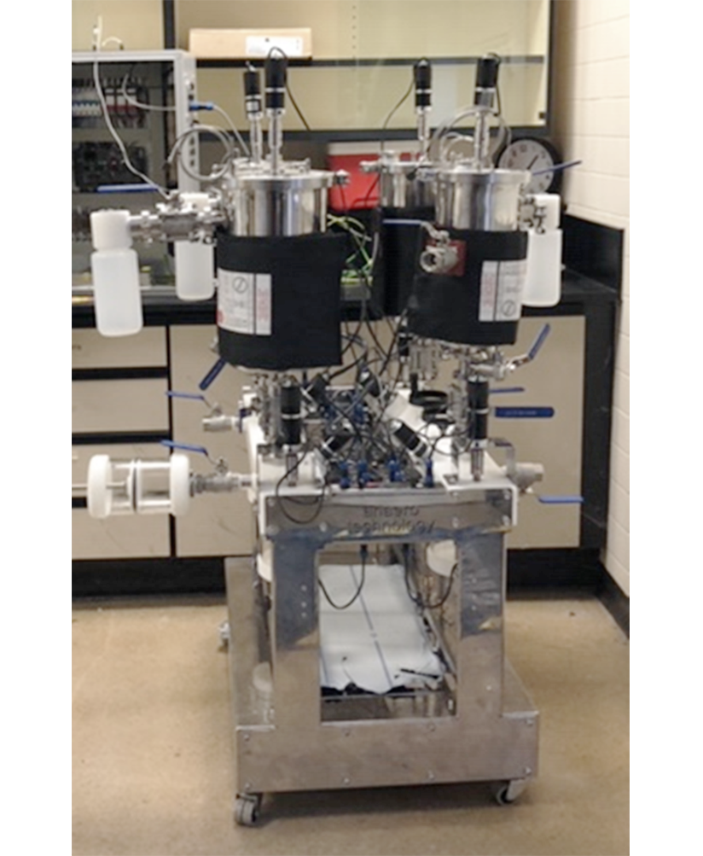
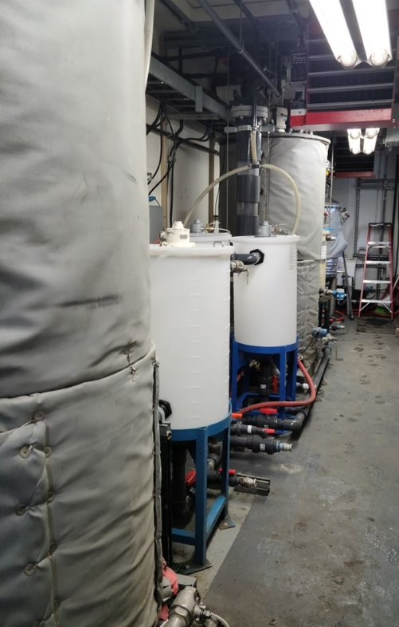
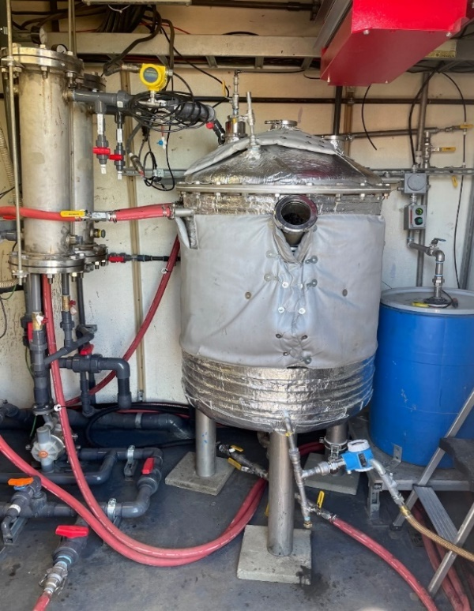
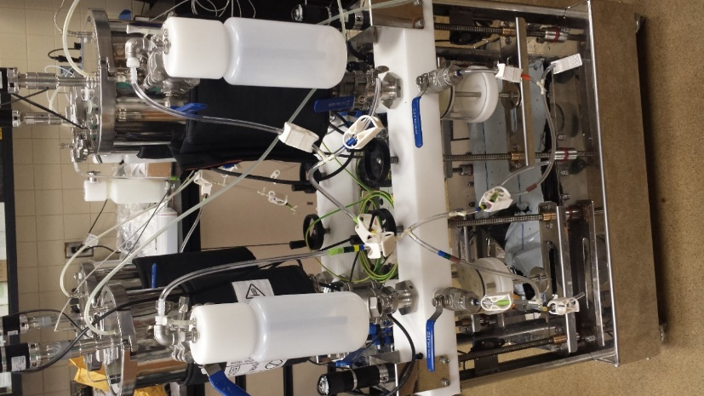
MHP using C. bescii has been tested at both lab- and pilot-scale.
Lab Scale
10-L Digesters and 5-L Hydrolysis Tanks
Pilot Scale
1200-L Digesters and 500-L Hydrolysis Tank

Slide 7
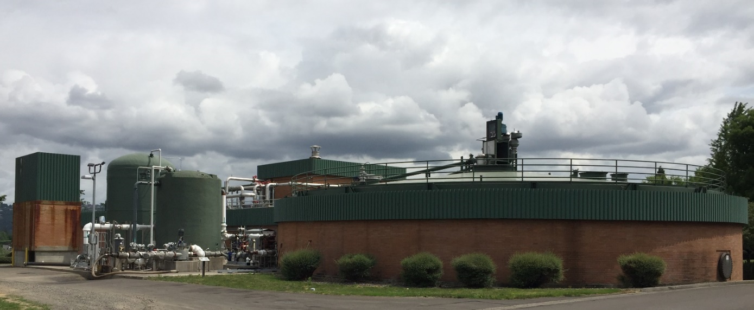
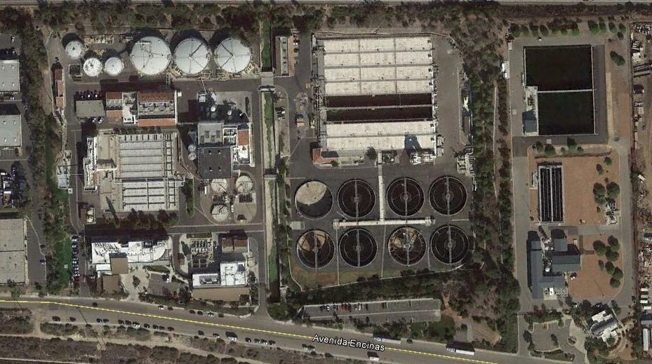
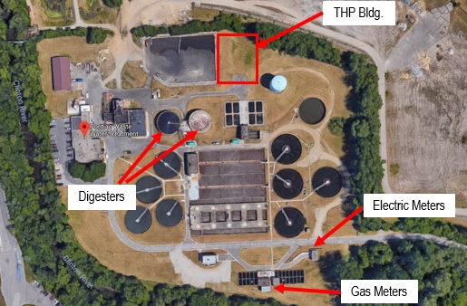
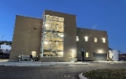
MHP was tested using sludge from high-performing digestion systems (>58% Volatile Solids Reduction (VSR))
Facility | Digestion | Existing Performance VSR | Method
Gresham WWTP; Gresham, OR | Mesophilic AD with FOG | 60% | Lab-scale
Encina Wastewater Authority WPCF; Carlsbad, CA | Mesophilic AD | 60% | Lab-scale
Clinton River WRRF, operated by Oakland County WRC; Pontiac, MI | THP Mesophilic AD | 58% | Pilot-scale
Gresham Wastewater Treatment Plant
Portland, OR
Encina Water Pollution Control Facility, Carlsbad, CA
Clinton River Water Resource Recovery Facility
Pontiac, Oakland County, MI

Slide 8
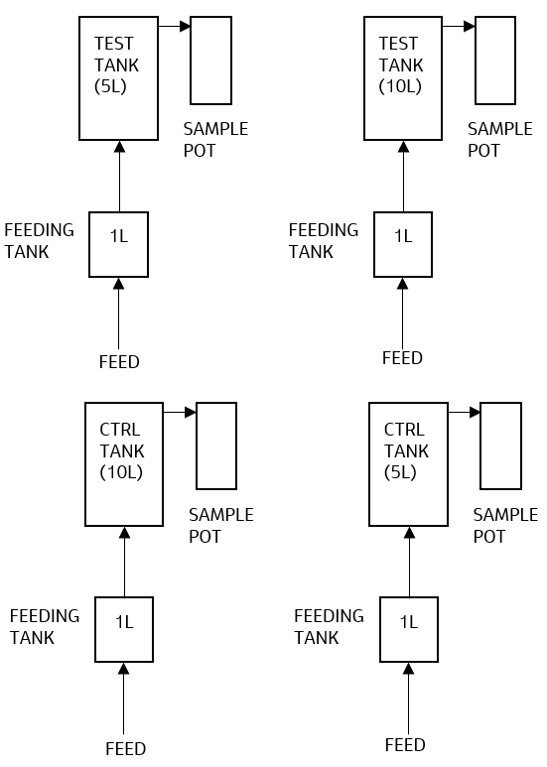
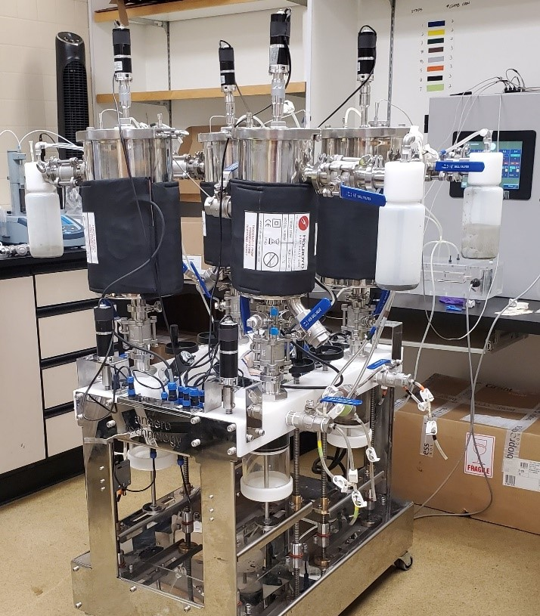
The lab-scale tests were performed using AnaeroTech anaerobic reactors (model Lobster-i).

Slide 9
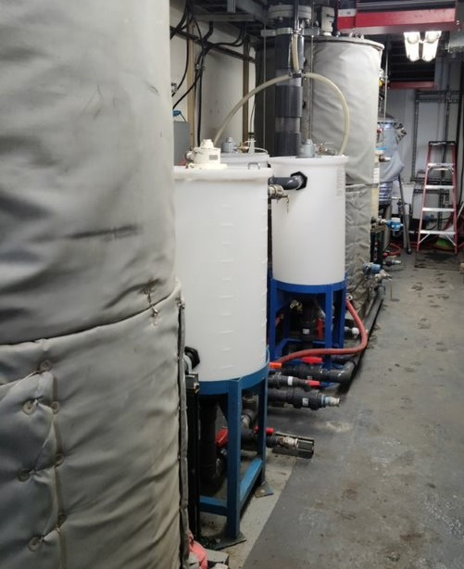
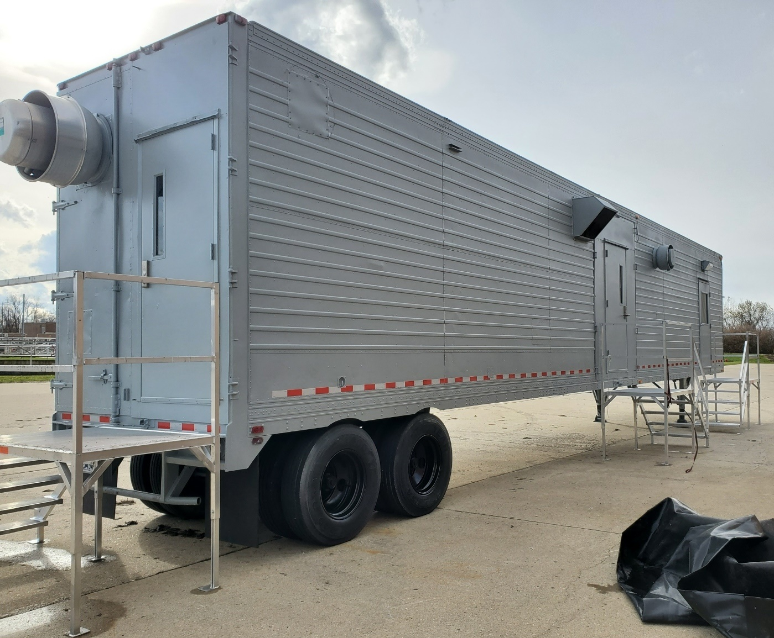
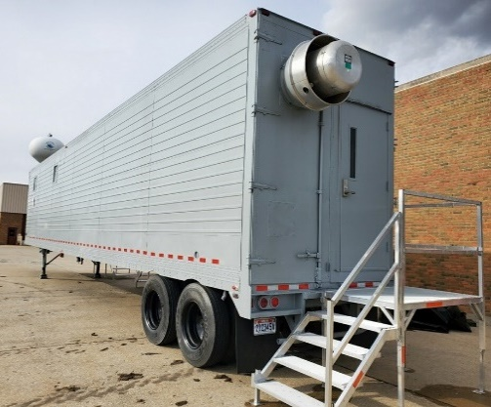
The pilot digestion facility process room contained two anaerobic digester tanks, one MHP tank, and 4 feed holding tanks.
Process Room
Control
Room

Slide 10
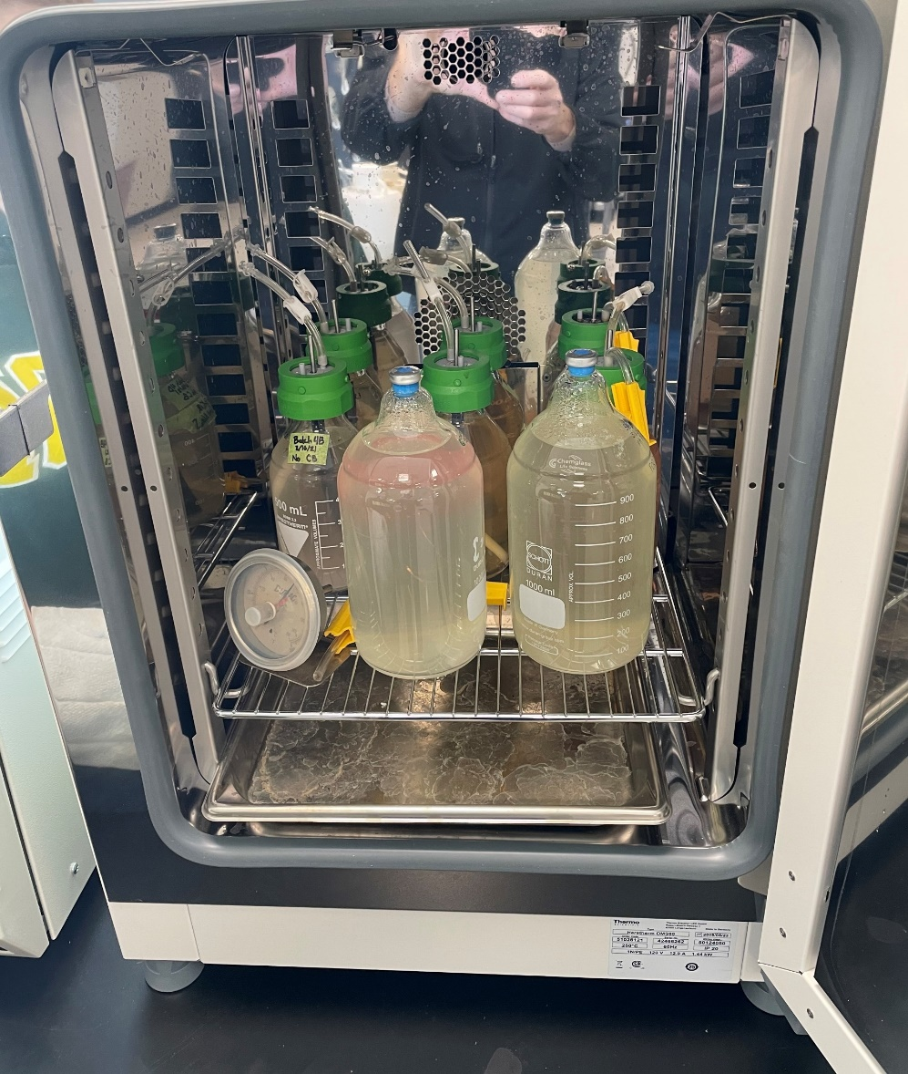
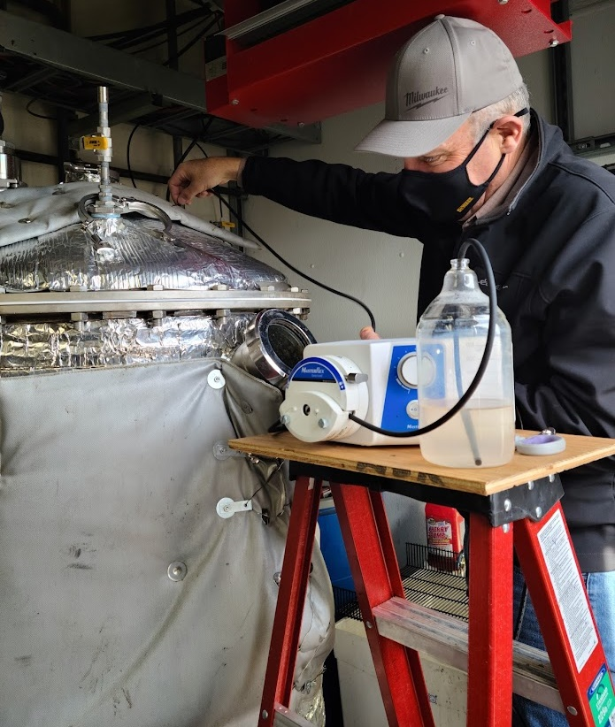
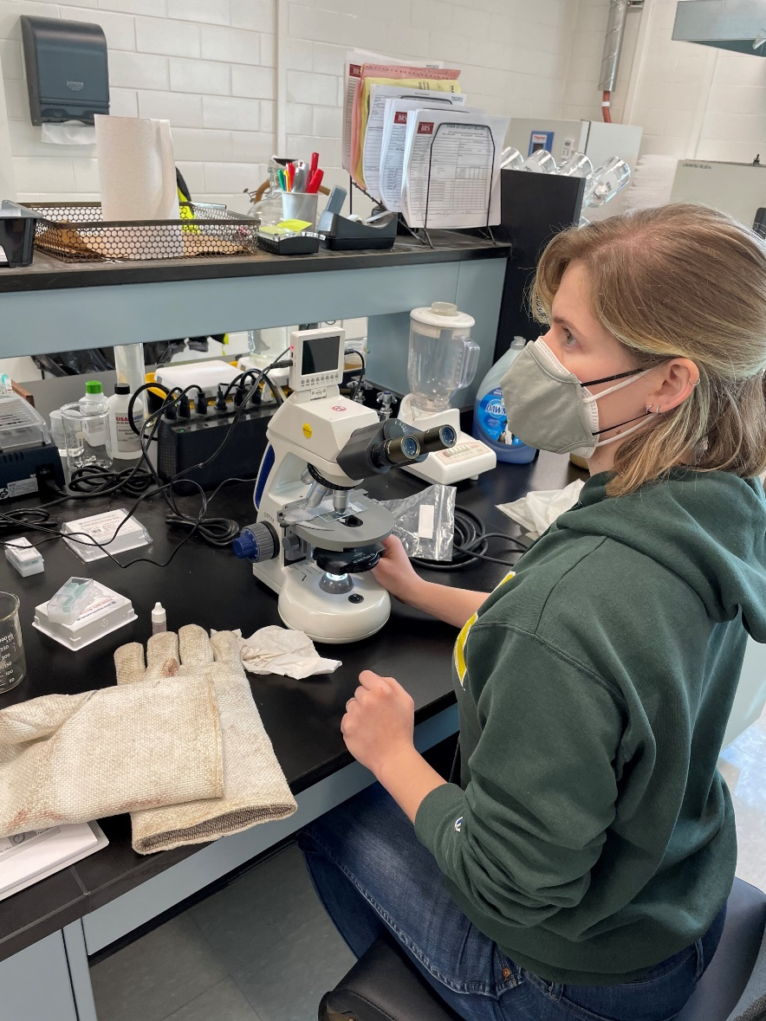
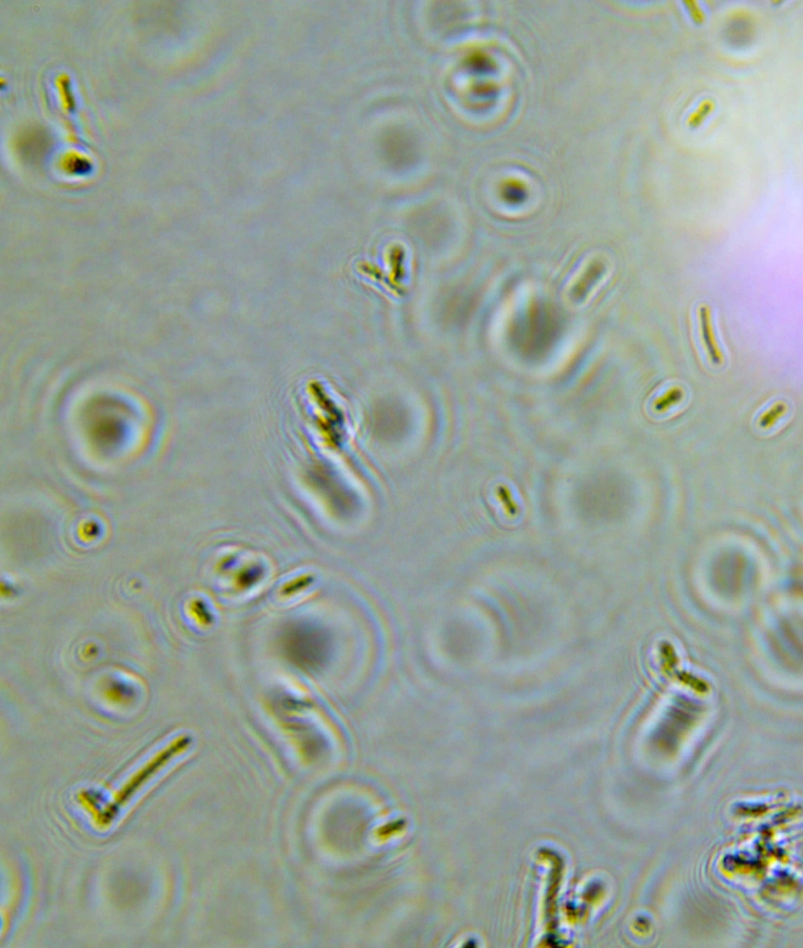
In pilot testing, C. bescii grew approximately 100-fold in 48 hours, for an estimated doubling rate of approximately 6-8 hours in digested sludge.

Slide 11
The primary measurement of AD performance was volatile solids reduction (VSR), calculated by mass balance.
Biogas
M
M
Data collected:
AD Feed rate
Circulation rate between AD and MHP
  Temperature
  Total solids
  Volatile solids
  Volatile fatty acids
  Alkalinity
  pH
  Ammonia (occasionally)
  Biogas produced (desired)
    Methane
    Hydrogen sulfide
Overflow to Drain
Overflow to Drain
Unseeded MHP Tank (lab only)
Control AD
Test
AD
MHP
Tank
Feed
Tank
Feed
Tank
Sludge
Notes:
We had a separate MHP tank on the control at lab-scale that was not seeded

Slide 12
Adding MHP at the Gresham WWTP increased VSR from 60% in full-scale AD to 80% VSR in the lab-scale AD with MHP.

Slide 13
Adding MHP on digested sludge from Encina WPCF increased VSR from 60% in full-scale AD to 77% in the lab-scale AD with MHP.

Slide 14
Adding MHP to THP-AD at Oakland County, AD increased VSR from 58% in full-scale AD to 75% in the pilot-scale THP-AD with MHP.

Slide 15
In summary, the addition of MHP increased anaerobic digestion performance from good VSR (~60%) to great VSR (>75%).
Facility | Digestion | Existing Performance VSR | Method | Control Performance VSR | Test Performance VSR
Gresham WWTP Gresham, OR | Mesophilic AD with FOG | 60% | Lab-scale | 70% Attributed to C. bescii in control | 80%
Encina Wastewater Authority WPCF Carlsbad, CA | Mesophilic AD | 60% | Lab-scale | 71% Attributed to long retention time | 77%
Clinton River WRRF, operated by Oakland County WRC; Pontiac, MI | THP Mesophilic AD | 58% | Pilot-scale | 65% Attributed to solids settling in control | 75%
Notes:
The control “kept us honest”. While we did see some improved digestion in the control digesters without intentional addition of MHP C. bescii, there was an explanation for the improved performance for each. Even still, addition of MHP outperformed the control and full-scale digesters.

Slide 16
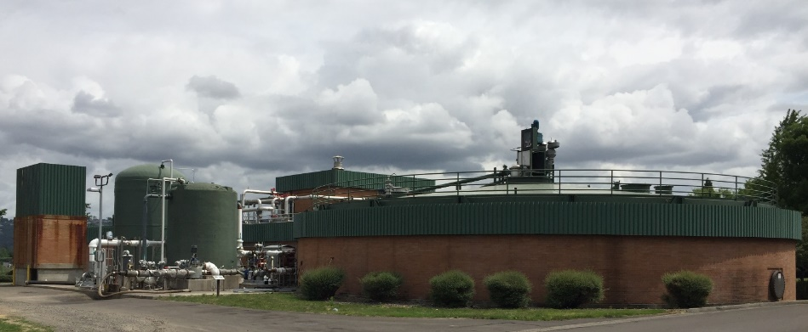
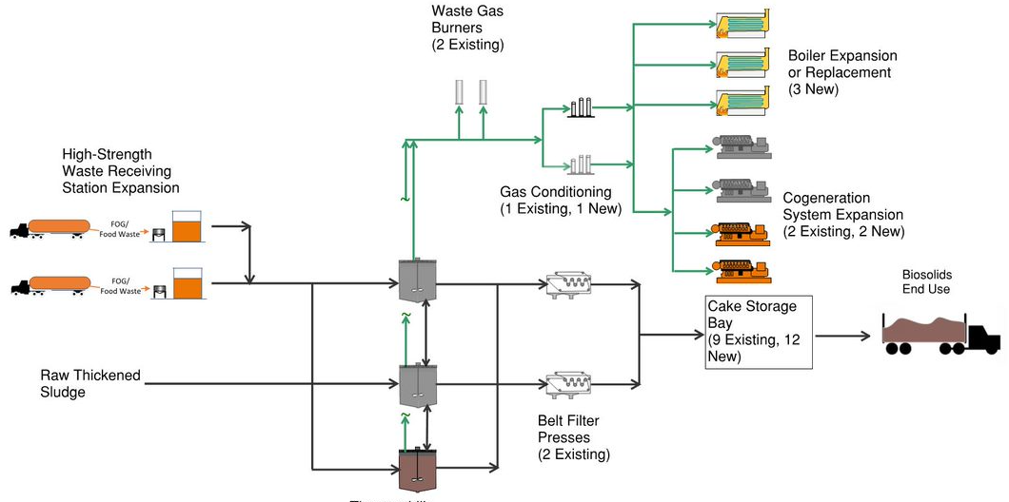
At Gresham, MHP with recuperative thickening can be added to enhance digestion capacity and performance.
MHP with recuperative thickening.

Slide 17
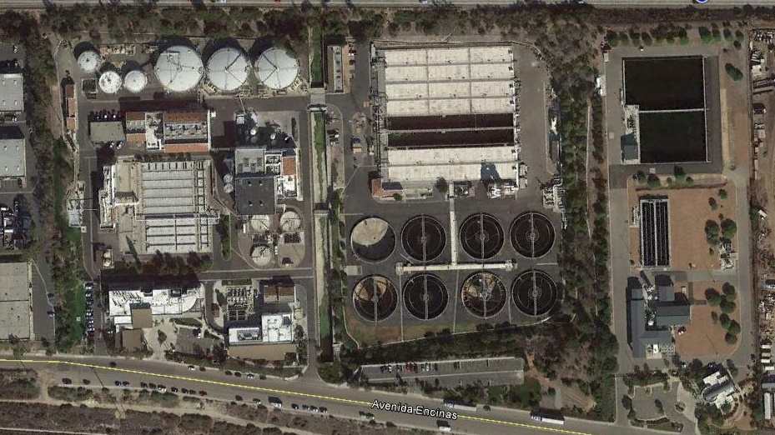
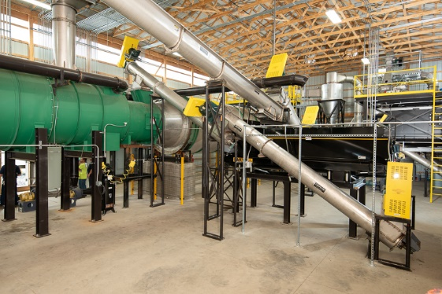
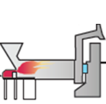
Encina plans to implement MHP in the future based on successful lab and future pilot tests.
1
Microbial Hydrolysis Process Tanks 1-3
2
2
3
Recuperative Thickening
Digested Sludge
Storage Tank
Heat Recovery
Thickened Primary
& Waste Activated Sludge
Dewatering
Biogas
Centrate
Centrate
4
Mesophilic Anaerobic Digesters 4-6
Biogas
5
Integrated Biosolids Dryer/Pyrolyzer/Gasifier
Biogas
6
Class A Biosolids

Slide 18
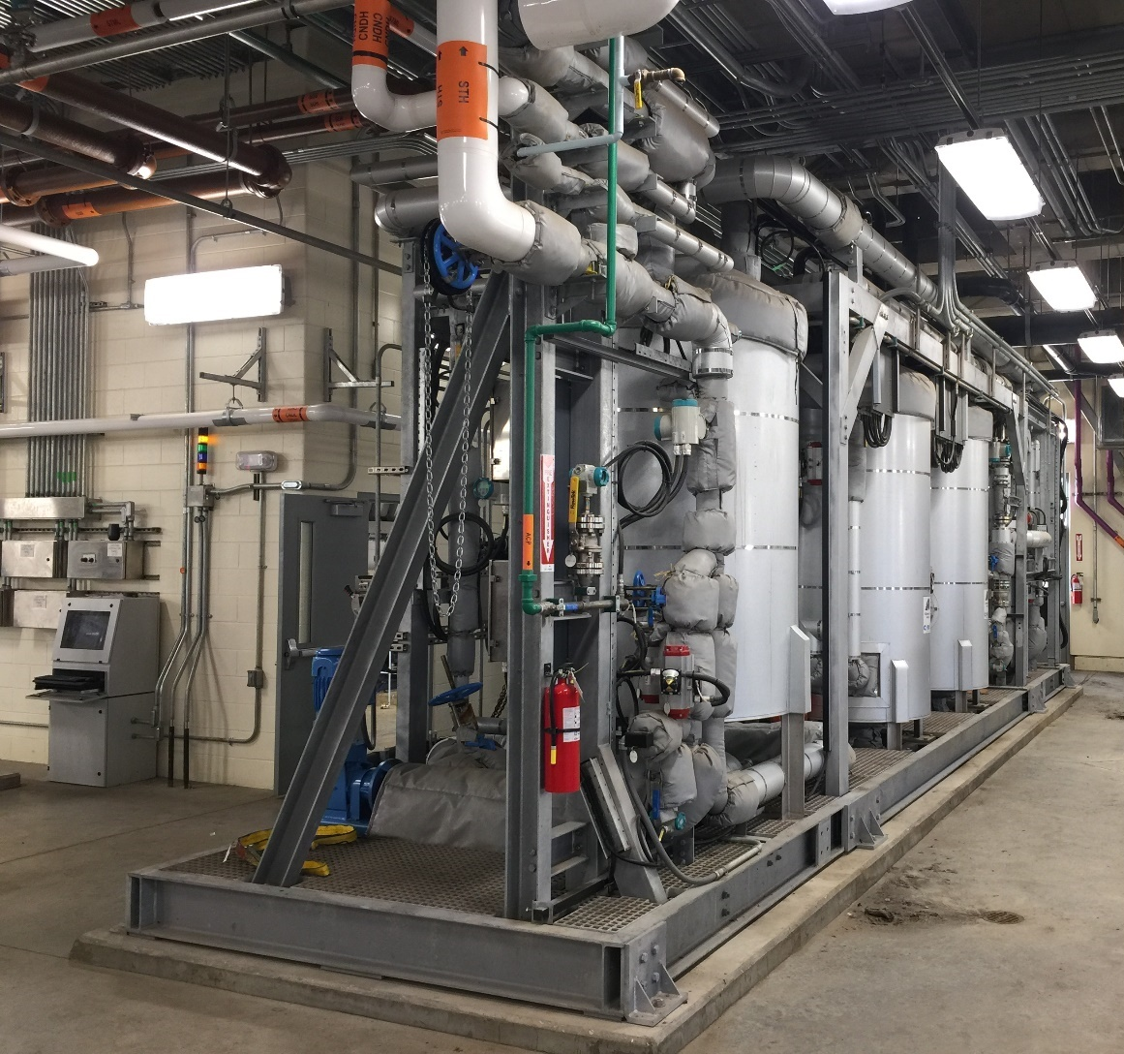
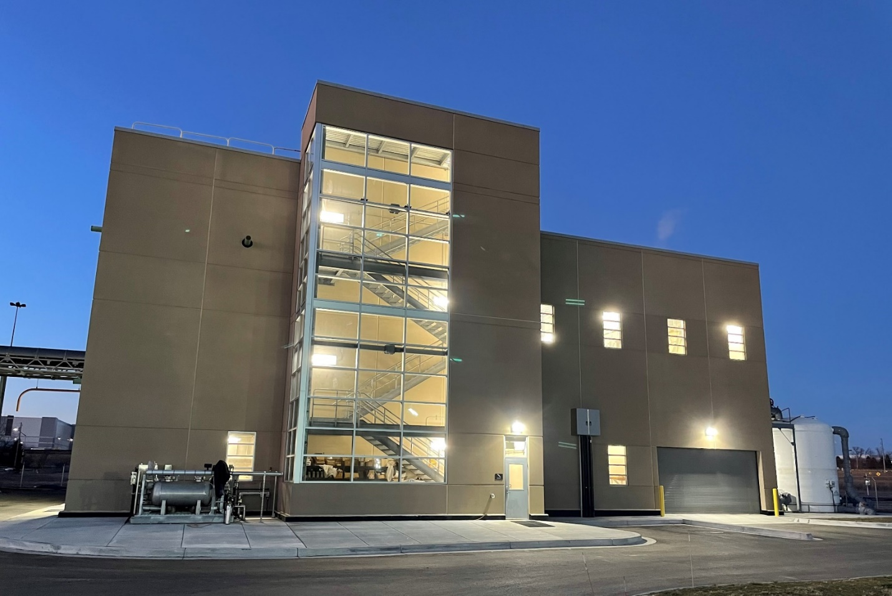
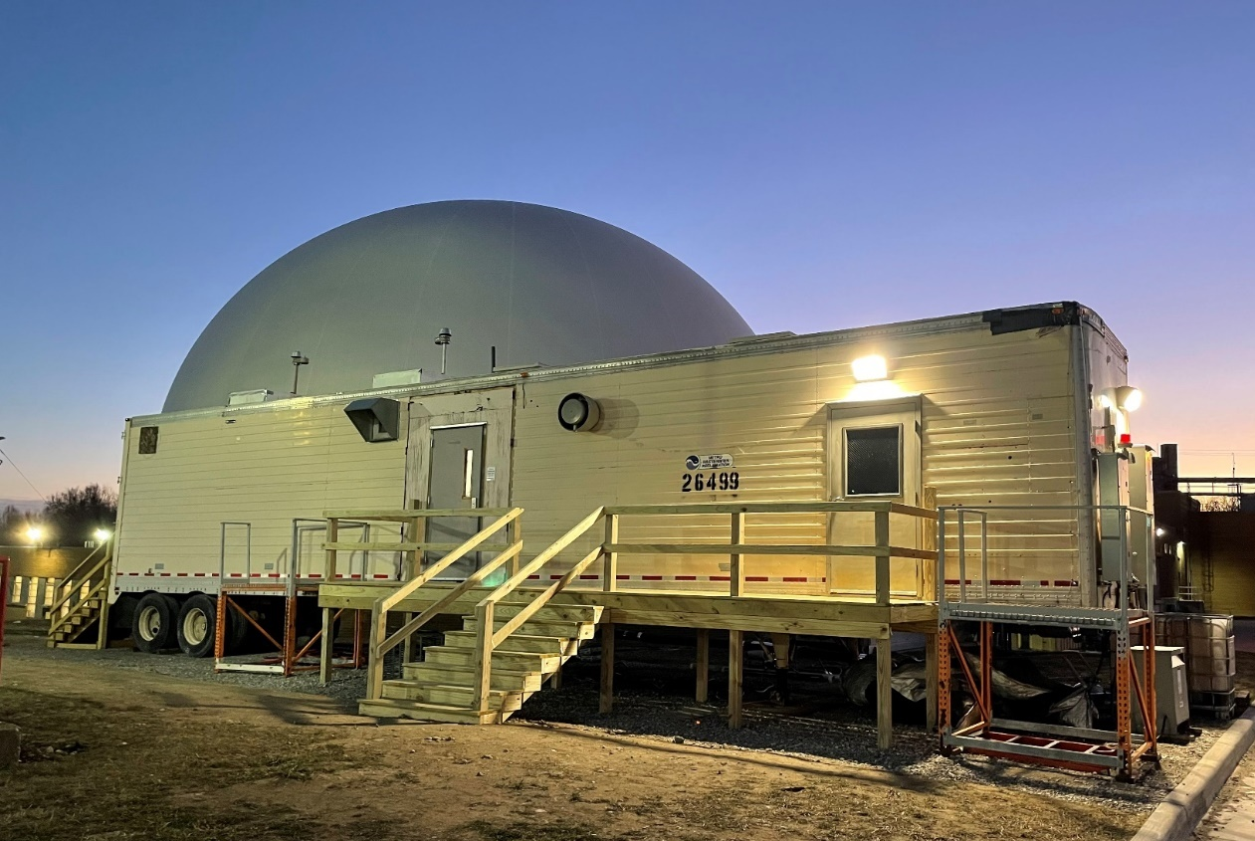
Oakland County piloted MHP to evaluate the potential improvement in performance to their THP AD process.

Slide 19
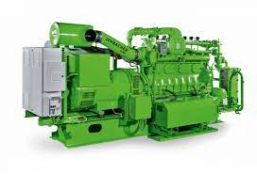
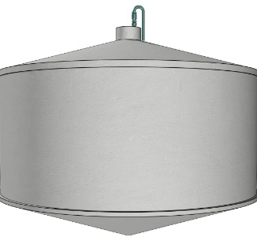

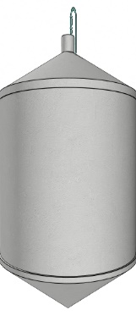
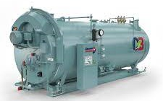
Clinton River WRRF
Oakland County
Pontiac, MI
Electricity
Natural Gas
Flare
Biogas Treatment
Biogas
Primary
Digester
Secondary
Digester
Standpipe
Standpipe
Sludge
Pre-Dewatering
THP
MHP Tank
Biosolids
Post-Dewatering
Steam
Buildings
Notes:
By adding MHP, Oakland County could increase their biogas production by 30 percent and reduce their biosolids production by 25 percent.

Slide 20
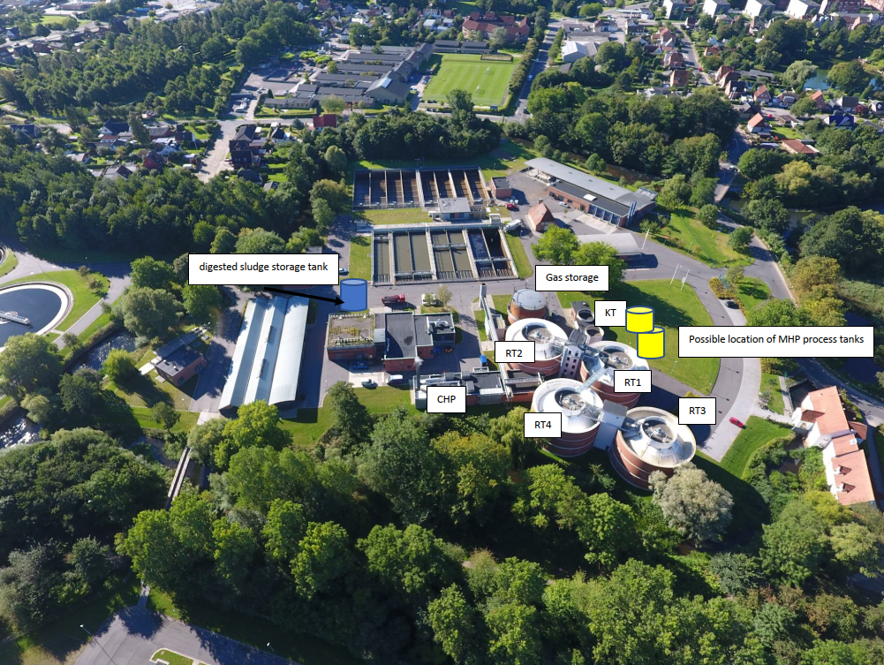
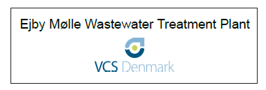
VCS Denmark Ejby Molle WRRF
500,000 population equivalent
Achieved Energy Neutrality through technology and business strategy

Slide 21
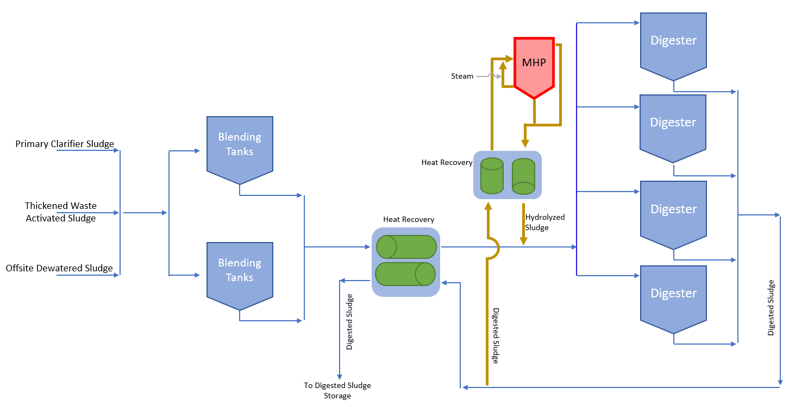
Microbial Hydrolysis Process at EJWRRF

Slide 22
For a conventional AD system at a 300,000 PE WRRF:
Applying MHP can result in a total value of 450,000 $/yr
Biogas w/o MHP: 340 m³/h (200 scfm)
Biogas with MHP: 480 m³/h (280 scfm)
40% More Biogas 180,000 $/yr
TS: 8.9 dry tonnes/day w/o MHP
TS: 6.5 dry tonnes/day with MHP
Thickened Sludge
MHP
Anaerobic
Digestion
30% Less Biosolids
270,000 $/yr Value
TS: 15 dry tonnes per day
VS/TS: 78%
VSR: 55% w/o MHP
VSR: 75% with MHP
Notes:
$80/dry tonne savings

Slide 23
MHP can be added to any digestion process to enhance anaerobic digestion performance and decrease operating costs.
Increase VSR of over 75%
Increased Biogas Production
Decreased Biosolids Production
More Biogas
Thickened Sludge
Anaerobic
Digestion
Less Biosolids
MHP

Slide 24
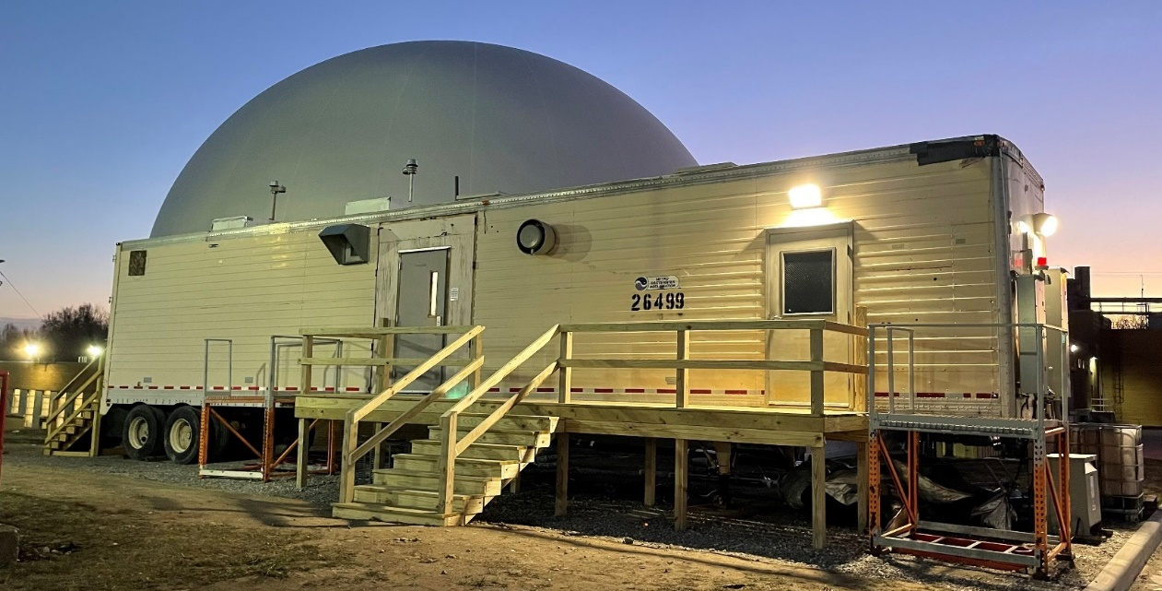
Enhancing Anaerobic Digestion Performance
with the
Microbial Hydrolysis Process
Questions?
David Parry, PhD, PE, BCEE
dave.parry@jacobs.com

