Slide 1



Managing Biosolids in a Circular Economy Future
Connecting People, Data and Processes

Slide 2

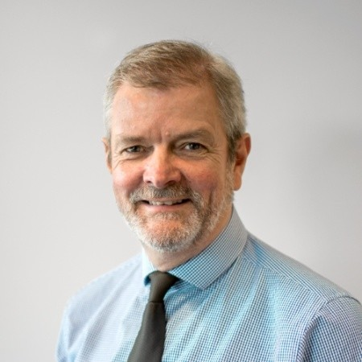

Presented By
Peter Donaghy
GM, Resource Recovery
Urban Utilities
Cillian O’Neill
Account
Executive, Klir
One Platform. All Teams. Just for Water.
‹#›
Notes:
Options:
Security: manage records in an application that's protected and locked
Information governance: maintain a single record of source
Cloud-based: it doesn't require a connection into our network, they can just go ahead and access it.
Integrations: with LIMS, SCADA, etc.
Fragmented internal information management: Individual information access vs. organizational information access creates risk & inefficiencies (sometimes called "tribal" access, but we should not adopt this term).
Capacity: Too many demands on the IT function from across internal customers.
Underserved by today's software market: Software for water was built 20 or 30 years ago, and has never been updated. It breaks, it doesn’t connect to their original data sources. It takes a ton of effort from IT to maintain.
Unexpected software requests: Teams will often come to them with a software they've selected to solve a problem. This often comes as a surprise, and it's hard for IT to support this request / see how it fits into the broader digital strategy at their organization.
Broken integrations: No easy way to pull data out of critical tech like SCADA, GIS, LINs, etc. because the systems they have are very fragile.

Slide 3
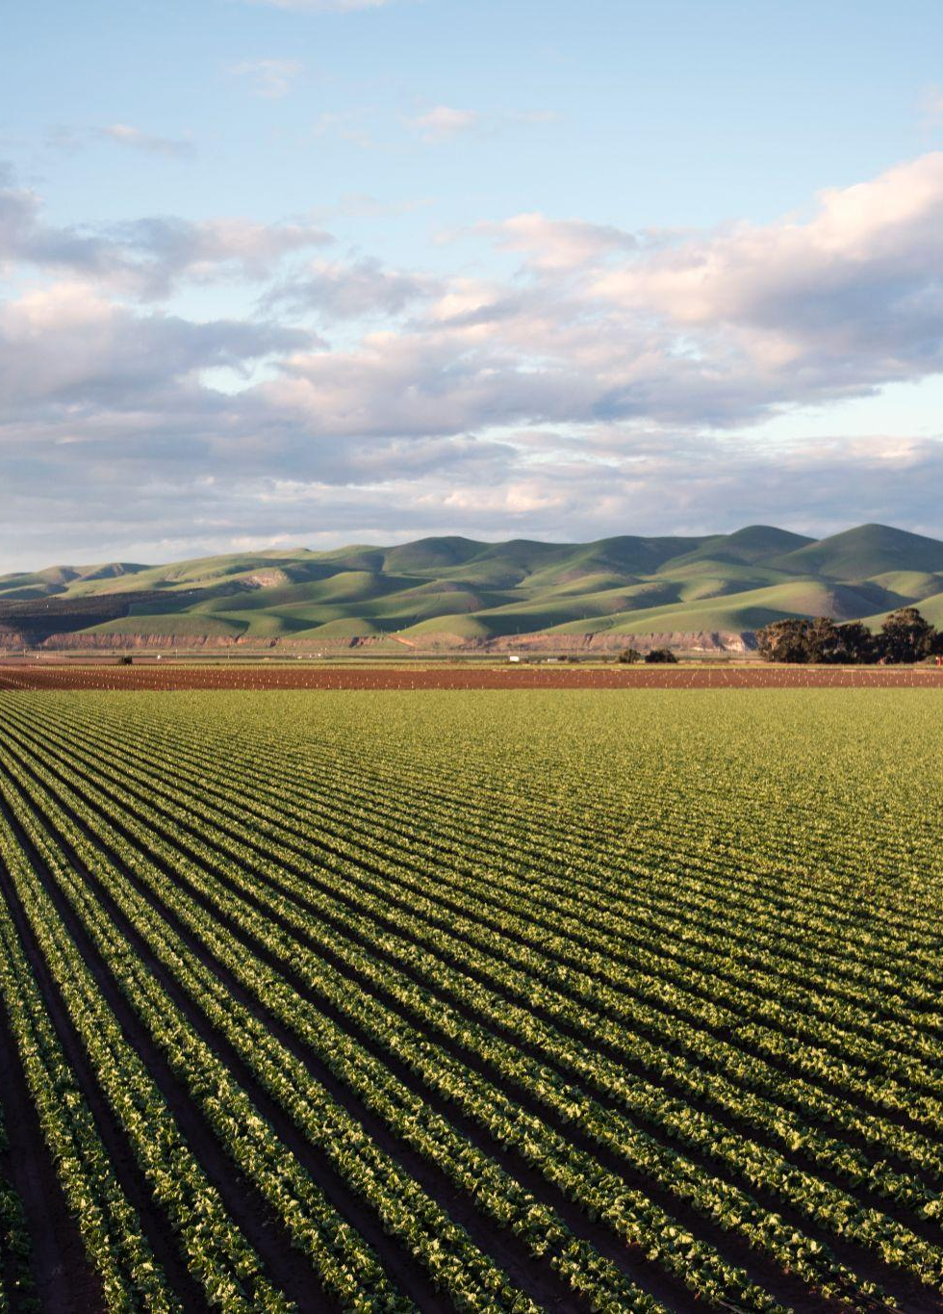

Biosolids Recovery at Urban Utilities
26 sites
120,000 ml water used
200,000 tonnes of sludge
25-35% of the total cost to treat wastewater
1,000,000 KM’s transport logistics
Beneficial reuse of biosolids on land
Est. 17,000t GHG emissions reduction per large RRC
One Platform. All Teams. Just for Water.
‹#›
Notes:
Disposing waste sludge is an expensive process, and getting better at biosolids—by reducing the amount of biosolids that are thrown out and increasing the amount of Class A material that can be sold—is a huge cost-saving and revenue opportunity.

Slide 4






Operating Risk is Rapidly Changing
Climate Change
Increasing Regulation
Increasing Customer Expectations
Contaminants of Concern
Retiring Workforce
& Staff Shortages
One Platform. All Teams. Just for Water.
‹#›

Slide 5



A resilient biosolids business must be agile to react to external threats and manage known risks.
‹#›

Slide 6




The Goal
Adapt to Changing Regulation: End of Waste
Decrease
Operating Costs
Increase Environmental Performance of Biosolids
One Platform. All Teams. Just for Water.
‹#›

Slide 7



The Problem
High Reliance
on Individual Expertise
Sharing Data & Lab Test
Results Was Difficult
Manual Workflows &
Interventions Subject to Error
One Platform. All Teams. Just for Water.
‹#›

Slide 8

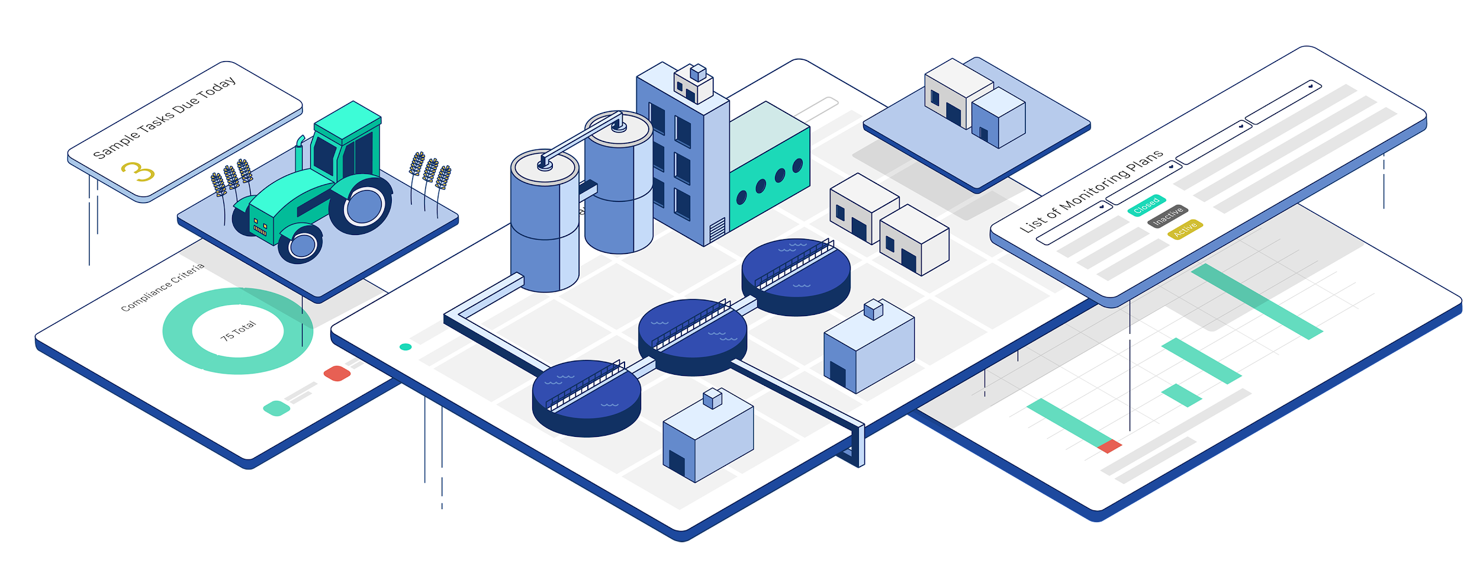


Understanding a Complex System
Systems and Processes
People & Function
Data Sources
One Platform. All Teams. Just for Water.
‹#›

Slide 9
Function vs Business Objective
Where structure and functions are too strong, there is a risk that the system is distorted and not optimized. We can focus on the wrong things, make less than optimal decision and potentially create or reinforce silos
Humility is required to accept that no one person, group or team can know the entirety of the system. It requires communication including active listening and all parties to co-create and optimize the system.
Understanding one’ place in the system is a process rather than a design activity
One Platform. All Teams. Just for Water.
‹#›

Slide 10
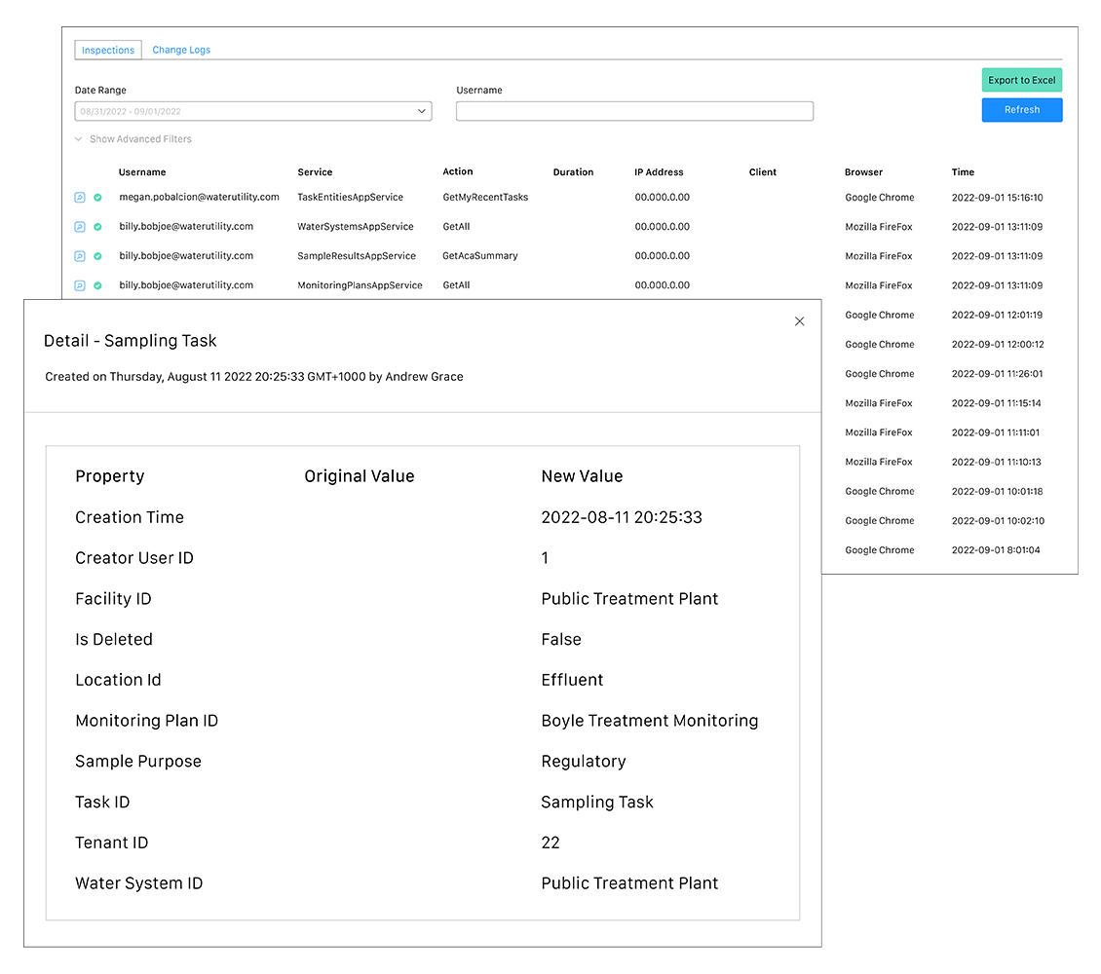
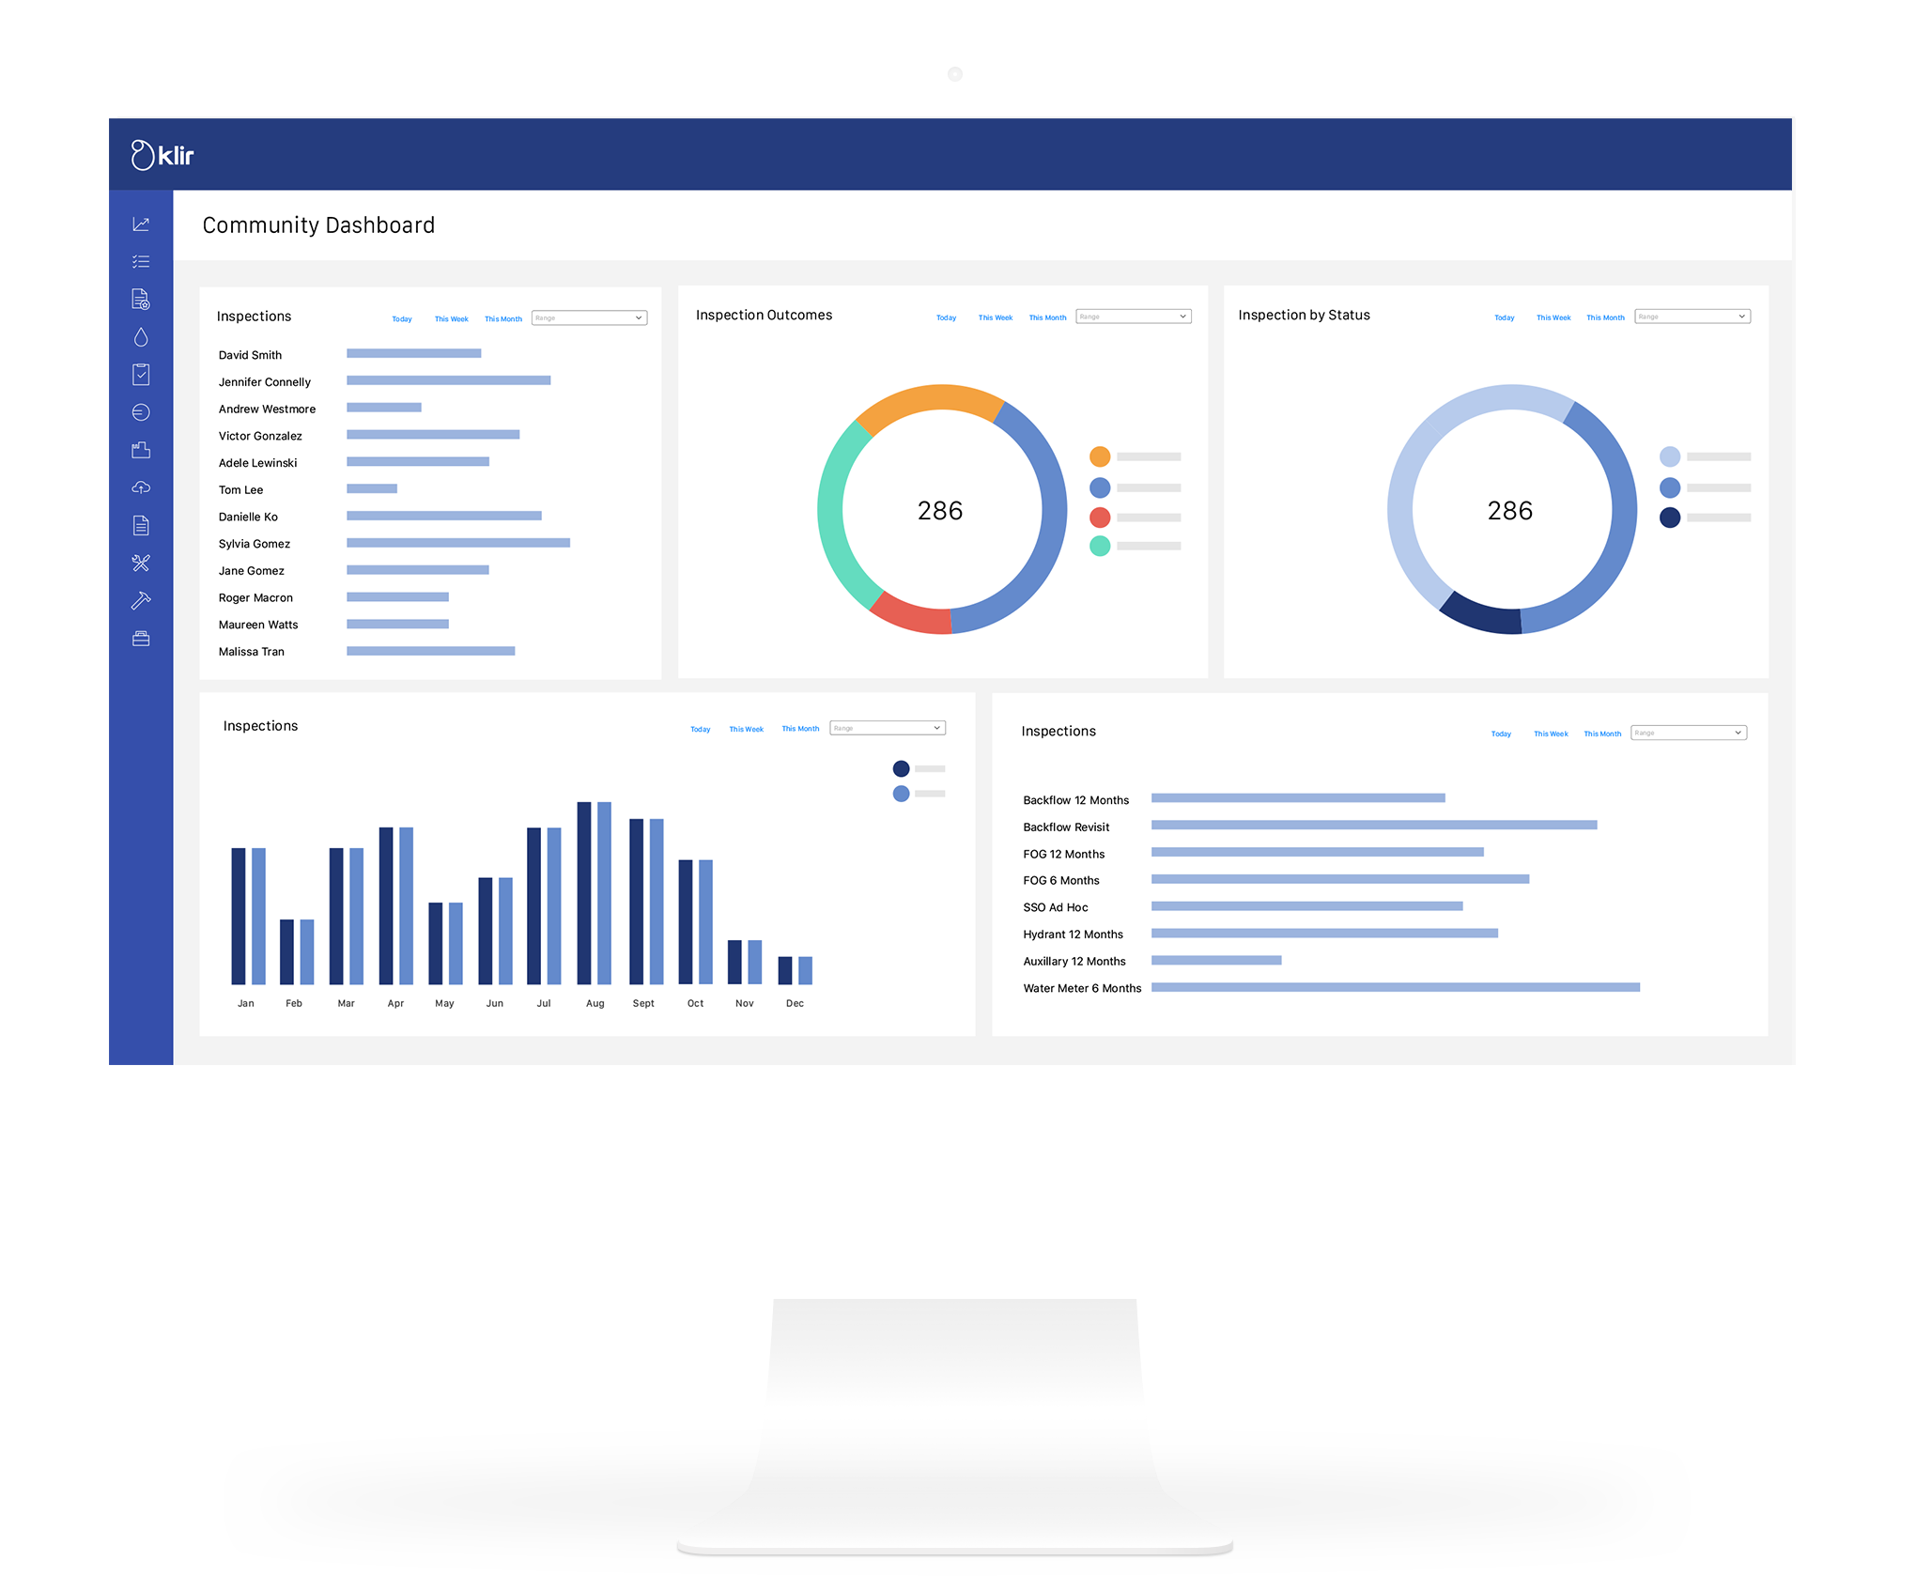
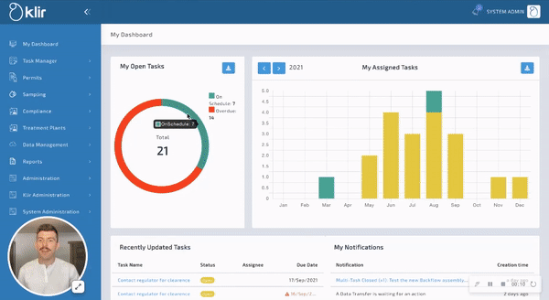
Klir SaaS Platform: Complete Visibility into Treatment Process
One Platform. All Teams. Just for Water.

Slide 11
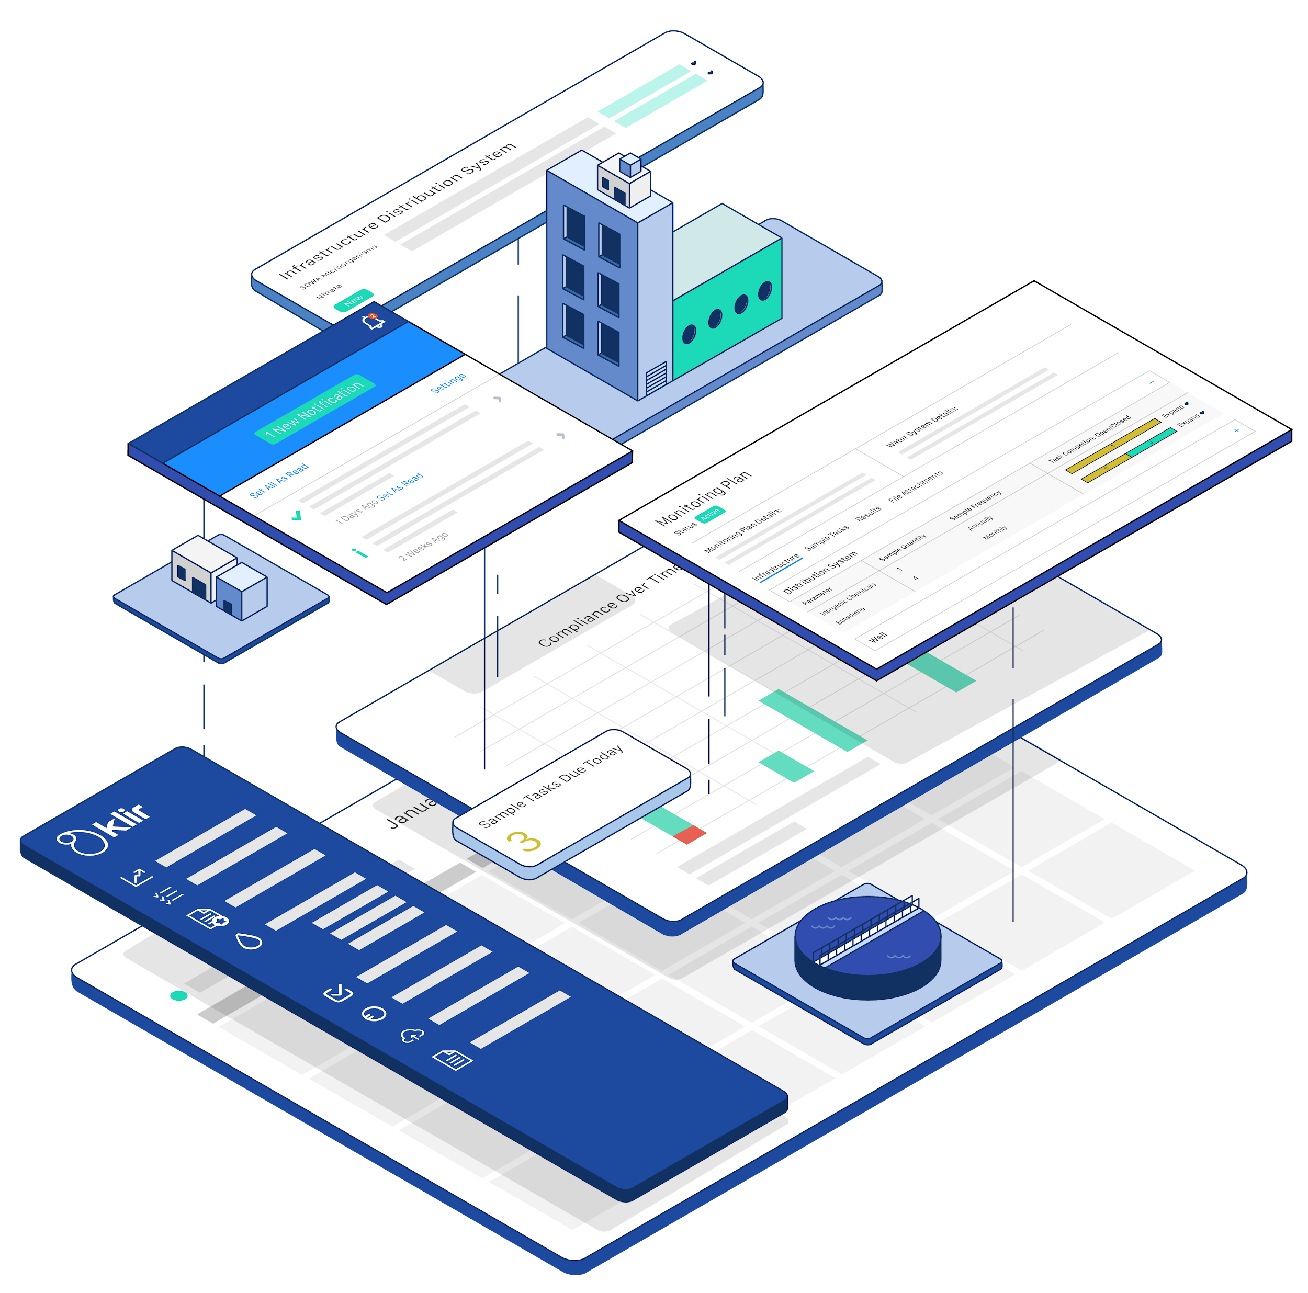
The Solution
📈 View product quality trends over time
💰 Disposal costs, volume & destination of biosolids transport
📉 Track annual budgets vs. costs & tonnage removal
✅ Pass / fail rates of sampling results
⚠️ Alerts when contaminant limit is approached or exceeded
One Platform. All Teams. Just for Water.
‹#›

Slide 12
Enhanced Decision Making & Performance
New core capability; supply chain, production, logistics
Diversified distribution & quality control
System view; Data to Information to insights
System Management; Informed decision making
Management system brings together people, data and systems to reliably and efficiently deliver economic, environmental and other non-financial outcomes.
One Platform. All Teams. Just for Water.
‹#›

Slide 13
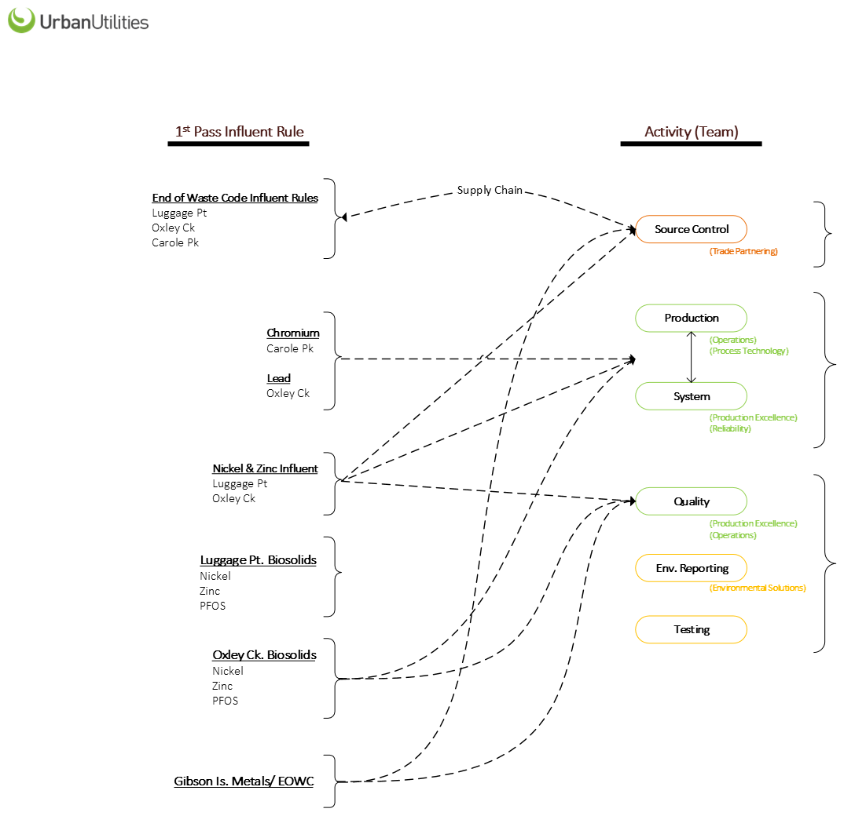

One Platform. All Teams. Just for Water.
‹#›

Slide 14



Case Study - Queensland Urban Utilities
The Results
Lower Costs
Lower transportation &
disposal costs
Avoid non-compliance penalties
Increased Sustainability
Eliminating landfill waste
Generating natural fertilizers & other beneficial reuse
Improved Resilience
Timely insights for decisions
Reduced reliance on key personnel
One Platform. All Teams. Just for Water.
‹#›

Slide 15


What’s next? Replicating results, organisation-wide.
‹#›
One Platform. All Teams. Just for Water.
‹#›

Slide 16
Ready for compliance certainty?
Klir.com

