Slide 1


Biosolids facilities planning using asset management and adaptive pathways
Gage Muckleroy (GHD)
Kevin Jankowski (MMSD)

Slide 2
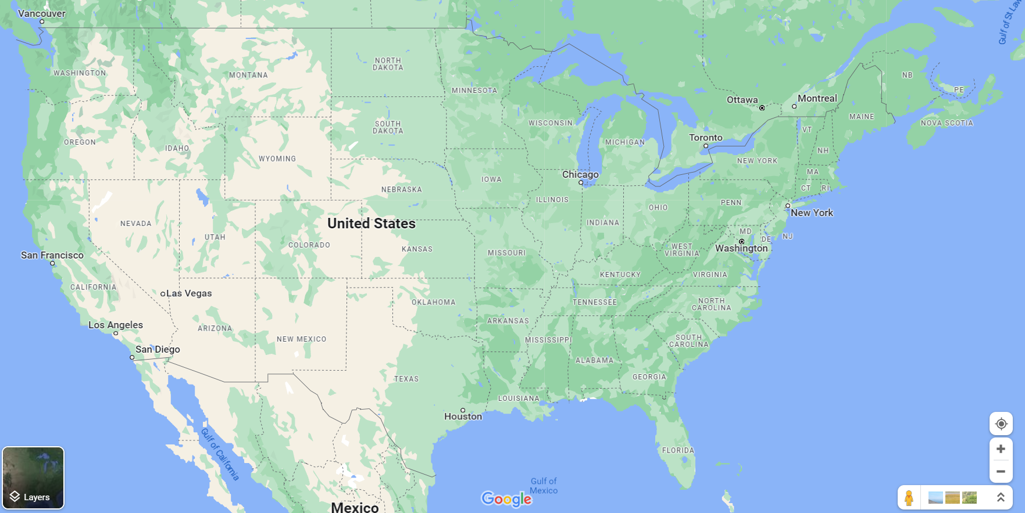
Project location

Slide 3

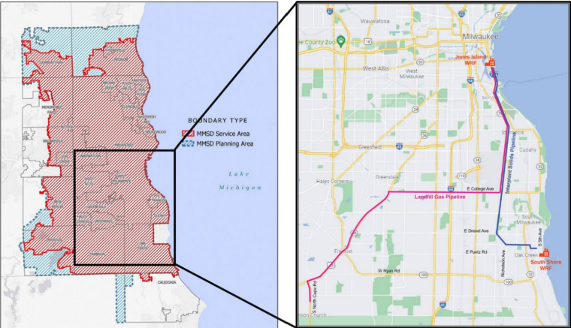
Project background
Milwaukee Metropolitan Sewerage District (MMSD) is a state-chartered governmental agency that provides water reclamation and flood management services for 28 municipalities in the greater Milwaukee area, serving about 1.1 million people.
MMSD’s mission is to cost-effectively protect the quality of the region’s water resources.
It is responsible for the construction, operation, and maintenance of interceptor sewers and water reclamation facilities within its sewer service area and has authority for flood management and watercourse improvements.

Slide 4
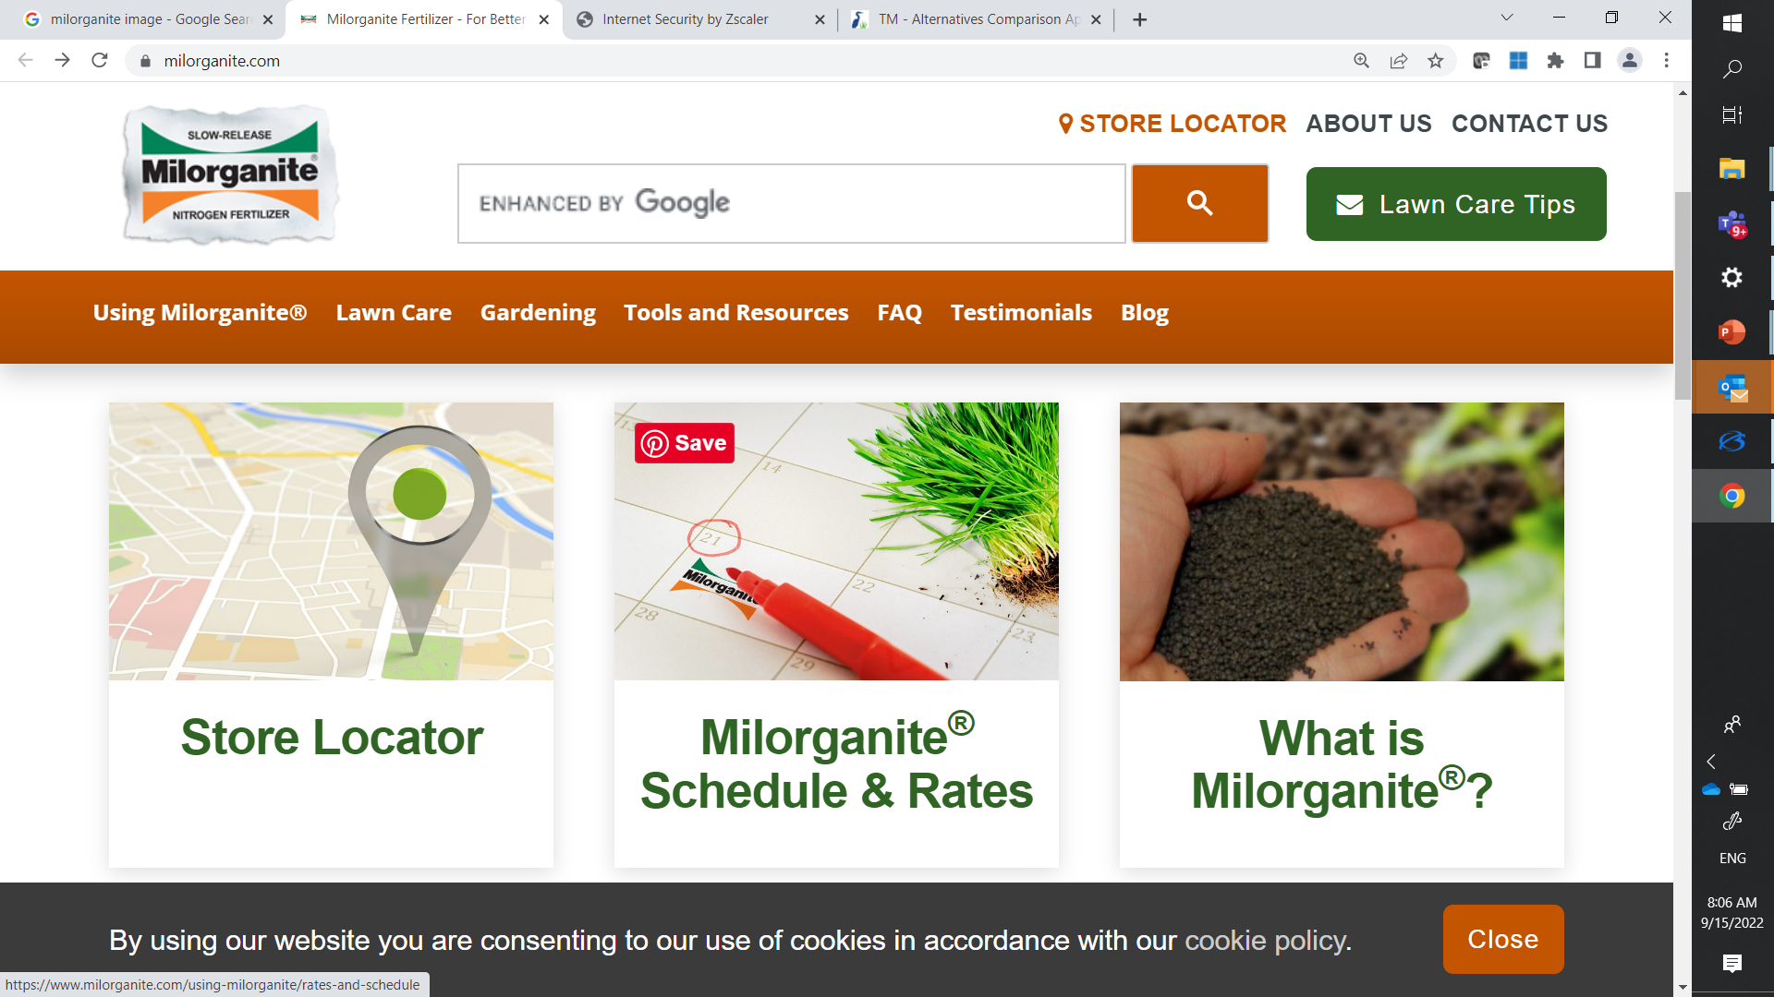
Milwaukee Metropolitan Sewerage District (MMSD)
Biosolids produced at two facilities:
Jones Island Water Reclamation Facility (JIWRF)
South Shore Water Reclamation Facility (SSWRF)
Biosolids converted to Milorganite® , a commercially available fertilizer product
Biosolids advanced facilities plan (AFP) focused on addressing three questions:
What is the best way to make Milorganite® ?
What drivers influence the long-term viability of Milorganite®?
How can the District adapt to changing drivers?
MMSD's 2035 Vision: is composed of two key elements: integrated watershed management and climate change mitigation/ adaptation with an emphasis on energy efficiency.

Slide 5
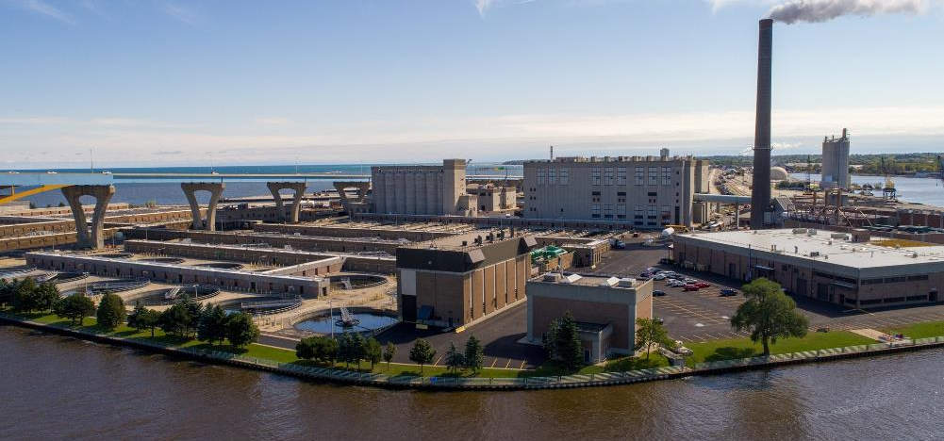
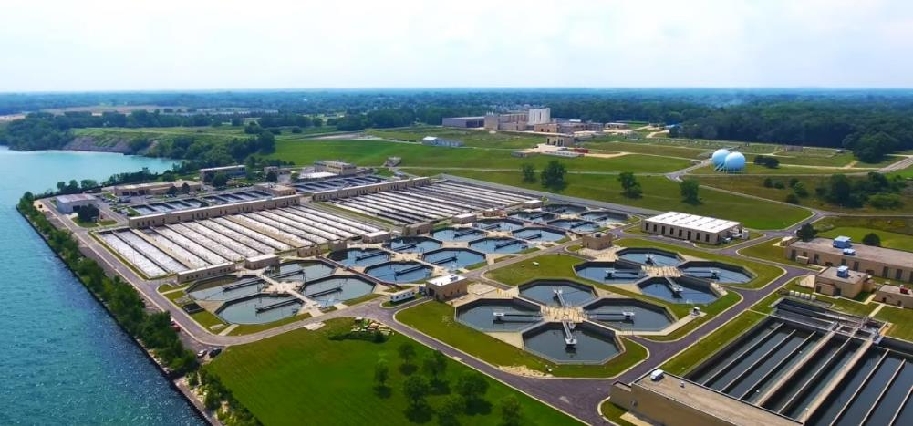
Jones Island Water Reclamation Facility
Located on Jones Island, just south of downtown Milwaukee under the Hoan Bridge
Rated at 1249 MLD for peak hour and 1135 MLD for peak day.
JIWRF was put into service in 1925 and uses activated sludge secondary treatment.
Receives both combined and separate sewer flow from the City of Milwaukee and most of the central portions of Milwaukee County.
Major processes at JIWRF include the biosolids handling facilities that produce Milorganite® and an electrical generation turbine facility that provides supplemental power.
South Shore Water Reclamation Facility
Located approximately 12 miles south of downtown Milwaukee in the city of Oak Creek, SSWRF
Rated at 1135 MLD for peak hour and 1000 MLD for peak day.
Receives separate sewer flow from the southern, far western, and far northern portions of the MMSD service area.
SSWRF was originally put into service in 1968 and uses activated sludge secondary treatment.
Major processes at SSWRF include anaerobic digesters and electrical engine generation facilities that provides supplemental power to the facility.
Notes:
Jones Island Water Reclamation Facility
Located on Jones Island, just south of downtown Milwaukee under the Hoan Bridge, JIWRF is
rated at 330 MGD for peak hour and 300 MGD for peak day. JIWRF was put into service in 1925
and uses activated sludge secondary treatment. It receives both combined and separate sewer flow
from the City of Milwaukee and most of the central portions of Milwaukee County. Major
processes at JIWRF include the biosolids handling facilities that produce Milorganite® and an
electrical generation turbine facility that provides supplemental power.

Slide 6
Project approach
Asset Management and Business Case Evaluation
Levels of Service, Risk and Lifecycle Cost Analysis
Basis of design
Levels of service
Technology screening
Market risk
Alternatives analysis
Implementation plan & advanced facilities plan
Adaptive Pathways Planning

Slide 7
Technology screening
Option / technology being assessed
  Criteria created collaboratively based on Levels of Service
  46 total criteria looked at with varying priority given
    E.g. Regulatory, Energy, Safety
  4 criteria seen as Hurdle Criteria
    Maturity of technology
    Scale of existing technology applications
    Net present value
    Alignment with operations at WRFs
Does it meet hurdle all hurdle criteria
Option / technology eliminated from further consideration
Option / technology is scored against relevant high and moderate priority criteria

Slide 8
Technologies Screened
Nutrient management
Primary clarification
Sludge thickening
Pyrolysis
Dryer
Irradiation
Anaerobic digestion
Bioplastics
Thermal hydrolysis
Biosolids transfer
Dewatering at SSWRF
Hydrothermal liquefaction
Supercritical water oxidation

Slide 9

Alternatives in Detail
Business Case Evaluation
  Baseline: ‘Business-as-usual’ alternative
  Alternative 1: Production of Milorganite® at both JIWRF and SSWRF and Class B at SSWRF
  Alternative 2: Production of Milorganite® at JIWRF, production of Class A dried product at SSWRF
  Alternative 3: Production of Milorganite® at JIWRF, production of biochar at SSWRF
  *Note: All alternatives address capacity constraints and physical mortality of existing infrastructure with upgrades and rehabilitation projects

Slide 10
Life Cycle Cost Analysis

Slide 11

Additional criteria
Based on MMSD’s LOS framework:
            Beneficial reuse of biosolids
            Greenhouse gas emissions
            Total energy consumption
            Renewable energy production
            Resilience to changed biosolids contaminant of emerging concern (CEC) regulations
            Ability to mitigate against short term risk of extended dewatering and drying (D&D) facility shutdown

Slide 12
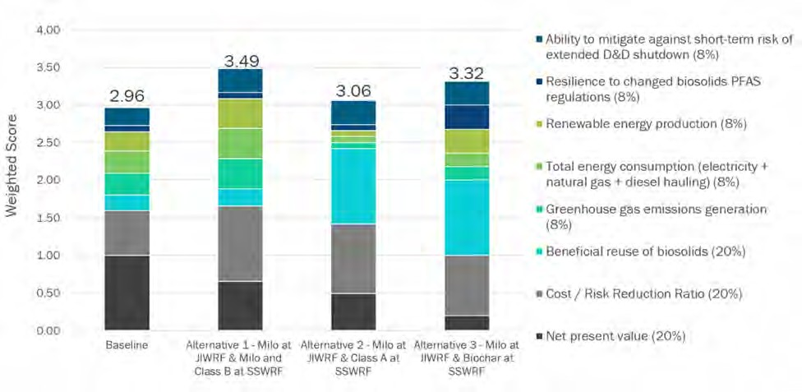
Detailed alternatives evaluation results

Slide 13
Key Outcomes
 | Baseline | Alternative 1 | Alternative 2 | Alternative 3
 | Milo (JI) & Class B | Milo (JI & SS) & Class B | Milo (JI) & Class A | Milo (JI) & biochar
Cost
Risk Exposure
Landfill disposal
PFAS/CECs
Cost/Risk Reduction
LOS & Org Goals
Low
Moderate
High
Best cost/risk reduction
Preferred short/ med-term destination
Highest cost
Mitigates key long-term risks
Most aligned to organization goals
Notes:
So this slide is intended to capture the key outcomes from the detailed alternatievs analysis, and help link this to the recommended plan coming up.
This is a summary traffic light assessment, with the red to green scale really being relative between the four alternatives there.
First key point is that the Baseline alternative while cheapest, conflicts with the District's organizational goals and carries high risk, and has been discarded.
From there, Alternative 1 offers the best balance between cost and risk, based on the risks we see currently facing the District in the short-term, and is therefore the preferred 'short-to medium- term destination' for the District.
However, Alternative 1 sees production of Class B biosolids and the District would remain exposed to the risks around landfill disposal and chemicals of concern.
It is alternative 3 (with pyrolysis and biochar), that provides best mitigation around these risks, and best aligns to the District's goals around renewable power and beneficial reuse of biosolids.
The team's approach in developing the recommended plan you'll see ahead, is to treat Alternative 3 as the preferred 'long-term destination' . That is, the risk environment, organizational goals, as well as technology readiness of pyrolysis and biochar, will change over the 25 year planning period and we believe will enhance the drivers to head in that direction owdn the road. Our adaptive pathway plan coming up, shows this.
As we get ready to talk through the recommended plan, I'll first throw to Gage to discuss the principles underpinning Adapative Pathway Planning.

Slide 14
Ideal path summary
Phase 1
Phase 3
(A&B)
Phase 5
Alleviate loadings to JIWRF by constructing SSWRF drying facility. Prepare for major construction in the D&D Facility.
Increase beneficial reuse of biosolids by producing and marketing SSWRF Class A product
Phase 6
2022
2025
2030
2035
2037
2040
Adapt for CEPT and increased digested sludge production. Address existing capacity deficiencies.
Complete D&D Facility modifications at JIWRF
Maximize energy production and renewable energy usage by implementing pyrolysis and producing biochar at SSWRF
Phase 2
Phase 4
Adjust to CEC regulations affecting the viability and sale of Milorganite.
Notes:
By the end of Phase 3, MMSD will have completely implemented the preferred Alternative
1 – Milorganite Production at Both Plants, with a continuous Class B biosolids outfall at
SSWRF. The District could choose to operate in this mode indefinitely, ceasing any further
capital projects, but this is not the recommended pathway.
2. Given the risks associated with the long-term landfilling of Class B Biosolids, the
recommended plan moves into Phase 4, in which the landfilling of Class B Biosolids ceases
and a Class A Biosolids product derived from digested sludge at SSWRF becomes the
operating mode.
3. The District moves into Phase 5, in which Alternative 3 is implemented to convert to
biochar production at SSWRF in place of Class A Biosolids. This operating mode would
be in place before the end of the planning period, in the 2040–2045 time frame.
4. Moving from Phase 5 to Phase 6 is an alternate pathway that would only occur should the
District need to terminate the Milorganite program due to future regulatory actions. This
could be accomplished by installing a separate pyrolysis system at JIWRF, or by expanding
the SSWRF biosolids dewatering, drying, and pyrolysis facility and pumping JIWRF
sludges to SSWRF. The scope of these works will likely be very large in cost and impact
to the District, and are outside the scope of this Biosolids AFP.

Slide 15
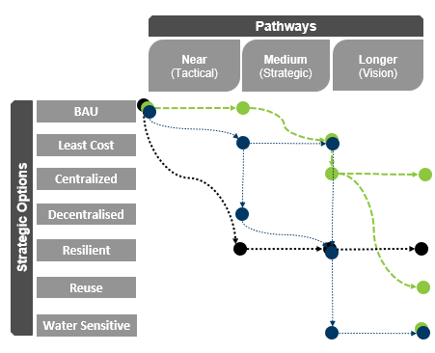
Adaptive pathways planning
  Embraces uncertainty with ‘multiple plausible futures
  Explores shocks, resilience, and opportunities
  Focuses on “decision points” - may drive a choice
  Identifies “no regrets” and potential “locked in” strategies
  Creates flexibility, and robust, strategies
  Creates a living plan
Notes:
APP results in a living plan with no winners.
The analysis embraces future uncertainty by exploring the impact of ‘multiple plausible futures and potential shocks (climate change, SLR, natural disasters, pandemics, etc.).
APP focuses on “decision points” which may drive a choice to change pathways (including thresholds/tipping points for built and natural systems or other triggers).
Is used to explore shocks and uncertainty to identify synergies “no regrets” and potential “locked in” strategies.
Scenarios are a useful tool for articulating the scale of the challenge, and future uncertainty.
They key thing is really how you then make decisions? How to develop options and solutions in response to multiple scenarios?
This is what we’re all grappling with – how to be resilient, adaptable, etc.
The key concepts in Adaptive pathways planning are:
Robustness – Performs well against multiple futures
Flexibility – If the future starts to change, strategies must be flexible and be able to switch from one path to another.
Adaptive pathways are about the sequencing of actions/options – the pathways of your strategy over time. Thinking about path dependencies and avoiding locking yourself into a particular unwanted future.
Tipping Points – points at which you need to change pathway, when a new action/option needs to be taken/implemented.
Trigger Points – speciﬁes the conditions under which a pre-speciﬁed action to change the plan is to be taken (a decision point with a lead time prior to the tipping point)
It’s a framework for developing, monitoring and implementing responses/solutions/options/strategies that have the ability to respond to multiple futures, and the ability to change options (or pathways) as the future unfolds.

Slide 16
Critical points in the adaptive pathways
Living Plan
Monitor drivers of system change/uncertainty, linked to decision points, to ensure decision makers are well prepared (sometimes called signposts)
Threshold
Option no longer available (e.g. age, capacity, regulatory limit)
Implementation Point
Option is operational
Decision / Trigger Point
Choice is required between options.
Current Option
Non-preferred option
Preferred option
Lead Time
Option Lead Time Includes: Concept planning (technical, community), Project development (approvals, contract), Construction (Design, Construct, Commissioning); and allowance for uncertainty in timing.
Notes:
Motion in this slide: it goes from right to left

Slide 17
Indicative time points:
2022
2025
2030
2035
2040
2045
Current Operation
Phase 1 Eliminate sludge handling capacity constraints and adapt for CEPT
Phase 2 Build drying facility at South Shore
Phase 3A Refurbish half of Jones Island D&D
Phase 3B Refurbish or replace remaining half of Jones Island D&D
Phase 4 Reconfigure existing assets to commence Class A biosolids production at South Shore
Phase 5 Incorporating pyrolysis and producing biochar at South Shore
Phase 6 Incorporate pyrolysis and produce biochar at Jones Island. Cease Milorganite production
Legend
 | Decision Point
 | Implementation Point
 | Tipping Point
 | Ideal Path
 | Lead Time
 | Reg. Tipping Pt (Risk)
 | Reg. Tipping Point Path
Load growth will make current operation unviable past 2025
Decision to proceed already made
High risk relying on JI D&D dryers beyond end of life in 2030, without any SS dryer capacity
4 years
Decision point soon
5-7 years
Decision point 1 yr before completion of Phase 2, to be ‘shovel-ready’ when Phase 2 works are completed
2-4 years
Decision point 1 yr before completion of Phase 3A, to be ‘shovel-ready’
All existing JI D&D dryers will need refurb or replacement before 2035
2-4 years
(a)
Policy/new regulations prohibit disposal of Class B Biosolids
(a), (b) and (c) – if regulations enacted before ideal decision point, MMSD to re-evaluate options and adapt pathway
Decision in time to coincide with completion of Phase 3B
1 year
(b)
New regulations prohibit disposal of Class A biosolids w/o PFAS destruction
5 years
Decision point when/if business case (economic or organizational) is established for biochar rather than Class A biosolids at South Shore
Adaptive Path if new regulations are enacted
(c)
Regulations prohibit land application of Milorganite (e.g., PFAS regulations)
7+ years
Notes:
Chemically Enhancd Primary Treatment

Slide 18
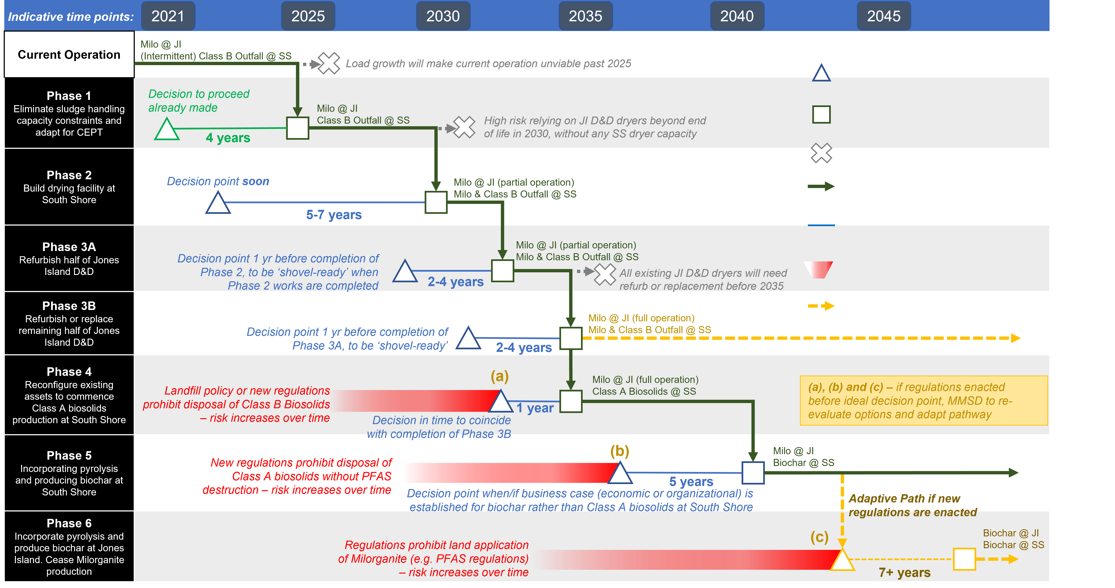
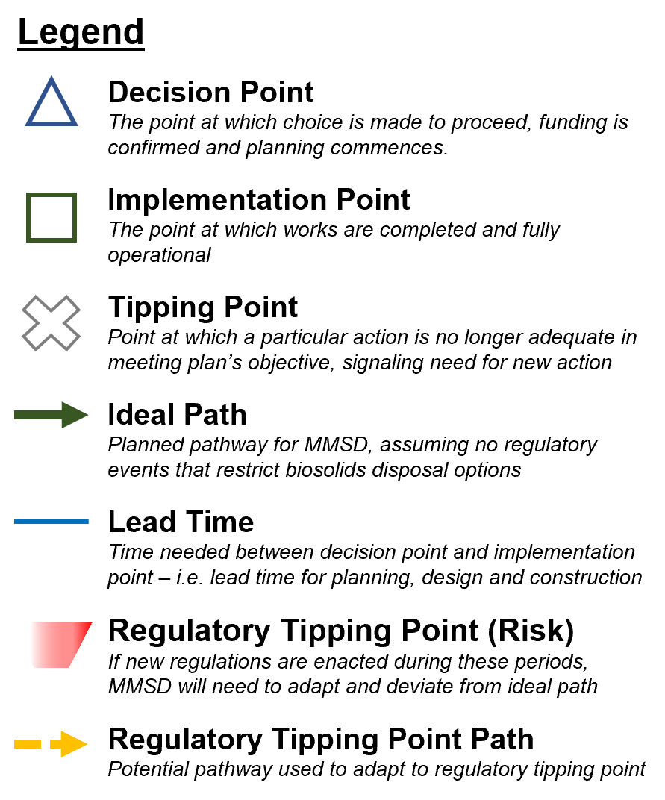
High risk relying on JI D&D dryers beyond end of life in 2030, without any SS dryer capacity
Eliminate sludge treatment capacity constraints.
  Execute sludge thickening anaerobic digestion projects at SSWRF.
  Convert SS dewatering process to a continuous flow system compatible with a future dryer technology.
  Conduct pilot testing to define a preferred SS dryer and gain confidence in the products.
  Construct Milorganite® bagging facility at JIWRF.
  JIWRF sludge thickening and dewatering improvements.

Slide 19
Prepare for major D&D construction.
  Construct a SSWRF drying facility to relieve capacity from JIWRF, allowing for future D&D construction.
  Add capacity to SSWRF sludge thickening and dewatering facilities.
  Construct biosolids storage facility at SSWRF.

Slide 20
All existing JI D&D dryers will need refurb or replacement before 2035
  Rehabilitate half of the D&D Facility dryers.

Slide 21
  Depending on experience with the SSWRF dryers, proceed with one of the options below:
    Continue to rebuild the other half of D&D
    Replace with new dryers
    Expand SSWRF
  Improvements to SSWRF sludge thickening and the IPS.

Slide 22
  Maximize biosolids reuse.
  Increase capacity of the SSWRF drying facility to produce Class A product.
  Increase capacity of SSWRF biosolids storage.
  Pilot test pyrolysis systems.

Slide 23
  Maximize energy production and renewable energy usage.
  Construct SSWRF pyrolysis facilities.

Slide 24
  Adjust to PFAS regulations, discontinue Milorganite®.
  Expand anaerobic digestion to digest WAS.
  Expand pyrolysis at both WRFs.

Slide 25
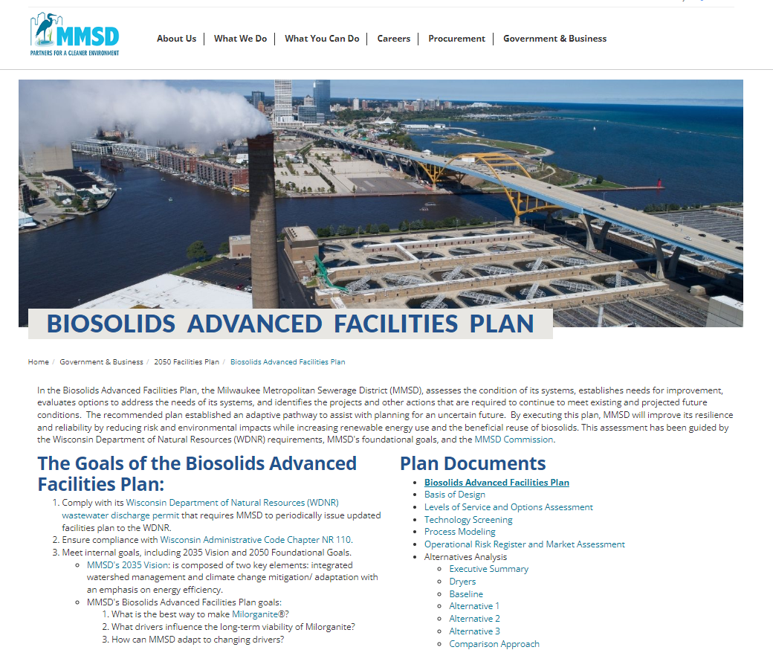

Next Steps
Plan has been approved by the MMSD Commission and WDNR
Phase 1 is currently being initiated, starting with a pilot for evaluating technologies/suppliers
https://www.mmsd.com/government-business/2050-facilities-plan/biosolids-advanced-facilities-plan

Slide 26




