Slide 1
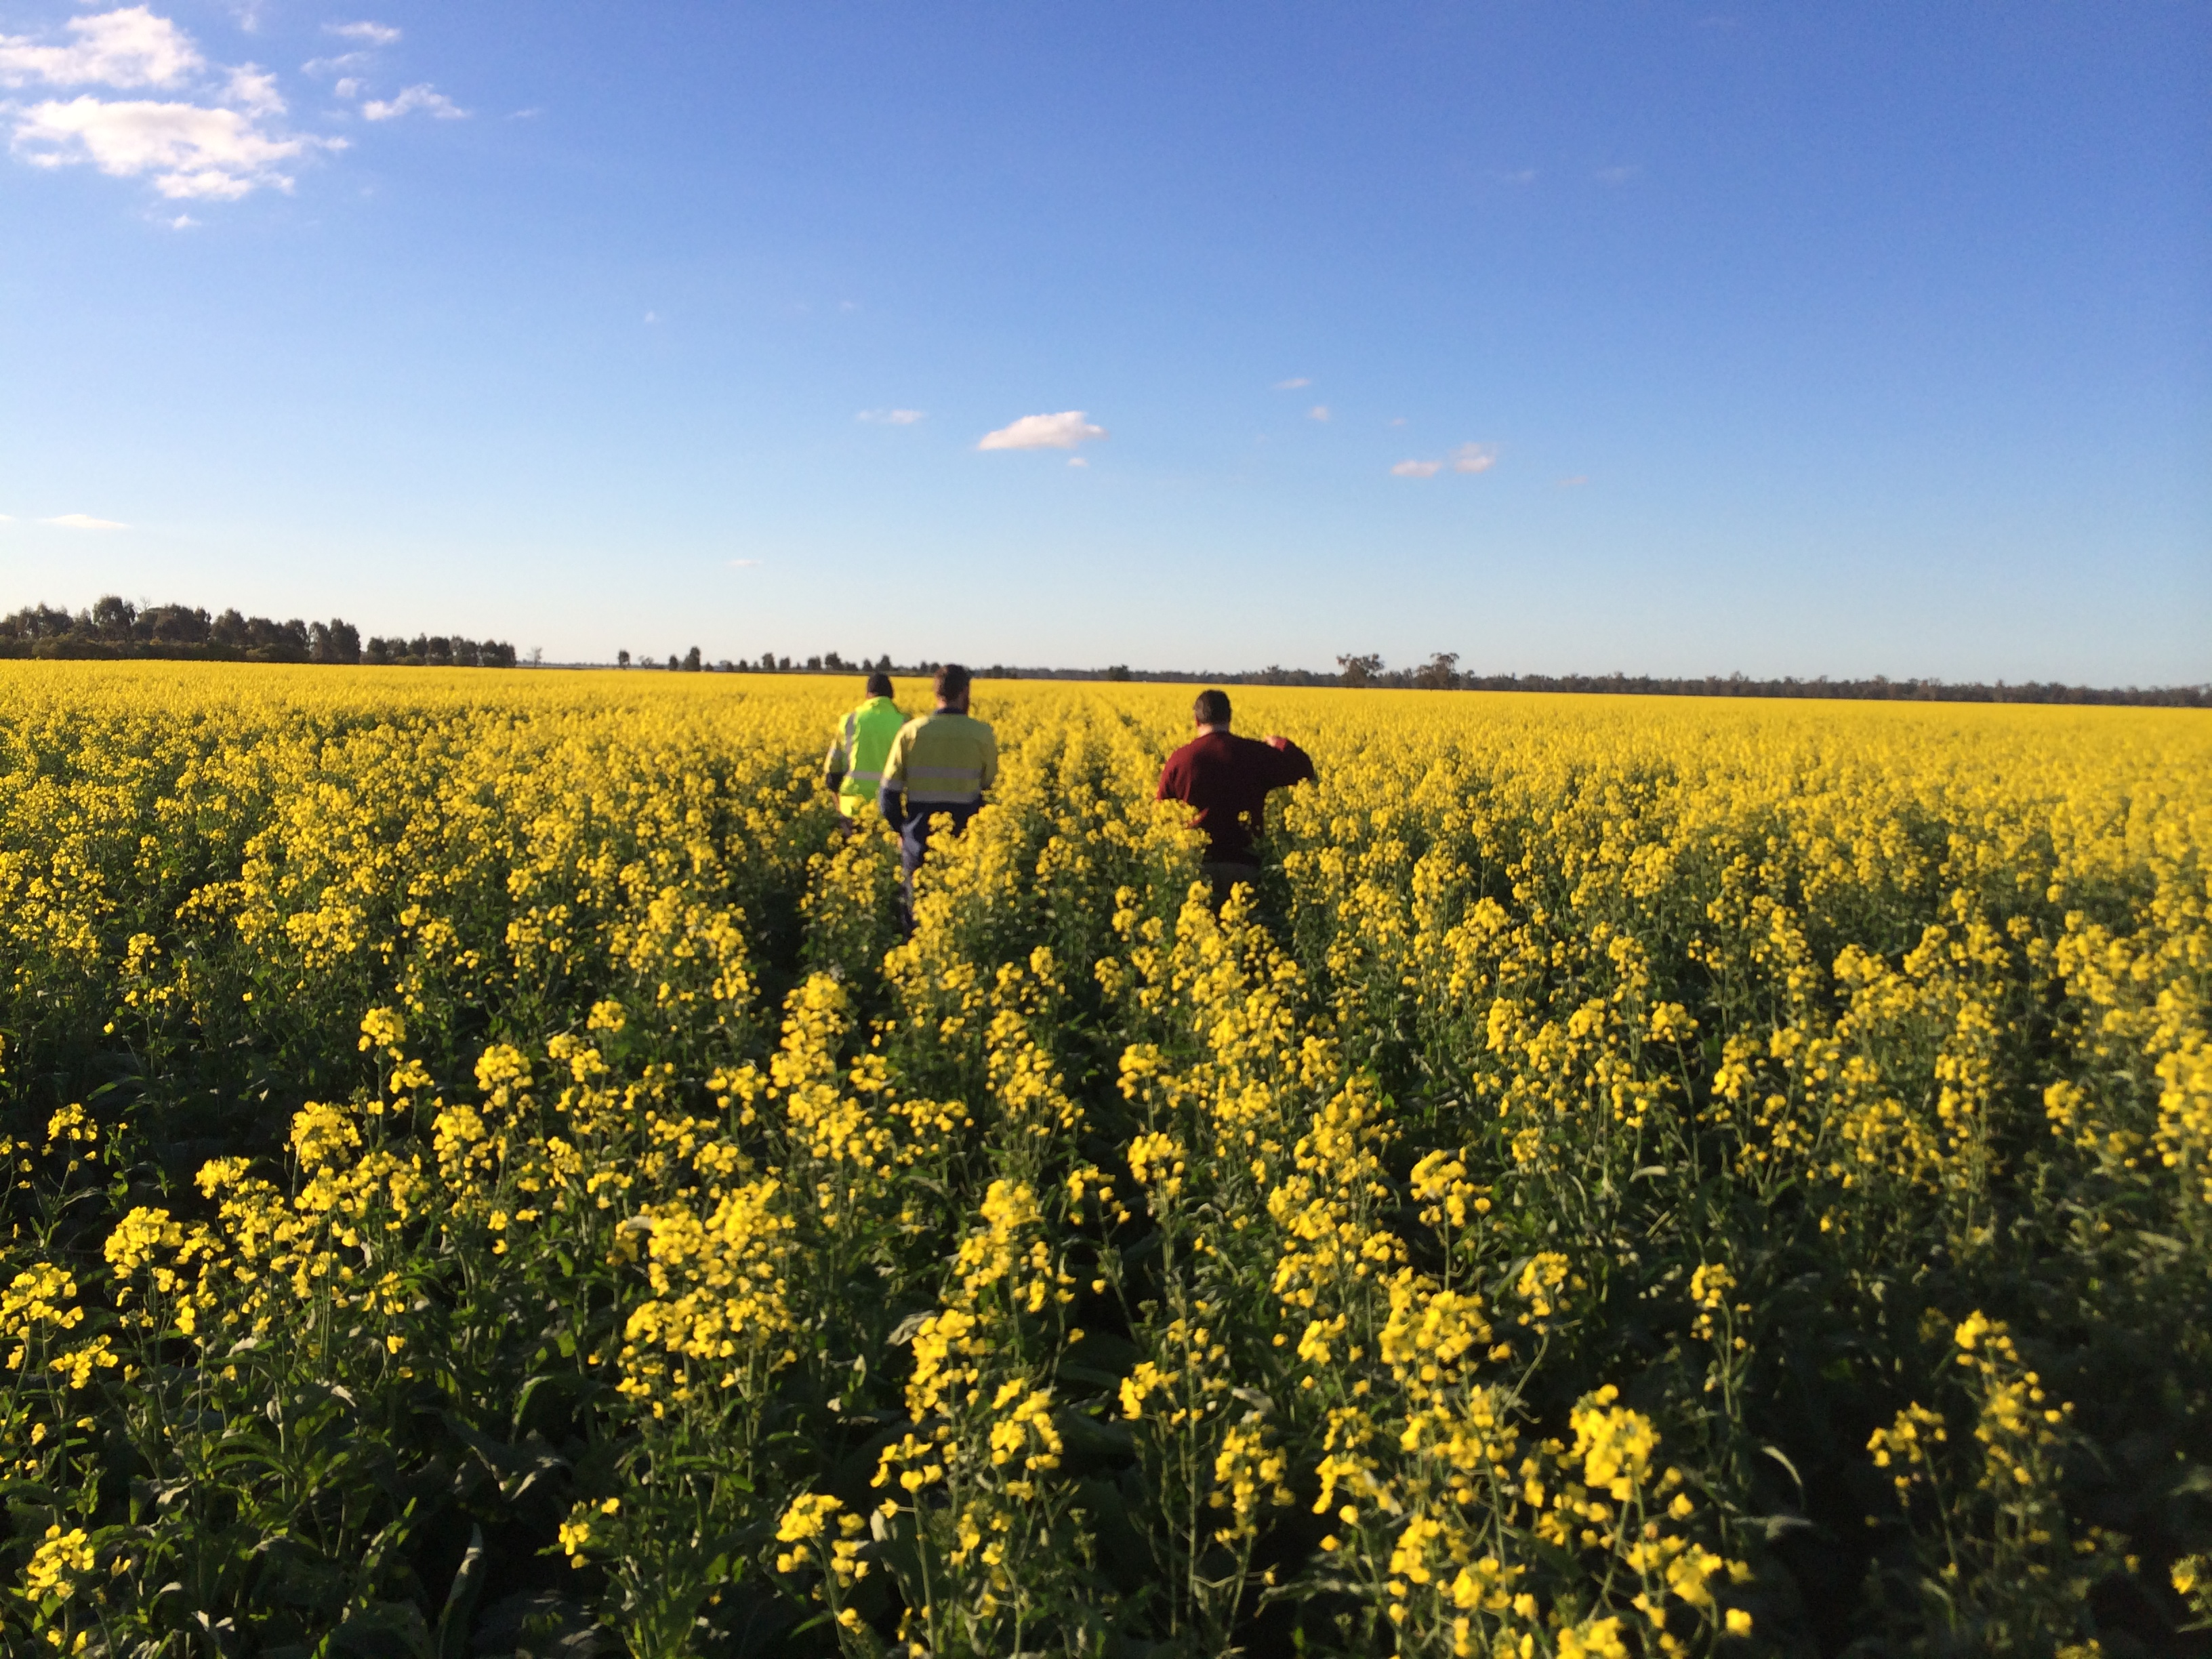



Screening-level Waste Life Cycle Assessment
To:
for the identification of environmental hotspots in biosolids processing
Jingwen Luo
Ruth Fisher Tommy Wiedmann

Slide 2
Fill in the Blanks
Yoshida et al., (2018) Life cycle assessment of sewage sludge management options including long-term impacts after land application
Energy
Polymer
Emission to air, soil, water
Energy
Emission to air
Energy
Mix sludge
Anaerobic digestion
Dewatering
Transportation
Land
application
Electricity to grid
Reject water
Fertiliser substitution
Land application
Electricity substitution
Fertiliser substitution
Mesophilic AD
Mechanical dewatering
Agricultural land
Process heat is provided by the utilisation of biogas
Treatment of reject water were considered to be the same as for the treatment of wastewater
Sandy loam soil under an average Danish precipitation regime
Reject water treatment
Transportation
Biosolids processing
97 % of biogas is used for electricity production at efficiency of 37.5%
Calcium ammonium nitrate, triple superphosphate, potassium chloride
Notes:
The graph is based on results from a LCA study by Yoshida et al., (2018), an outstanding researcher in the area of applying LCA in biosolids processing. This study is based on data from a large scale WWTP in Greater Copenhagen area, Denmark.

Slide 3


Background
Preliminary Treatment
Stabilisation
Moisture Removal
Post-treatment
“Waste”
“Resource”
Thickening
AD
Dewatering
Composting
Land application
Chemical treatment
Aerobic digestion
Thermal drying
Thermal technologies
Construction material
Lime Stabilisation
Hydrothermal technologies
Activated carbon
Emerging pollutants???
Sustainability Implication ???
Energy/resource recovery???

Slide 4










Life cycle assessment
What is LCA ?
Life Cycle Assessment (LCA) quantifies ecological and human health impacts of a product or system over its complete life cycle.
A powerful tool
LCA considers diverse environmental impacts from different stages and prevents against “burden shifting”
Research gap
An updated comprehensive LCA of different biosolids processing options in an Australian context is still lacking

Slide 5

Fill in the Blanks
Energy
Polymer
Emission to air, soil, water
Energy
Emission to air
Energy
Mix sludge
Anaerobic digestion
Dewatering
Transportation
Land
application
Reject water treatment
Electricity to grid
Reject water
Fertiliser substitution
Land application
Electricity substitution
Fertiliser substitution
LCA
Impact
Hidden
Reject water treatment
Transportation
Biosolids processing
Benefit
Notes:
The graph is based on results from a LCA study by Yoshida et al., (2018), an outstanding researcher in the area of applying LCA in biosolids processing. This study is based on data from a large scale WWTP in Greater Copenhagen area, Denmark.

Slide 6
Methodology
LCA methodology
Goal and scope definition
Results interpretation
Inventory analysis
Impact assessment

Slide 7
Methodology
Results interpretation
Functional unit: The processing of 1000 kg of biosolids on a dry matter basis
System boundary: All processes after the thickening up to the final beneficial utilisation or disposal
Goal and scope definition
Inventory analysis
Data source: Literature data, Ecoinvent database AusLCI database
Software: EASETECH (Environmental Assessment System for Environmental Technologies)
LCIA method: Based on the International Reference Life Cycle Data System (ILCD) handbook
Impact category: Global Warming Potential 100 years (GWP) and Human Toxicity Potential (HT) (cancer effect and non-cancer effect)
Impact assessment

Slide 8
Methodology
Results interpretation
Sensitivity analysis:
Parameter tested:
Biogas generation rate
Dewater biosolids moisture content
Transportation distance
N₂O emission rate after land application
Biosolids Zn content
Methodology:
The sensitivity ratio is calculated as the ratio of the degree of change in the result to the degree of change in the parameter
Maximum and minimum value from literature

Slide 9



Methodology
Electricity
GHG
Electricity
Emission
GHG/Heavy metal
Thickened
Biosolids
Anaerobic digestion
Dewatering
T
Land application
S1
Fuel
Electricity recovery
Fertiliser substitution; carbon sequestration
Electricity
GHG
Electricity
Emission
Emission
Emission
Thickened
Biosolids
Anaerobic digestion
T
Dewatering
Incineration
Landfill
S2
Fuel
Electricity recovery
Fuel, Electricity
Electricity
GHG
Electricity
Fuel, Electricity
Emission
GHG/Heavy metal
Thickened
Biosolids
Anaerobic digestion
T
Land application
S3
Dewatering
Drying
Pyrolysis
Fuel
Electricity recovery
Fuel, Electricity
Heat recovery from products
Fertiliser substitution; carbon sequestration

Slide 10
Methodology
Electricity
GHG
Electricity
Emission
GHG/Heavy metal
Thickened
Biosolids
Anaerobic digestion
Dewatering
T
Land application
S1
Fuel
Electricity recovery
Fertiliser substitution; carbon sequestration
Mesophilic AD with SRT of 13 days; centrifuge dewatering
Biosolids composition data and the processing flow diagram were taken from an operational study at a secondary WWTP in Sydney
Process data for AD and dewatering were sourced from Alvarez-Gaitan et al. (2016), which used the same case study location.
C, N, P distribution in the land application stage were sourced from Bruun et al. (2016) based on Danish conditions; urea and monoammonium phosphorus (MAP) were assumed to be displaced

Slide 11
Data source
Electricity
GHG
Electricity
Emission
Emission
Emission
Thickened
Biosolids
Anaerobic digestion
T
S2
Dewatering
Incineration
Landfill
Fuel
Electricity recovery
Fuel, Electricity
Process data for incineration was based on a full-scale fluidised bed incinerator reported by Yoshida et al. (2018) equipped with electrostatic precipitation, wet scrubbers, and a sludge dryer
The landfill process from EASETECH were used to model the associated environmental impacts
Mass balance and the distribution of heavy metals through incineration were modelled based on data from literature

Slide 12
Data source
Electricity
GHG
Electricity
Fuel, Electricity
Emission
GHG/Heavy metal
Thickened
Biosolids
Anaerobic digestion
T
Land application
S3
Dewatering
Drying
Pyrolysis
Fuel
Electricity recovery
Fuel, Electricity
Heat recovery from products
Fertiliser substitution
The material balance data for pyrolysis was based on a pyrolysis experiment by Chen et al. (2021) in a tube furnace under 500 °C with a heating rate of 10 ◦C/min and a residence time of 30 min under the final temperature.
The thermal energy consumption during pyrolysis and prior drying was calculated based on empirical equations; the electricity consumption data from an industrial pyrolysis furnace reported in the literature was used
The gaseous and liquid pyrolysis products were assumed to be utilized to offsite heat from natural gas

Slide 13
Results

Slide 14
Results
CO₂
N₂O
N₂O
CO₂

Slide 15
Results

Slide 16
Results
Biogas generation rate
Dewatered biosolids solids content
Transportation distance
N2O emission rate for land application
Zn content in biosolids
Some operational parameters can bring large impacts to the assessment results
The importance of some locally relevant parameters cannot be over looked

Slide 17
Conclusion and Future Perspective
S3 (AD-Pyrolysis-land application) has the best performance compared to other two scenarios in terms of global warming potential and human toxicity cancer effect
Some key operational and locally relevant parameters (e.g. biogas generation rate and N and C balance after land application) can bring large influence to the assessment results
There is a need for collaboration with the industry to refine biosolids processing and composition data as well as studies into land application of biosolids, specifically carbon and nitrogen balance and fertiliser offsets
In future studies, the scope of the assessment will be expanded to include more biosolids processing scenarios, impact indicator, operating conditions; expand system boundary and use Australian specific data

Slide 18
Acknowledgment
This research is funded by:
ITTC for Transformation of Australia’s Biosolids Resource Project IC190100033
UNSW University International Postgraduate Award (UIPA) scholarship
Petre Foundation scholarship
Thank you for support and advice:
My industry mentor: Joel Edwards - thinkstep-anz

Slide 19

Thank You !!!

