Slide 1
Towards the production of least contaminant grade biosolids and biochar via mild acid pre-treatment
Presented at the 2023 ANZBP National Biosolids Conference
By
Ibrahim Hakeem
3rd year PhD Candidate (Chemical Engineering)
ibrahim.hakeem36@yahoo.com
Supervisors:
Prof Kalpit Shah A/Prof Jorge Paz-Ferreiro
Dr Aravind Surapaneni
08 February 2023

Slide 2
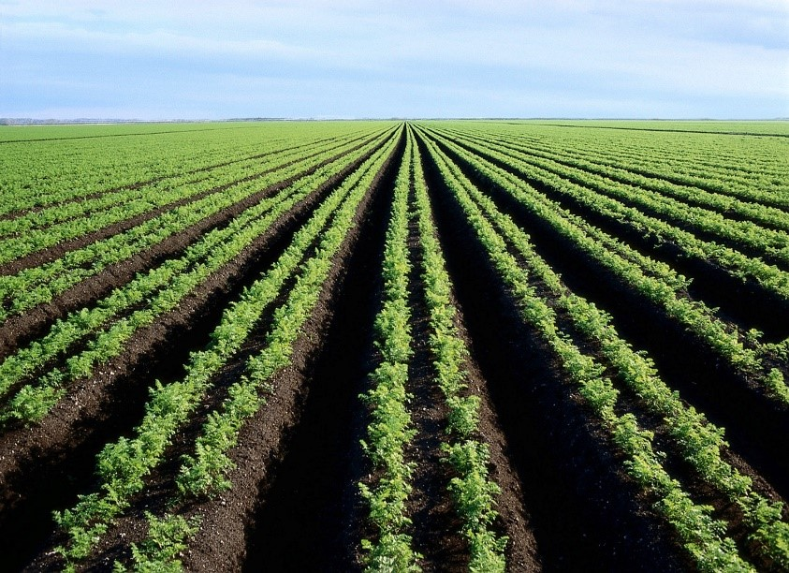
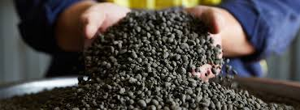
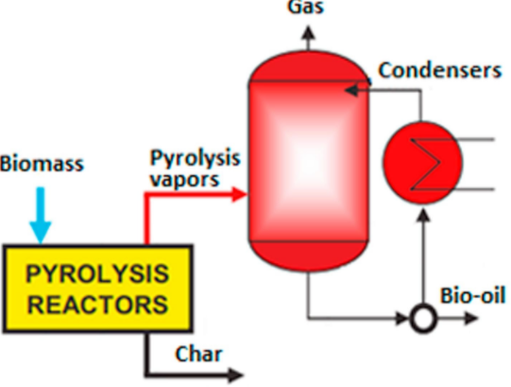
Background
Organic matter (40-60 wt%)
Inorganic matter (20-60 wt%)
Microplastics
Inert -Silicates
Ash-forming elements
Heavy metals
PFAS
Heavy metals
https://cbsupplements.com/cc/collagen-peptides-heavy-metals/
A multi-residue analytical method for extraction and analysis of pharmaceuticals and other selected emerging contaminants in sewage sludge - Analytical Methods

Slide 3
Methodology Design
Bio-oil: Platform chemicals
Dry biosolids
Biosolids pre-treatment
Treated biosolids
Biosolids pre-treatment
Pyrolysis
Chemical solvents
For land application
High-grade biochar
Solvent type: acids, oxidising agents, chelating agents
Solvent concentration: 1-5% v/v
Solids concentration: 1-20% w/v
Temperature: 25-100 ºC
Stirring speeds: 300-900 rpm
Residence time: 5-180 mins
Leachate
Metals Recovery

Slide 4
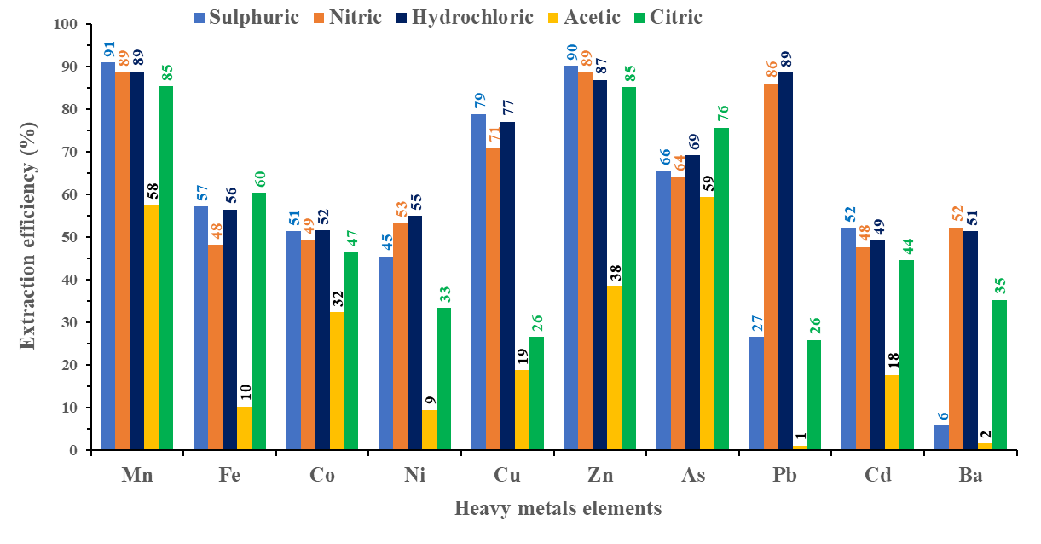
Metals removal from biosolids
Table 1: Composition of raw biosolids
Major and trace elements (mg/kg)
Ca | Mg | Na | K | Al | Fe | Mn | Mo | Ba
44215.3 | 6352.2 | 4747.3 | 6423.8 | 5305.6 | 15133.6 | 273.0 | 5.8 | 229.9
Controlled heavy metals (mg/kg)
 | Cr | Ni | Pb | Cd | As | Co | Cu | Zn
This study | 21.4 | 35.4 | 23.6 | 1.9 | 3.6 | 3.13 | 1239.8 | 1075.1
C1-grade* | 400 | 60 | 300 | 1 | 20 | - | 100 | 200
C2-grade* | 3000 | 270 | 500 | 10 | 60 | - | 2000 | 2500
Minerals components (wt%)
CaO | MgO | K₂O | Al₂O₃ | SiO₂ | SO₃ | P₂O₅ | Fe₂O₃ | Na₂O
13.2 | 1.0 | 1.2 | 1.7 | 7.1 | 2.9 | 3.3 | 5.7 | 0.3
*according to EPA Victoria biosolids guidelines
Fig. 1: Effect of acid type
Cd
Cu
Ni
Fig. 2: Effect of process variables

Slide 5
Prospects for critical metals recovery
NaOH/H₂O₂
Recycled leachate
Conc. leachate
Leachate purification pH 4.5
Metal sludge 1
Leachate purification and HMs recovery:
Case 1: 2-step NaOH co-precipitation
Case 2: H₂O₂ oxidation pre- NaOH co-precipitation
Case 3: Single step NaOH co-precipitation
Case 4: Biochar sorption
3% v/v acid solution
Metals extraction
NaOH
HMs recovery pH 9.0
Metal sludge 2
Dry biosolids
Treated biosolids
Effects of solids concentration: 1-20% w/v
Clarified liquid
Leachate
Extraction conditions:
Temperature - 25 ºC
Time - 30 min
Stirring speeds - 600 rpm

Slide 6
Results: Metal recovery
H₂SO₄ consumption of 0.56 g/g dry biosolids
NaOH consumption of 0.50 g/g dry biosolids.
Metal sludge recovery was 0.166 g/g dry biosolids.
Composition (wt%) of metal sludge 1 is 10.7% Fe, 8.8% Na, 8.2% S, 7.9% P, and 5.5% Al
Metal sludge 2 is 13.1% Na, 12.5% S%, 12.4% Ca, 6.0% P, and 3.3% Mg.
Fig 3: Metal recovery under different methods
Table 2: Metal concentration (mg/kg) in the treated biosolids
Nutrient wt% in the treated biosolids
Elements | As | Cd | Co | Cu | Cr | Fe | Mn | Mo | Ni | Pb | Zn
Raw biosolids | 3.6 | 1.3 | 3.1 | 690 | 20 | 13000 | 210 | 8 | 18 | 20 | 850
5% Treated biosolids | 1.2 | 0.4 | 1.0 | 170 | 14 | 6900 | 10 | 9 | 7 | 18 | 22
10% Treated biosolids | 1.7 | 0.7 | 1.4 | 220 | 14 | 7700 | 17 | 9 | 8 | 18 | 48
C-1 grade | 20 | 1 |  | 100 | 400 |  |  |  | 60 |  | 200
C | N | K | P
35.4 | 5.6 | 1.1 | 1.2
32.9 | 5.5 | 0.4 | 0.6

Slide 7
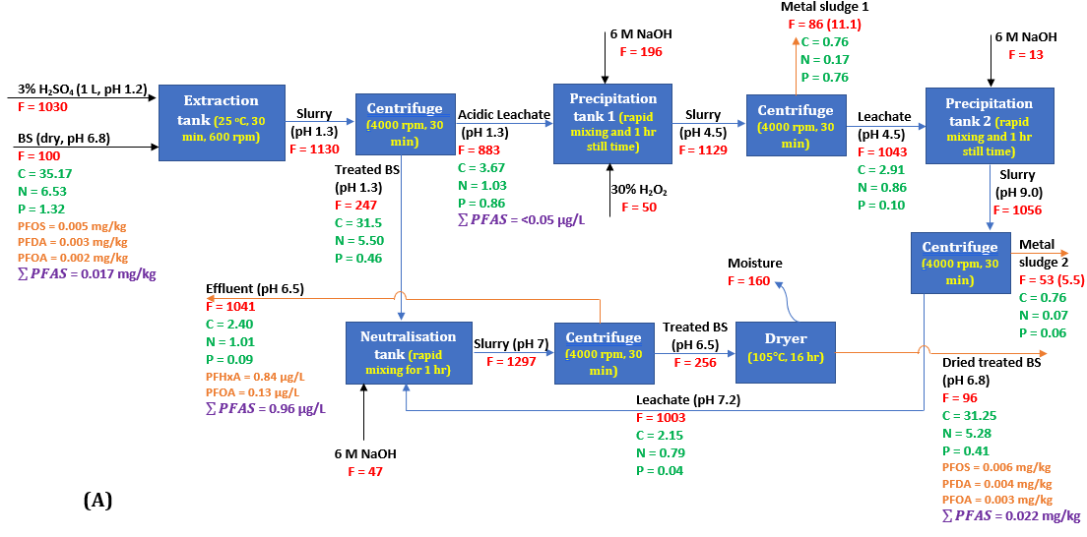
Process flow diagram – Mass balances
Fig 3: Process configuration and mass balances to process 10% solids

Slide 8
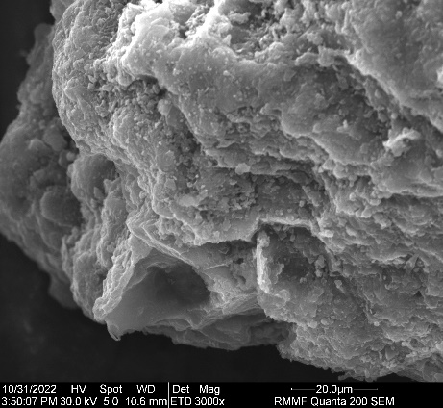
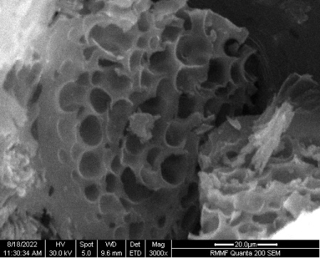
Biochar from pre-treated biosolids
Table 3: Effects of pre-treatment on biochar properties
Samples |  | C1-grade* | RBB@500 ℃ | TBB@500 ℃
Biochar yield (wt%) |  |  | 50.7 | 39.6
HMs concentration (mg/kg)
As | 20 |  | 5.3 | 3.9
Cd | 1 |  | 2.9 | 1.3
Cr | 400 |  | 40.9 | 28.9
Cu | 100 |  | 2335.2 | 619.6
Ni | 60 |  | 58.3 | 29.4
Pb | 300 |  | 41.8 | 42.3
Zn | 200 |  | 2045.2 | 209.5
Total AAEMs (g/kg) |  |  | 133.2 | 53.67
Ash contents (wt%) |  |  | 52.3 | 41.0
Fixed carbon (wt%) |  |  | 17.6 | 27.7
Volatile matter (wt%) |  |  | 29.3 | 30.7
C (wt%) |  |  | 32.8 | 41.7
H (wt%) |  |  | 1.0 | 1.5
N (wt%) |  |  | 5.5 | 5.6
O/C (polarity) |  |  | 0.18 | 0.13
H/C (aromaticity) |  |  | 0.37 | 0.43
Calorific value (MJ/kg) |  |  | 10.7 | 15.0
Carbon retention (%) |  |  | 44.8 | 51.1
Surface area (m²/g) |  |  | 55.1 | 106.9
RBB
TBB

Slide 9
Key Takeaways
Mild sulfuric acid treatment of biosolids can remove 60-85% heavy metals, 70-90% of ash forming elements, and preserve organic nutrients
Cu remain the limiting element to achieve the production of C-1 grade biosolids for unrestricted land application
About 60-95% of dissolved metal can be recovered for potential applications in smelting, inorganic fertiliser, catalysis, and adsorption
Pre-treatment enhanced the production of high quality biochar from biosolids

Slide 10
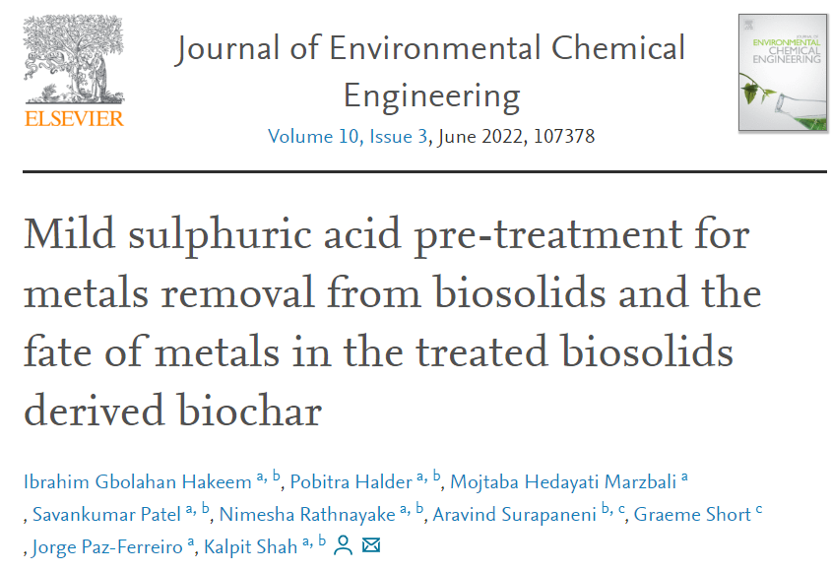
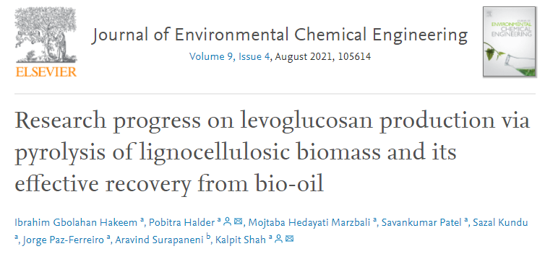
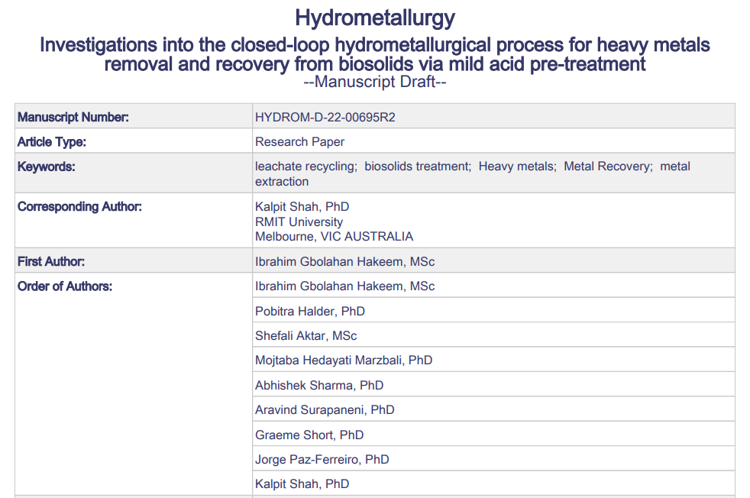
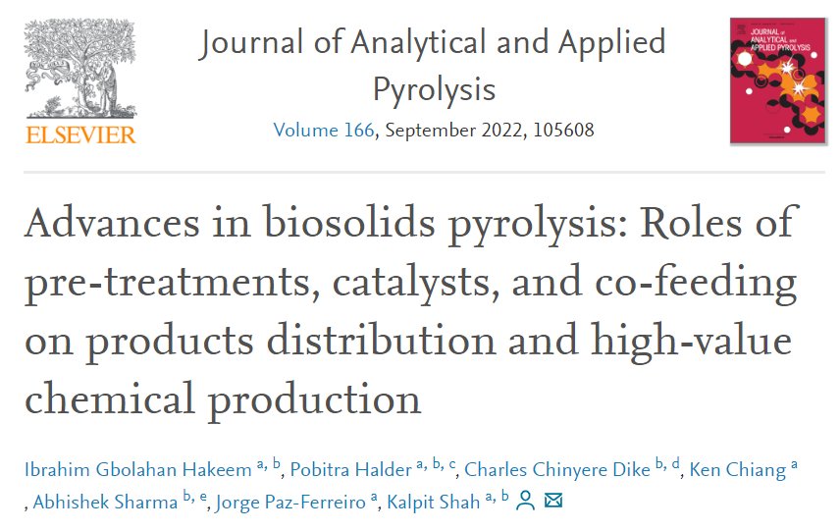
Publications

Slide 11
Acknowledgements
Paul Darvodelsky Scholarship
Supervisory Team led by Prof Kalpit
ARC Transforming Biosolids Training Centre Top-Up Scholarship
School of Engineering, RMIT University Top-Up Scholarship
South East Water Corporation for Resources and Consultation
RMIT University for HDR Scholarship

Slide 12
Thank you
Let’s get connected
s3822367@student.rmit.edu.au ibrahim.hakeem36@yahoo.com
LinkedIn
Google Scholar

