Slide 1



City of Gold Coast
Provision of Professional
Services
IT’S NOT ALL ABOUT TECHNOLOGY – A JOURNEY OBTAINING ORGANISATIONAL SUPPORT FOR BIOSOLIDS MANAGEMENT INNOVATION
Elena Mejia Likosova, Kelly Hopewell, Graham Gloag, Cameron Staib
ANZBP National Biosolids Conference
8-9 February, 2023 Sydney

Slide 2


  Stantec’s Journey by Chern’ee Stutton
  Stantec acknowledges the Traditional Custodians of Country throughout Australia and their connections to the land, waters, and communities where we work.
  We pay our respect to their Elders past, present and emerging, and extend that respect to all Aboriginal and Torres Strait Islander peoples.
Kombumerri (Gold Coast)
Jagera and Turrbul (Brisbane)
The Gadigal of the Eora Nation (Sydney)
Acknowledgement of Country
Notes:
I would like to begin by acknowledging the Jagera, Turrbul, Kombumerri and Gadigal of the Eora Nation people, Traditional Custodians of the land on which we meet today, and pay my respects to their Elders past and present. I extend that respect to the Aboriginal and Torres Strait Islander peoples here today.

Slide 3
Take Home Message:
Key Message
The City of Gold Coast has now approved progression to a Business Case for a Centralized Biosolids Facility!

Slide 4
CoGC Biosolids Management Journey Timeline
2
CoGC Biosolids Timeline
Resilience…
Centralised Biosolids Facility Feasibility Study (2007)
Allconnex Water CBF Scoping Study (2012)
GC Bioresources Stage 3: Detailed Market & Strategy Analysis (2018)
Integrated Waste Planning Program: Biosolids Stabilisation Masterplan (2020)
Commissioning of COGEN 1 at Coombabah STP (2022)
GC Bioresources: Initial Product/ Market Review (2017)
2007-2011
2012-2016
2017-2021
NOW
Short Term Biosolids Management (2008)
Commissioning of Anaerobic Digestion of WAS at Coombabah STP (2012)
GCW Biosolids Management Options Finalization (2013)
GC Bioresources Stage 2: Preliminary Market Analysis (2017)
Coombabah STP Stage 6 – Additional Dewatering: Centrifuge Trial (2019)
Coombabah STP Covered Drying Beds Assessment (2022)
Biosolids Masterplan Addendum and CBF Business Case (2022)

Slide 5
Coombabah STP Long Term Master Plan Layout
Proposed CBF Site
Reserved space for Biosolids upgrade

Slide 6
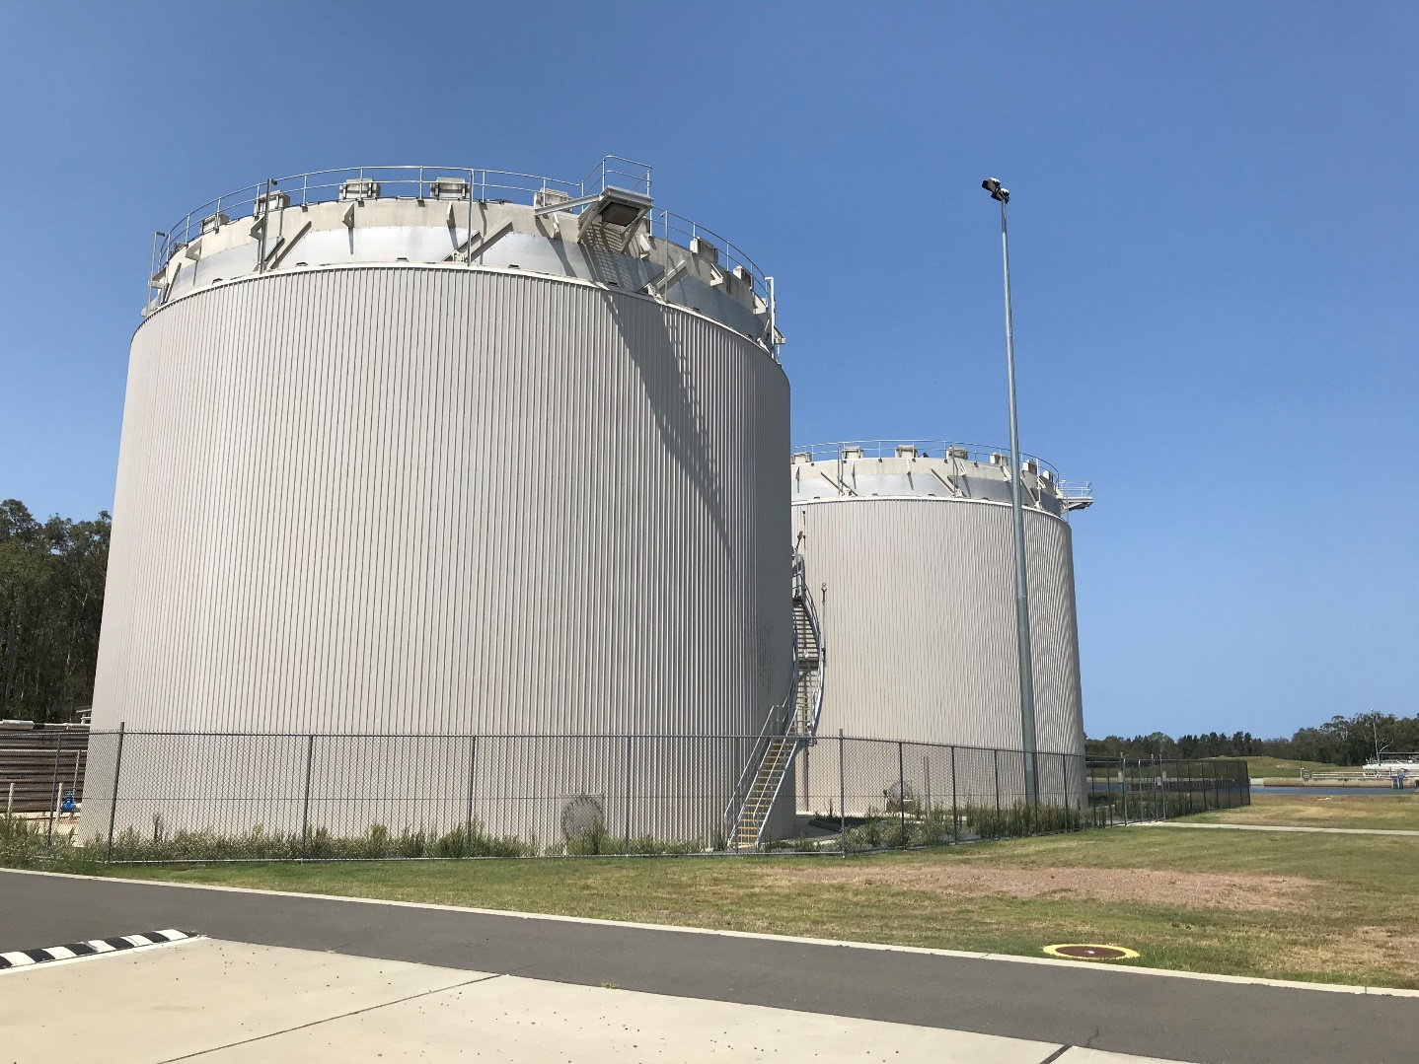
Coombabah STP Anaerobic Digesters 1&2 (Commissioned in 2012)
Coombabah STP AnD

Slide 7
CoGC Biosolids Management Journey Timeline
2
CoGC Biosolids Timeline
Resilience…
Centralised Biosolids Facility Feasibility Study (2007)
Allconnex Water CBF Scoping Study (2012)
GC Bioresources Stage 3: Detailed Market & Strategy Analysis (2018)
Integrated Waste Planning Program: Biosolids Stabilisation Masterplan (2020)
Commissioning of COGEN 1 at Coombabah STP (2022)
GC Bioresources: Initial Product/ Market Review (2017)
2007-2011
2012-2016
2017-2021
NOW
Short Term Biosolids Management (2008)
Commissioning of Anaerobic Digestion of WAS at Coombabah STP (2012)
GCW Biosolids Management Options Finalization (2013)
GC Bioresources Stage 2: Preliminary Market Analysis (2017)
Coombabah STP Stage 6 – Additional Dewatering: Centrifuge Trial (2019)
Coombabah STP Covered Drying Beds Assessment (2022)
Biosolids Masterplan Addendum and CBF Business Case (2022)

Slide 8
STPs Stabilisation Process, Dewatering Technology and Biosolids Grade in 2019
Technology Trials
STP | Stabilisation Process | Dewatering Technology | Biosolids Grade
 |  |  | Stabilisation | Contaminant
Coombabah | Anaerobic Digestion of Thickened WAS (TWAS) | BFP plus drying beds of dewatered digested sludge | B | C
Pimpama | Extended aeration and barrier method | GDD/BFP of WAS | B | B
Merrimac | Extended aeration and barrier method | GDD/BFP of WAS | B | B
Elanora | Anaerobic Digestion of Primary Sludge and WAS | BFP of digested sludge | B | C

Slide 9
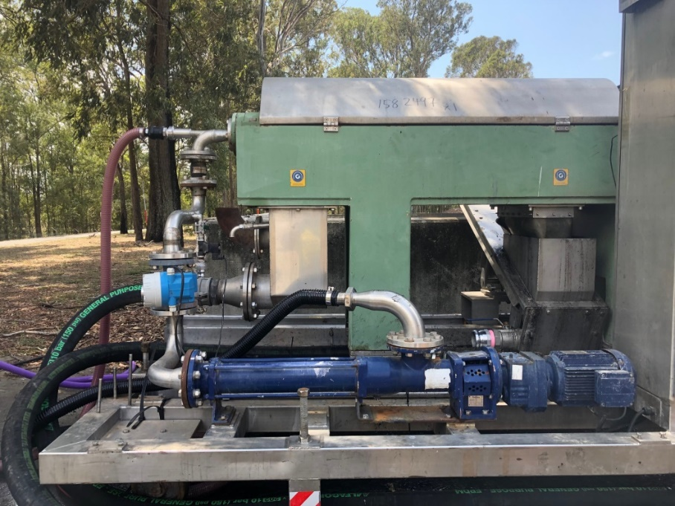
Technology Trials - Dewatering
Technology Trials
Activated Chemical Dosing Line
Water Flushing Supply
Flocculated Sludge
Dry Cake
Centrate
Digested Sludge Feed Supply
Cake Drain
Coombabah STP Centrifuge Trial Assembled Skid (2019)
Coombabah Centrifuge Trial – Relationship between Solids Loading Capacity, Hydraulic Capacity and Centrifuge Dewatering Performance

Slide 10
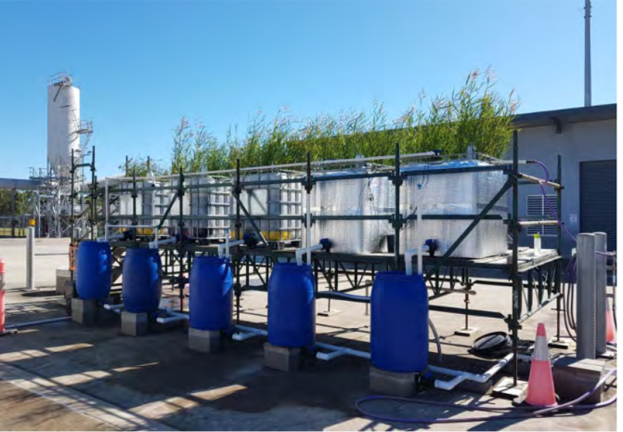
Other Technology Trials
Technology Trials
Pimpama Sludge Treatment Reed Beds Pilot Facility (2018-2019)
DehydrisTM Twist Pilot Unit at Merrimac STP (2018-2019)

Slide 11
CoGC Biosolids Management Journey Timeline
2
CoGC Biosolids Timeline
Resilience…
Centralised Biosolids Facility Feasibility Study (2007)
Allconnex Water CBF Scoping Study (2012)
GC Bioresources Stage 3: Detailed Market & Strategy Analysis (2018)
Integrated Waste Planning Program: Biosolids Stabilisation Masterplan (2020)
Commissioning of COGEN 1 at Coombabah STP (2022)
GC Bioresources: Initial Product/ Market Review (2017)
2007-2011
2012-2016
2017-2021
NOW
Short Term Biosolids Management (2008)
Commissioning of Anaerobic Digestion of WAS at Coombabah STP (2012)
GCW Biosolids Management Options Finalization (2013)
GC Bioresources Stage 2: Preliminary Market Analysis (2017)
Coombabah STP Stage 6 – Additional Dewatering: Centrifuge Trial (2019)
Coombabah STP Covered Drying Beds Assessment (2022)
Biosolids Masterplan Addendum and CBF Business Case (2022)

Slide 12
2020 BSM Preferred Option: CBF at Coombabah STP without Elanora STP
BSM 2020
BSM Preferred Option
THICKENING
STABILIZATION
DEWATERING
DRYING
Coombabah STP
Centrifuge
Advanced digestion (based on THP)
Centrifuge and BFP
Partial drying bed or solar dryer
To Reuse
Merrimac STP*
Centrifuge (if onsite)
Pimpama STP*
Centrifuge (if onsite)
Elanora STP
DAF
Anaerobic Digestion
BFP, centrifuge or piston press
To Reuse

Slide 13
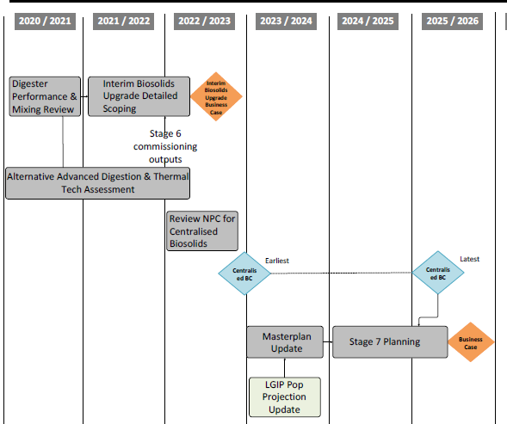
Agreed Roadmap to CBF
BSM 2020
BSM Preferred Option

Slide 14
CoGC Biosolids Management Journey Timeline
2
CoGC Biosolids Timeline
Resilience…
Centralised Biosolids Facility Feasibility Study (2007)
Allconnex Water CBF Scoping Study (2012)
GC Bioresources Stage 3: Detailed Market & Strategy Analysis (2018)
Integrated Waste Planning Program: Biosolids Stabilisation Masterplan (2020)
Commissioning of COGEN 1 at Coombabah STP (2022)
GC Bioresources: Initial Product/ Market Review (2017)
2007-2011
2012-2016
2017-2021
NOW
Short Term Biosolids Management (2008)
Commissioning of Anaerobic Digestion of WAS at Coombabah STP (2012)
GCW Biosolids Management Options Finalization (2013)
GC Bioresources Stage 2: Preliminary Market Analysis (2017)
Coombabah STP Stage 6 – Additional Dewatering: Centrifuge Trial (2019)
Coombabah STP Covered Drying Beds Assessment (2022)
Biosolids Masterplan Addendum and CBF Business Case (2022)

Slide 15
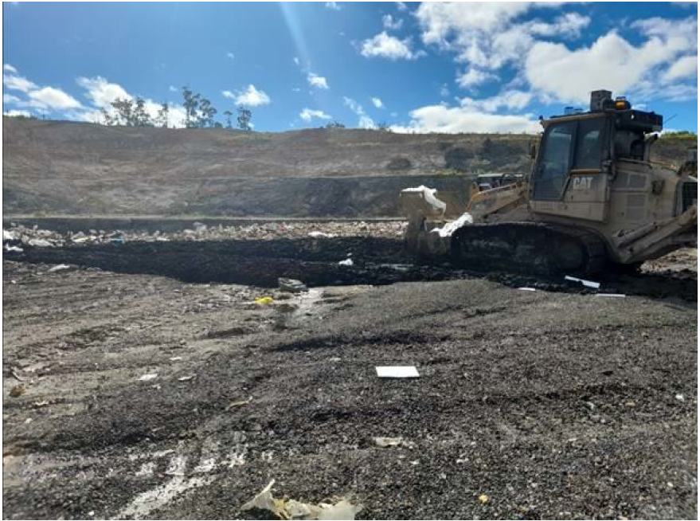
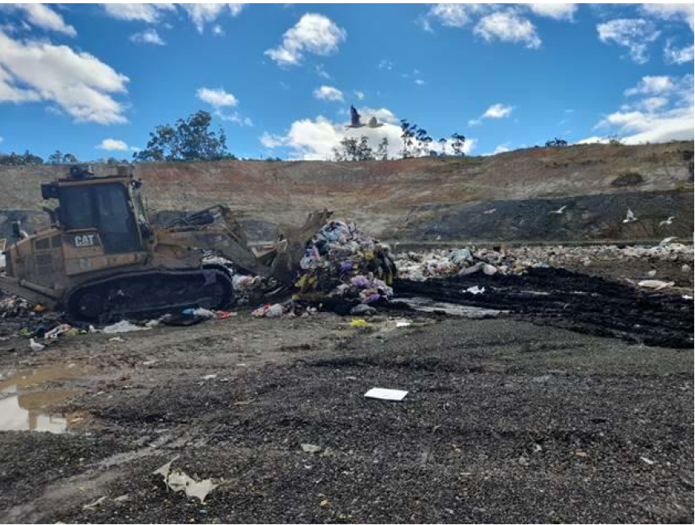
2022 Floods: CoGC’s Current Biosolids Management Practice Resilience
Coombabah STP Drying Beds
Biosolids Unloaded from the truck directly onto the tip pad.
General Waste blended into the stockpile of biosolids

Slide 16
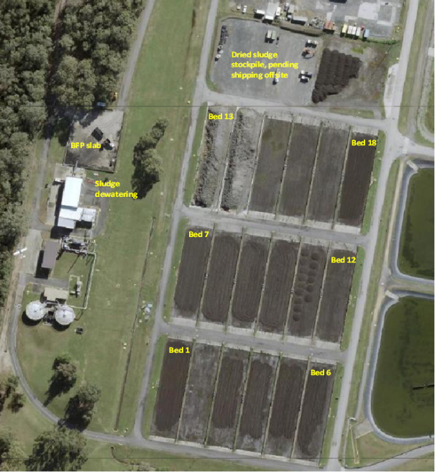
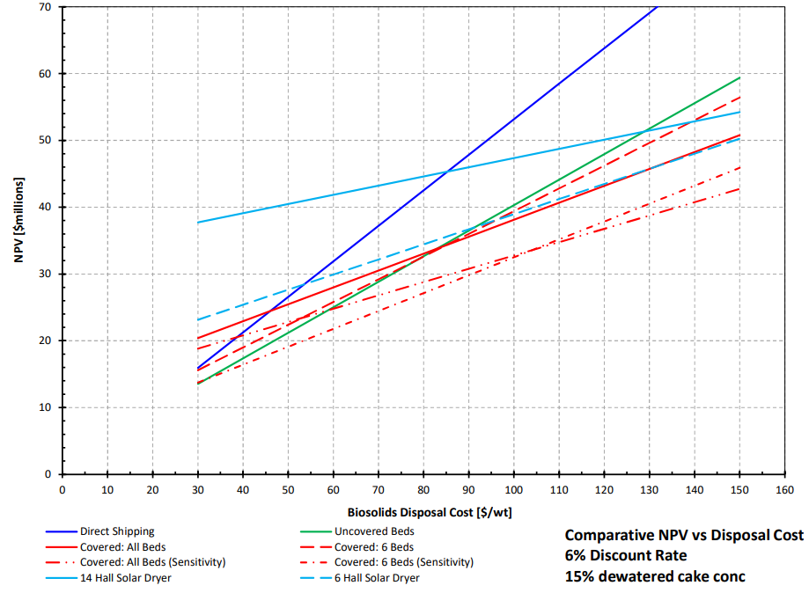
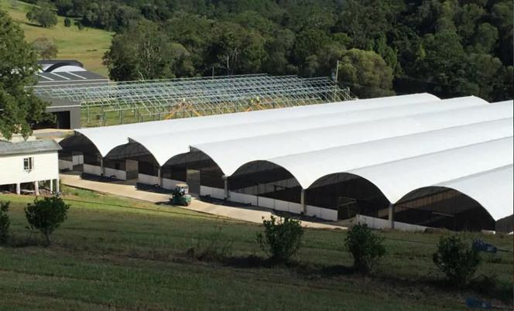
2022 Floods: CoGC’s Current Biosolids Management Practice Resilience
Coombabah STP Drying Beds
Coombabah STP Drying Beds
Coombabah STP – Covering of Drying Beds NPV Assessment Sensitivity to Disposal Cost
BC to design and construct greenhouse-like structure to cover 2 of the 18 existing sludge drying beds has been approved!

Slide 17
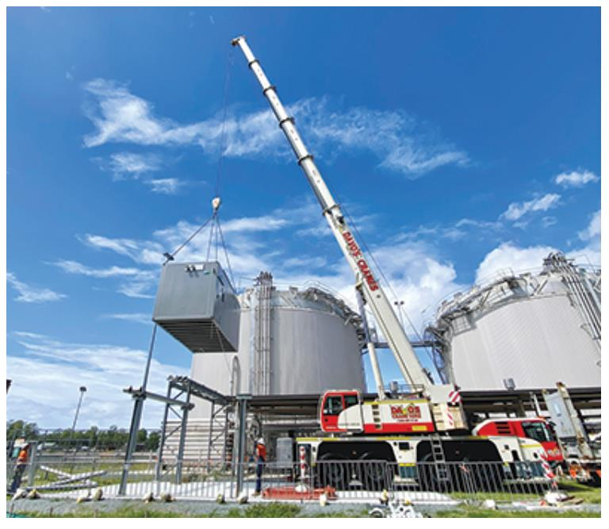
Coombabah STP COGEN 1 Commissioned in 2022
Coombabah STP COGEN 1

Slide 18
CoGC Biosolids Management Journey Timeline
2
CoGC Biosolids Timeline
Resilience…
Centralised Biosolids Facility Feasibility Study (2007)
Allconnex Water CBF Scoping Study (2012)
GC Bioresources Stage 3: Detailed Market & Strategy Analysis (2018)
Integrated Waste Planning Program: Biosolids Stabilisation Masterplan (2020)
Commissioning of COGEN 1 at Coombabah STP (2022)
GC Bioresources: Initial Product/ Market Review (2017)
2007-2011
2012-2016
2017-2021
NOW
Short Term Biosolids Management (2008)
Commissioning of Anaerobic Digestion of WAS at Coombabah STP (2012)
GCW Biosolids Management Options Finalization (2013)
GC Bioresources Stage 2: Preliminary Market Analysis (2017)
Coombabah STP Stage 6 – Additional Dewatering: Centrifuge Trial (2019)
Coombabah STP Covered Drying Beds Assessment (2022)
Biosolids Masterplan Addendum and CBF Business Case (2022)

Slide 19
BSM Addendum→ CBF BC
CBF Business Case
Improved Digestion → Reduces Mass and Volume of Biosolids
Volatile Solids Destruction Improved
Dewatered Cake Concentration Increased
Digestion at Coombabah STP + Dewatering at Pimpama and Merrimac STPs
Centralised Thermal Hydrolysis & Digestion
Additional Digestion Capacity Delayed!

Slide 20

Conclusion
It is Certainly Not just ALL about technology:
Changing Disposal Cost
Flood Resilience
Water Reform
Competing Project Delivery Priorities
CBF
Operational Preferences
Organisational Readiness
Net Zero
Climate Change

Slide 21
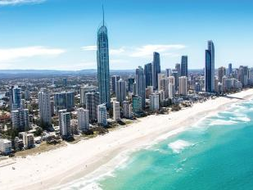

Questions/Discussion
Thank you
Notes:
To be modified by Stantec Graphics

