Slide 1

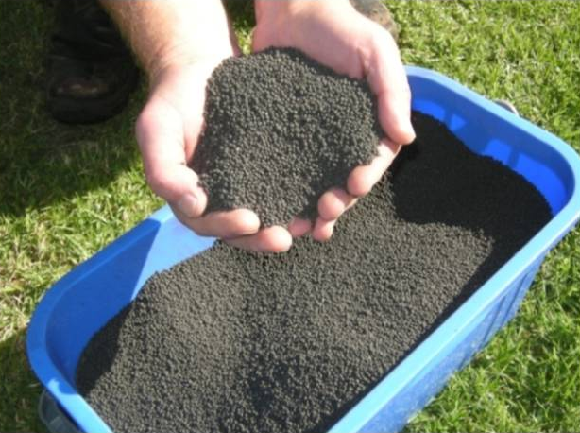

20 Years of Bioboost ® - a New Zealand Story of Beneficial Biosolids Re-Use
Graham Morris (NPDC) & Jessica Daly (BECA)
Notes:
Intro

Slide 2
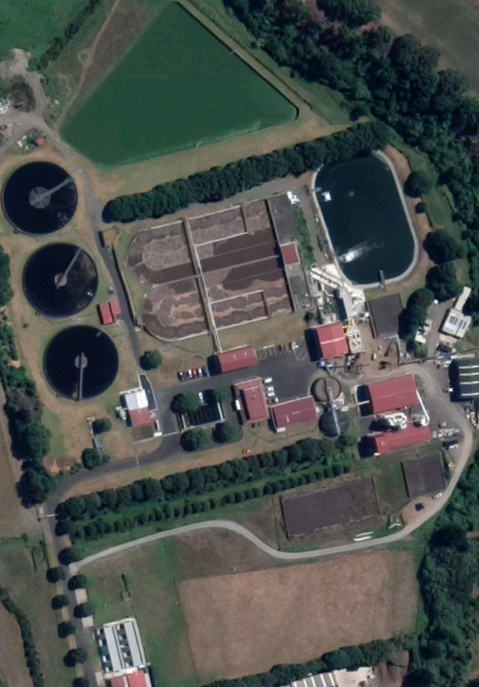
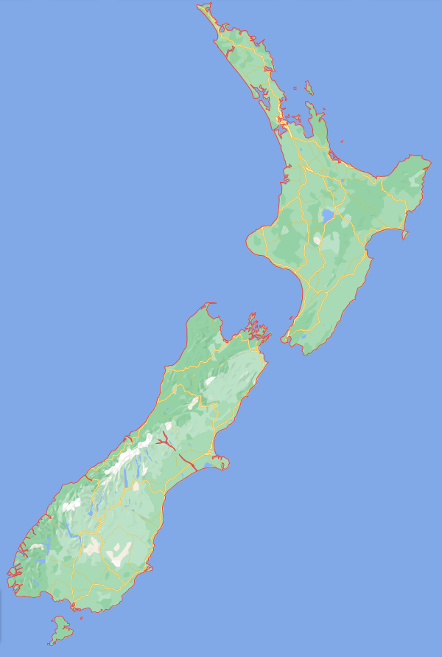
New Plymouth Wastewater Treatment Plant
Notes:
Background

Slide 3
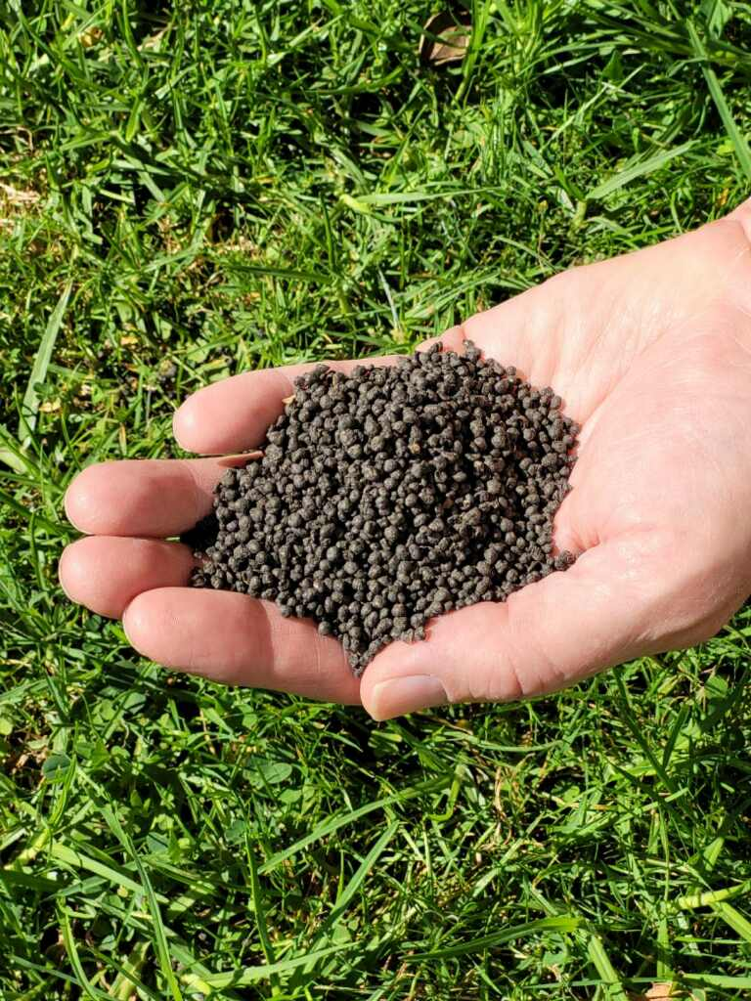
Parameter | Bioboost ®
Production | 1,700T/yr
Size | 2-4mm diameter
Moisture Content | 91% dry solids
Quality | Grade A biosolid
Notes:
What is Bioboost?

Slide 4
How is Bioboost® made?
Natural Gas
Hydrogen
Burner
End Product Silos (91%DS)
Dewatered Sludge (18%DS)
Raw Material Silo
Mixer
Rotary Drum
Cooling Screws
Screen
Crusher
Recycle Silo
Cyclone
Condenser
KO Drum
Biofilter
Notes:
How is it made?
Block flow diagram

Slide 5
Success Factors – Physical Properties
Hard, granular product
2-4mm diameter
Low dust
Organic, slow-release fertiliser – 12-16 week breakdown
Notes:
Success Factor #1 – Good product

Slide 6
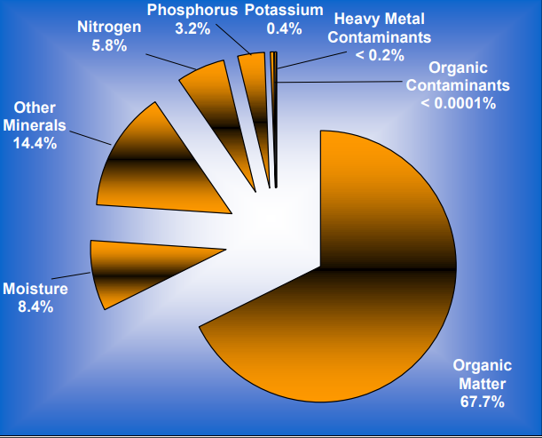
Success Factors – Chemical Properties
NPK + trace nutrients
Low heavy metal concentrations
Low pathogen content
Low moisture content – stable if stored in dry conditions
Grade A biosolid standard in NZ
Notes:
Success Factor #1 – Good product

Slide 7
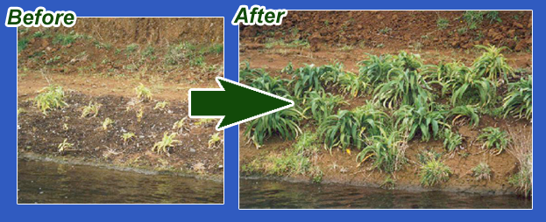
Success Factors
Quality Management – control & consistency of product
Astute Marketing
  Tell the story – beneficial re-use
  Good communication and honesty regarding the product
  Brand champion to market the product
  Treat the product as a valuable commodity
Notes:
Success Factor #2 – consistency and quality control of product

Slide 8
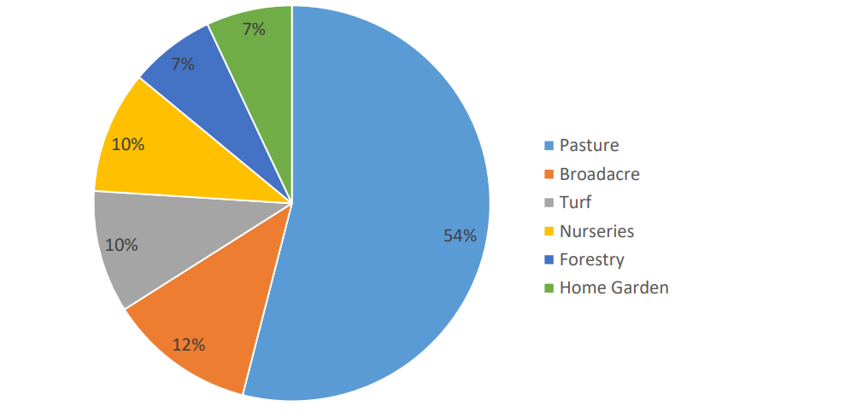
Bioboost’s ® Market
Notes:
Bioboost users

Slide 9
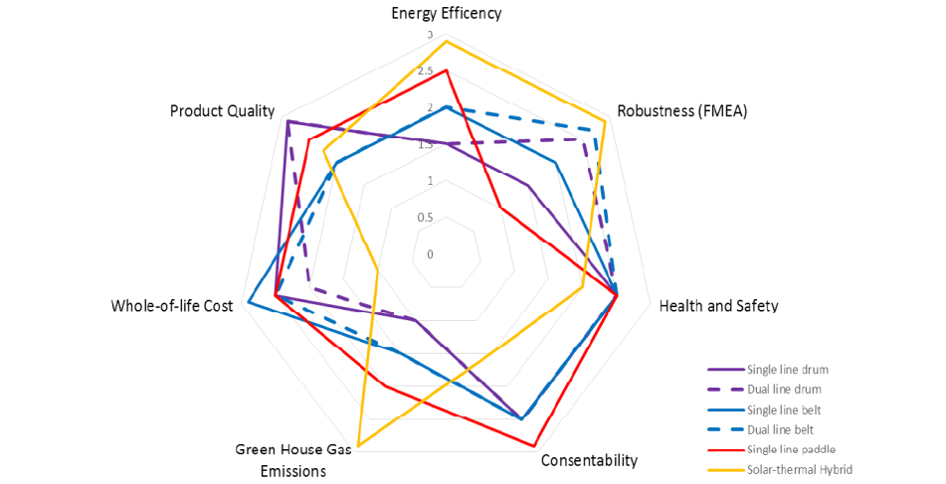
Bioboost ® Next Steps

Slide 10
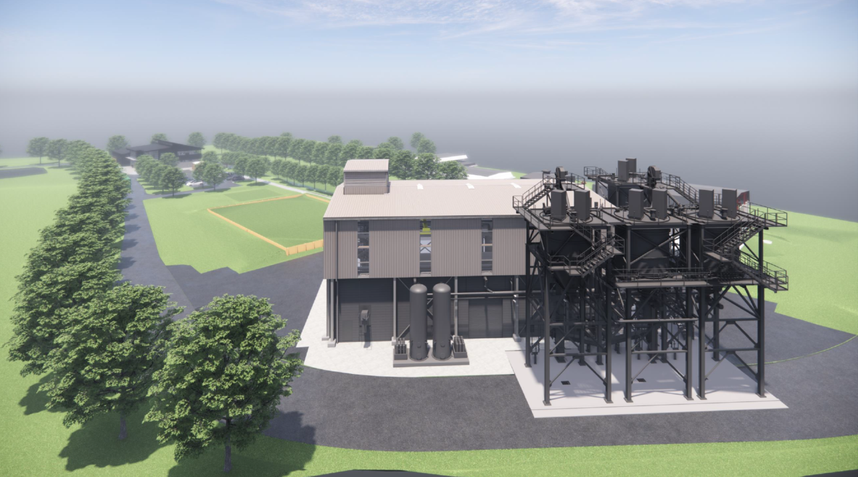
Why H₂?
NPDC plans to decarbonise
Drum dryer process can be co-fired with NG and H₂
Taranaki regional roadmap for green hydrogen
Notes:
Why H2?

Slide 11
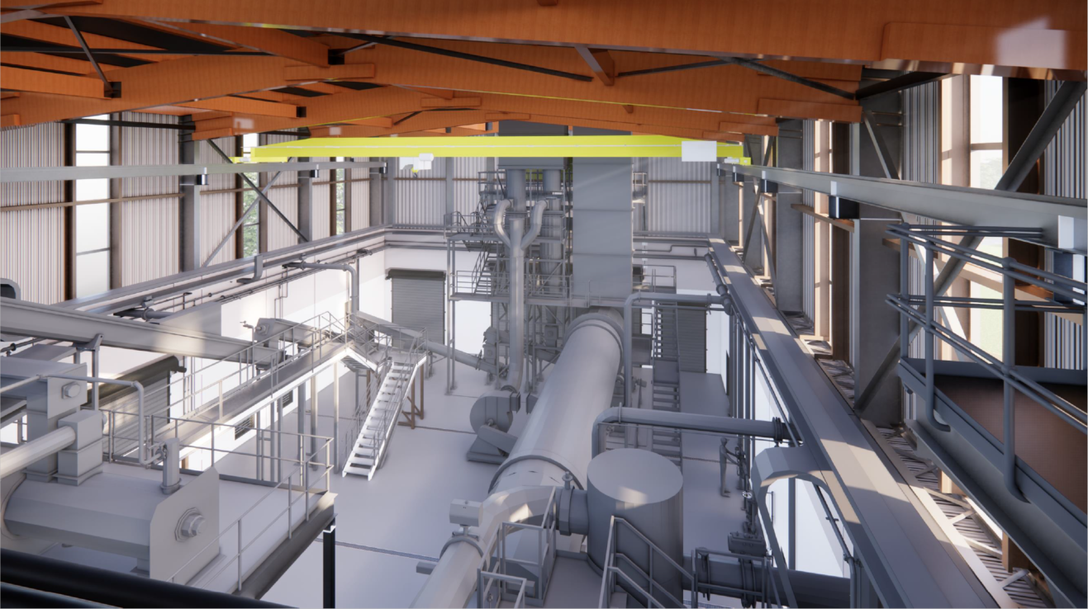
Notes:
Replacement dryer – currently in the end stages of design.
Enabling works began and were completed last year, with construction of the main dryer hall beginning this year

Slide 12
Conclusions
Bioboost ® produced for over 20 years
Critical success factors:
  Consistent, high-quality product in terms of physical and chemical properties
  Astute and continued marketing
New dryer co-fired on hydrogen will allow continued 100% beneficial re-use of biosolids for next 20 years
Notes:
Process of selection for renewal
Why hydrogen?

Slide 13
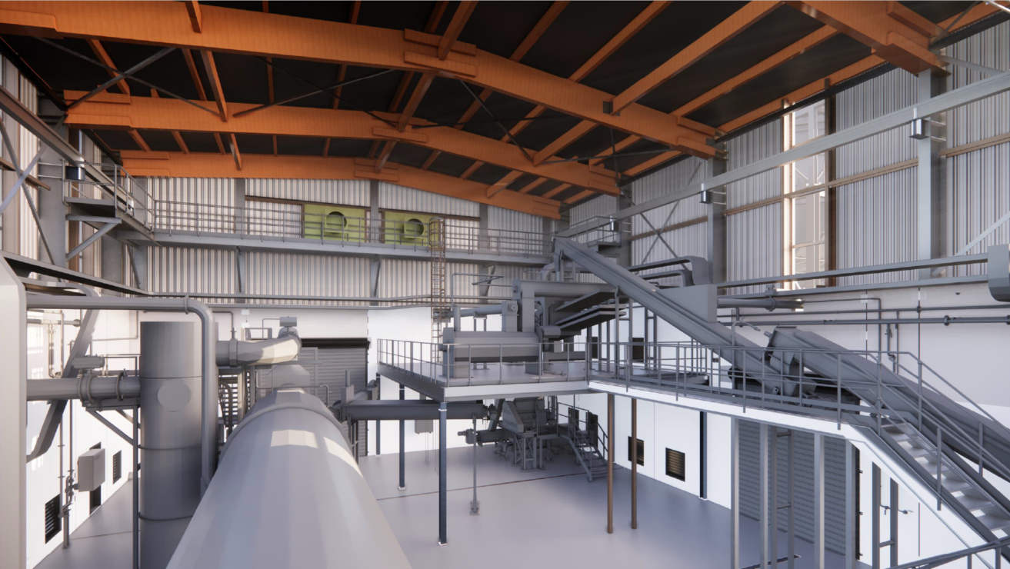
Questions?
Many Thanks to Graham morris Npdc

