Slide 1
Public acceptance in a time of change
ANZBP National Biosolids Conference
9th February 2023
Patrick Bonney, Lauren Rickards, Matthew Kearnes

Slide 2
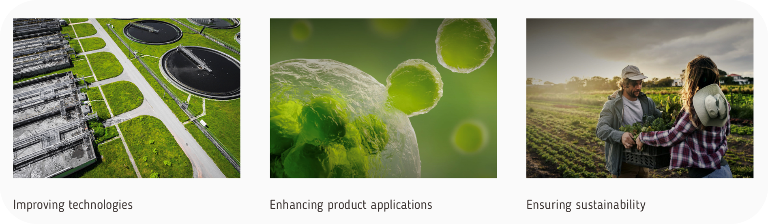
ARC Training Centre for the Transformation of Australia’s Biosolids Resource

Slide 3





Project 3D – ARC Training Centre
Strategic
Economic
Regulatory
Community
Practical/operational
Technological
Research objectives:
To explore the evolution of biosolids strategies and the forces opening and closing different biosolids use pathways in Australia
To explore decision making around biosolids use pathways at the water utility scale in order to identify what is prioritised by whom and why
To assess the challenges, opportunities, and emergent futures at a sectoral level
To embed into biosolids innovation efforts awareness of the dynamic complexities and challenges of biosolids use, changing biosolids use pathways and stakeholder engagement.
BIOSOLIDS MANAGEMENT
Prof Lauren Rickards
RMIT University
Prof Matthew Kearnes
University of New South Wales
Prof Michael Burton
University of Western Australia
Dr Patrick Bonney
RMIT University
Dr James Hayes
University of New South Water

Slide 4
"Forget the science with biosolids management – the biggest issue facing the Australian water industry is not the science; it is public perceptions and how the industry manages these perceptions."
“
- Gale (2007)

Slide 5
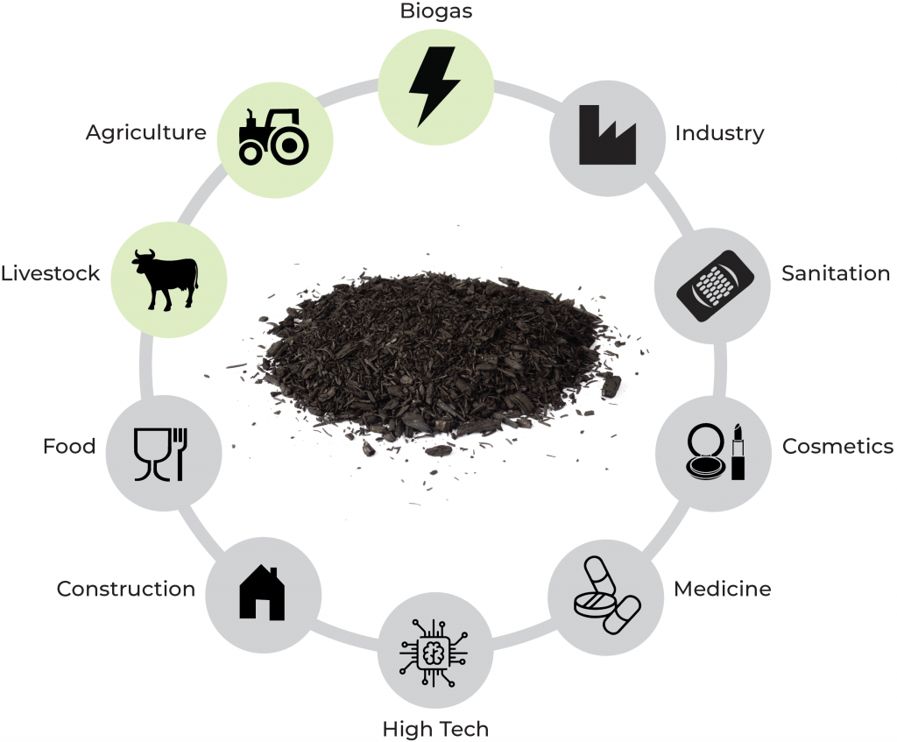
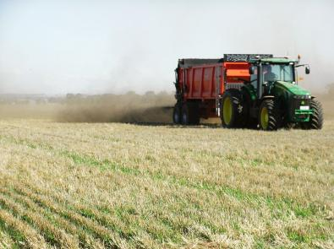
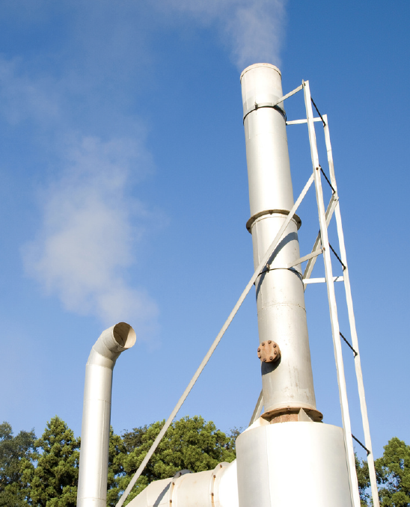
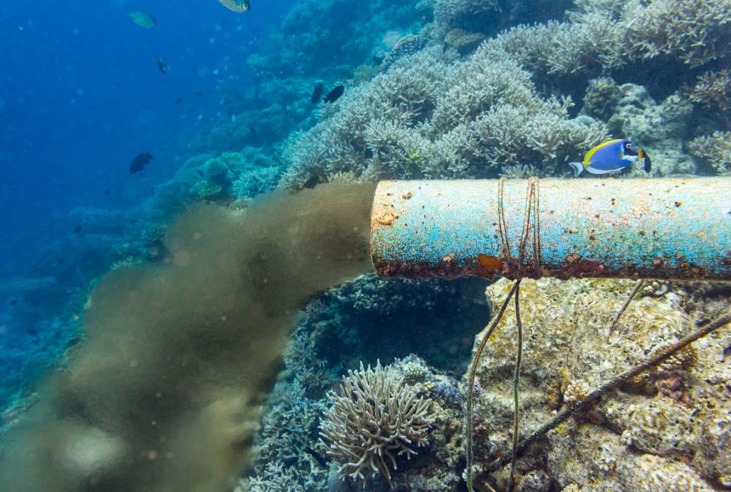
Biosolids evolution: diversification or step change?
Novel reuse pathways e.g. thermal treatment
Land application of biosolids
Implications
Scientific and management uncertainties
Increasing public visibility
Larger number of & greater diversity of stakeholders
Sewage
Disposal
Drivers of change
Technological development and capabilities
Evolving regulations and policy
Shifts in societal concerns and public perceptions

Slide 6
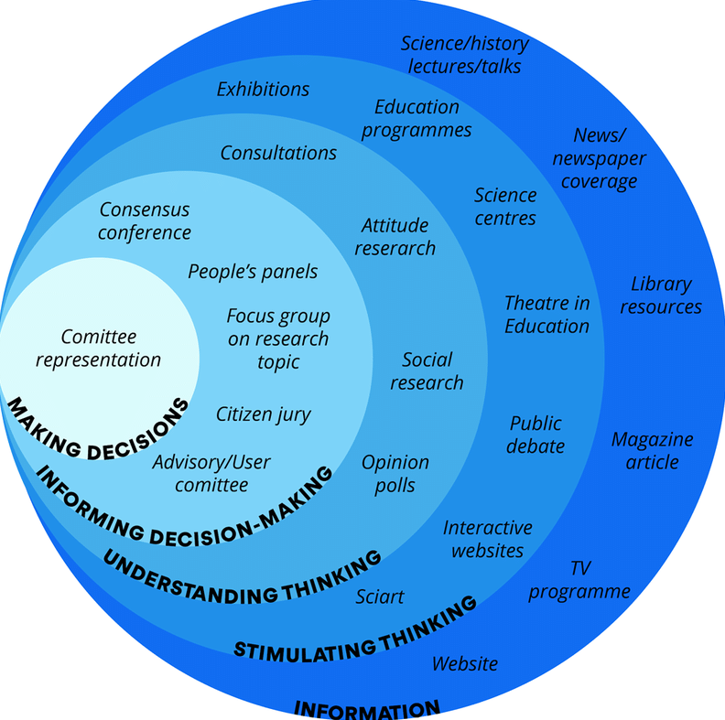
A need to rethink public engagement?
Approaches to public engagement with science (Source: Wellcome Trust)
Who are the “publics” of biosolids management? Who are the stakeholders?
Where are they? What stake do they have?
What are they concerned about? What do they expect?
What forms of engagement are needed?
Public impact on research/policy
Dialogue
Information

Slide 7
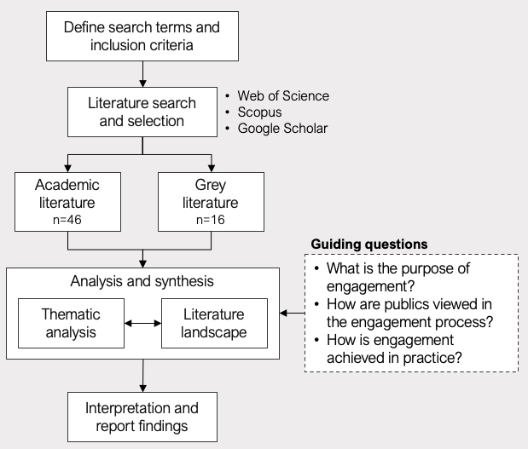
What forms of public engagement with biosolids management have been used to date, and are emerging now?
Literature review process
1986
2000
2022

Slide 8

Models of engaging publics in biosolids management
Dissemination model
Consultation model
Participation model
Communicating benefits and safety of biosolids
Promoting pre-determined strategies
Defending biosolids against criticism
Discussing the risks of biosolids
Listening to stakeholders
Understanding factors that drive public acceptance
‘Opening up’ the problem for deliberation
Acknowledging areas of uncertainty
Facilitate learning by all stakeholders
Purpose
Attitudes towards publics
They can be hostile and emotional
They are misinformed or lack the "right" information
They can be persuaded
We acknowledge their diverse needs
We understand their perspectives
They talk back and share views
Together we understand the problem
Together we set the agenda
Together we negotiate solutions
Engagement practices
Keeping the public “in the dark”
Marketing and public relations
One-way communication
Surveys and opinion polls
Two-way communication
Relationship building
Participatory decision-making
Scenario planning workshops
Consensus building
Reactive, hierarchical, closed
Responsive, participatory, open

Slide 9
Shifting perspectives
While no panacea, scenario workshops and related methods represent an opportunity to enhance sustainable waste management through their ability to elicit widely distributed relevant knowledge; facilitate learning by all stakeholders…and involve the public in decision-making in a way that encourages more than a simple ‘not in my back yard’ response.
- Goven & Langer (2009)
“The public does not yet have enough information to be fearful, but is headed in that direction unless we can educate them to the fact that risks from beneficial use of biosolids are low”
- Logan (1995)
“
“
Reactive, hierarchical, closed
Responsive, participatory, open
“The ultimate goal of…public participation efforts should be to develop “public relationships” with the variety of stakeholders who may be involved with and/or potentially impacted by a biosolids recycling program.”
- Beecher et al. 2004
“

Slide 10
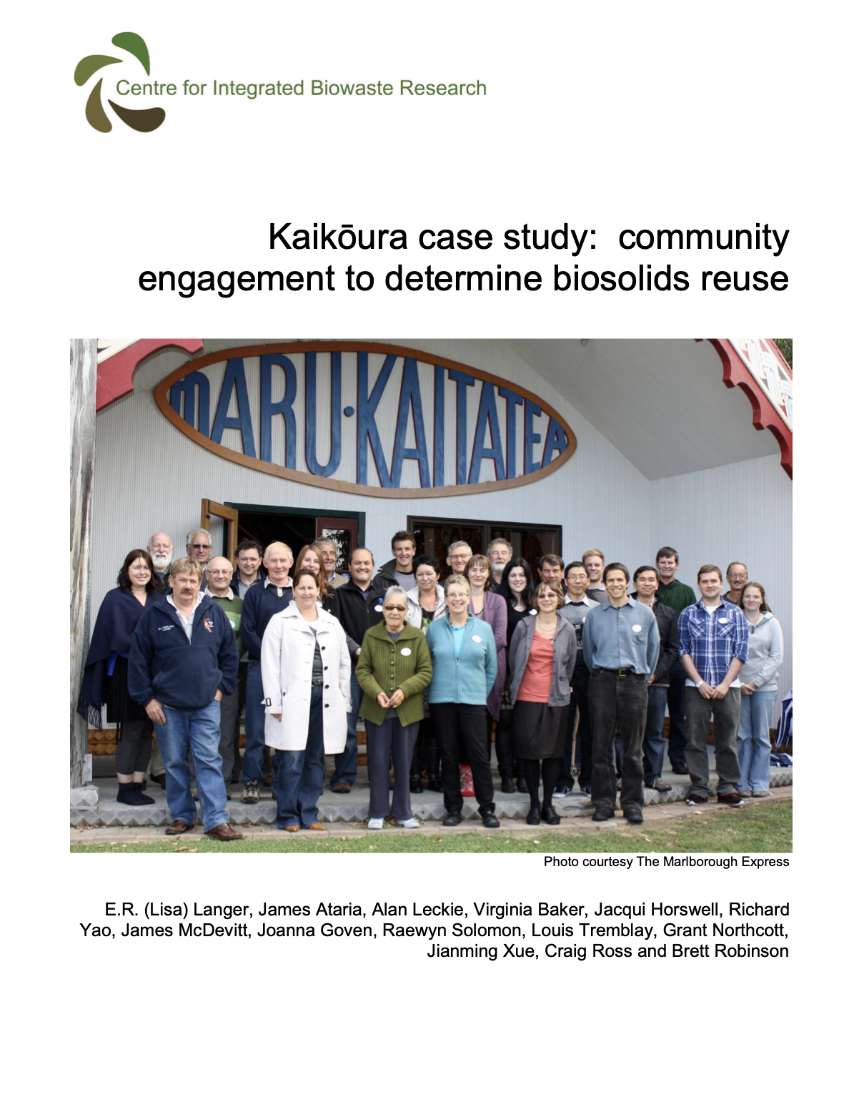
Participation in practice: A case study from NZ
The Kaikōura case study (2009-2013) aimed to support a shared-learning process amongst stakeholders to identify the strengths and weaknesses of possible biosolids reuse strategies for 1500 tonnes of stockpiled biosolids.
Initial stakeholder engagement and community interviews
Informed biophysical research program e.g. contaminants of community concern
Phase 1
Workshop to (1) discuss findings of social and biophysical research and (2) discuss feasible biosolids reuse options
Phase 2
Community input into environmental life cycle assessment and economic analysis of reuse options
Phase 3
Life Cycle Assessment
Cost-Benefit Analysis
Final workshop to (1) discuss scientific and economic data and (2) vote on most suitable reuse options
Phase 4
Refinement of Cost-Benefit Analysis

Slide 11
Novel pathways, novel forms of engagement?
The future of biosolids management is increasingly complex and uncertain.
This presents an opportunity to rethink and innovate public engagement:
Keep public engagement practices constant?
Diversify existing engagement practices?
Incorporate participatory models of engagement?
A participation model of engagement is yet to be widely applied but has potential to improve decision-making and the implementation of “acceptable” biosolids management pathways.
Novel reuse pathways e.g. thermal treatment
Land application of biosolids
Sewage
Disposal

Slide 12
References
Beecher, N. (2004). Public perception of biosolids recycling: developing public partnering & earning trust.
Gale, A. J. (2007). The Australasian Biosolids Partnership and Public Perceptions. Water Practice & Technology, 2(4). https://doi.org/10.2166/WPT.2007081
Goven, J., & Langer, E. R. (2009). The potential of public engagement in sustainable waste management: Designing the future for biosolids in New Zealand. Journal of Environmental Management, 90(2), 921–930. https://doi.org/10.1016/j.jenvman.2008.02.006
Goven, J., Langer, E. R. L., Baker, V., Ataria, J., & Leckie, A. (2012). Community engagement in the management of biosolids: Lessons from four New Zealand studies. Journal of Environmental Management, 103, 154–164. https://doi.org/10.1016/j.jenvman.2012.02.007
Langer et al. (2013). Kaikōura case study: Community engagement to determine biosolids reuse. Centre for Integrated Biowaste Research
Logan, T. J. (1995). Gaining public acceptance for beneficial use of biosolids. BioCycle (Vol. 36).

