Slide 1
tuas wrp - a resource Recovery factory
Nunthinee Sundaramurthi, PUB, Singapore
Liow Wee Siang, PUB, Singapore
Gokul Bharambe, Jacobs, Brisbane
Colin Newbery, Jacobs, Singapore
Peter Burrowes, Jacobs, Kitchener, ON, Canada
Mark Wong Wei Qiang, PUB, Singapore

Slide 2
Courtesy: Paul Reiter, IWA

Slide 3
Courtesy: Paul Reiter, IWA

Slide 4
Courtesy: Paul Reiter, IWA

Slide 5
Disruptive Approaches are Needed to go from Treatment to Product Recovery
?
Biorefinery
Metals
Biofuels
Sustainability & Human Survival
Biofplastics
Increasing Level of Disruption
Bioplastic
Chemicals
√
Nutrient, Energy, Water
TN & TP
Used Water
√
Nitrification
Wastewater Treatment
Environmental Protection
√
Nitrification
cBOD & Solids
Basic Sanitation
√

Slide 6
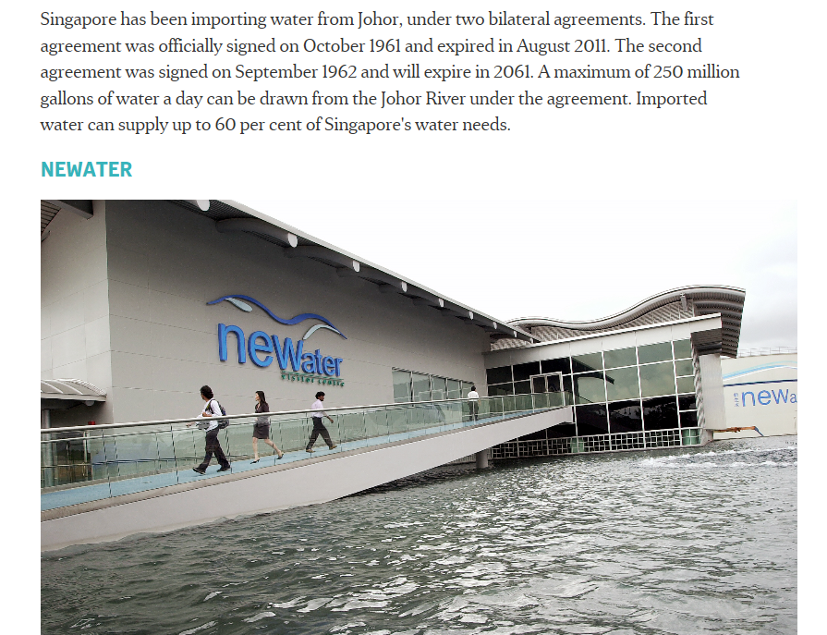
Drivers in Singapore
Maximise Water Reclamation
Minimise Energy
Consumption
Maximise Energy Recovery
Minimise Land Take
Drivers
Maximise Carbon Diversion

Slide 7
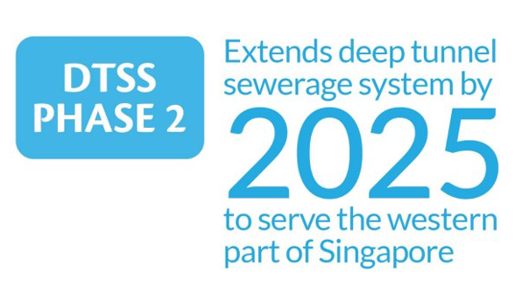
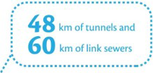
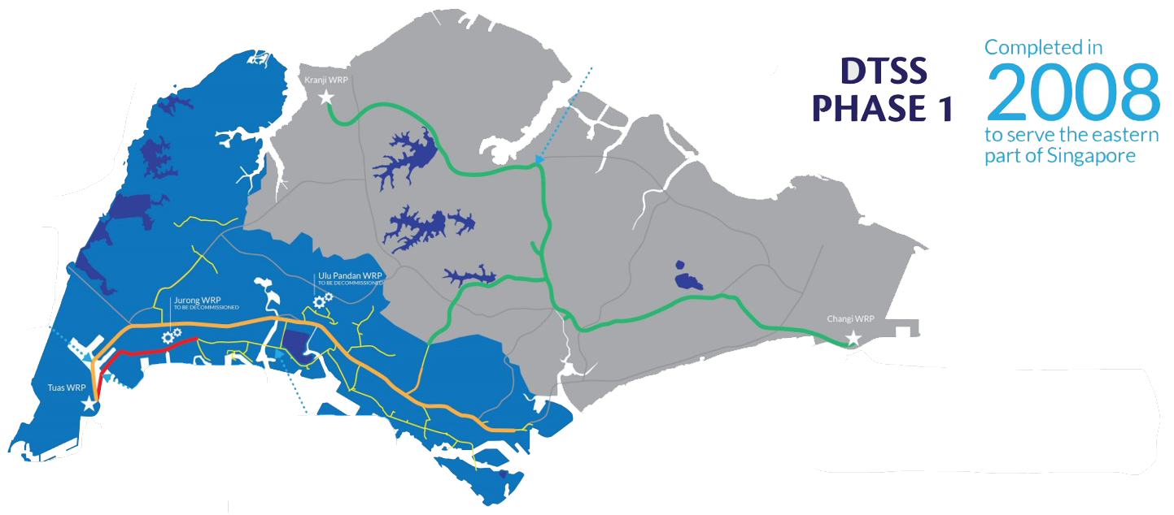
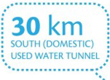


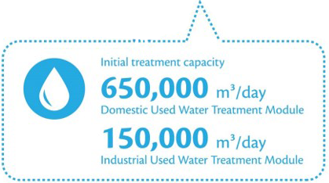

Deep Tunnel Sewerage System (DTSS)

Slide 8
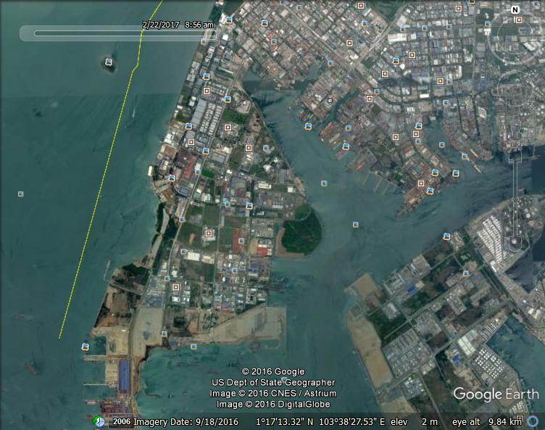
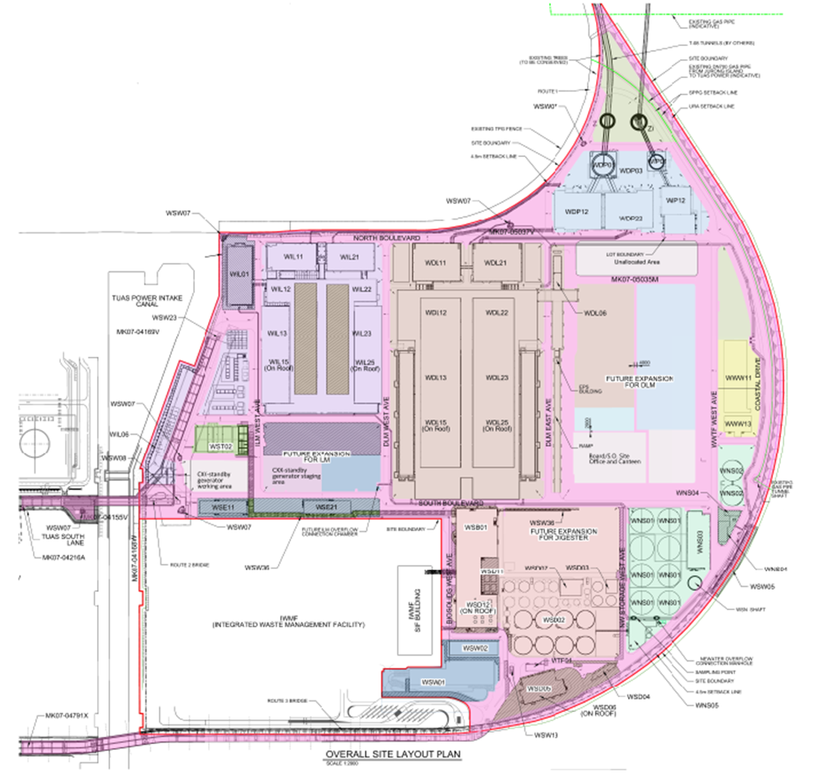
TWRP Location and Footprint
Notes:
Far West of Singapore
Reclaimed land

Slide 9

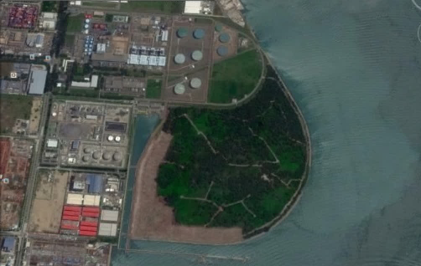
Our Aims:
No compromise on Health & Safety
Maximise Water Reclamation
Minimise Energy Use
Optimise Land Use
Exploit synergies with IWMF to create a localised circular economy
≈1km
≈1km

Slide 10
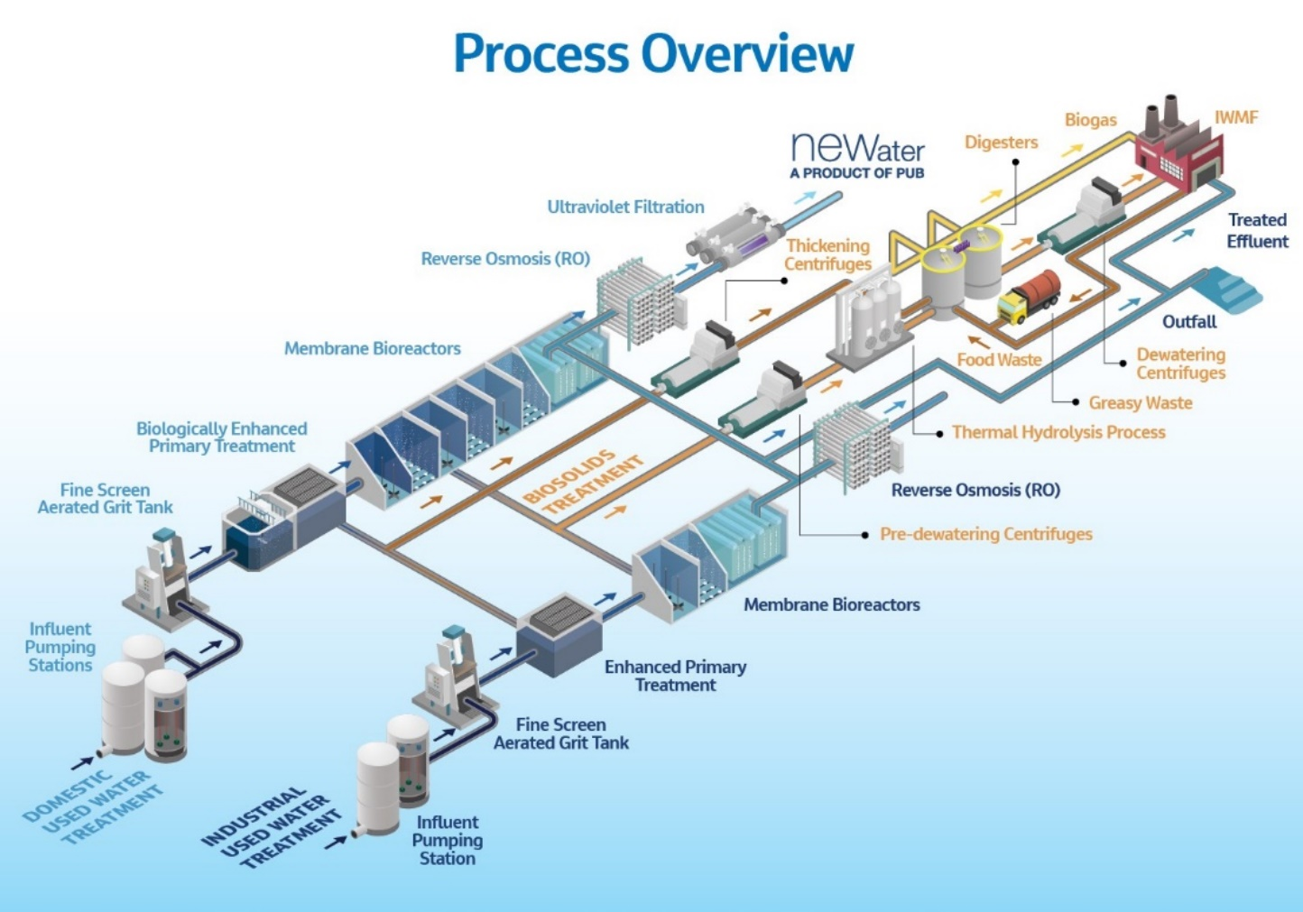

Slide 11
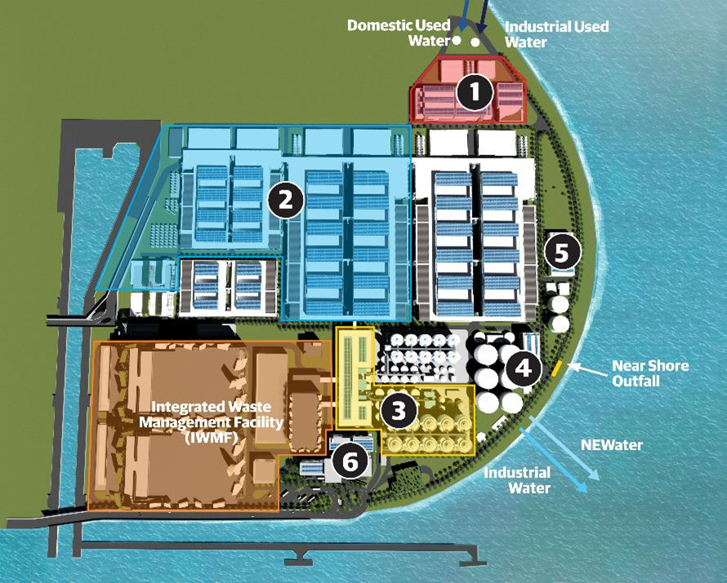

Site Layout
Influent Pumping Stations
Liquids (Domestic and Industrial Used Water) Treatment Facilities
Biosolids Treatment Facility
NW and IW Storage & Pumping
Wet Weather Treatment
Admin/O&M with Visitor Gallery
F
F
F
F
Future Expansions
Click number for more information

Slide 12
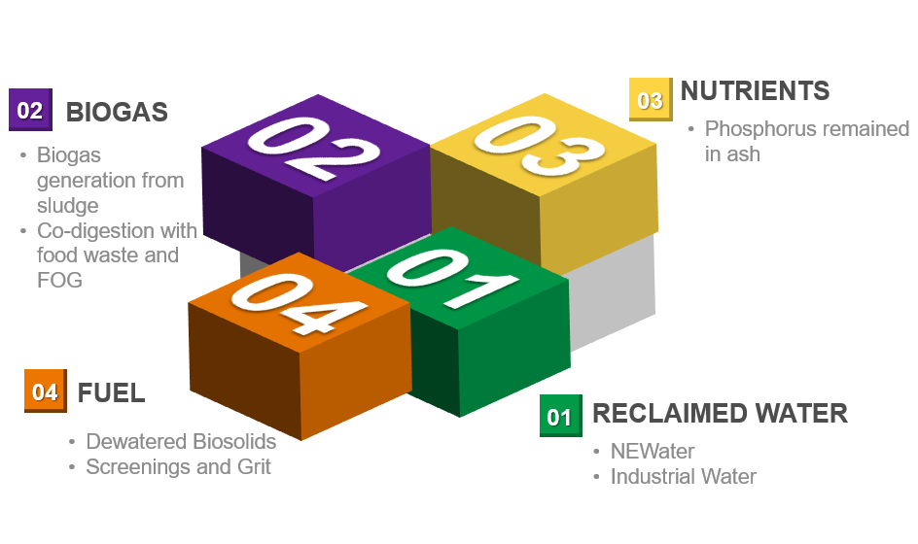
Resources Recovered from Tuas WRP

Slide 13
TWRP Key Features
Primary treatment design and flexibility
The advanced digestion process and THP design consideration
Digester geometry
Dewatered cake as fuel source
Highly efficient biogas use
Co-digestion

Slide 14
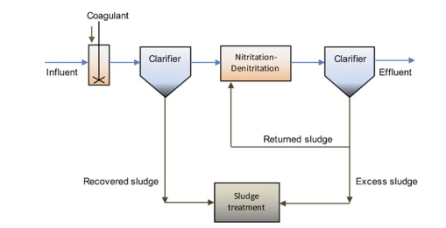
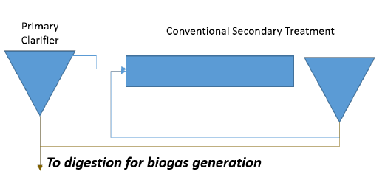

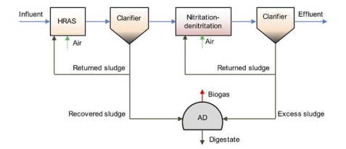
Carbon Diversion
50-70% COD diversion
Increase biogas production
Reduction in aeration demand
Integrated CEPT
Conventional primary treatment
Integrated HRAS
Flexibility provided in the process design to deliver an optimised C:N ratio in the bioreactor feed.

Slide 15
Advanced Digestion
WAS only THP selected
Higher net energy generation potential
Hydrolysed WAS allows for higher digester operating solids concentration
Increase in volatile solids destruction & digester biogas production
Increased dewaterability of digestate resulting in higher calorific value of sludge per wet tonne
Lower odor generation
Reduced quantity of solids requiring further handling
Allows increased volatile solids loading to the digester

Slide 16
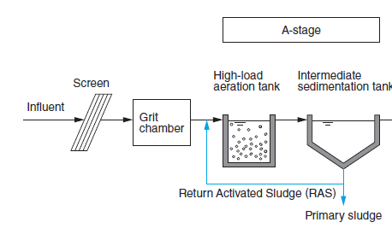
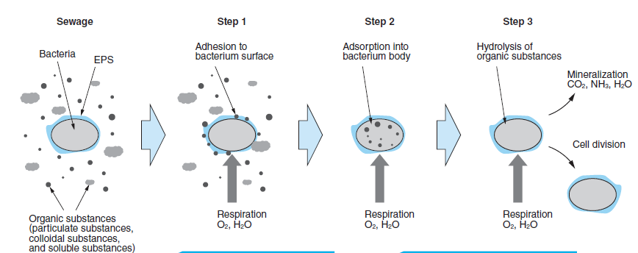
THP Design Consideration

Slide 17
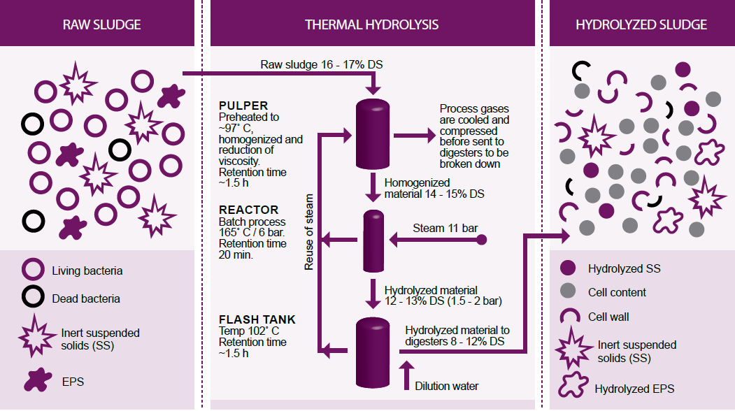
THP Design Consideration
50%
Hydrolysis of sludge reduces Viscosity and allows digester to be operated at higher solids concentration.

Slide 18
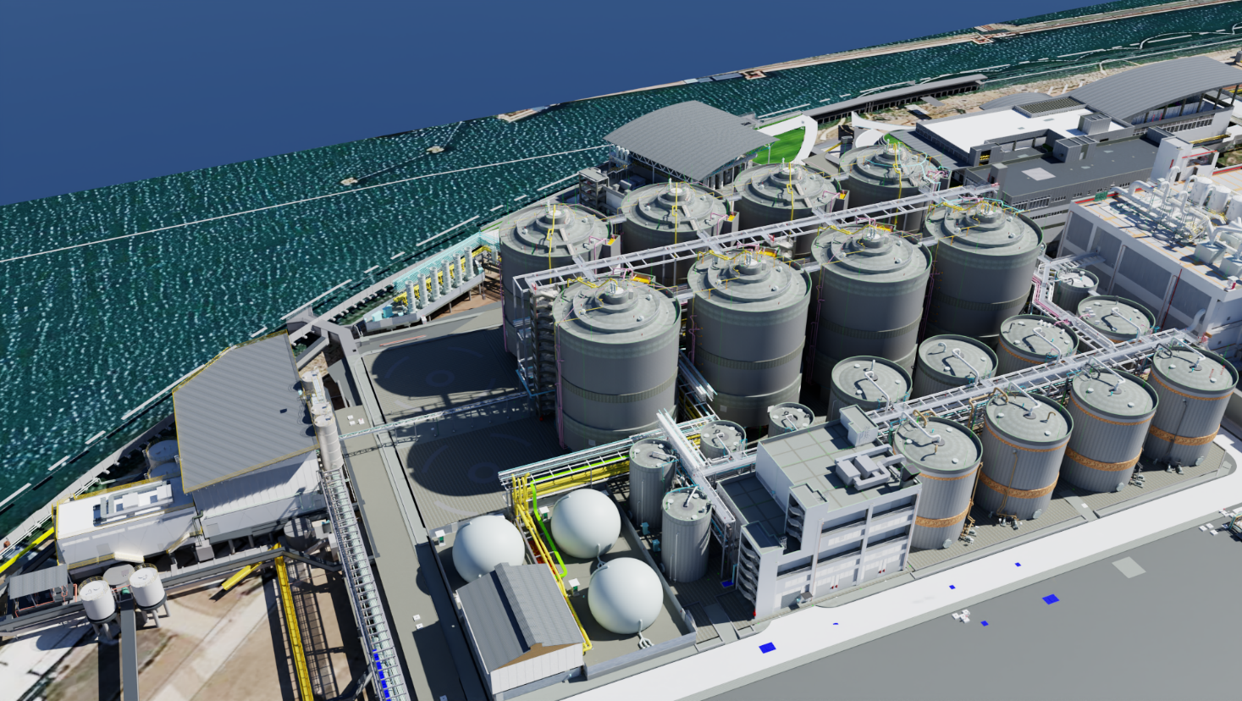
Biosolids Treatment
Key Details:
Multilevel biosolids building for thickening, pre-dewatering and dewatering centrifuges
Thermal Hydrolysis pre-digestion to increase biogas production and energy recovery, as well as reduce sludge for disposal using steam from IWMF
8 silo mesophilic anaerobic digesters co-digesting municipal biosolids with food waste and greasy waste
Biogas transferred to IWMF to superheat the steam upstream of turbines to increase electricity production
Sidestream nitrogen removal for the treatment of dewatering centrate
Phosphorus sequestration
Dewatered cake transferred to the IWMF for incineration and further energy recovery

Slide 19
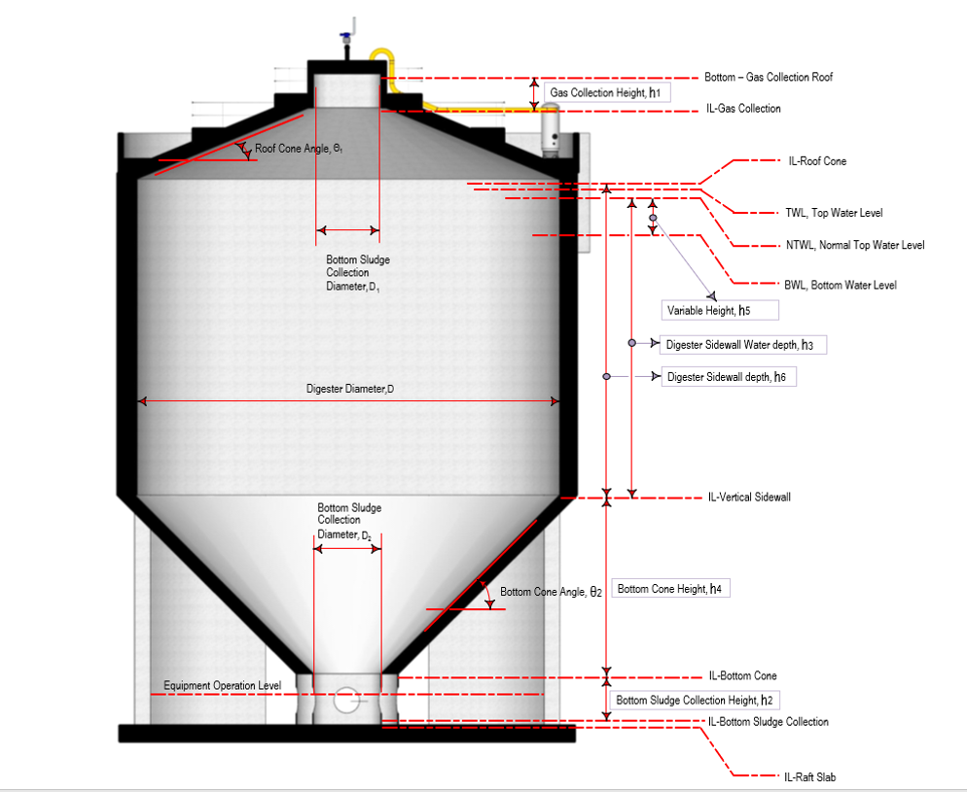
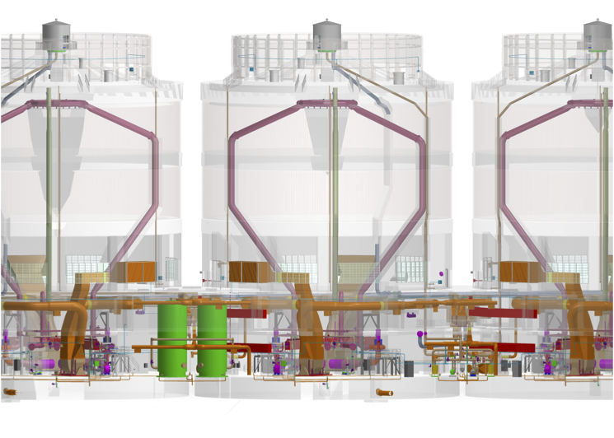
Digester Geometry
Silo Tall & Combined Egg / Silo
Combines best features of both egg-shaped and tall
Low mixing power required
Virtually no grit buildup
Easy scum removal
Small footprint
More expensive than conventional but less than egg

Slide 20
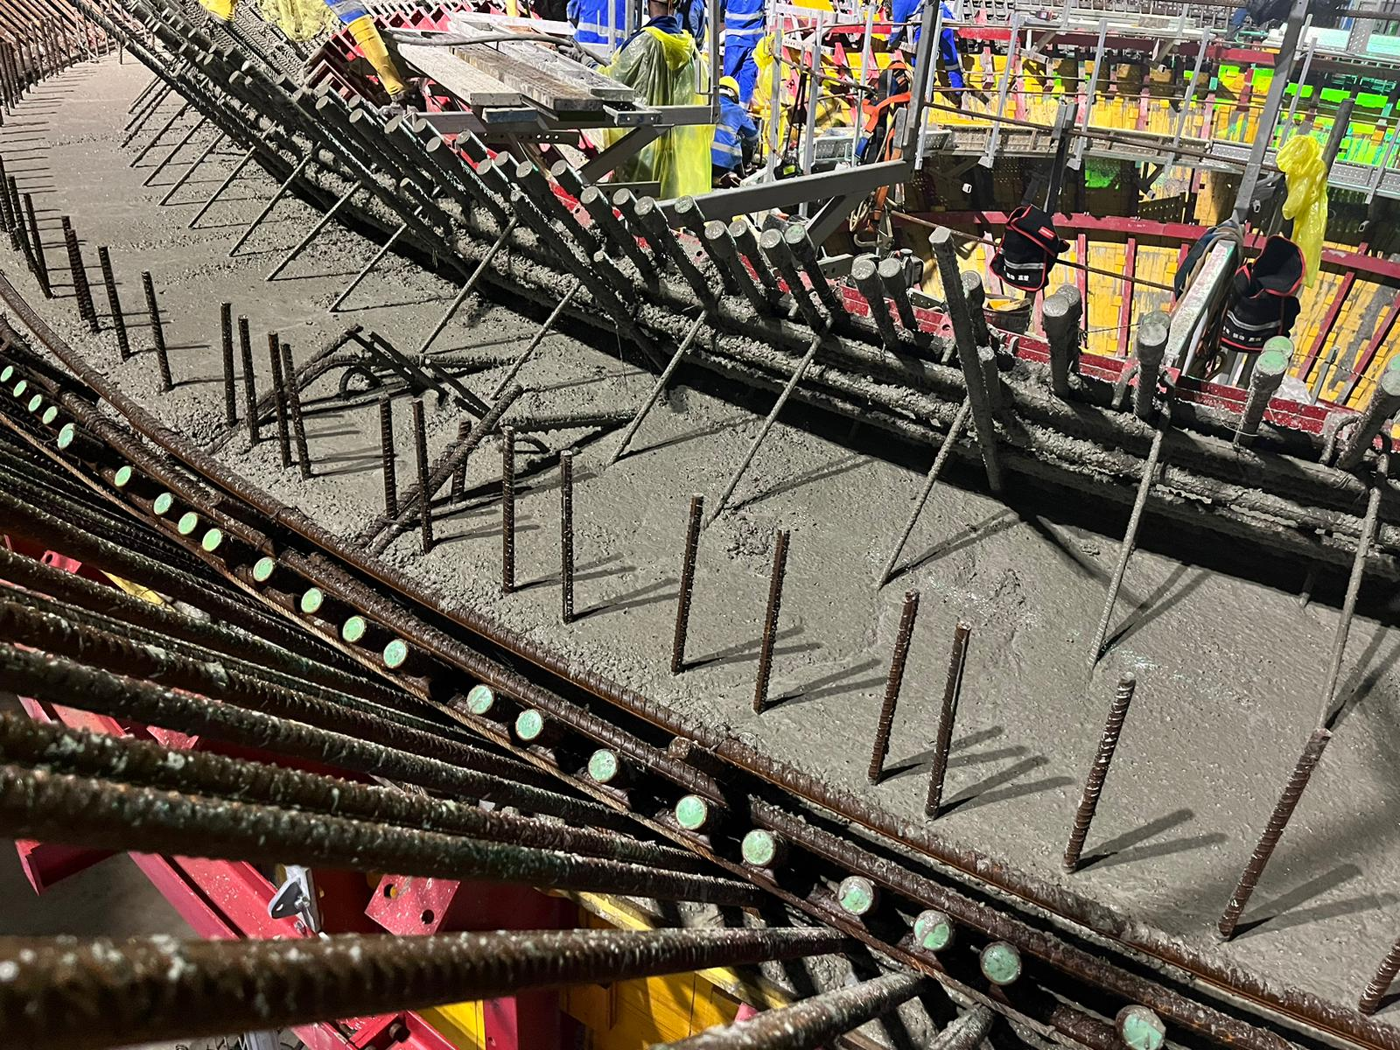
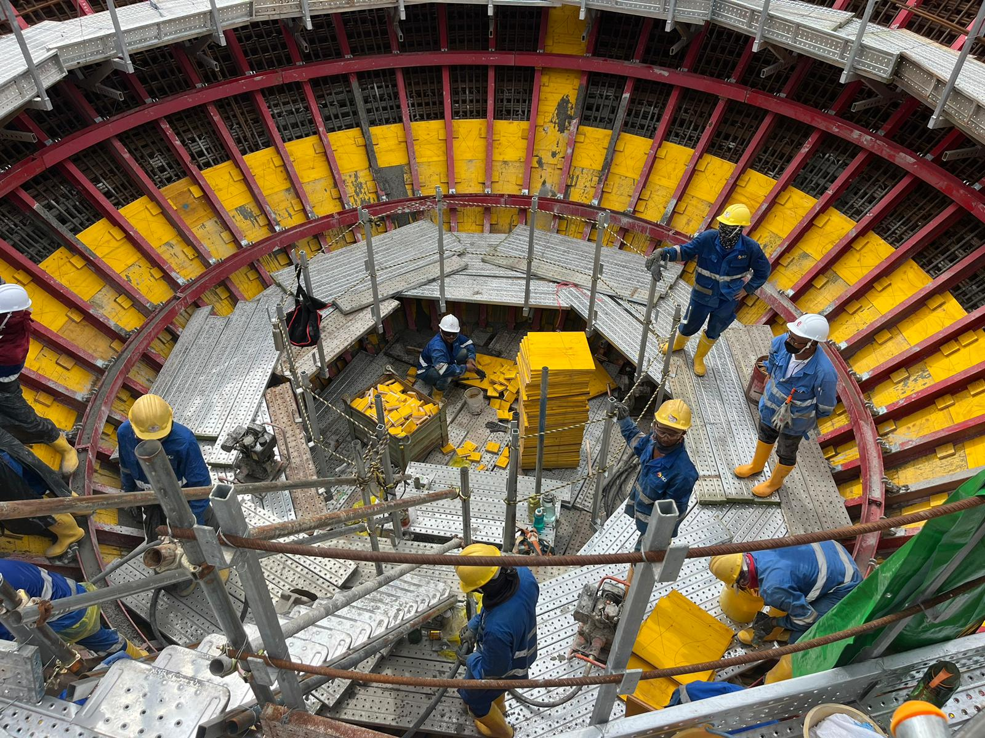
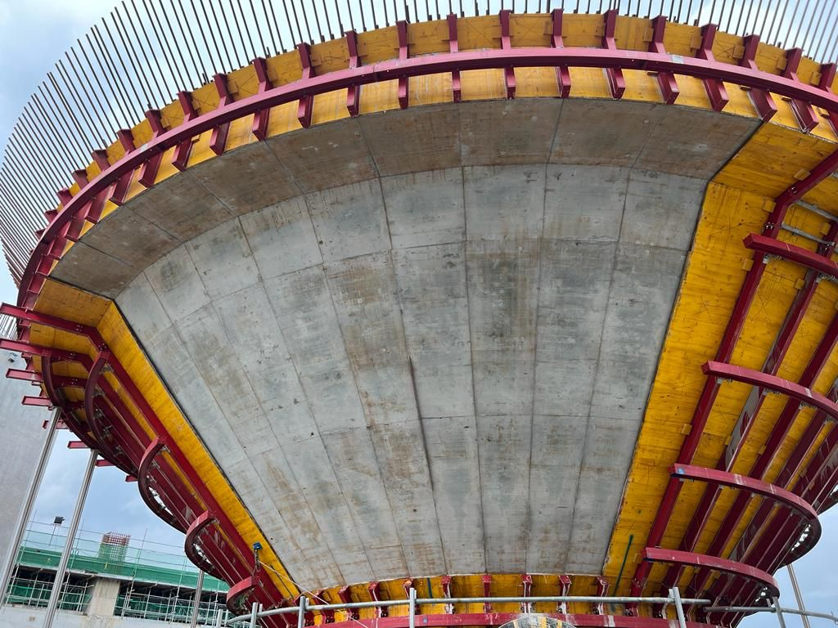
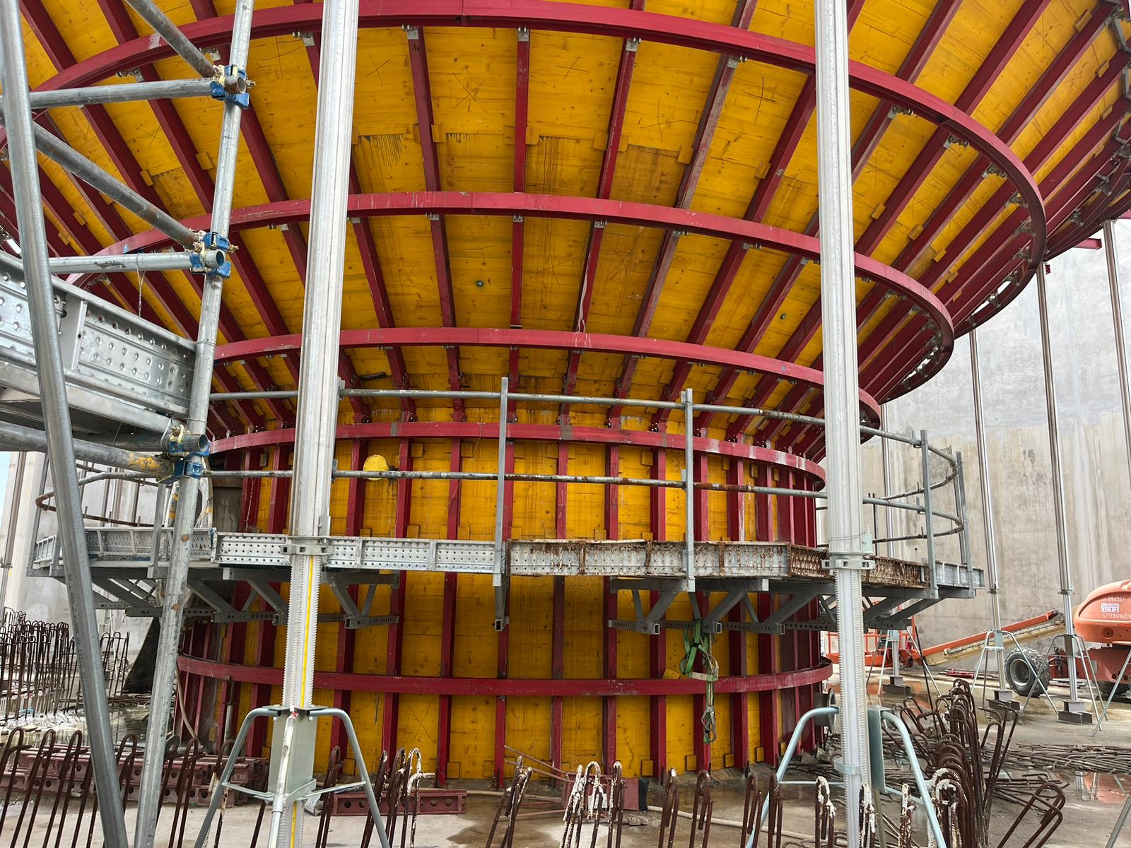
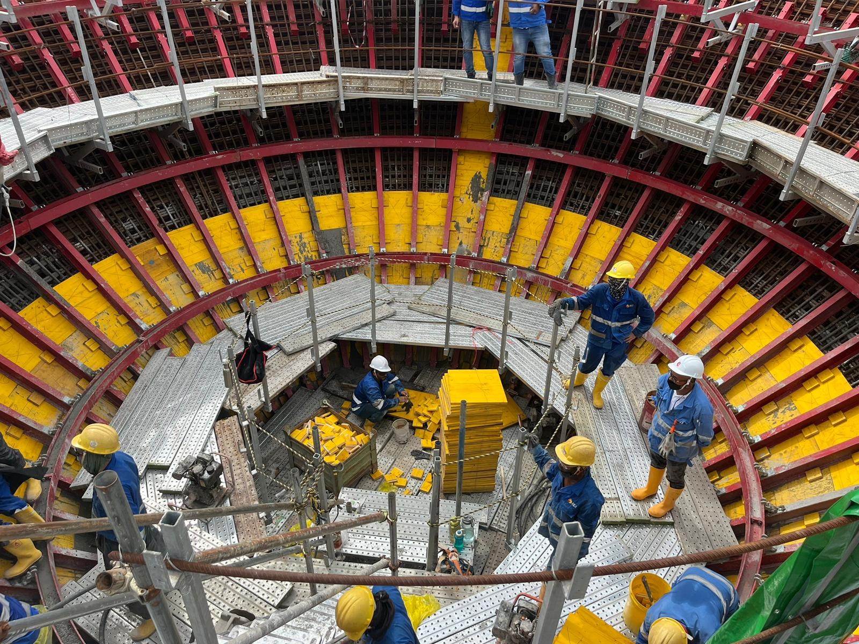

Slide 21
What is Co-Digestion?
Simultaneous digestion of two or more substrates
Why co-digest?
Parameters | Food Waste | Sewage sludge (Conventional)
Micro-nutrients
Buffer capacity
Digestibility
Percent solids
Carbon : Nitrogen | Carbon source | Ammonia toxicity

Slide 22
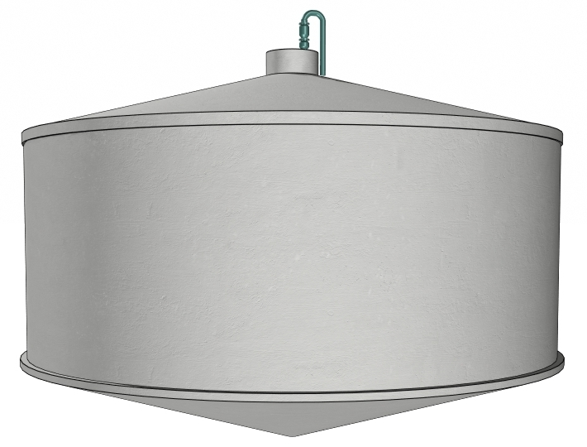
Co-Digestion at TWRP
Hydraulic Retention Time
Digester operating solids concentration
VS Loading Rate (kg VS/m3/d)
SELR
Biogas
Energy Rate to IWMF
Specific Energy Loading Rate (SELR, kgCOD/day/kgVSS)
(Energy Feed Rate per mass of Volatile Solids in Digester)
Energy Feed Rate
COD/day
(PS + HWAS+ Food Waste + Greasy Waste)
Dewatered Cake
to IWMF
Notes:
Compare to Human Organic Loading Rate
300-770 kJ/day/kg solids based on
2000 kcal/day, 0.239 cal/J, 60% water, 150 lb or 68 kg total; 5000 kcal max

Slide 23
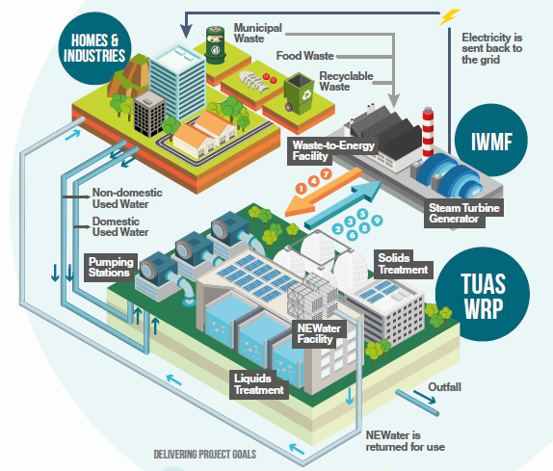
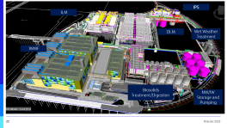
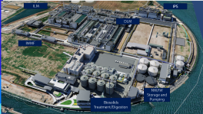
TWRP-IWMF Synergies
TWRP: Tuas Water Reclamation Plant
IWMF: Integrated Waste Management Facility
Material Handling Synergies
1) Food waste from IWMF to TWRP
2) Dewatered sludge from TWRP to IWMF
3) Screenings and grit from TWRP to IWMF
Energy Synergies
4) Power supply from IWMF to TWRP
7) Steam From IWMF to TWRP
5) Biogas from TWRP to IWMF
Water Synergies
6) Water From TWRP to IWMF
9) Condensate from IWMF to TWRP
Other Synergies
10) Chilled Water from IWMF to TWRP
8) Ammonia recovery from TWRP to IWMF
11) Admin Building and Carpark
10
9
*Note
Synergy 8: Ammonia Recovery from TWRP for IWMF’s use will be trialed after TWRP & IWMF have been commissioned

Slide 24
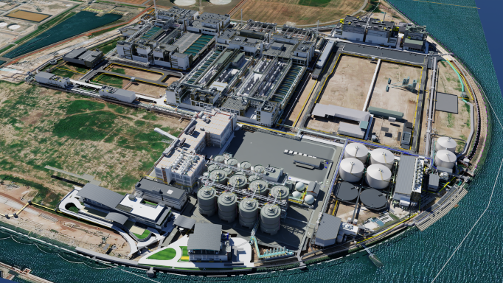
ILM
IPS
DLM
IWMF
NW/IW Storage and Pumping
Biosolids Treatment/Digestion

Slide 25
tuas wrp - a resource recovEry factory
Charles Lim, PUB, Singapore
Nunthinee Sundaramurthi, PUB, Singapore
Liow Wee Siang, PUB, Singapore
Gokul Bharambe, Jacobs, Brisbane
Colin Newbery, Jacobs, Singapore
Peter Burrowes, Jacobs, Kitchener, ON, Canada
Mark Wong Wei Qiang, PUB, Singapore

